Slide 1

Well Come To Jimsmowing Melbourne West
Lawn Mowing Thornhill Park

Slide 2
Welcome to Jim's Mowing
A professional job at an affordable price If you think hiring a professional to look after your lawn and garden is out of your reach, think again. At Jim’s Mowing we can provide you with a range of services to make your life easier and get your garden looking its very best. From lawn mowing and gutter cleaning, to rubbish removal and landscaping, we have the expertise and equipment to do it all. No job is too big or small for our dedicated team. Get a load of your mind Is household rubbish, waste and garden refuse clogging up your backyard and garden? If the job seems too big to tackle yourself, the rubbish removal experts at Jim’s Mowing are here to lend a helping hand. Whether it’s a pile of junk, a heavy tree trunk or even the body of a car, we can remove it from your property with no mess and no fuss. Don’t put it off any longer! Enjoy your weekends again Life is too short to waste your spare time. If you work long hours during the week, your weekends are precious. If you would prefer to relax and unwind on your days off rather than spending hours doing tiring and back-breaking jobs in the garden, call in Jim’s Mowing for an obligation-free quote today. Say goodbye to weeds and pests Handling chemicals and pesticides to kill off pests and weeds can be hazardous. If you’re not sure what you’re doing, you could also ending up causing more harm than good. Let our garden and lawn care professionals do the job for you. We’ll make these annoying invaders disappear for good! Save money on your water bills If your water bills are on the rise, we can establish a drought-tolerant garden that is beautiful yet easy to maintain. Your Jim’s Mowing professional will choose the right plants for your local climate and soil so that it flourishes all year round.

Slide 3
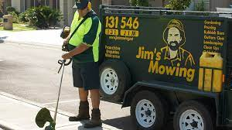
Gardening Services Melbourne West
Do You Wish You Could Spend Less Time Working In Your Garden And More Time Actually Enjoying It? Jim’s Mowing Can Not Only Look After Your Lawn, We Can Look After Your Garden Too, With Professional Care That Will Have It Looking Beautiful And Healthy In Next To No Time. Let Us Provide You With An Obligation Free Quote On The Garden Services You Need And Then Schedule In A Time To Visit That Suits You. We Guarantee Your Garden Will Transform Before Your Very Eyes!
Weeding, Pruning, Hedging – We Do It All!
Is your garden crying out for some love and attention? Whether it’s carpet weed invading your lawn or bridal creeper taking hold in your garden, we know the most effective ways to kill off garden weeds and stop them in their tracks. Or if you find pruning and hedging a chore, Jim’s Mowing can step in to make your trees, shrubs and hedges look healthy and in great shape again. We have the patience and experience to turn your garden into a place you’ll want to spend more time in, all without you having to do a thing! For More Info. Lawn Mowing Diggers Rest

Slide 4
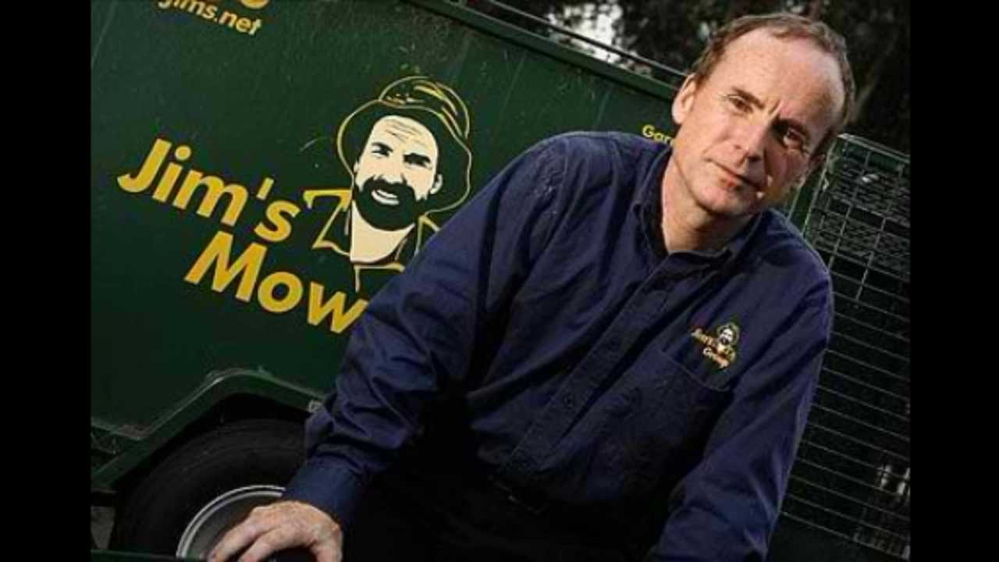
About Us
About Us
Welcome To Jim’s Mowing Melbourne Western Suburbs. If You’re After A Reliable, Prompt And Professional Lawn And Garden Care Service That You Can Afford, Jim’s Moving May Just Be The Answer You’ve Been Looking For. We Can Do Much More Than Just Mow And Care For Your Lawn. We Can Also Provide Garden Makeover And Landscaping, Rubbish Removal, Gutter Cleaning Services And More. Whether It’s Fertilising And Weeding, Installing Gutter Guards Or Even Laying New Turf, We’re More Than Happy To Help! With A Network Of Over 1,500 Franchisees Operating Around Australia And Over Three Decades Of Experience, You Can Rely On Jim’s Mowing To Get The Job Done. Our Team Of Dedicated Professionals Know Your Local Area And Are Highly-skilled In Using All The Tools And Equipment Needed To Get Your Lawn And Garden Looking Its Absolute Best. We Are Passionate About Providing Our Customers With A Personalised And High-quality Service That Is Second To None.
For More Info Visit About Us. Lawn Mowing Kurunjang

Slide 5
Contact Us
Address Us: Melbourne, Victoria, Australia
Contact Us: 13 15 46
For More Information Please Visit Here: https://www.jimsmowingmelbournewest.com.au
Thanks

