Slide 1

Obtain Quick and High-quality Lawn Care Services
Welcome to Jims Mowing Melbourne West

Slide 2
A beautiful and green lawn makes for a welcoming house and can increase the values of your house. So if you are thinking to maintain your lawn then you have to hire a professional and certified lawn service provider. lawn mowing truganina and maintaining a lawn is not an easy task so hiring a lawn service provider is an ideal option for you. Jim’s mowing is an experienced and certified gardening service provider. We are here to save your time, money, and efforts. We offer professional gardening services which include garden care, lawn mowing, lawn care, garden design, hedging and pruning, rubbish removal, and gutter cleaning. We are a one-stop destination for lawn care solutions. Whether it is a small lawn or large, we can manage everything for you.

Slide 3
High-quality lawn and garden maintenance service
Our expert and certified lawn specialists and highly prepared teams can assist you with accomplishing an extravagant, green lawn that is normally more impervious to disease, bugs, and weeds. Jim’s mowing lawn specialists are prepared to help, regardless of whether you need to treat lawn your current lawn, have issues developing grass, or simply need to learn your alternatives. We are consistently here to help you. We will help you to make your garden more delightful. Our ensured lawn service specialists will work for hand in hand with you to build up a lawn administration routine that precisely meets your particular necessities and needs.

Slide 4
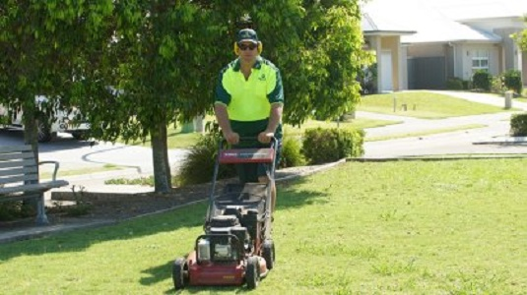

Slide 5
One of most advantages of recruiting gardening services administrations is that we are equipped with the most latest and advanced tools so you will get quick and best services. Proficient experts, useful assets, and best-in-class service give us the assets to best deal with any size work in the most productive, conservative, and responsible way. Our services of lawn mowing in melton south, melton west, caroline springs, and deer park are accessible at a cost-effective price. With proper lawn care services, we can make your grass develop to turn out to be more delightful, greener, and more grounded than a year ago. So if you want our gardening services then you can avail by calling us. our team is always ready to offer the best services and support you.

Slide 6
Thank You
Contact Details
Business Name: Jims Mowing Melbourne West
Phone Number: 131 546
Website: https://www.jimsmowingmelbournewest.com.au/

