Slide 1
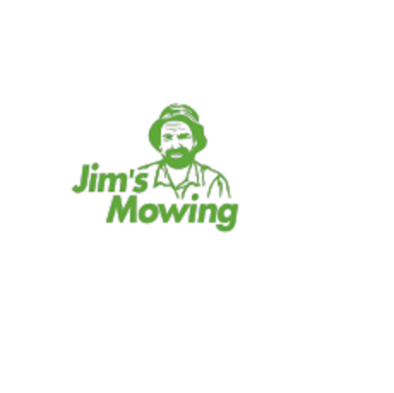
Jim’s Lawn Mowing & Gardening Maintenance

Slide 2
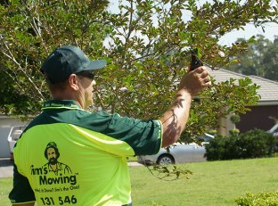
Professional Lawn Mowing Services in Point Cook
Find a range of highly professional lawn mowing Point Cook services with Jim’s Mowing; great techniques and methods are used to deliver the best results.

Slide 3
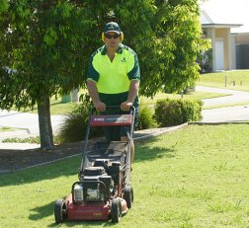
Best Lawn Mowing Services in Werribee
Jim’s Mowing is the name that people trust when it comes to finding the best lawn mowing Werribee services; we offer a range of quality lawn mowing Werribee services at affordable rates; enjoy hassle-free services. Contact us today!

Slide 4
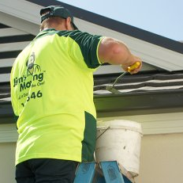
Our Services
Lawn Mowing
Gardening Services
Hedging & Pruning
Lawn Care
Garden Landscaping
Rubbish Removal
Gutter Cleaning

Slide 5

Thank you
131 546
https://www.jimsmowingmelbournewest.com.au/

