Slide 1

Best Lawn Mowing Services in Werribee

Slide 2
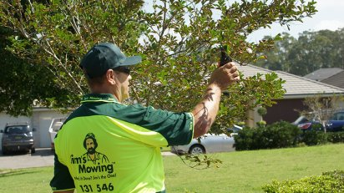
Jim’s Mowing – The Ultimate Lawn & Garden Care Professionals – Call Jim’s Mowing:131 546
Hi, We’re lawn mowing Werribee, the best value service you will find. We love working outdoors and enjoy spending our time indulging our green thumb through gardening! We love the challenge of turning an overgrown and unkempt property into a neat and tidy garden with perfectly manicured lawns! Whether you need gardening, mowing, trimming, landscaping, garden clean up or gutter cleaning- Jim’s Mowing can do it!

Slide 3
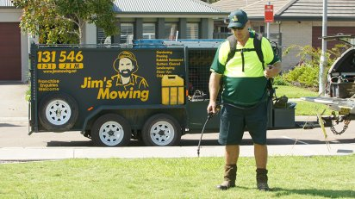
Welcome To Jims Mowing Melbourne West
For More Info Visit Here: https://jimsmowingmelbournewestt.blogspot.com/2020/11/best-lawn-mowing-services-in-deer-park.html

Slide 4
Jim’s Mowing Werribee provide the following lawn and garden services:
Mulching
Hedge clipping
Tree pruning & trimming
Lawn mowing
Edge trimming
Irrigation supply and installation
Garden maintenance
Top dressing and fertilising
Aerating of lawns
Turf laying and repair
Rubbish removal
Commercial mowing
Landscaping
Gutter cleaning
Garden clean up

Slide 5
To contact your local Jim’s Mowing franchisee call 131 546 today!
For More Info Visit Here: https://www.jimsmowingmelbournewest.com.au/

