Slide 1
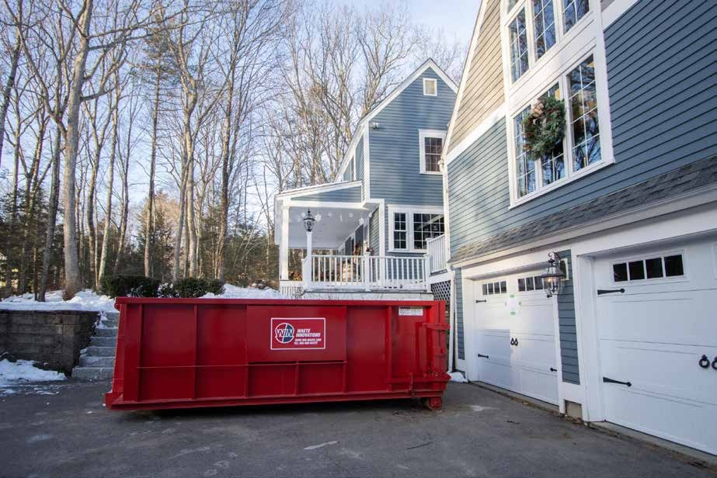
DUMPSTER RENTAL IN
DANBURY
CONNECTICUT
https://local.win-waste.com/dumpster-rental-danbury-ct

Slide 2

ABOUT US
Our large roll-off dumpster inventory allows us to offer convenient options for any project. We’ll drop your dumpster off where and when you need it and pick it up when you request. Our ﬂexible scheduling and friendly support make dumpster rental easy. See the table below to help you
decide on a container size and contact us today for delivery as soon as tomorrow in Danbury, CT.
https://local.win-waste.com/dumpster-rental-danbury-ct

Slide 3
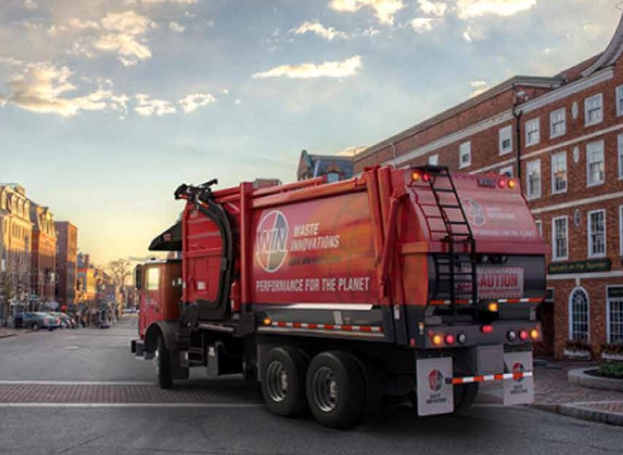
WIN Waste Innovations offers roll-off dumpsters in a variety of sizes to make sure you have the perfect option for your needs. Plus, we recycle as much construction and demolition debris as possible to help you maintain your LEED certiﬁcation.

Slide 4
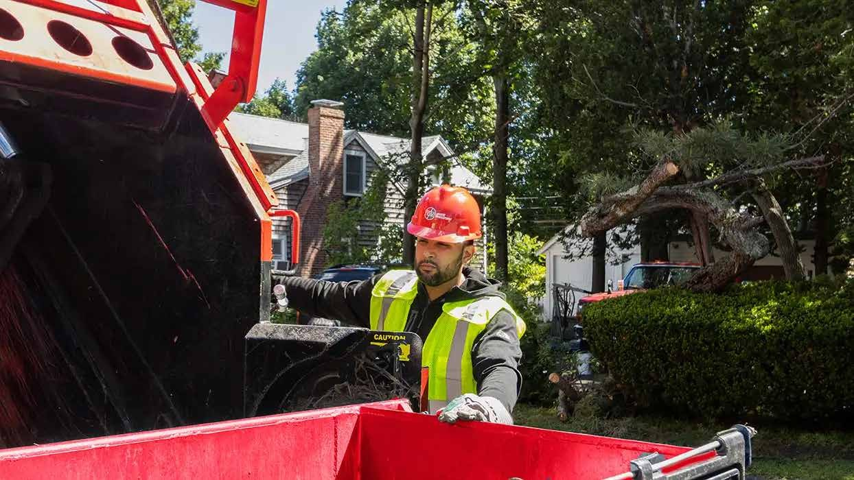
We know that renting a dumpster can be confusing, so our team is here to help you every step of the way. We offer ﬂexible scheduling and easy payment for dumpster rental in Danbury, Connecticut, so you can focus on your project and not worry about the details. Contact us today to rent a dumpster for your next project!

Slide 5

www.facebook.com/performancefortheplanet/
https://twitter.com/win_waste
https://www.linkedin.com/company/win-waste-innovations/
https://www.instagram.com/win_waste/
https://www.youtube.com/channel/UC_zngFGiwqXWYUuMKfRXYPg

Slide 6

Contact Us
Call
Reach WIN’s Customer Care:
1-866-WIN-WASTE / 866-946-9278
Email
Send a message
and we’ll respond quickly.
Chat
Talk now with a member of the WIN team.
Text
Text with a WIN Agent:
1-833-4TXT-WIN / 1-833-48

Slide 7
Thank You

