Slide 1

GEORGE ORWELL
Peluzzi Federico, Pezzali Alice
Pezzali Andrea, Tordera Bianca

Slide 2
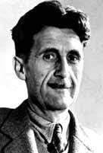
LIFE
born in India in 1903 as Eric Arthur Blair
service for the British Imperial Police force in Burma
starting his career as writer in Europe
went to Spain during the civil war
opposition to totalitarian regimes and every form of oppression

Slide 3
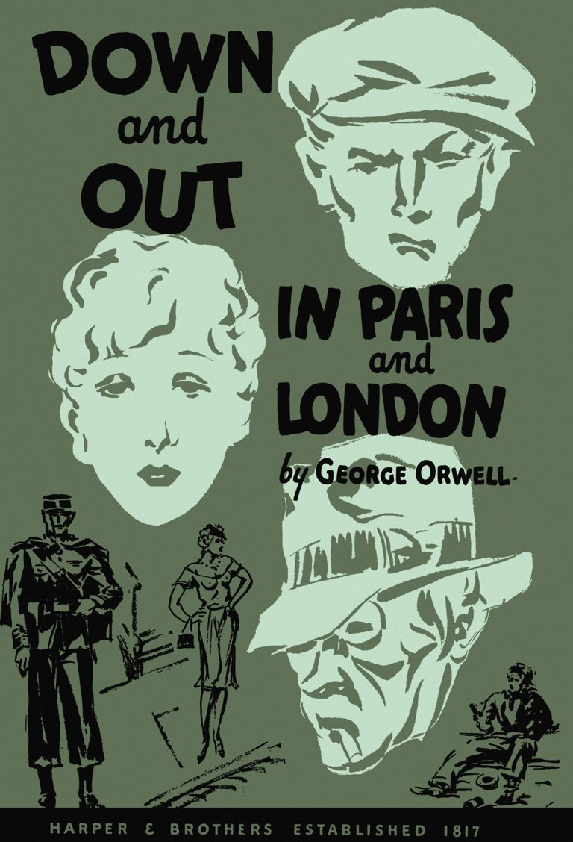
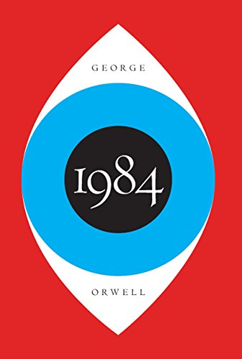

WORKS
“ DOWN AND OUT IN PARIS AND LONDON ”
1933
“ 1984 ”
1949
“ ANIMAL FARM “
1945

Slide 4

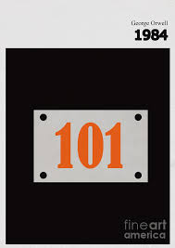
PLOT
Party controls everything
  Winston falls in love with Julia
  they meet O’Brien
  O’Brien is a spy
  O’Brien tortures and brainwashes Winston
  Room 101
  Winston gives up

Slide 5


PLOT ANALYSIS
In the novel
  time proceeds chronologically
  flashbacks
  Big Brother, Winston, society
  details show repressive society

Slide 6
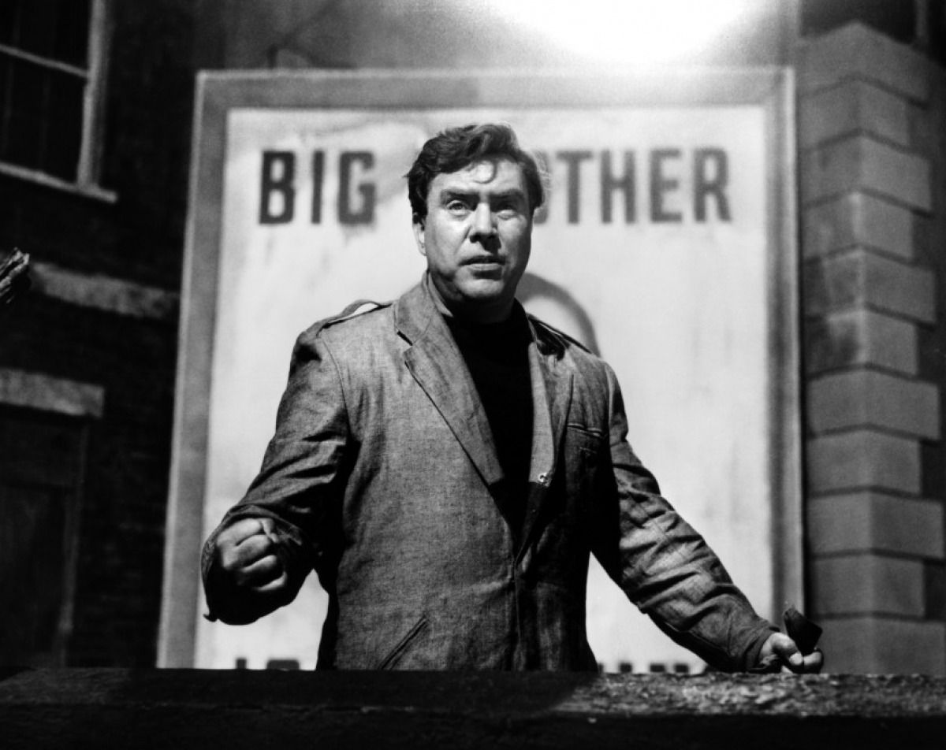
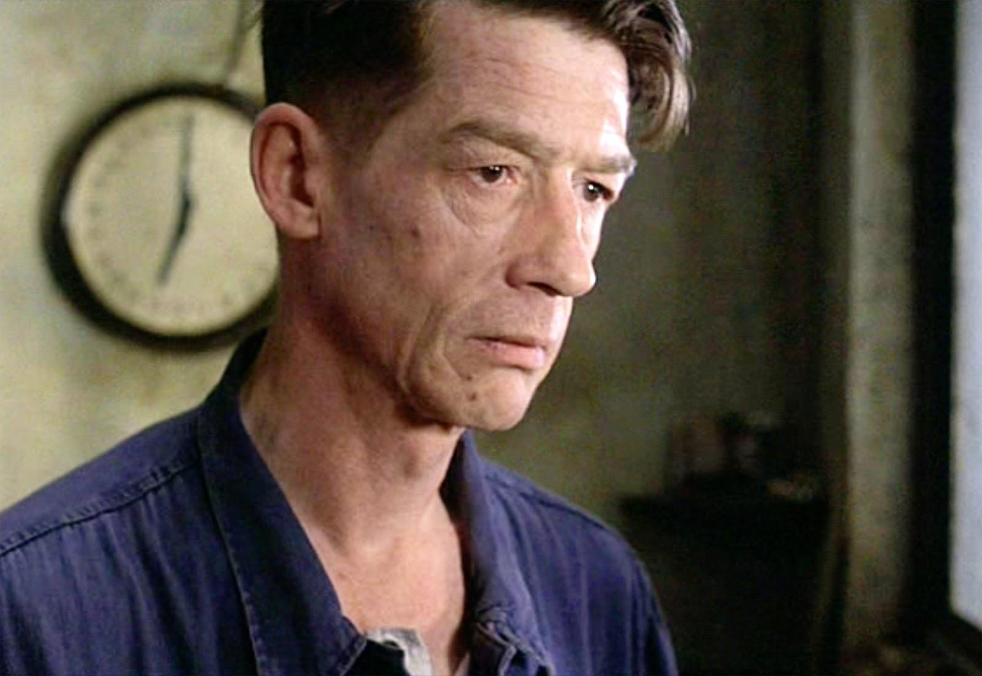
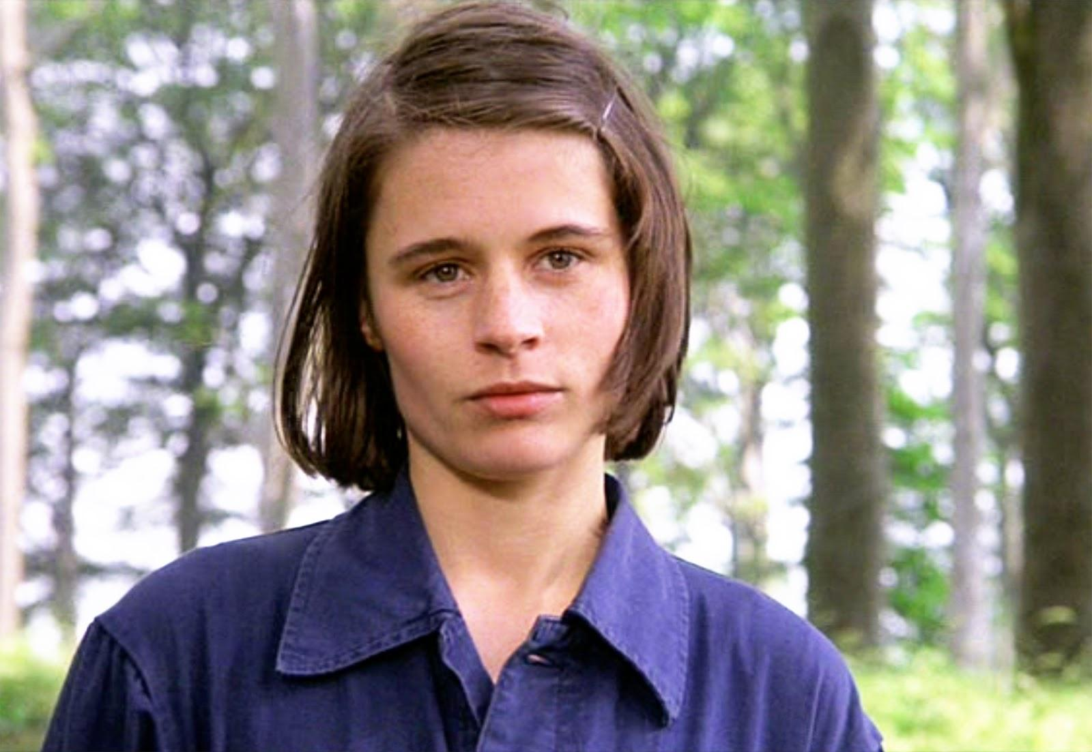
MAIN CHARACTERS
O’BRIEN
WINSTON SMITH
JULIA

Slide 7
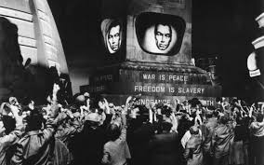
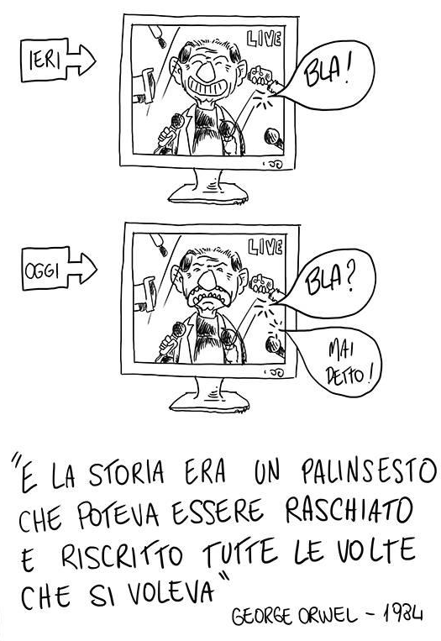
THEMES
THE DANGERS OF TOTALITARIANISM
  role of technology
  the State
PSYCHOLOGICAL MANIPULATION
  giant telescreen
  Junior Spies

Slide 8
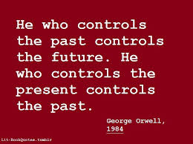
PHYSICAL CONTROL
  punished and “reeducated”
  physical pain
CONTROL OF INFORMATION AND HISTORY
  the Party controls every source of information
  the Party controls the present and manipulates the past

Slide 9

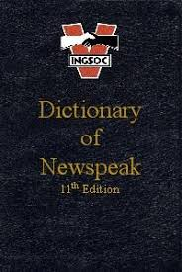
TECHNOLOGY
  telescreens and microphones across the city
  fearsome machinery
LANGUAGE AS MIND CONTROL
  Newspeak
  impossibility of independent thought

Slide 10
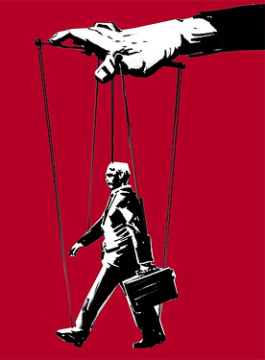

MOTIFS
DOUBLETHINK
  hold two contradictory ideas in one’s mind at the same time
URBAN DECAY
  able enhancing their own power
  incompetent at providing for their citizens

Slide 11
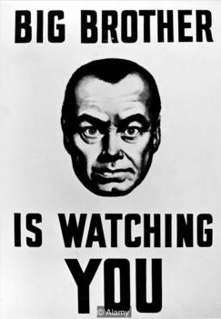

SYMBOLS
BIG BROTHER
  Party in its public manifestation
  vagueness with which the higher ranks present themselves.
THE GLASS PAPERWEIGHT
  tentative to reconnect with the past

Slide 12
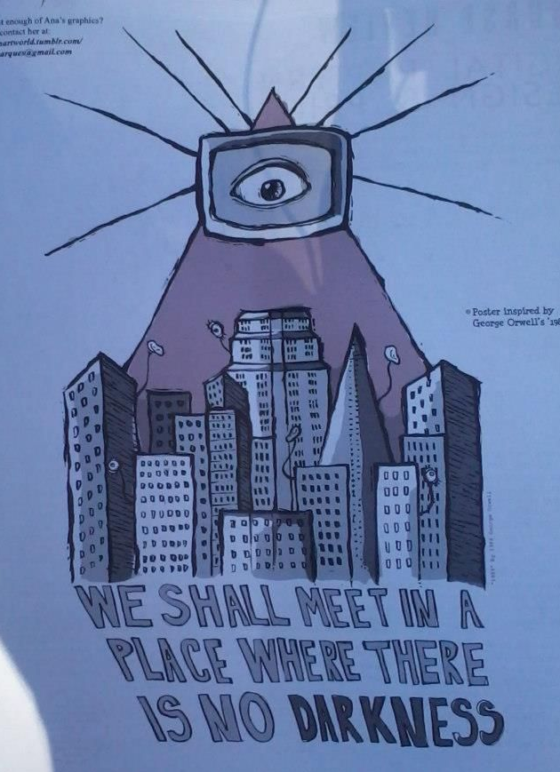
THE PLACE WHERE THERE IS NO DARKNESS
  Winston’s approach to the future: he believes that he is doomed
THE TELESCREENS
  Party’s constant monitoring
  abuse technology for its own ends

Slide 13

GENRE AND STYLE
DYSTOPIAN FICTION
  London: dirty and crumbling
  Government: all-powerful force of oppression and control
  man’s inherent nature: corrupt and repressive

Slide 14
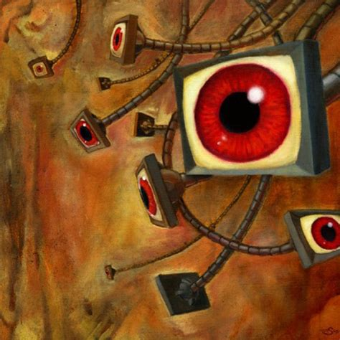

SCIENCE FICTION
  futuristic inventions not different from familiar technologies
  inaccurate: failed to anticipate the way people would use technology to record themselves
STYLE
  bleak and depressing
  straightforward grammar

