Slide 1

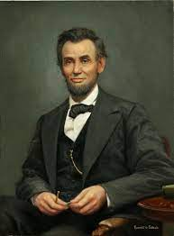
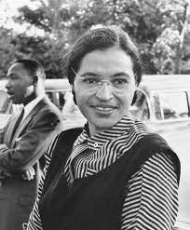
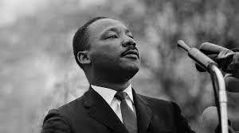
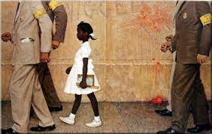
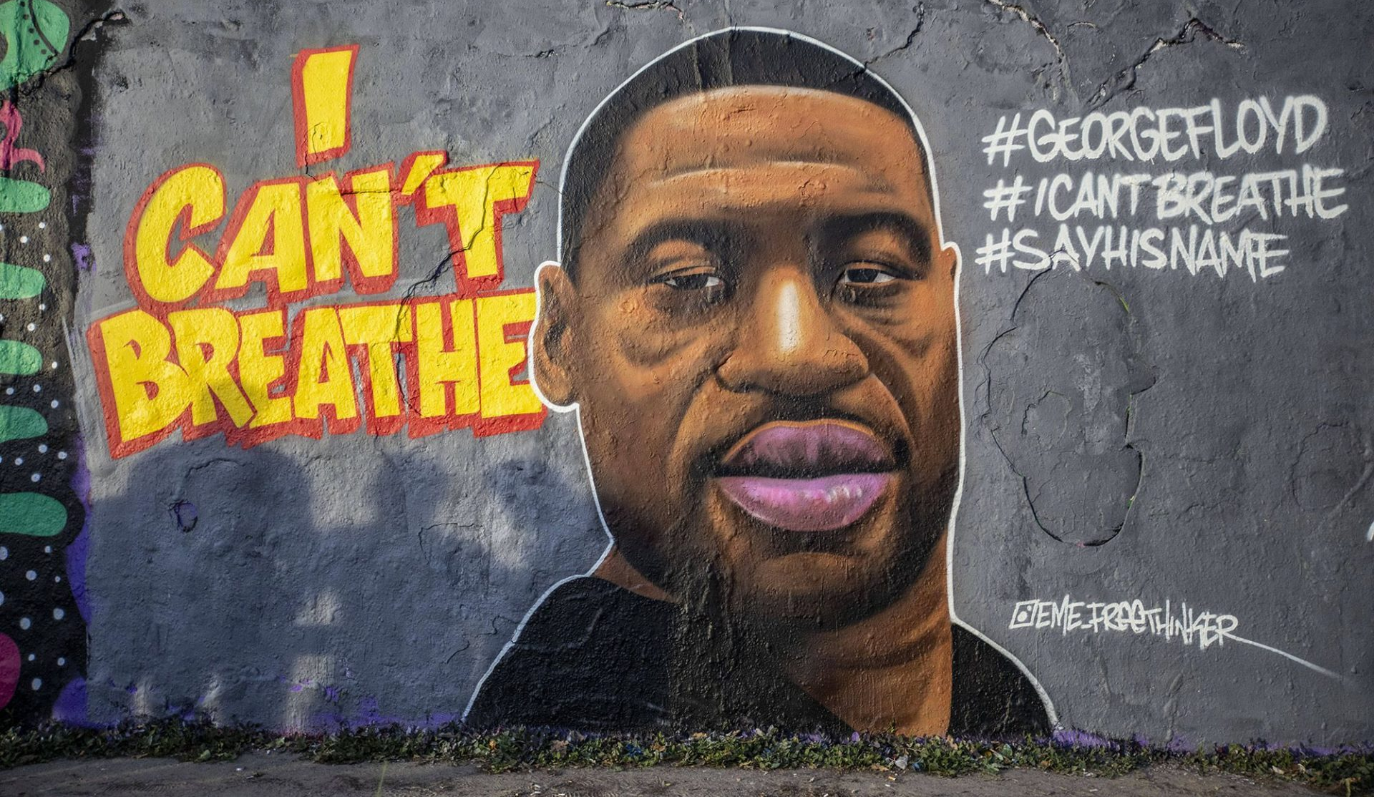
Who do you recognize?

Slide 2
BLACK
HISTORY
IN THE USA

Slide 3
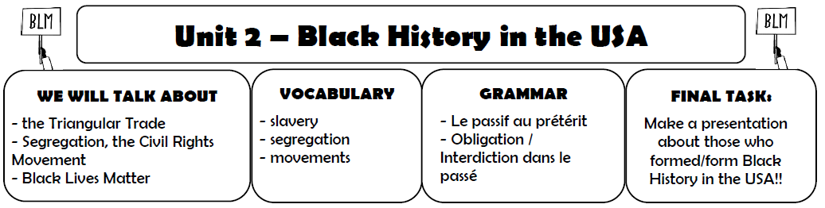

Glue it in your copybook!

Slide 4

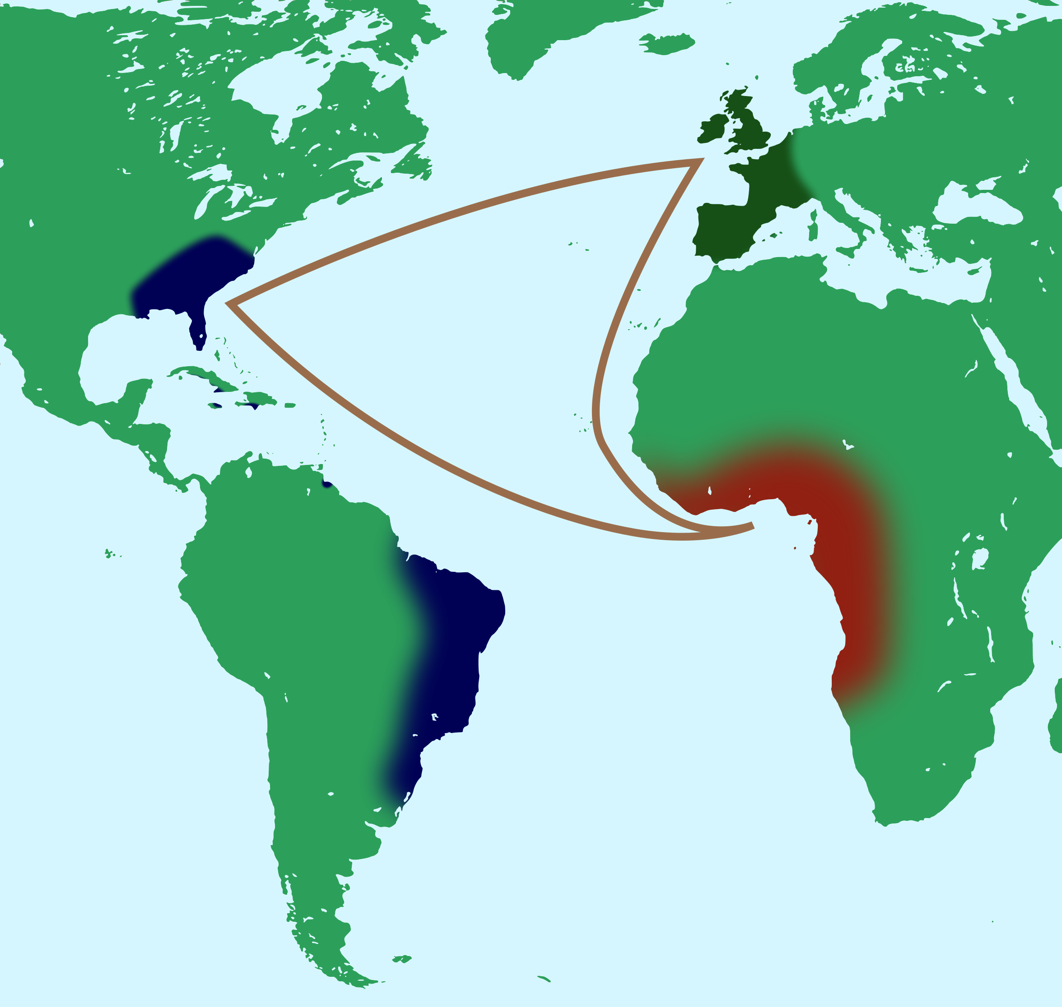
What are we going to talk about?

Slide 5
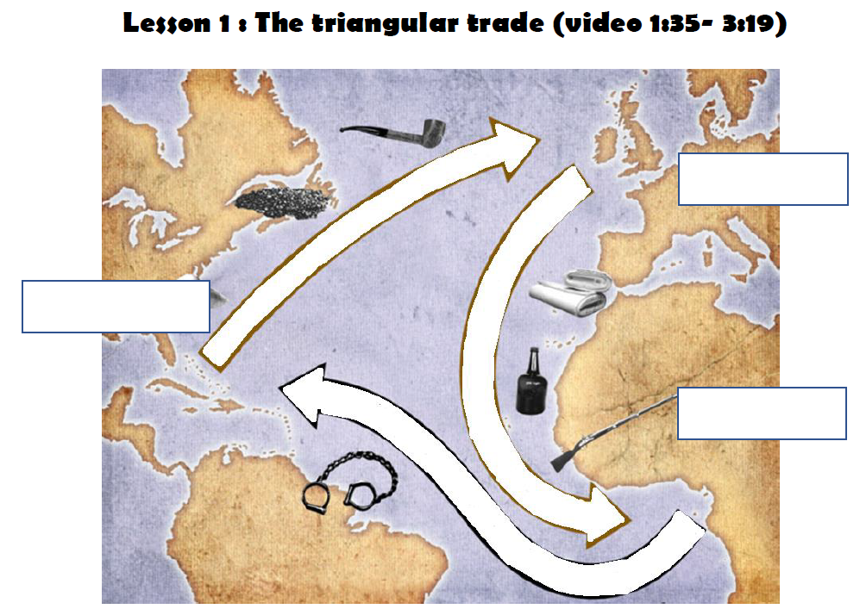
Underline the title in red
(or highlight it)

Slide 6
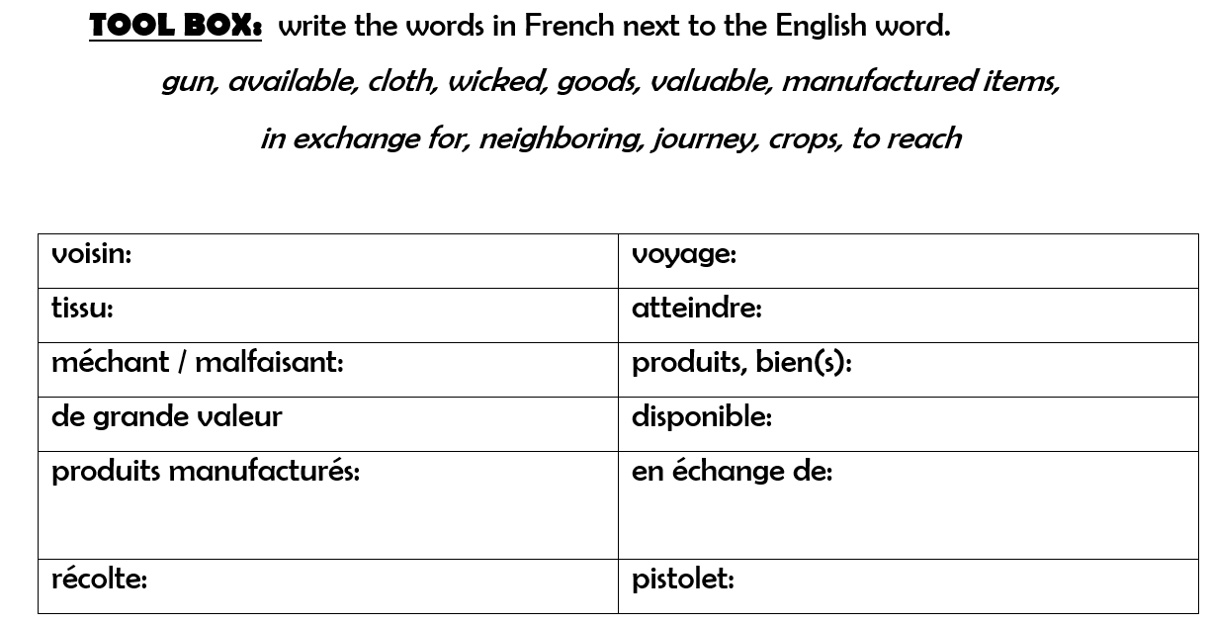
neighboring
journey
cloth
to reach
wicked
goods
valuable
available
in exchange for
manufactured items
crops
gun

Slide 7
Lesson 1: The triangular trade
Watch the video about the triangular trade to understand how it worked.
a, Write captions on the map above (continents, goods)

Slide 8
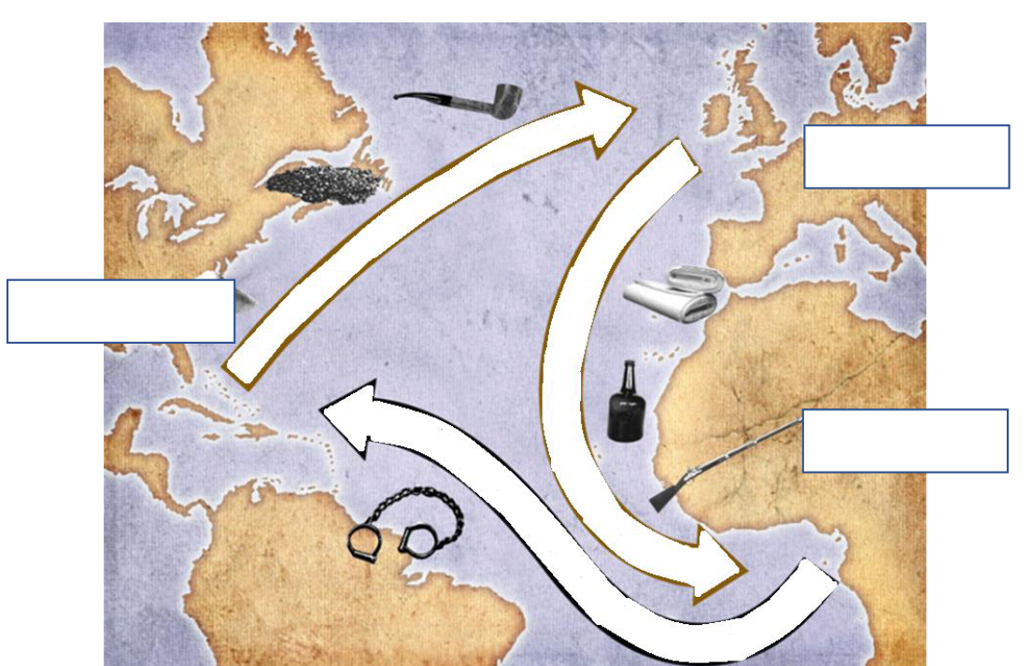

Slide 9
b, Explain the triangular trade
My notes:
When: between the 15 and 1800s (16th to 19th century)
Where:Europe, West Africa, Americas, Atlantic Ocean
Who: European traders, African people, Americans
What:
Why:

Slide 10


Prepare the recap together
with your group!
You have 6 minutes.

Slide 11
Class: Triangular trade (recap)

Slide 12
What are we going to talk about?

