Slide 1
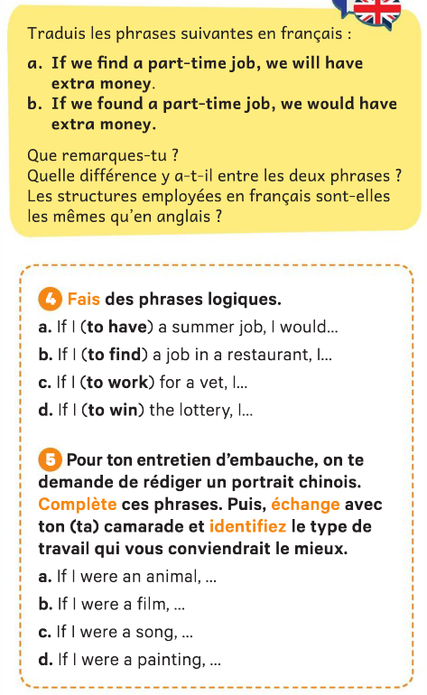
- Si nous trouvons un petit boulot nous aurons de l'argent en plus.
-Si nous trouvions un petit boulot, nous aurions de l'argent en plus.

Slide 2
-

Slide 3
-

Slide 4
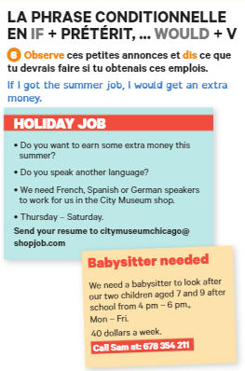
-

Slide 5
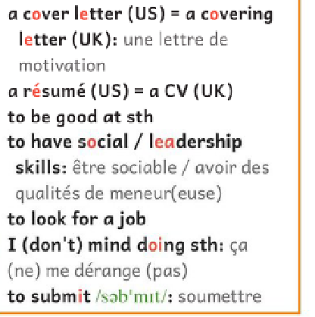
être bon/doué pour quelque chose
chercher un emploi

Slide 6
Eval second conditional

Slide 7
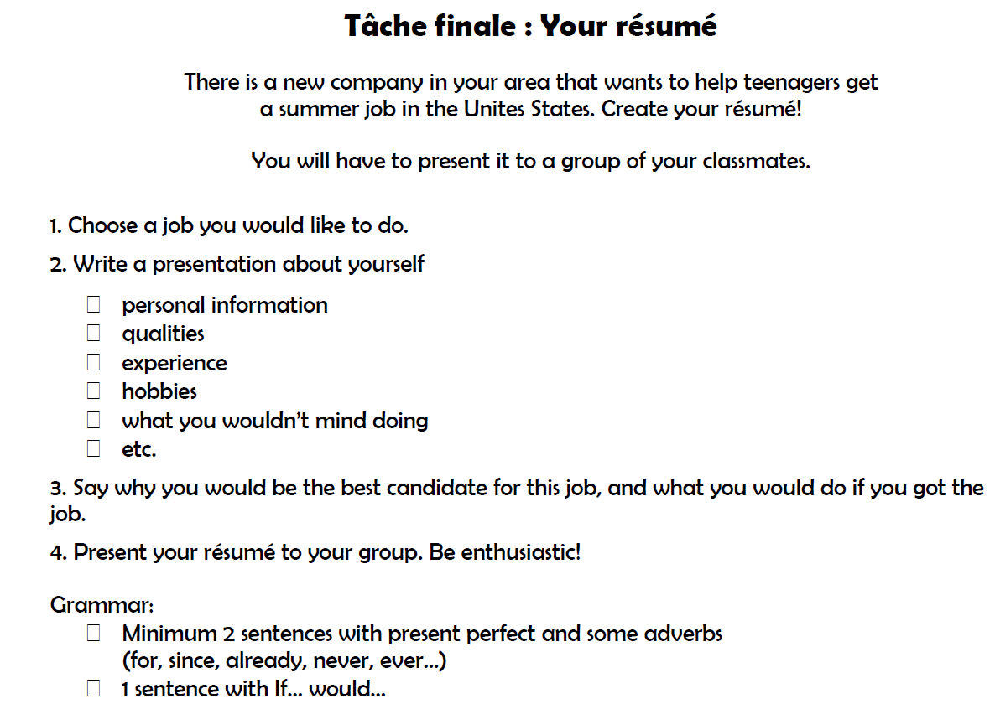

Slide 9
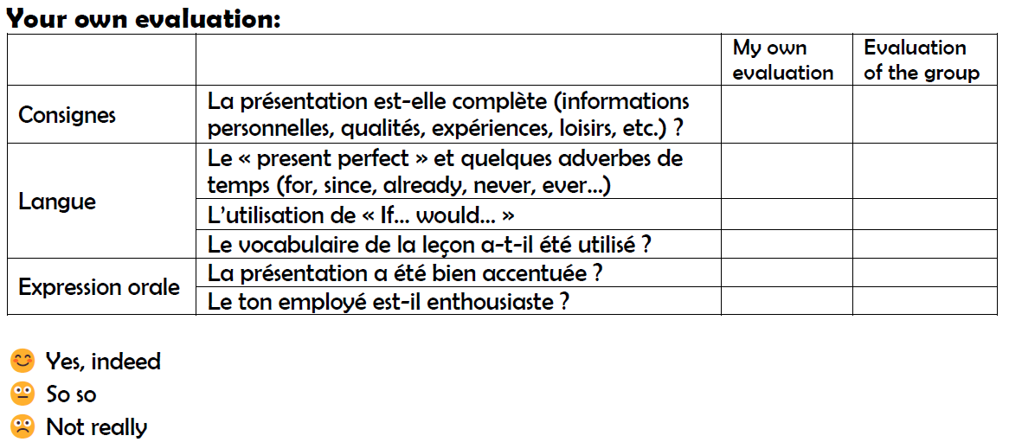

Slide 10
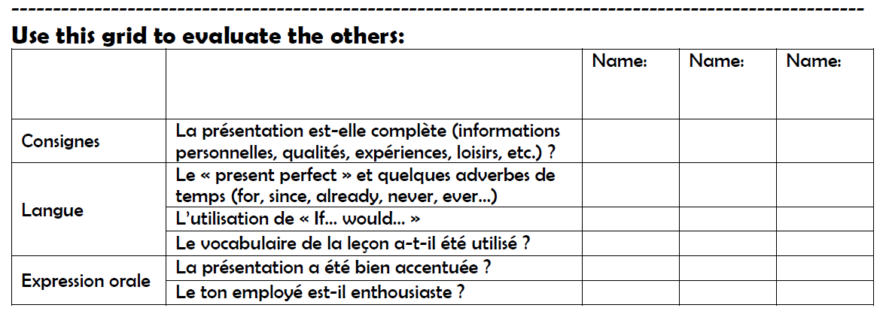

Slide 11
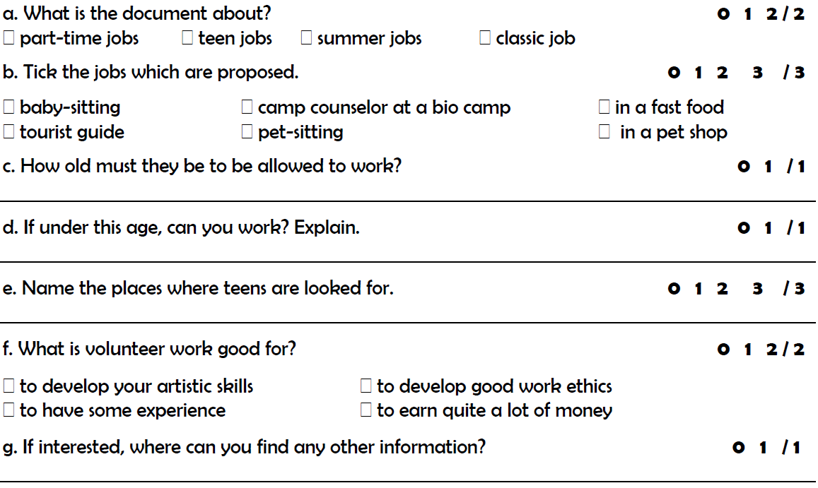
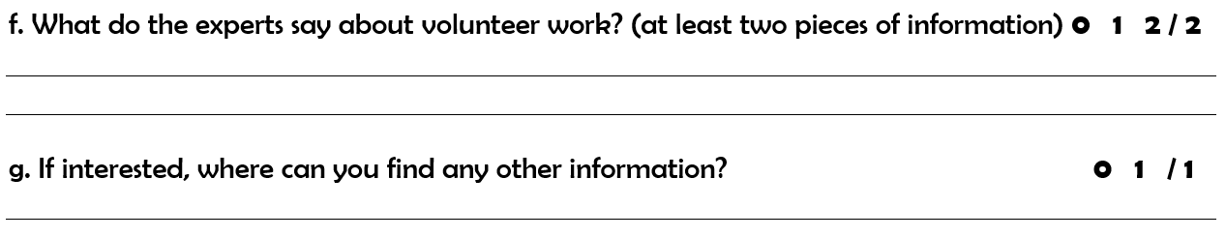
16 years old
Yes. Need a special work permit from the States Deprtment of Labor.
They are looking for teens in golf courses, offices, museums and restaurants
Volunteer Work might not be paid, but is good to have a sense of ethics and to get some experience.
On their website.

