Slide 1
Unit 5: Gender equality

Slide 2
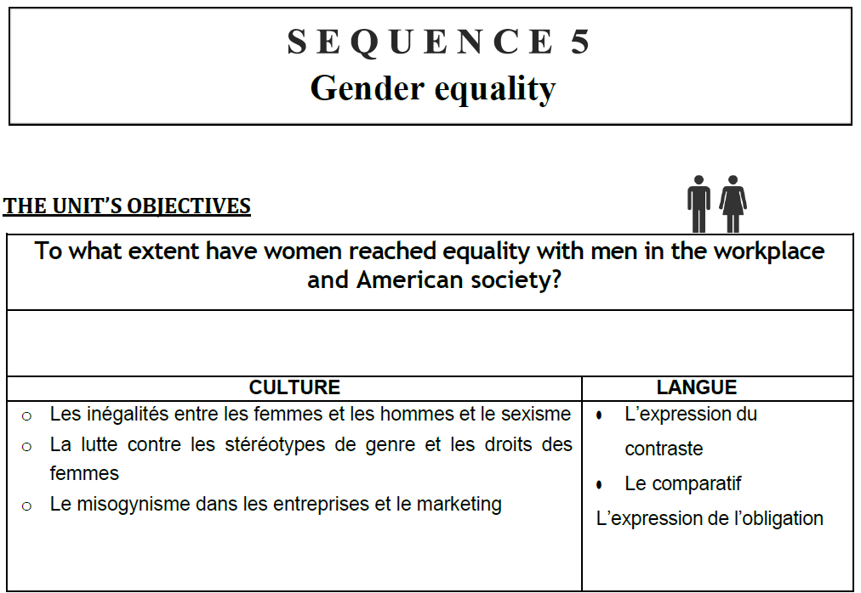

Slide 3
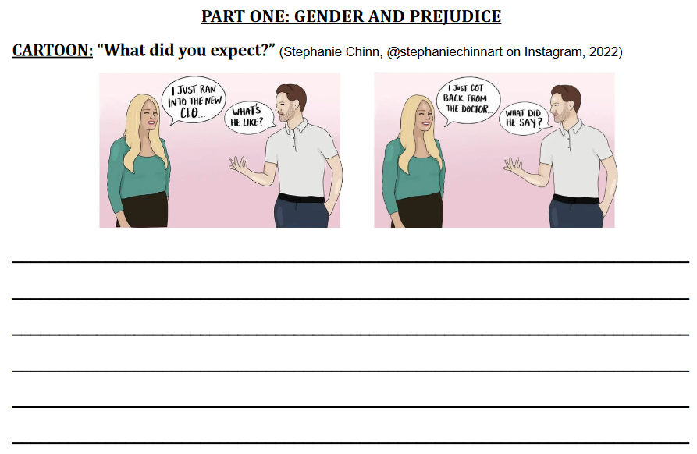
We don’t know the gender of the CEO or the doctor, but the man always uses “he”.
It is still a “reflex”, a prejudice we have in the soci

Slide 4
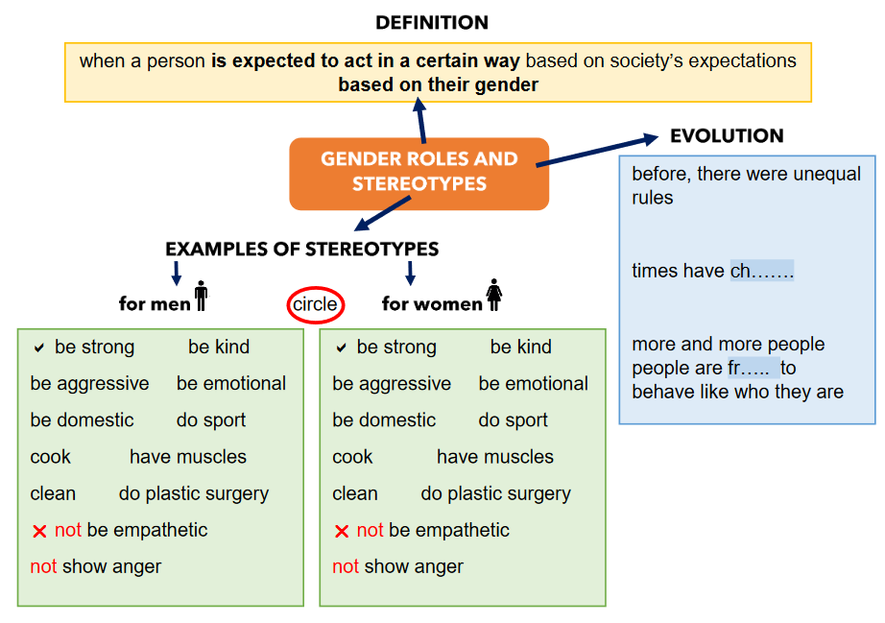
anged
ee

Slide 5
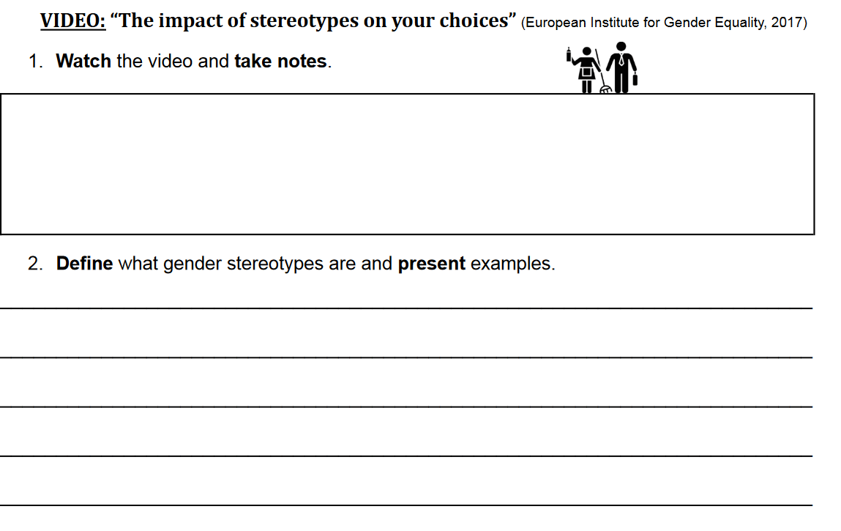
-
Gender stereotypes are behaviors that are ecpexted from the different genders. (behavior=comportement)
For example, women must be able to cook, take care of children, they must be domestic, nice, emotional, etc…
In the other hand, men must be strong, do sports, be aggressive, etc.

Slide 6
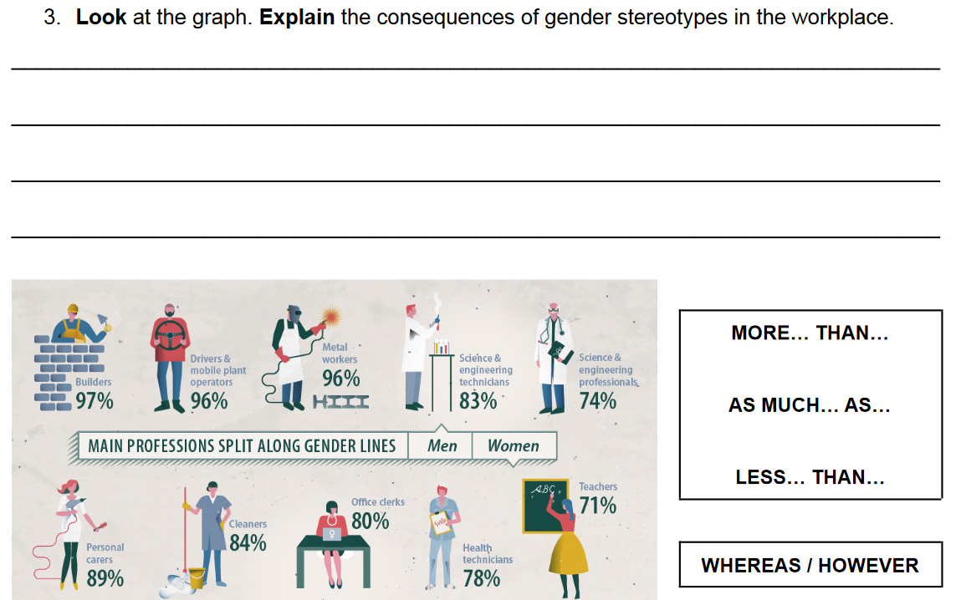

Slide 7
