Slide 1
Bonus Lesson: Chinese Portrait Date?
Watch the video and write down what the colors symbolize!
My notes:

Slide 2

Watch the video! What do the colors symbolize?
Lesson 8
Notes:
2

Slide 3
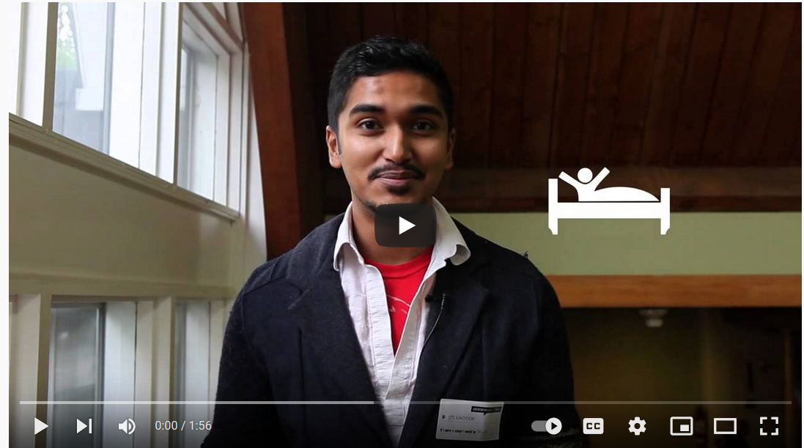

Slide 4

Let’s speak!
What do the colors symbolize?

Slide 5

Let’s speak!
Can you think of any other questions to ask?
What would you be, if you were
?
What would you be, if you were
?
What would you be, if you were
?
What would you be, if you were
?
What would you be, if you were
?

Slide 6
My Chinese portrait:

Slide 7



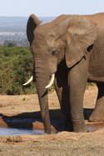
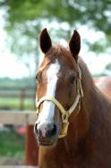


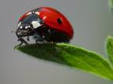
Let’s answer!
If I were an
animal,
I would be a/an
etc.
because…

Slide 8

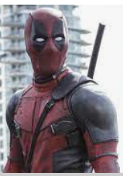
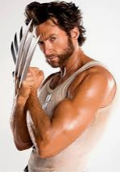
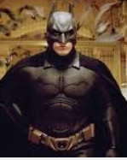
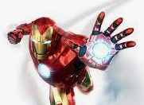
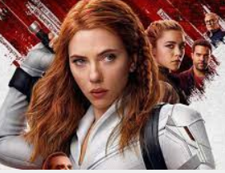
Let’s answer!
If I were a
superhero,
I would be a/an
etc.
because…

Slide 9


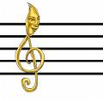
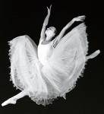

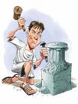
Let’s answer!
If I were
a type of art,
I would be a/an
etc.
because…

Slide 10
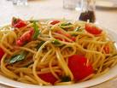
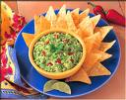
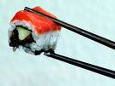
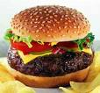

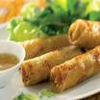
Let’s answer!
I would be
etc.
If I were a
type of cuisine,
because…

Slide 11




Let’s answer!
I would be
If I were a
natural element,
because…

Slide 12

Listen to Rebecca!
1st listening:
Take notes in your copybook

Slide 13

Listen to Rebecca!
If I were a… | I would be… | Because…

Slide 14
Listen to Rebecca!
1st listening:
Take notes in your copybook
2nd listening:
Organize your notes + complete them

Slide 15
Listen to Rebecca!
1st listening:
Take notes in your copybook
2nd listening:
Organize your notes + complete them
3rd listening:
Finalize your notes

Slide 16
Listen to Rebecca!
If I were a… | I would be… | Because…
drink | a nice cup of tea | there’s nothing like a cup of tea.
food | chocolate | I love chocolate, I could eat it all day
season | winter | I love snow
day | Friday | it means it’s the end of the week.
month | it would be in the summer | I like being warm
date | 5 of March | it’s my birthday
sport | football | watching, not playing
film | Dirty Dancing | romantic film, with a few songs

Slide 17
Make sentences about her!
If I were a… | I would be… | Because…

Slide 18
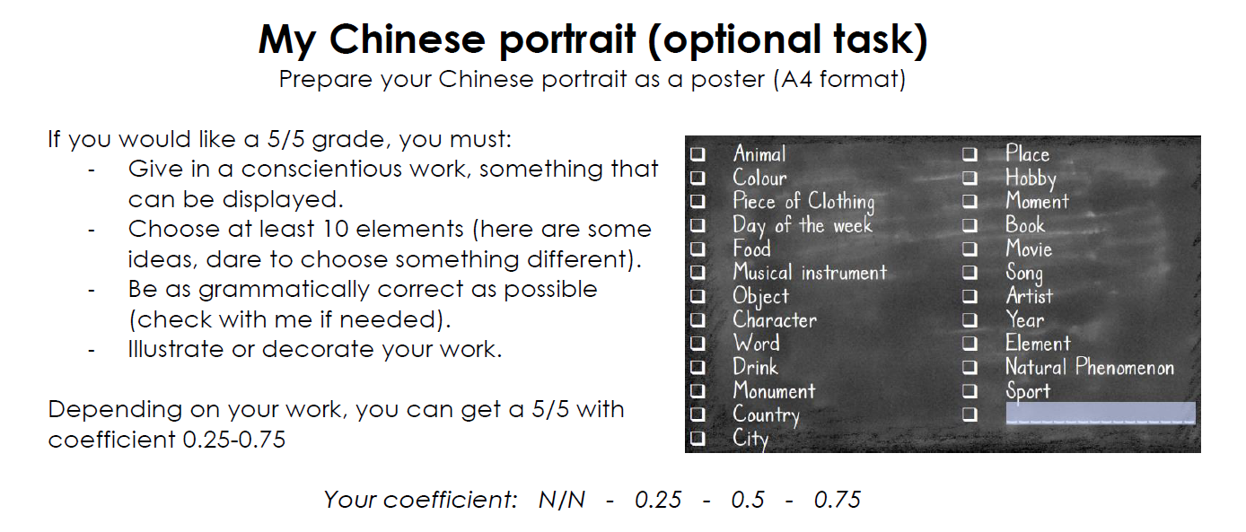
Create your own Chinese portrait!

Slide 19
Big test
Compréhension orale
Vocabulaire
Décrire quelqu’un
Comparer deux personnes
Chinese portrait

