Slide 1
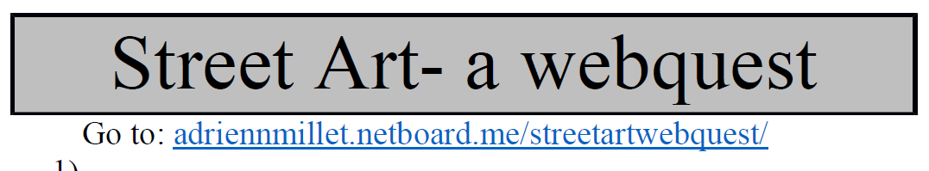

Slide 2
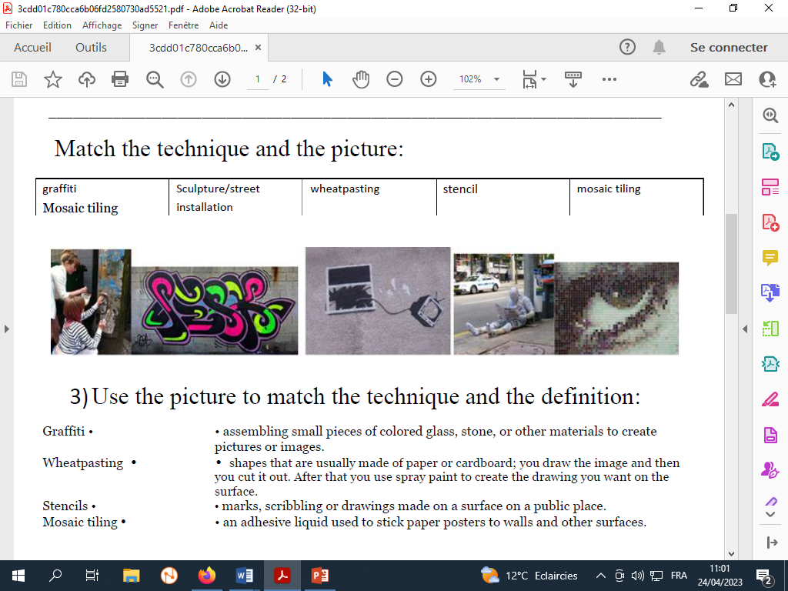

Slide 3
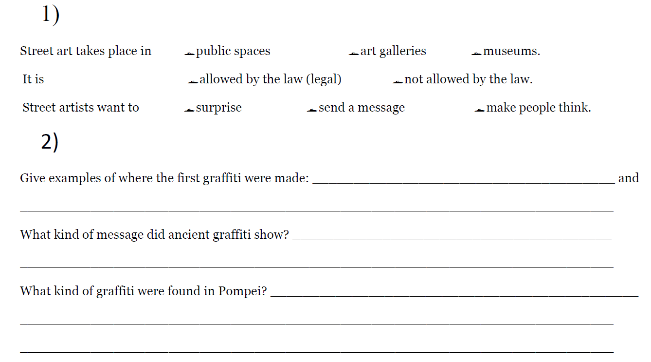
walls of ancient sepulchres (tombs) or ruins, as in the Catacombs of Rome or at Pompeii.
love declarations, political rhetoric, and simple words of thought
Latin curses, magic spells, declarations of love, insults, alphabets, political slogans, and famous literary quotes

Slide 4
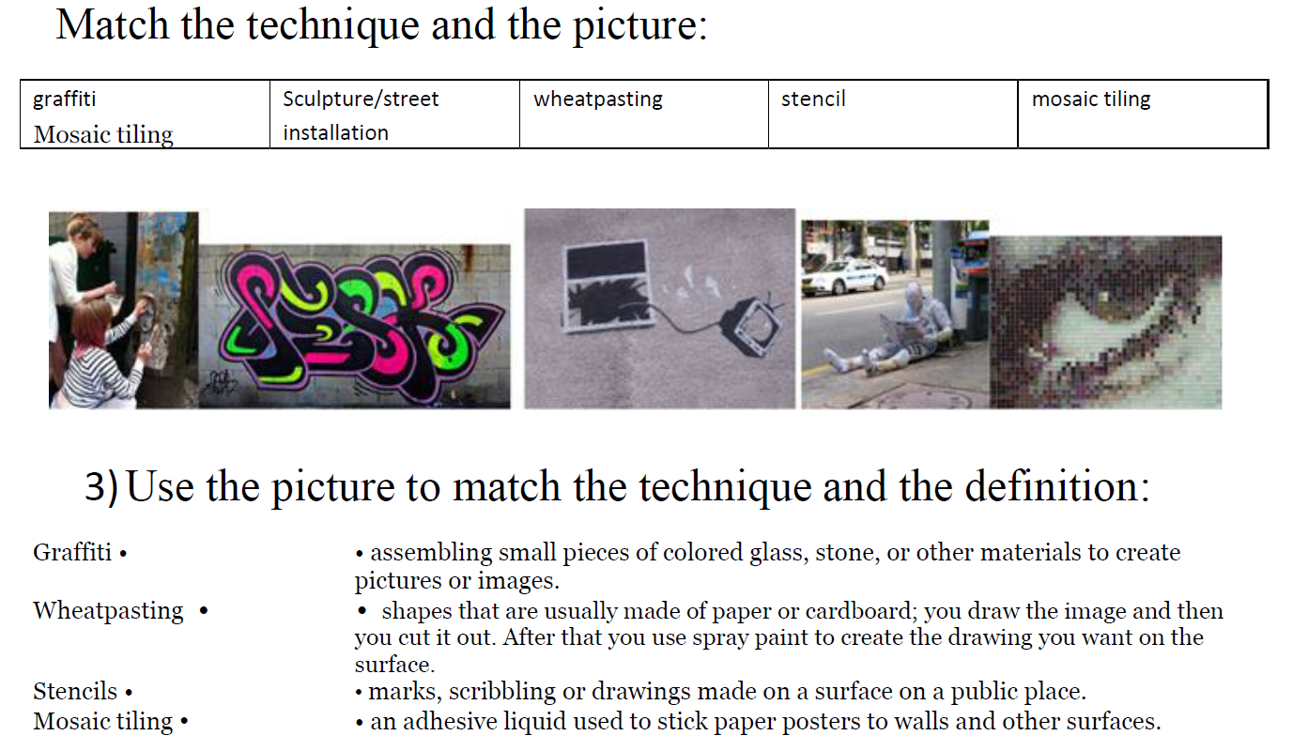

Slide 5
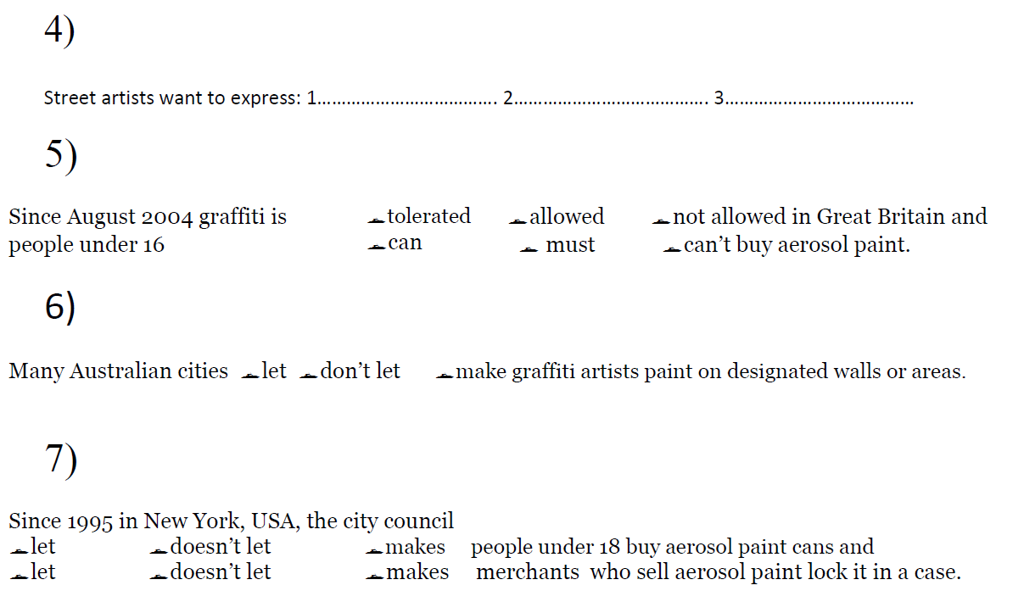
political issues
feelings
emotions

Slide 6
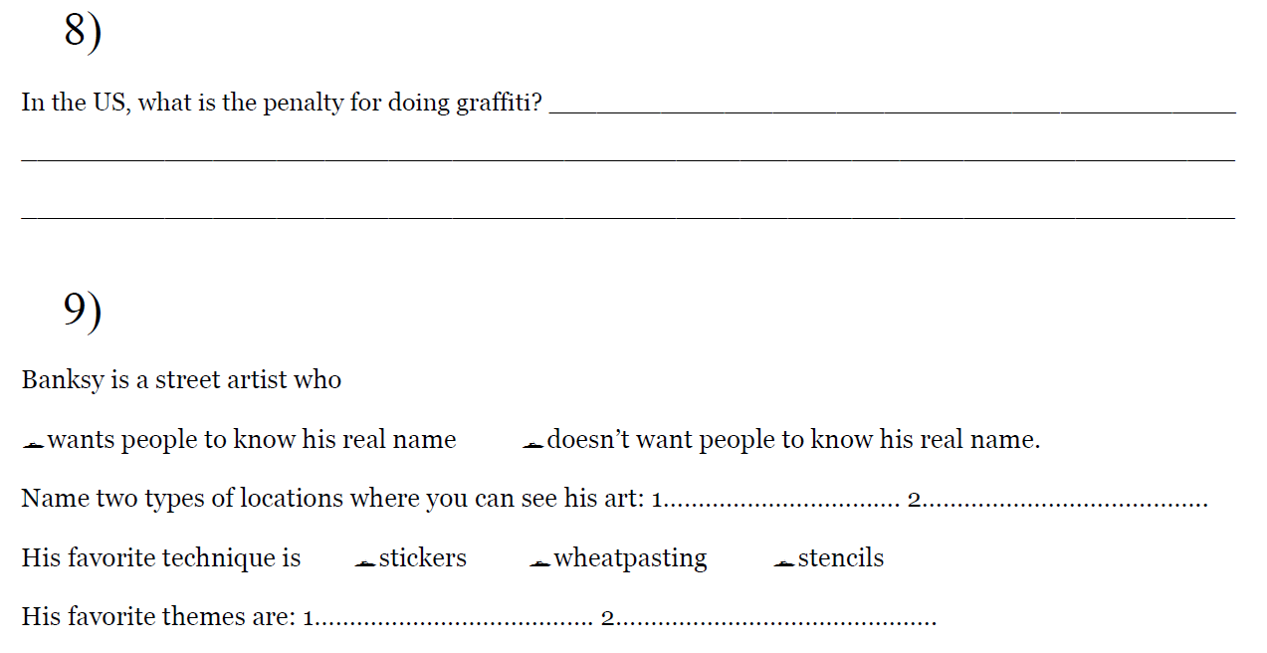
US$500 per incident
Paris
London
(Bristol, NYC etc.)
politics
war

