Slide 1
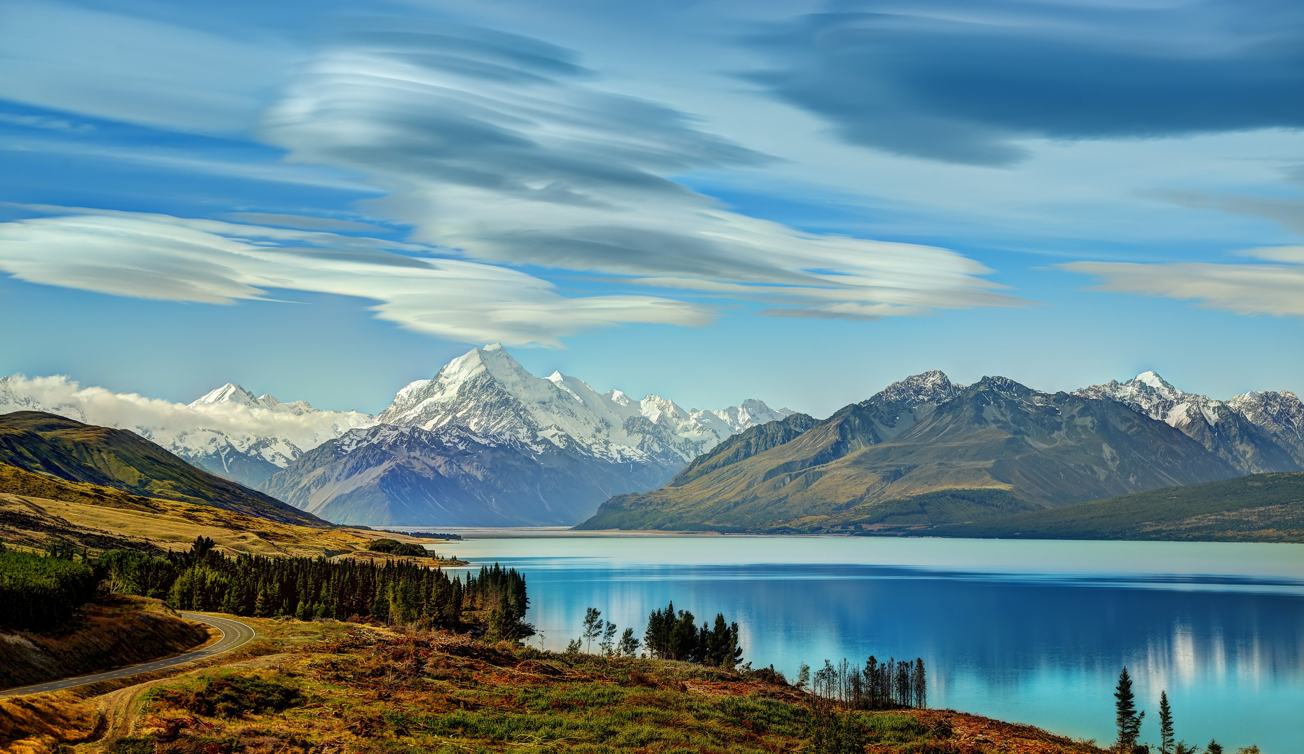
What are we going to talk about?

Slide 2
Unit 3: Kia ora
(New Zealand)

Slide 3
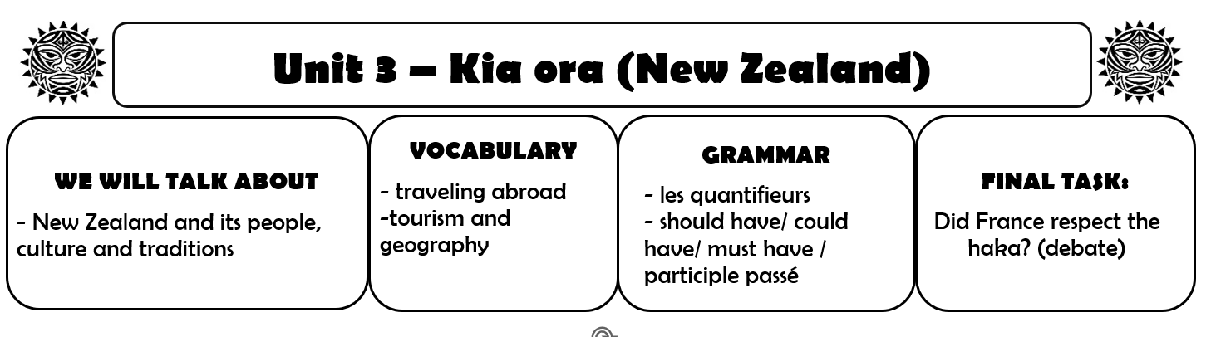

Slide 4
In your copybook:
Lesson 1: Discover New Zealand

Slide 5
What do you know about New Zealand?

Slide 6
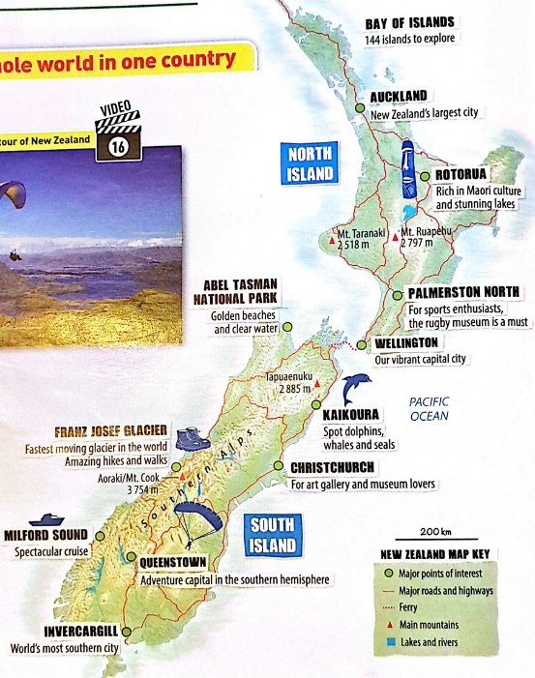
1. Look at the map.
What do you notice about New Zealand?
What is NZ famous for?

Slide 7
2. Watch the video.
New Zealand is said to be :
“the extreme sports capital of the world”
What extreme sports do you see on the map and in the video?

Slide 8
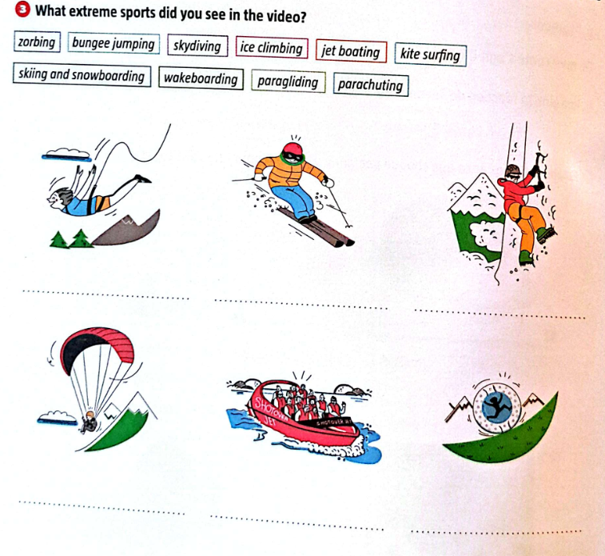
What extreme sports do you see?
bungee jumping
skiing
ice climbing
paragliding
jet boating
zorbing

Slide 9
3.
New Zealand is also said to be :
“any travelers dream”
Let’s find the positive expressions in the video!

Slide 10
In your copybook:
Lesson 1: Discover New Zealand
Video: Take a tour of New Zealand
Positive expressions:

Slide 11
In your copybook:

Slide 12
3.
New Zealand is also said to be :
“any travelers dream”
So, do you agree?

Slide 13
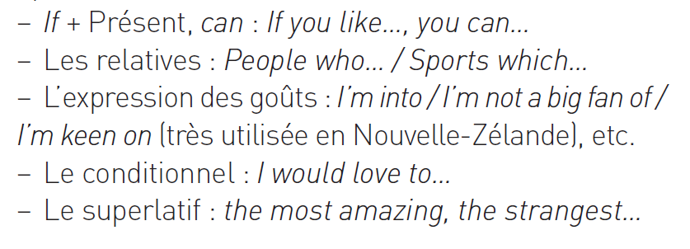
3.
New Zealand is also said to be :
“the place where there is something for everyone”
Do you agree?
Work in groups! Help:

Slide 14
Time to write!
What would you do in New Zealand?
In your copybook, write 4 sentences to present the activities you would / wouldn't do if you were in NZ and why.
Ex : If I were in New Zealand, I would go canoeing
because I love water sports.

Slide 15
Lesson 2: 10 fun and quirky facts about New Zealand

Slide 16
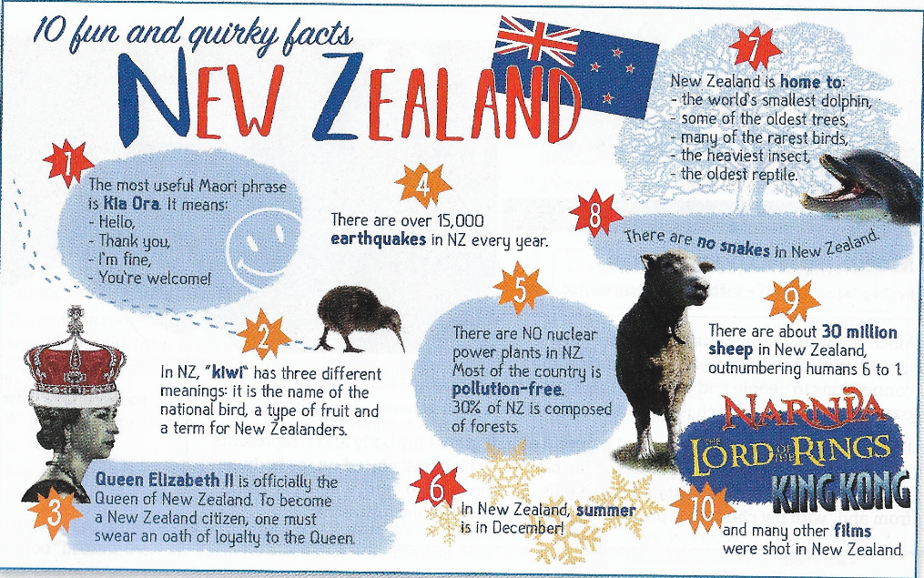
Lesson 2: 10 fun and quirky facts about New Zealand
What does quirky mean?
Read the facts and find your favourite one.

Slide 17
Lesson 2: 10 fun and quirky facts about New Zealand

Slide 18
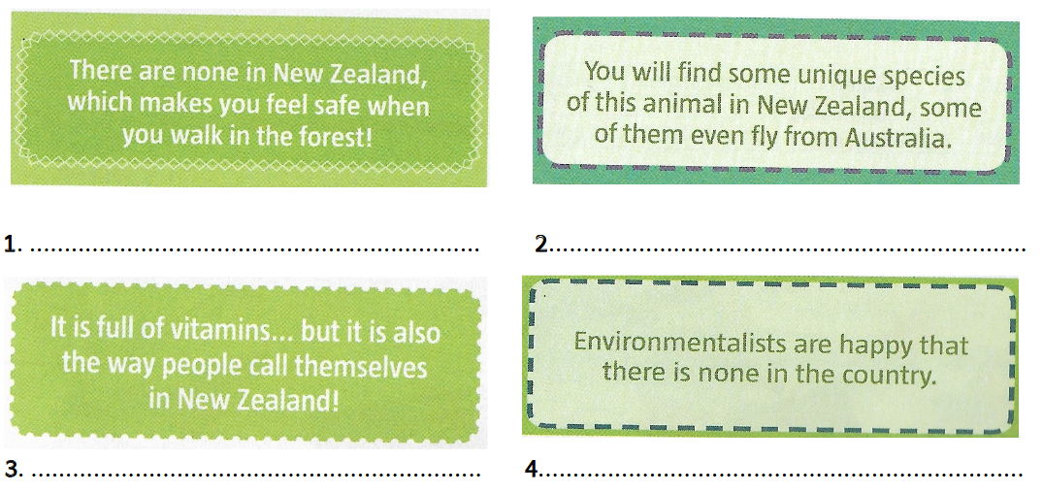
Can you solve these riddles ?
Find the answer of these 8 riddles using to the infographic.
snakes
birds
kiwi
nuclear plants

Slide 19
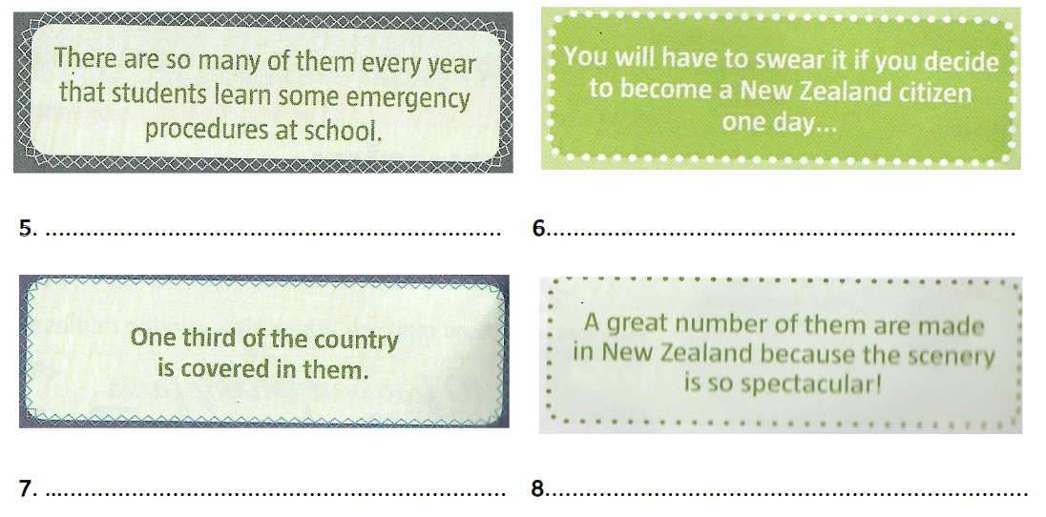
Can you solve these riddles ?
Find the answer of these 8 riddles using to the infographic.
earthquakes
the oath of loyalty
forests
films

Slide 20
New Zealand’s history
Watch the video.

Slide 21
New Zealand’s history
What do you remember?
          Who were the colonizers?
          Did the Maori fight back?
          Why was the capital moved?
          What’s an interesting fact about women’s right to vote?

Slide 22
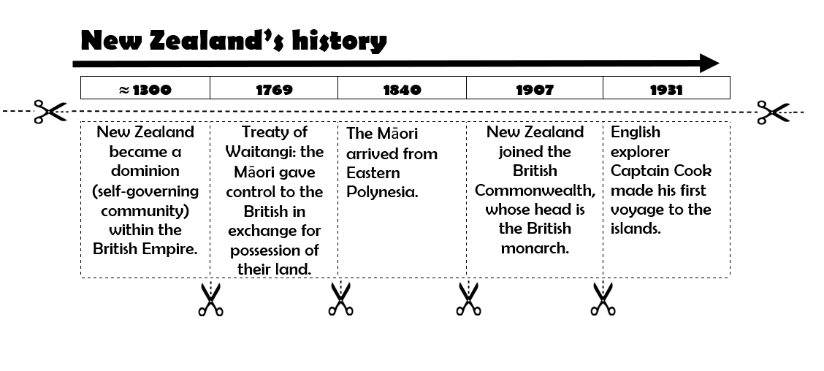
New Zealand’s history
Cut out the historical events and put them in the good order.
Only glue this part!
Cut this
part into pieces!

Slide 23
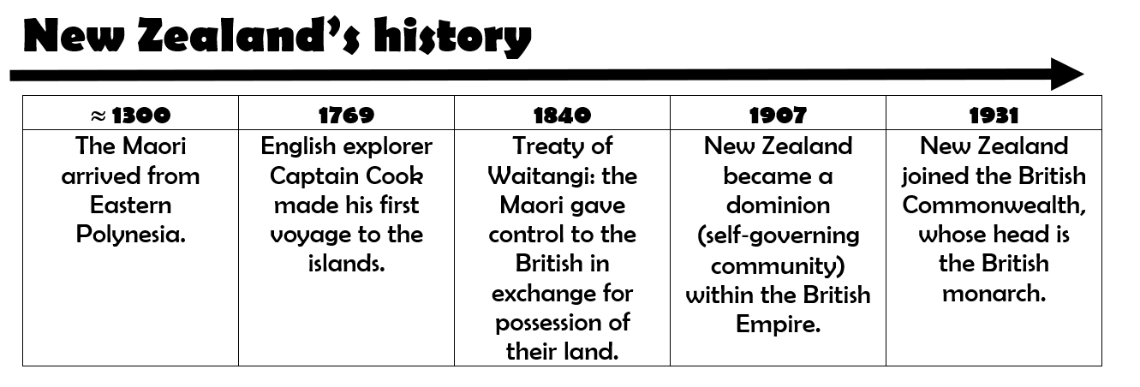

Slide 24
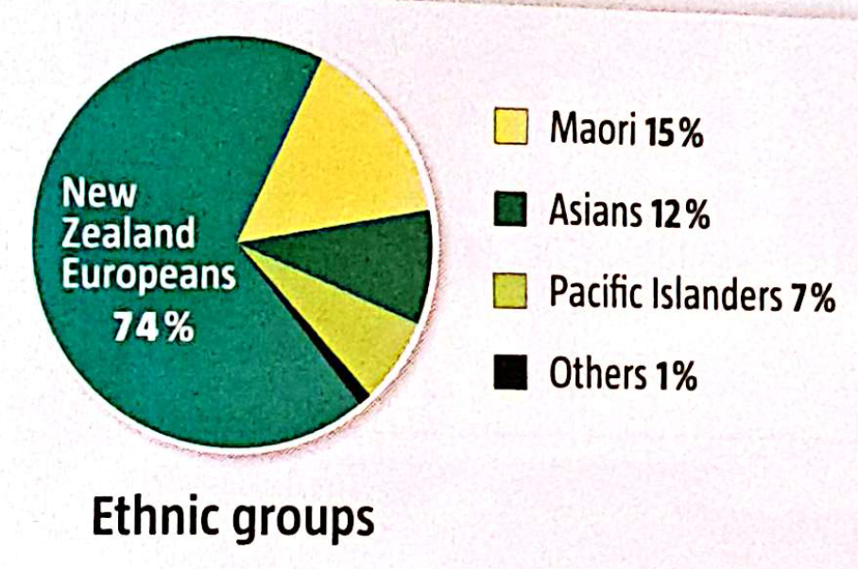
New Zealand’s population
How do you explain this pie chart?

Slide 25
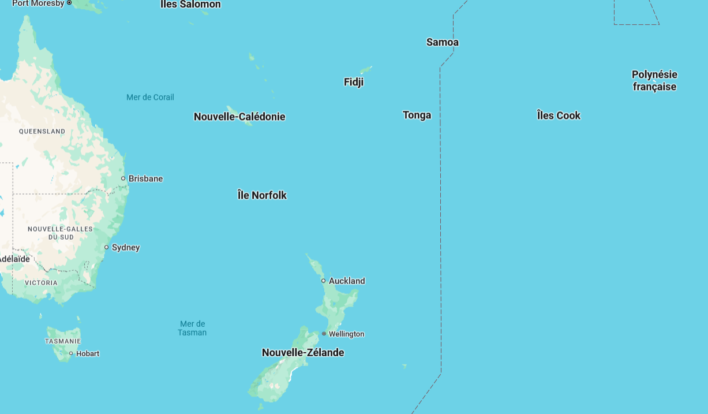
What are we going to talk about?

Slide 26
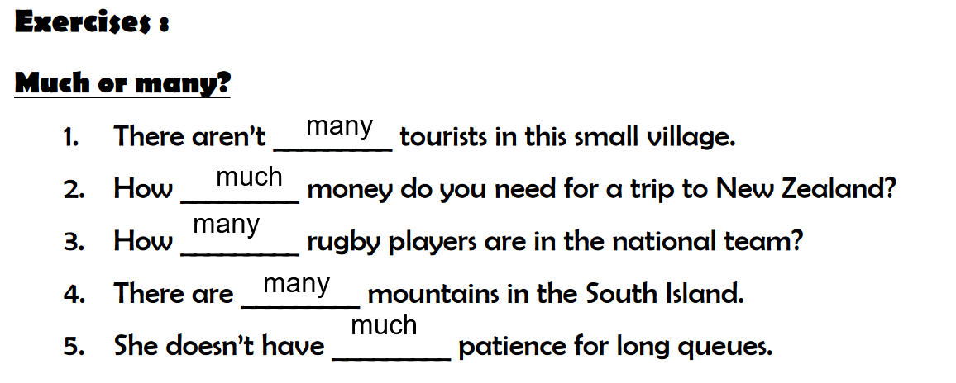
Les quantifieurs
pdf

Slide 27
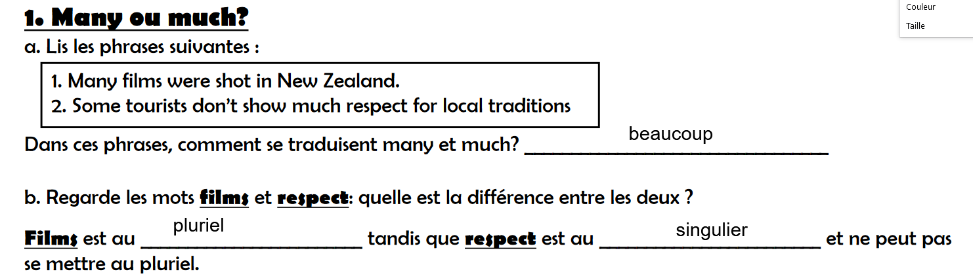
Les quantifieurs
pdf

Slide 28
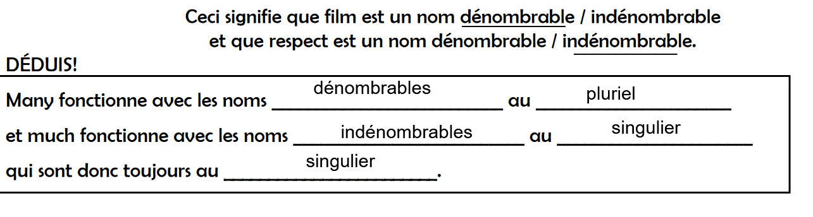
Les quantifieurs
pdf

Slide 29
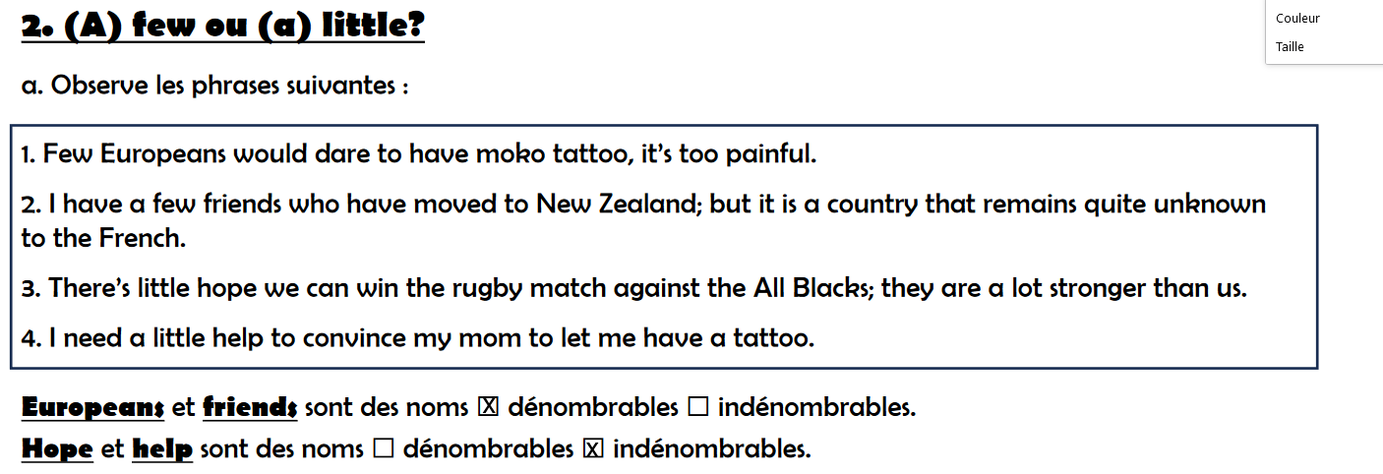
Les quantifieurs
pdf

Slide 30
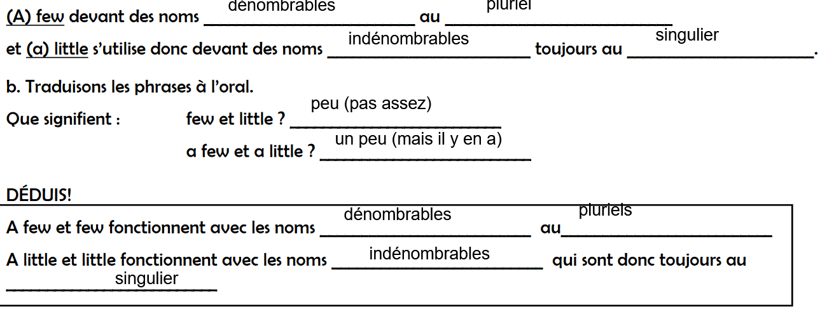
Les quantifieurs
pdf

Slide 31
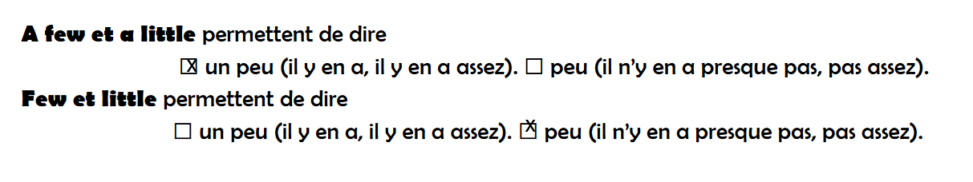
Les quantifieurs
pdf

Slide 32
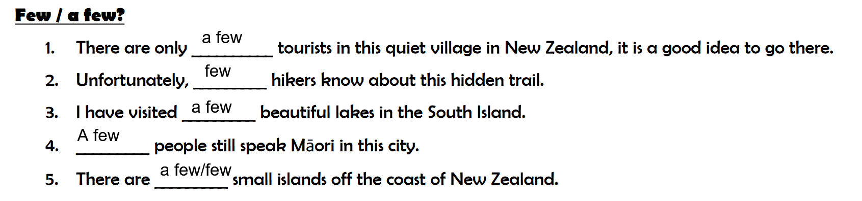
Les quantifieurs
pdf

Slide 33
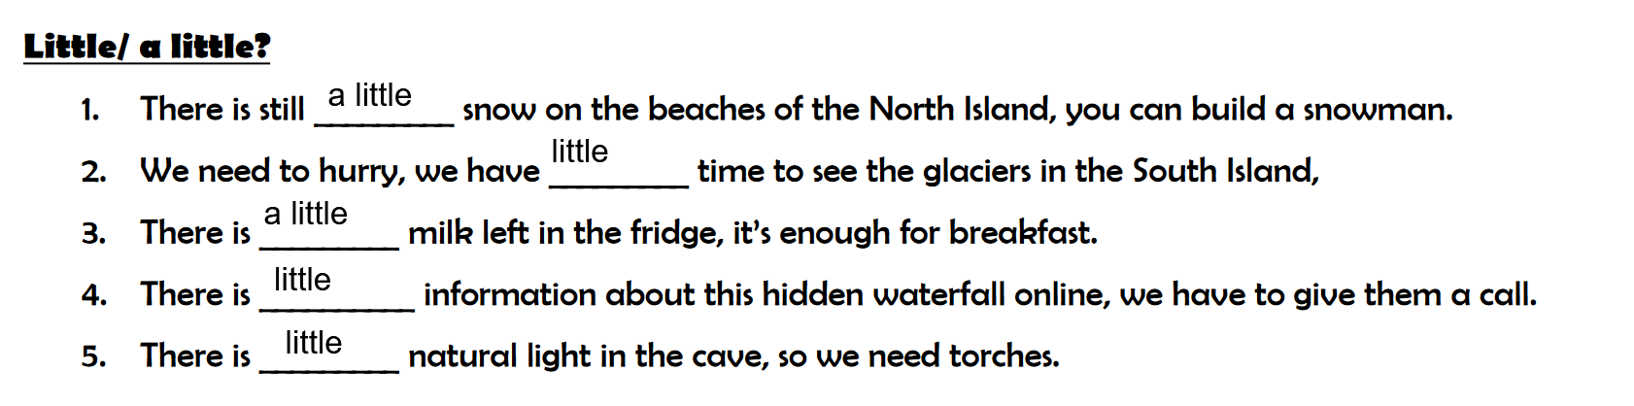
Les quantifieurs
pdf

Slide 34
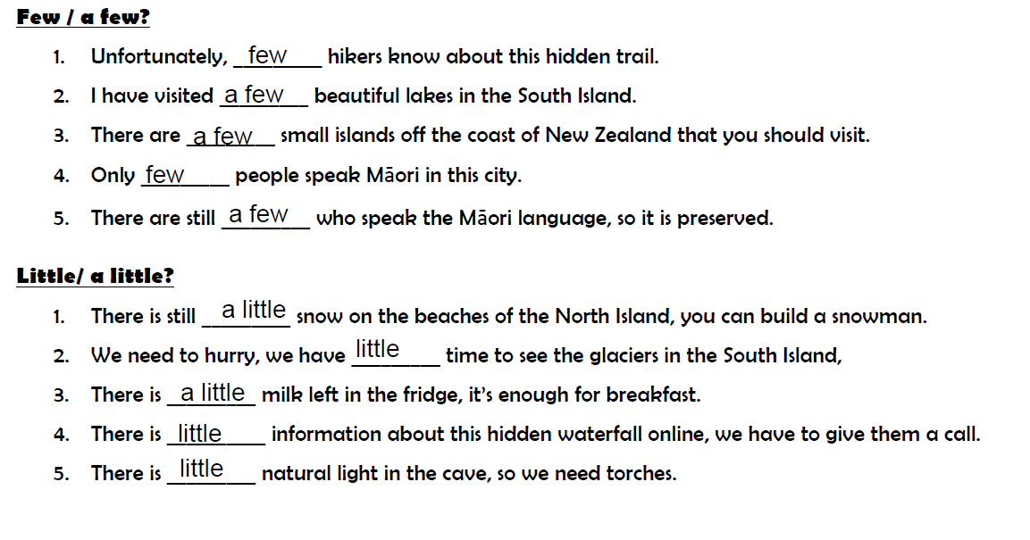
Les quantifieurs
pdf

Slide 35
Les quantifieurs
pdf

Slide 36
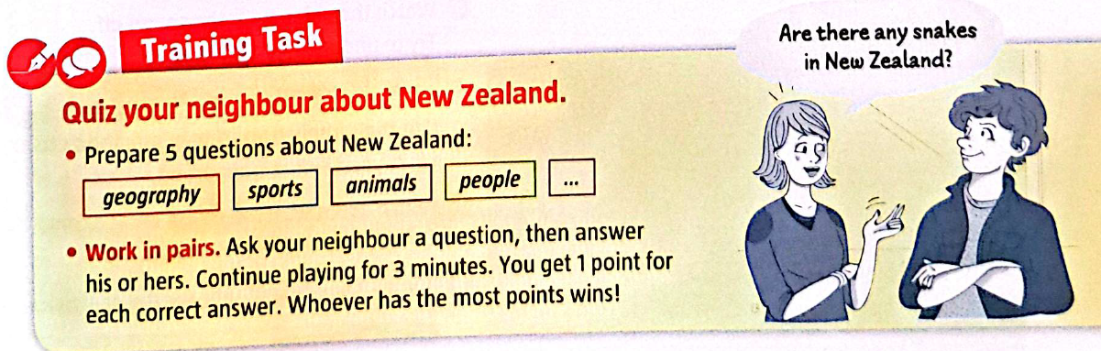
Training task
pdf

Slide 37
What are we going to talk about?
Peu d’Européens oseraient se faire tatouer un moko, c’est trop douloureux.
J’ai quelques amis qui ont déménagé en Nouvelle-Zélande, mais c’est un pays qui reste assez méconnu des Français.
Il y a peu d’espoir que nous puissions gagner le match de rugby contre les All Blacks, ils sont beaucoup plus forts que nous.
J’ai besoin d’un peu d’aide pour convaincre ma mère de me laisser me faire un tatouage.

Slide 38
CE correction
rzgzg

Slide 39
rzgzg

Slide 40
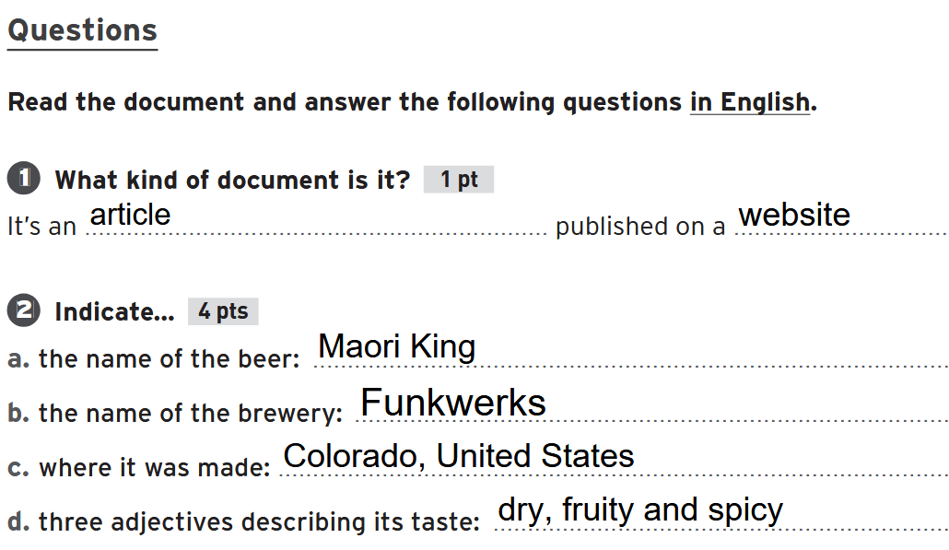

Slide 41
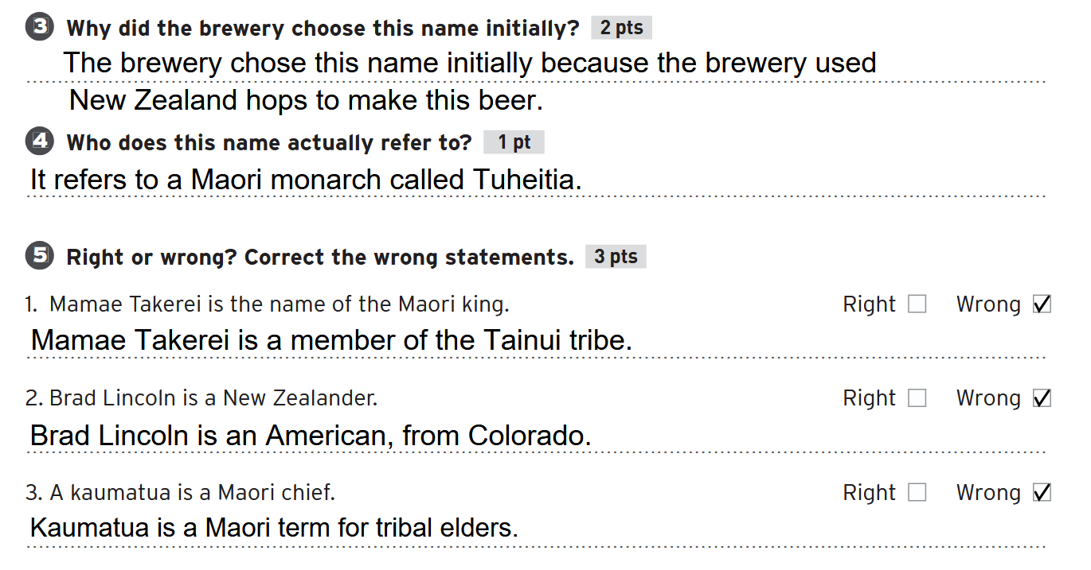
kaumatua are tribal elders
Mamae Takerei of Tainui
A co-founder of Funkwerks, Brad Lincoln, A co-founder of Funkwerks, Brad Lincoln
kaumatua are tribal elders

Slide 42
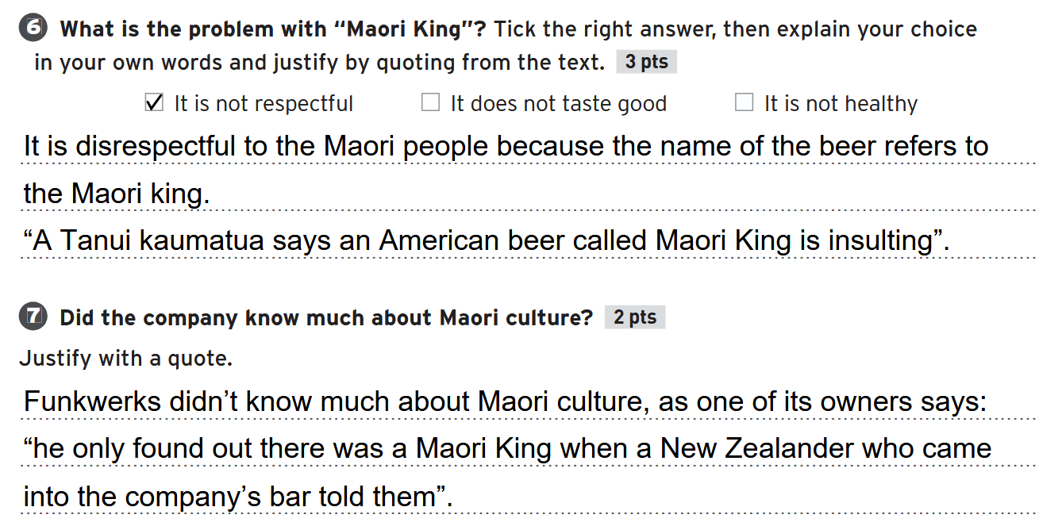

Slide 43
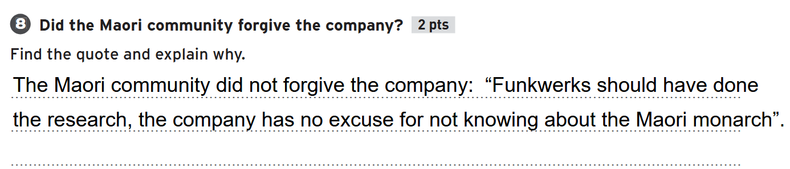

Slide 44
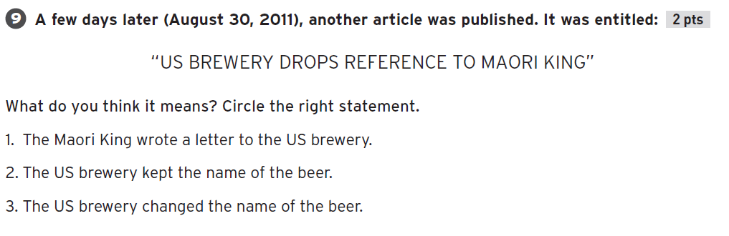

Slide 45
What are we going to talk about?
rzgzg

Slide 46
What are we going to talk about?
rzgzg

