Slide 1

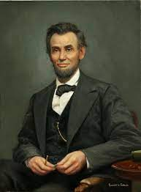
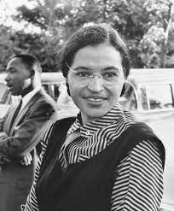
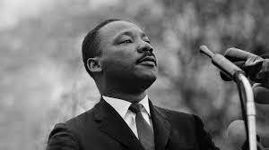
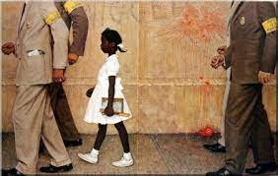
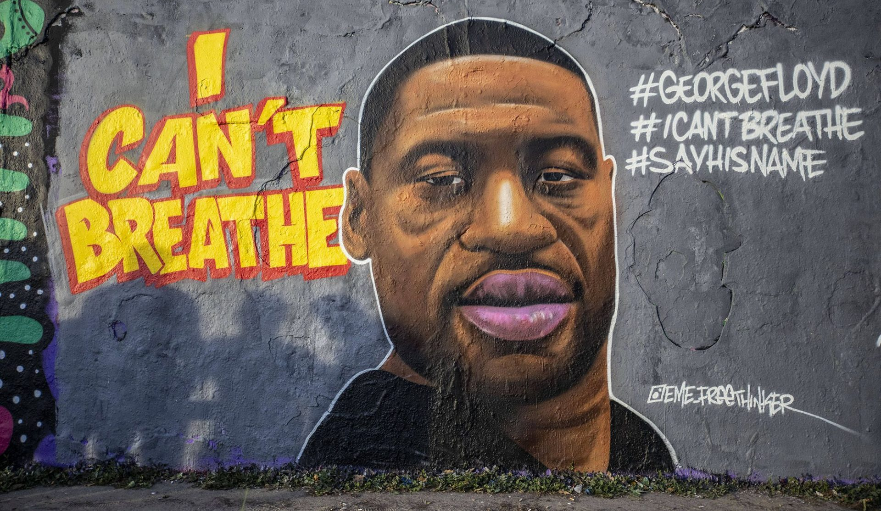
Who do you recognize?

Slide 2

BLACK
HISTORY
IN THE USA

Slide 3
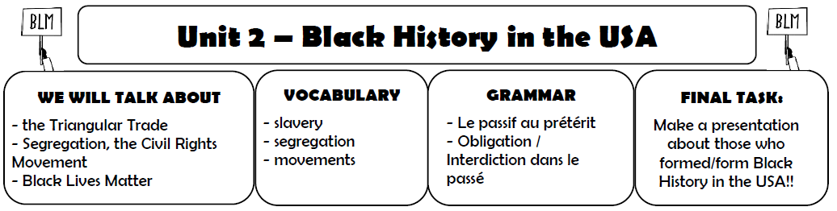

Glue it in your copybook!

Slide 4

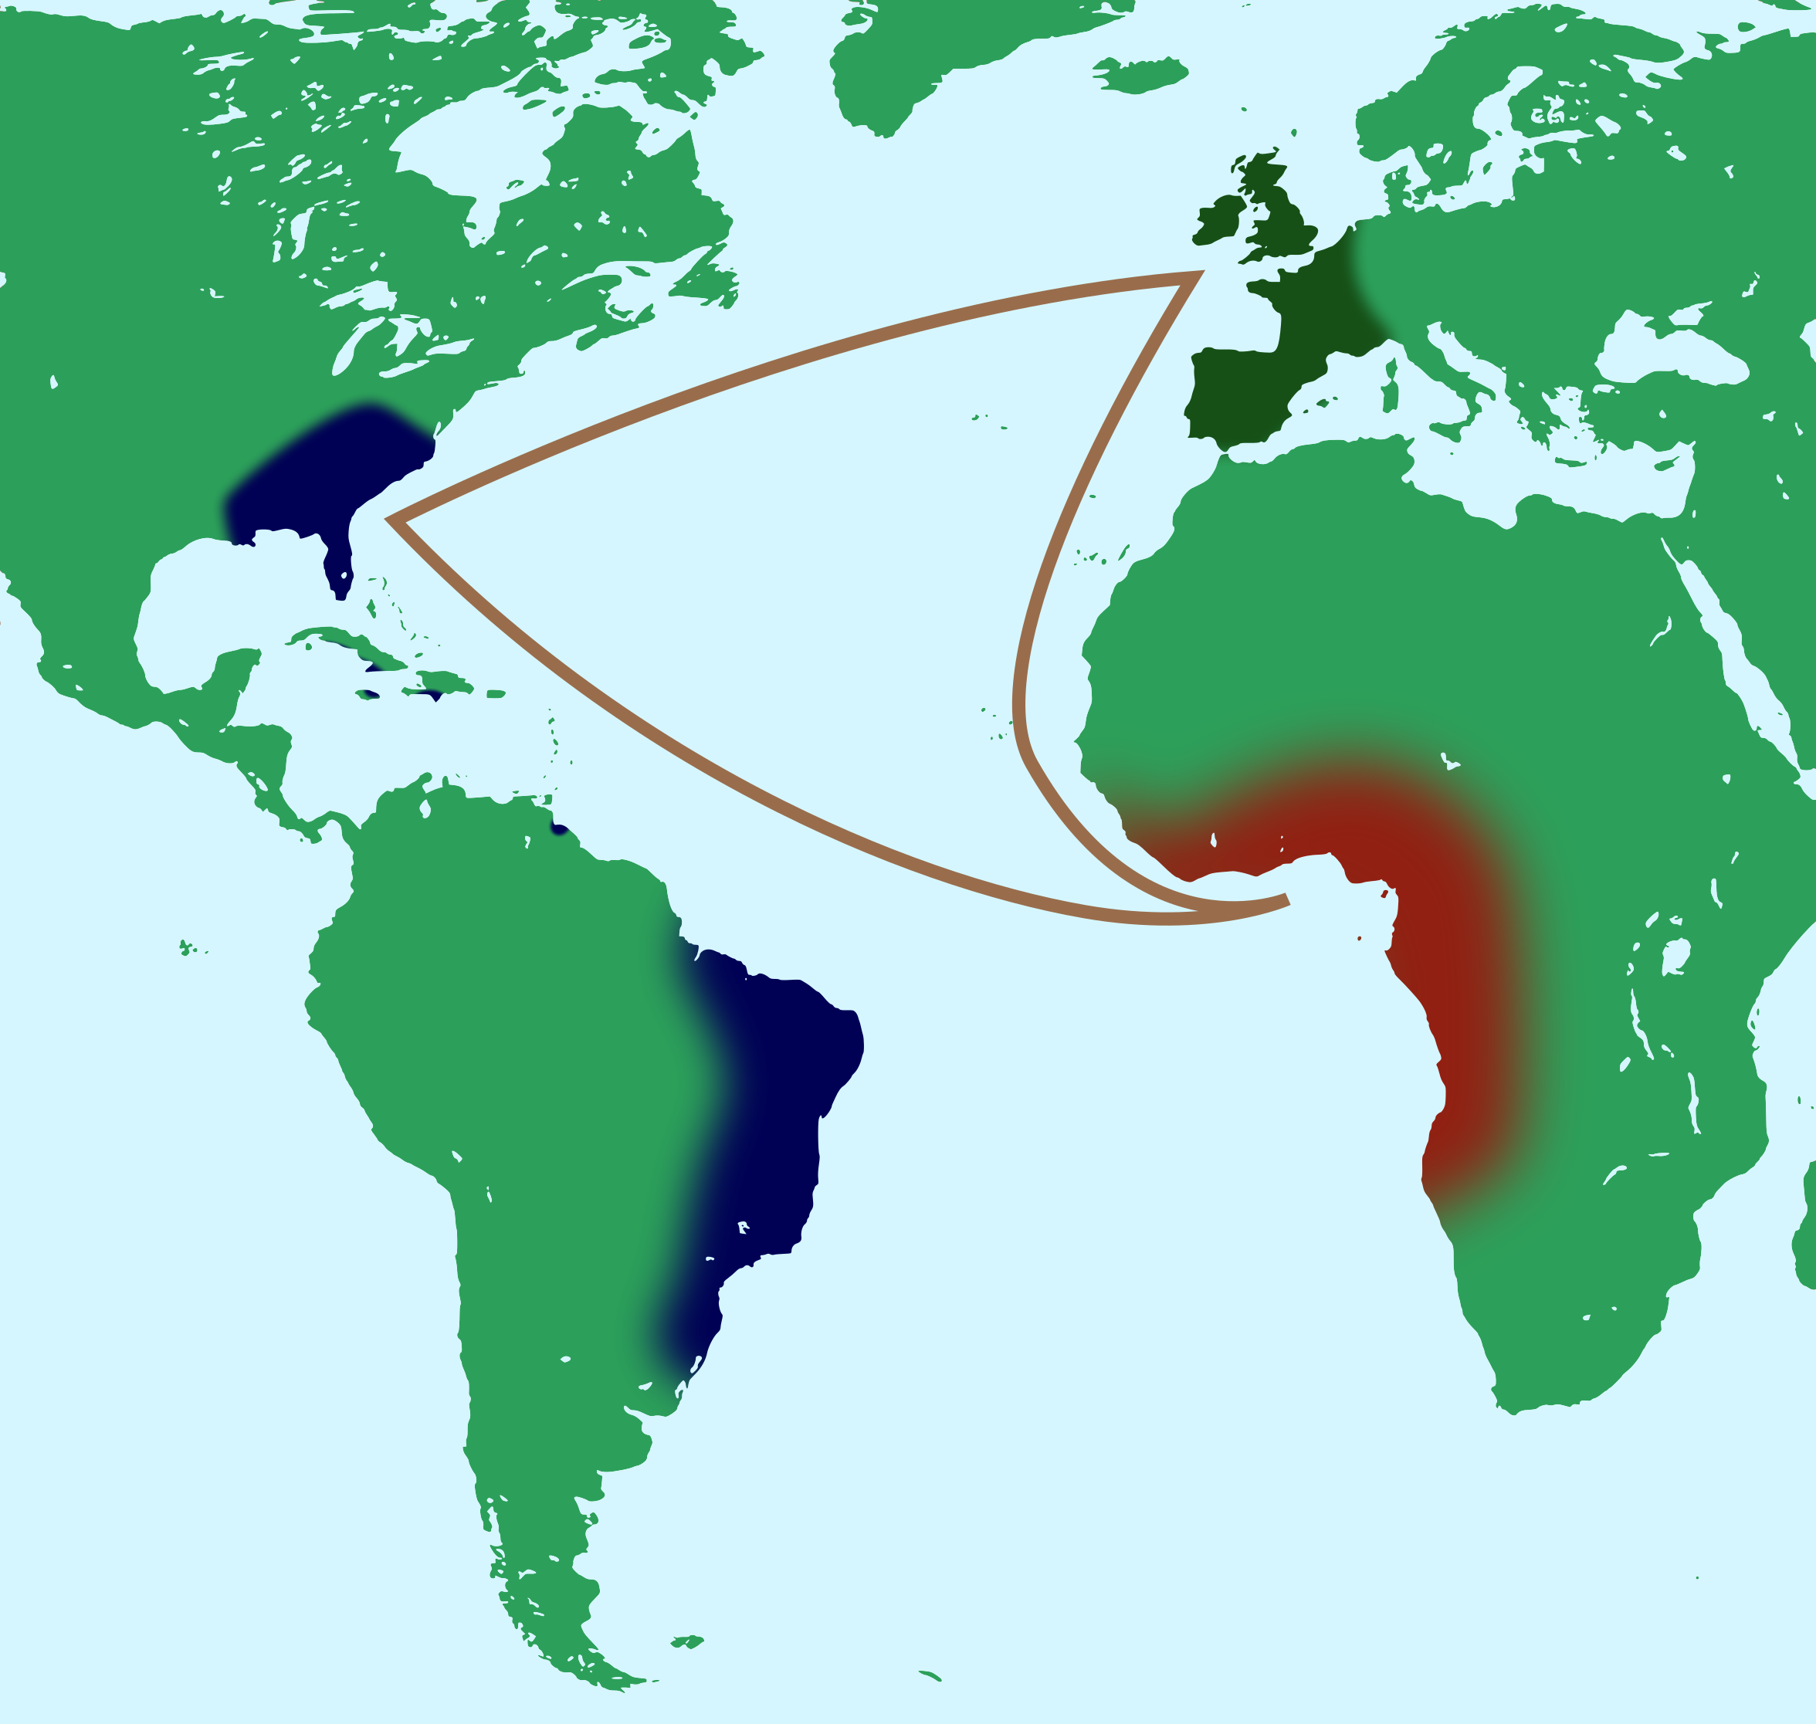
What are we going to talk about?

Slide 5
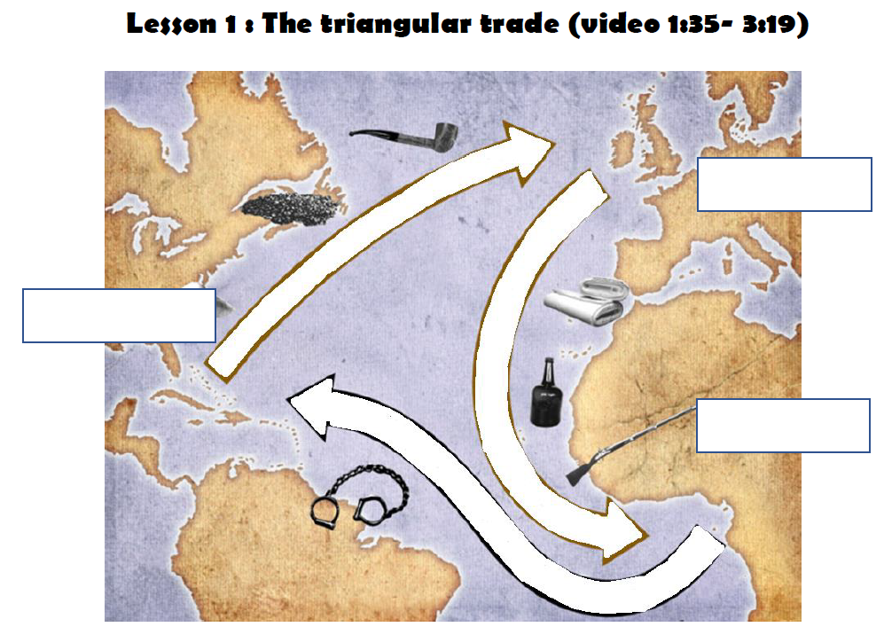
Underline the title in red
(or highlight it)

Slide 6
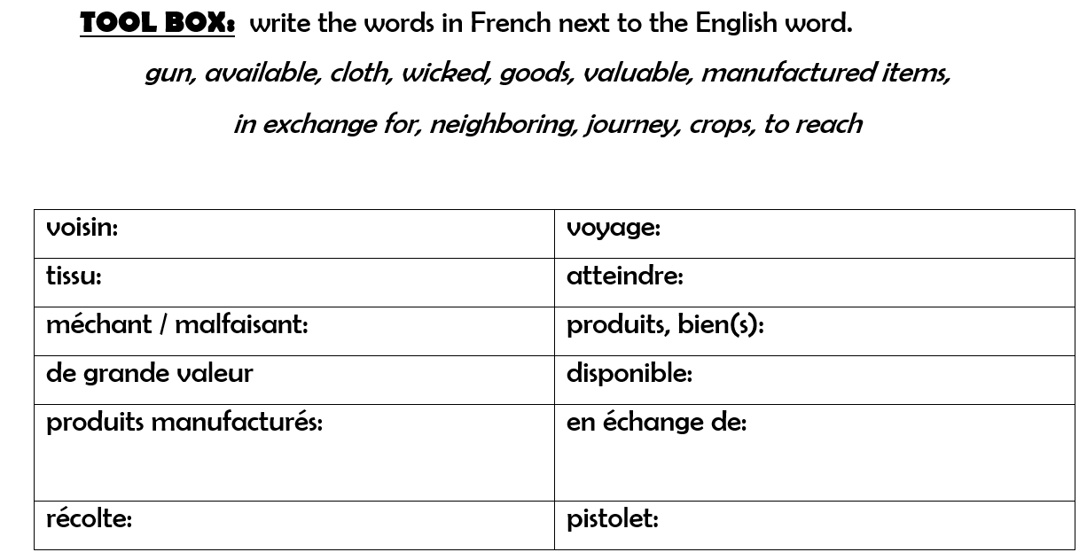
neighboring
journey
cloth
to reach
wicked
goods
valuable
available
in exchange for
manufactured items
crops
gun

Slide 7
Lesson 1: The triangular trade
Watch the video about the triangular trade to understand how it worked.
a, Write captions on the map above (continents, goods)

Slide 8
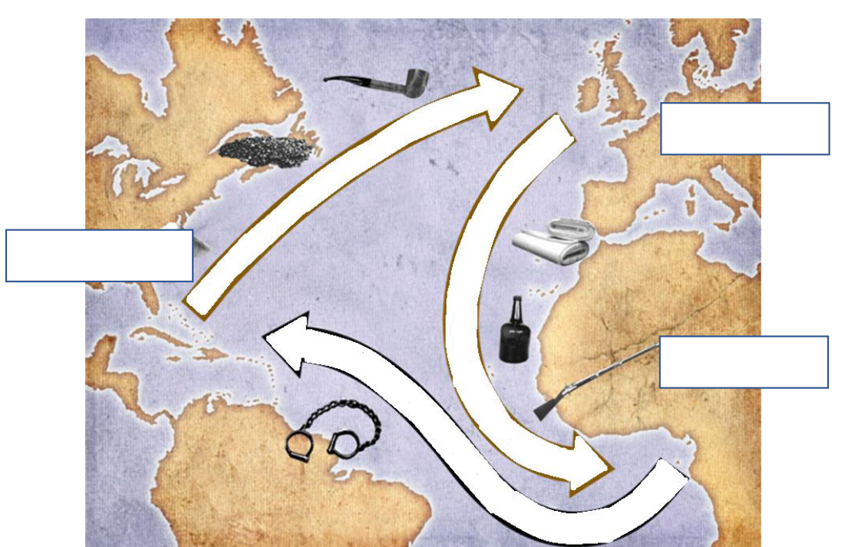

Slide 9
b, Explain the triangular trade
My notes:
When:
Where:
Who:
What:
Why:

Slide 10


Prepare the recap together
with your group!
You have 6 minutes.

Slide 11
Class: Triangular trade (recap)

Slide 12
What are we going to talk about?

Slide 13
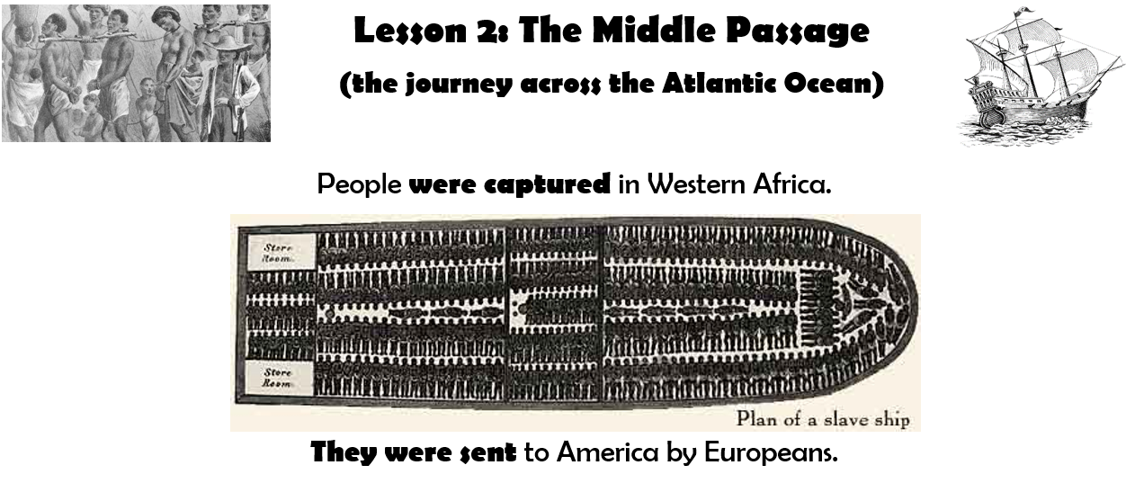
Underline the title in red
(or highlight it)

Slide 15
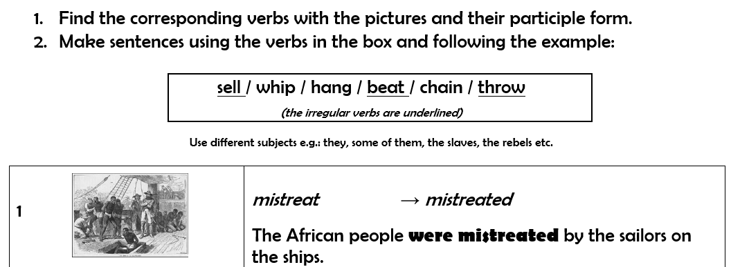

Slide 16
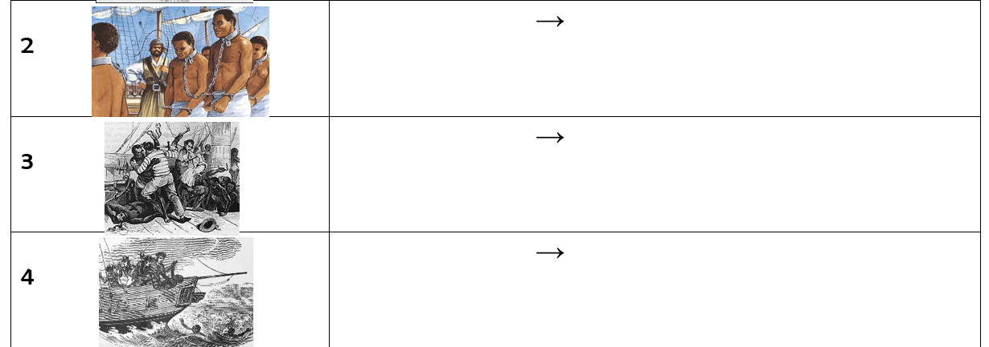
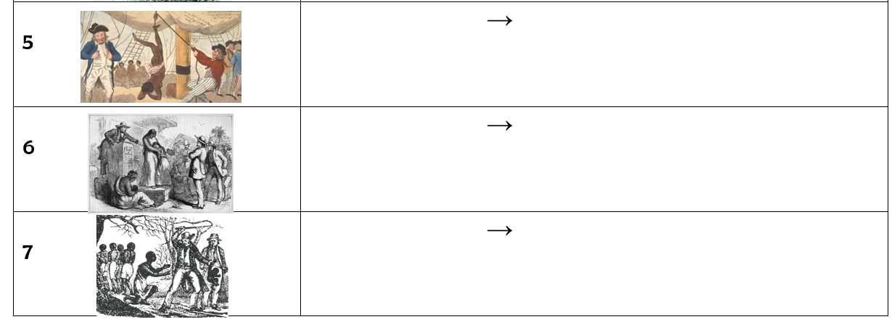

Slide 17
chain
chained
-
beat
beaten
-
throw
thrown
-

Slide 18
hang
hung
-
sell
sold
-
whip
whipped
-

Slide 20
chain
chained
-
beat
beaten
-
throw
thrown
-

Slide 21
hang
hung
-
sell
sold
-
whip
whipped
-

Slide 22
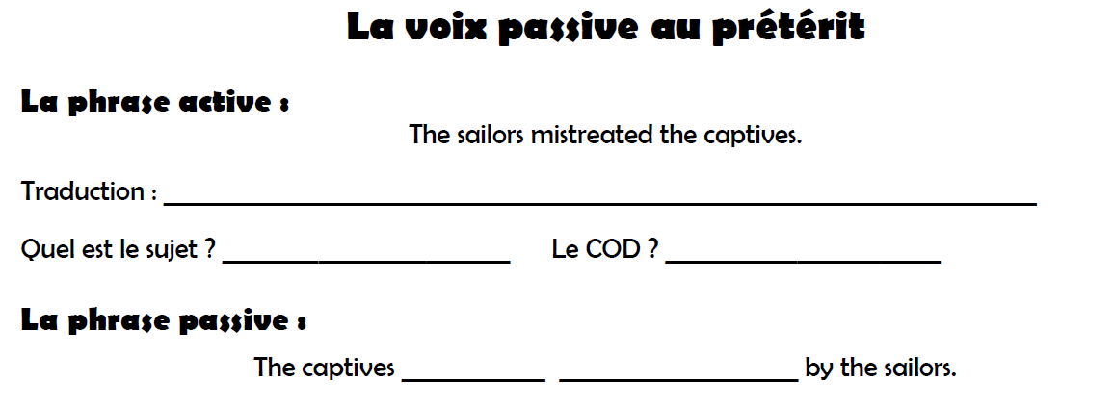
Les marins ont maltraité les prisonniers (captifs).
the sailors
the captives
were
mistreated

Slide 23
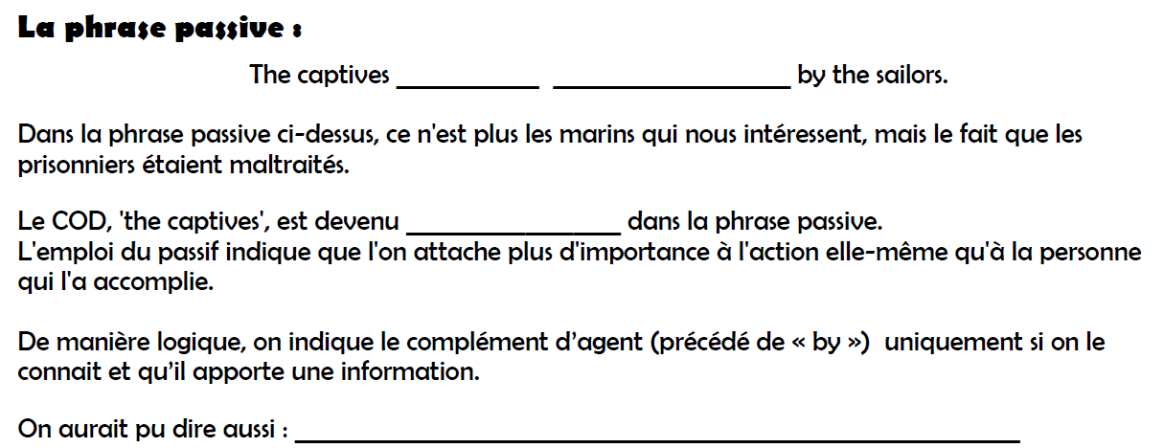
were
mistreated
sujet
The captives were mistreated.

Slide 24
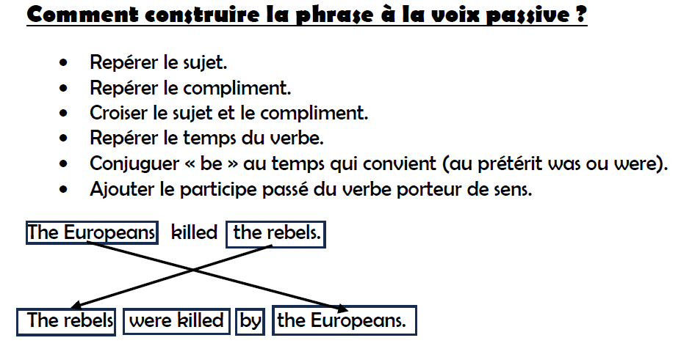

Slide 25
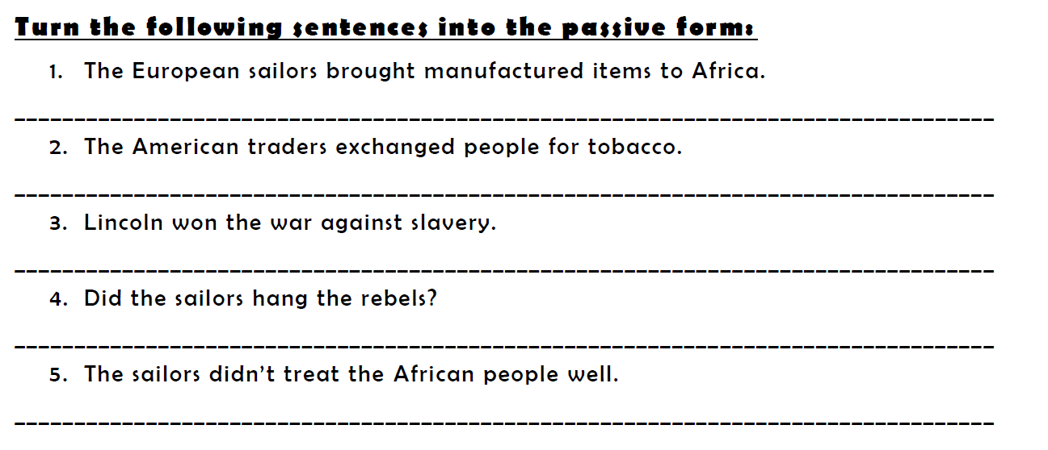
Practise!
-
-
-
-
-

Slide 26
Practise!
Make sentences in the passive voice in the past.
You have to use the following verbs:
Eg. The Titanic was directed by James Cameron in 1997.
BUILDx2, PAINT, WIN, ELECT, DISCOVER x2, FIGHT, WRITE, HOLD, DESIGN
BUILDx2, PAINT, WIN, ELECT, DISCOVER x2, FIGHT, WRITE, HOLD, DESIGN

Slide 27
Practise!
Turn the sentences into the active form:
1. The African people were bought by the Americans.
……………………………………………………………………………………
2. The captives were tortured by the Europeans.
……………………………………………………………………………………
3. Goods were given to the tribes by the traders.
……………………………………………………………………………………
4. Why were the slaves whipped by their owners?
……………………………………………………………………………………
5. The rebels weren’t treated well by the sailors.
……………………………………………………………………………………
BUILDx2, PAINT, WIN, ELECT, DISCOVER x2, FIGHT, WRITE, HOLD, DESIGN

Slide 28
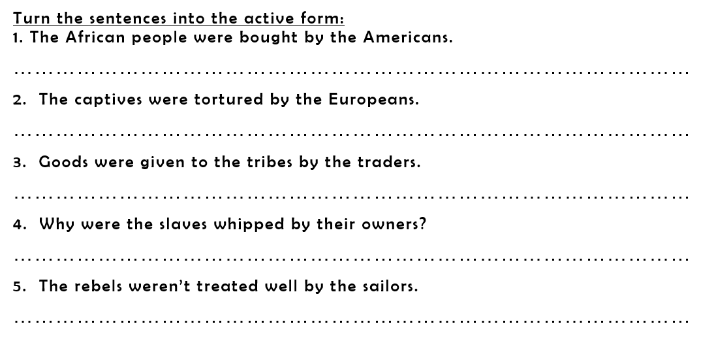

Slide 29
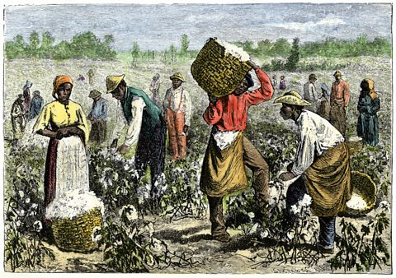
What are we going to talk about?

Slide 30
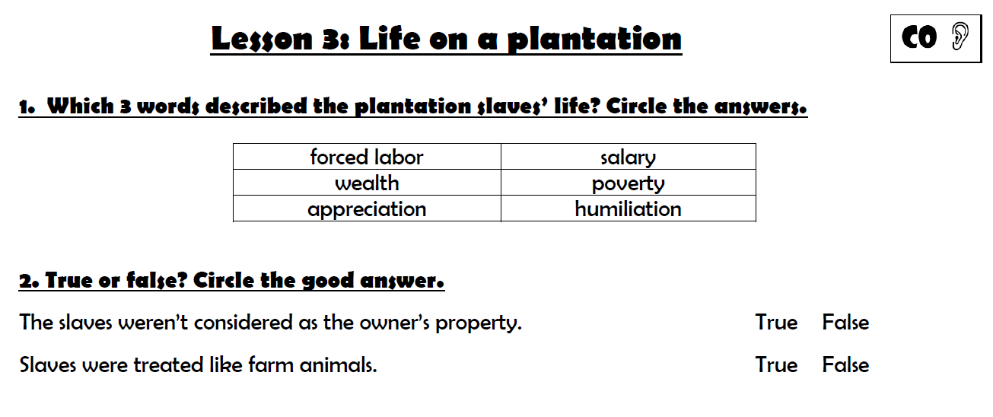
Underline the title in red
(or highlight it)

Slide 31
Before watching the video

Slide 32
Check your answers!

Slide 33
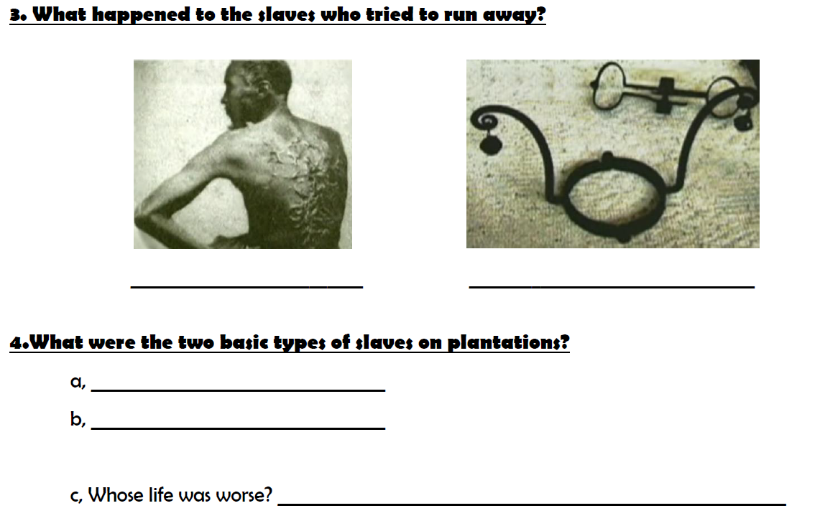
They were whipped
They had to wear a slave’s collar
house slaves
field slaves
The field slaves’ life.

Slide 34
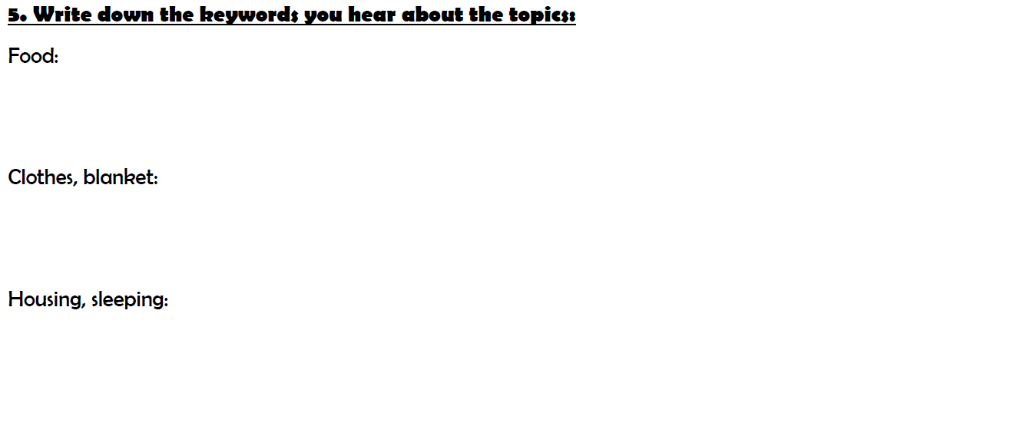
-pork, cornmeal (semoule de maïs), maigre rations, molasses (mélasse)
They received a new set of summer and winter clothes and a
blanket each year.
-They had to share a small cabin with 10-12 people, they slept straw (paille)
on the floor.

Slide 35
Write in your copybook.
Listen to the audio en complete!
Prohibitions
Obligations
To receive an education
To vote
To marry
To own property
(posséder des biens)
To testify in court
(témoigner devant un tribunal)
To earn their freedom
through work (gagner leur liberté par le travail )
Take care of the house and
the family
Work from sunrise to sunset with
a 15 minute break

Slide 36
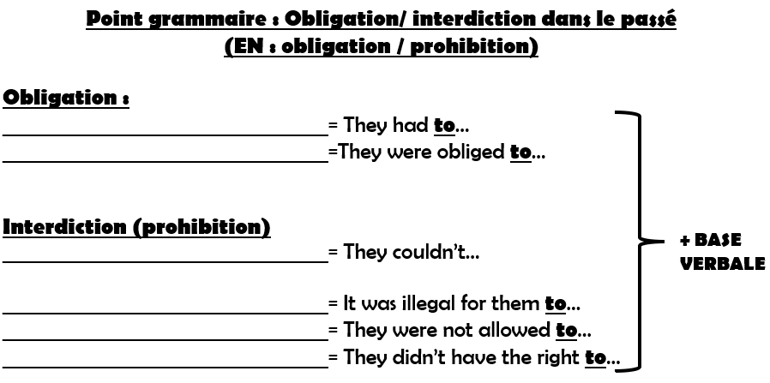
Ils devaient…
Ils étaient obligés de…
Ils ne pouvaient pas…
C’était illégal pour eux de…
Ils n’étaient pas autorisés à…
Ils n’avaient pas le droit de…

Slide 37
Make full sentences with the obligations and prohibitions
from ex. 6! Use all the six expressions!
7. Make sentences:
-

Slide 38
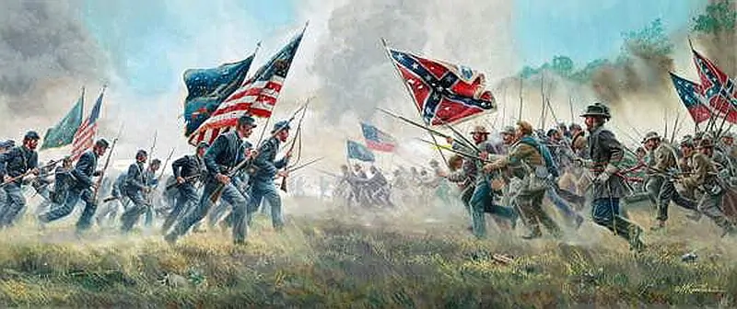
What are we going to talk about?

Slide 39
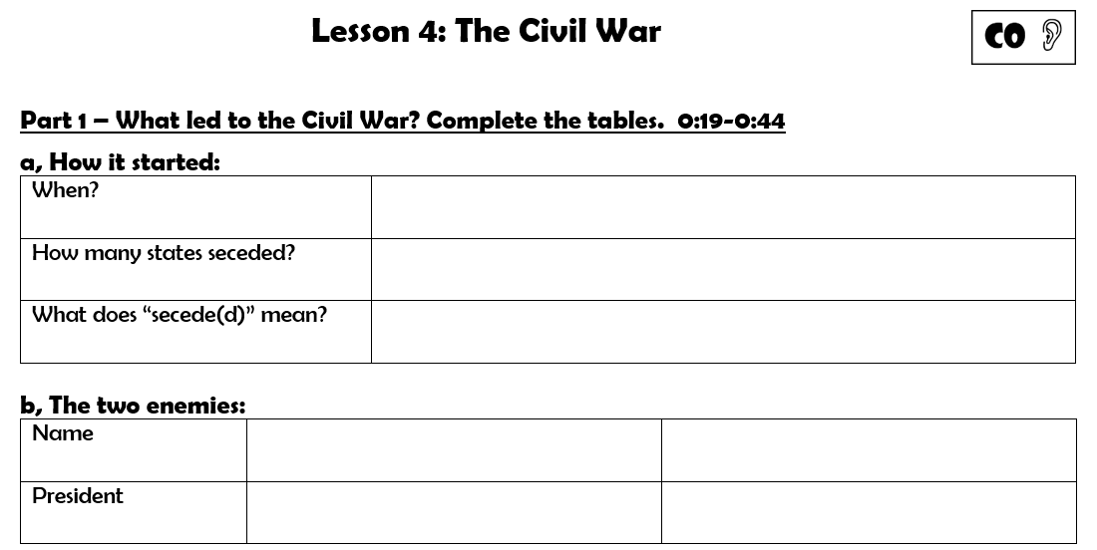
Underline the title in red
(or highlight it)

Slide 40
In 1860 and 1861
11 Southern states seceded.
They left the United States to make their own country.
the Confederacy
the Union
Jefferson Davis
Abraham Lincoln

Slide 41
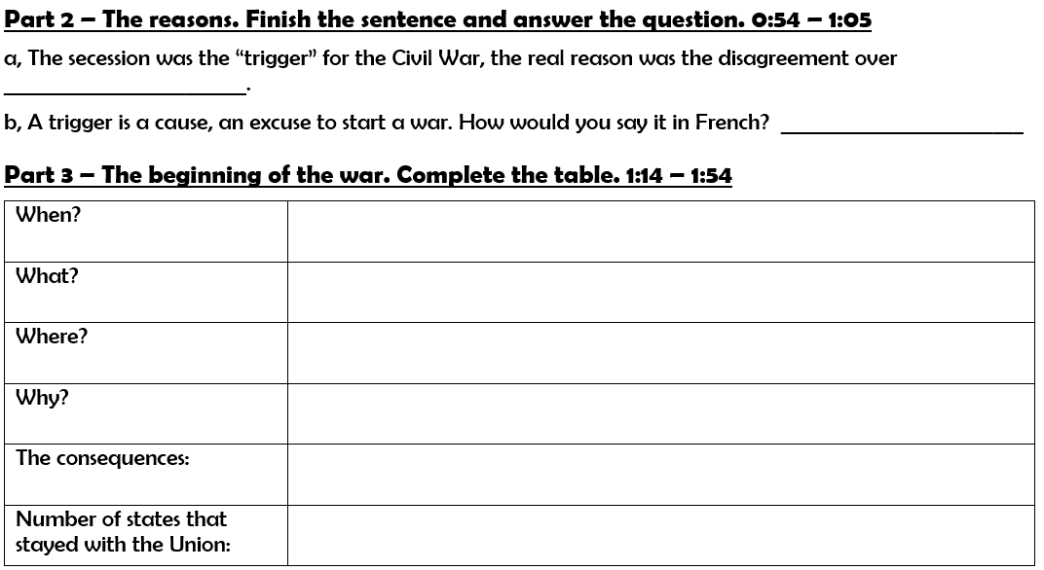
slavery
déclencheur
in April 1861
Confederate soldiers fired on Fort Sumter.
Fort Sumter, a US army outpost in South Carolina
Confederate soldiers wanted Fort Sumter for their own military use.
President Lincoln declared the South in rebellion.
The Civil War began.
24

Slide 42
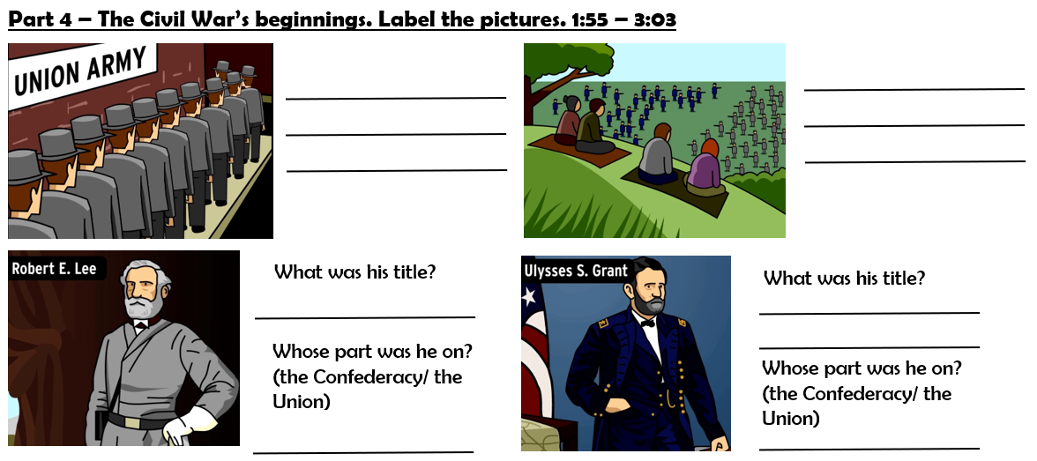
people lined up to join the army
people had picnics watching the battles
commander
General/ commanding officer
the Confederacy
the Union

Slide 43
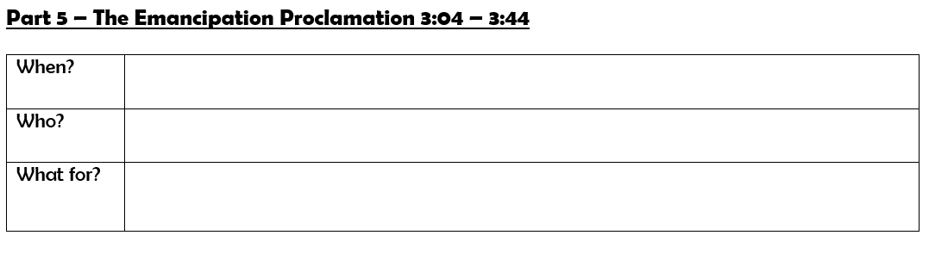
In 1863
(Abraham) Lincoln
To free all slaves

Slide 44
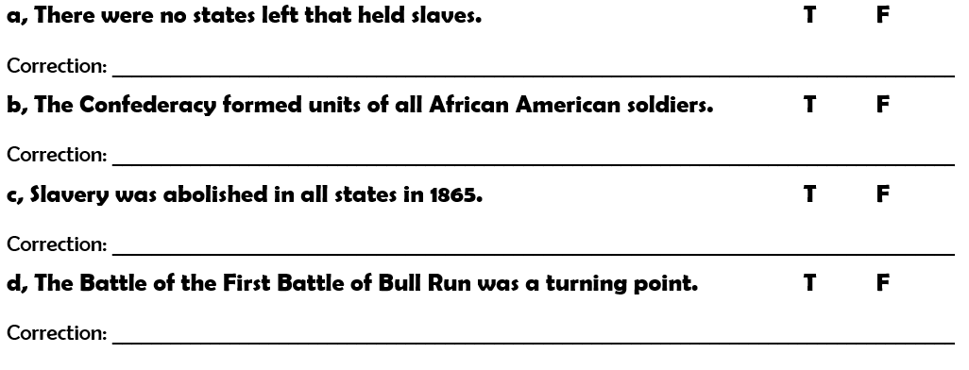
Some border states (like Maryland) still
The Union
Gettysburg

Slide 45
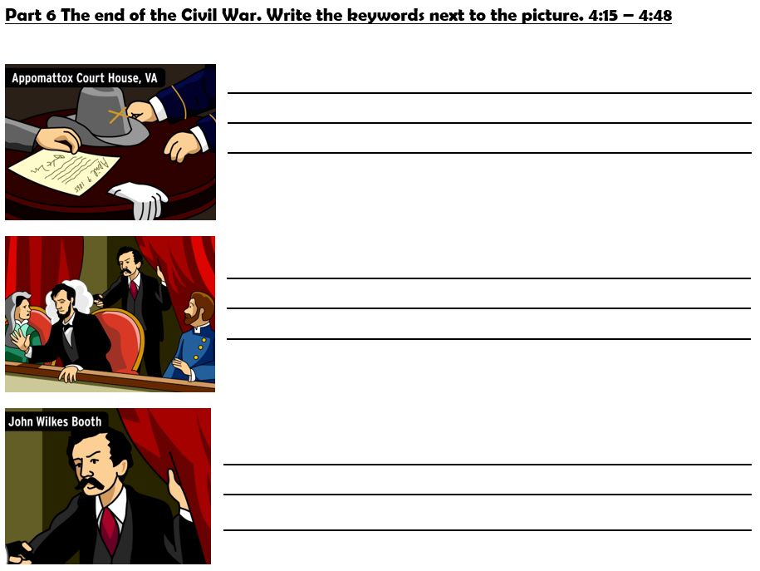
On April 9th 1865, Commander Lee surrendered to General Grant. The war was over.
On April 14th 1865 Abraham Lincoln was assassinated in Washington DC in a theater.
His killer was John Wilkes Booth, an actor from Maryland who was angry at Lincoln for abolishing slavery.

Slide 53
