Slide 1
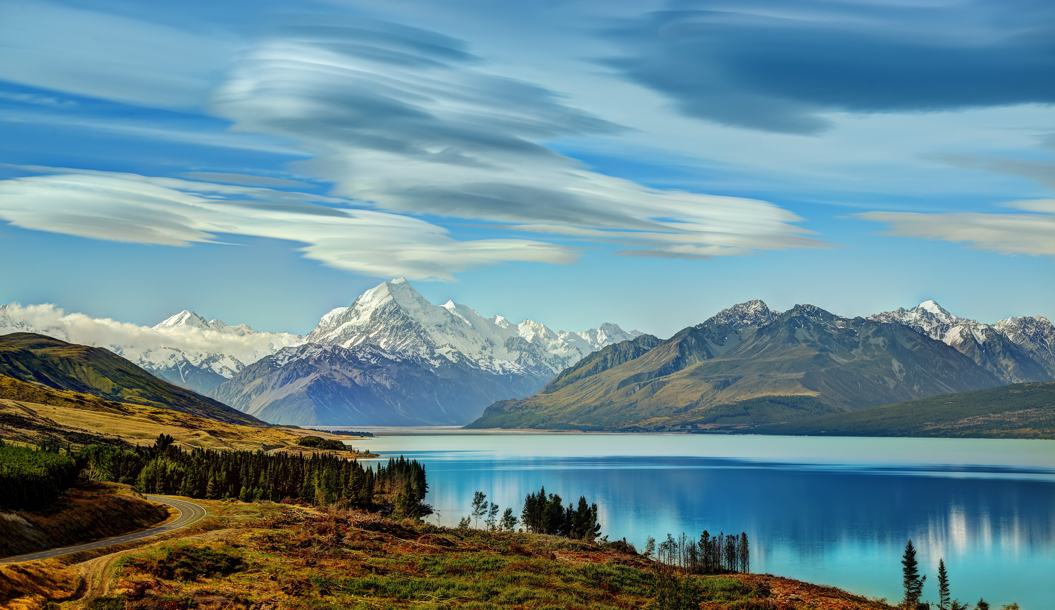
What are we going to talk about?

Slide 2
Flash unit: Kia ora
(New Zealand)

Slide 3
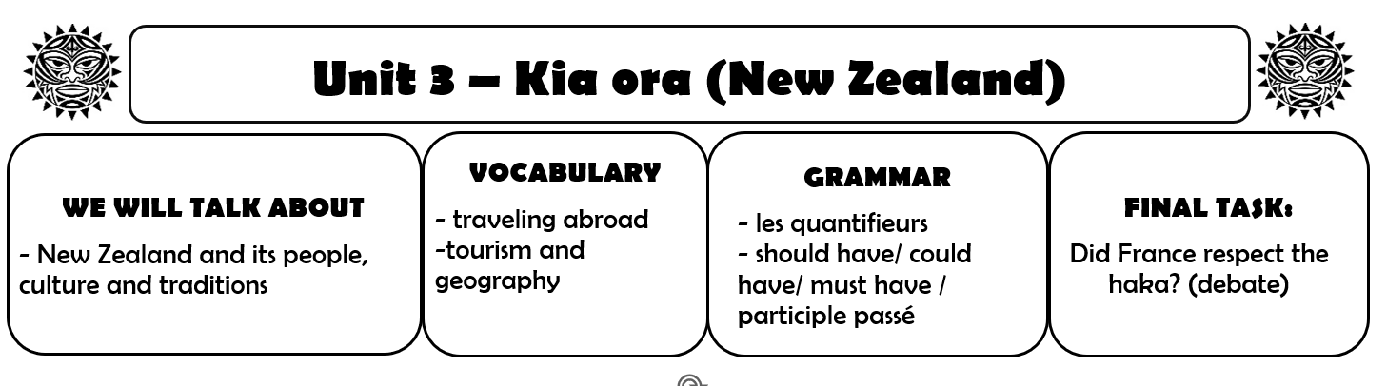

Slide 4
In your copybook:
Lesson 1: Discover New Zealand

Slide 5
What do you know about New Zealand?

Slide 6
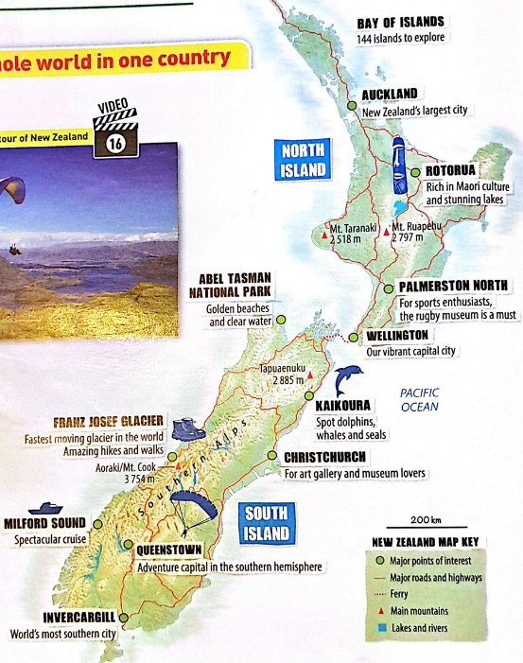
1. Look at the map.
What do you notice about New Zealand?
What is NZ famous for?

Slide 7
2. Watch the video.
New Zealand is said to be :
“the extreme sports capital of the world”
What extreme sports do you see on the map and in the video?

Slide 8
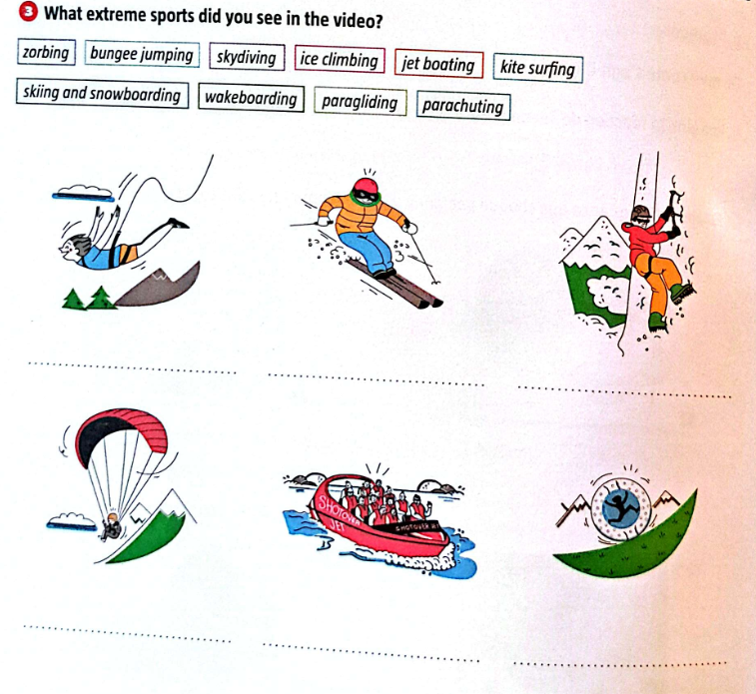
What extreme sports do you see?
bungee jumping
skiing
ice climbing
paragliding
jet boating
zorbing

Slide 9
3.
New Zealand is also said to be :
“any travelers dream”
Let’s find the positive expressions in the video!

Slide 10
In your copybook:
Lesson 1: Discover New Zealand
Video: Take a tour of New Zealand
Positive expressions:

Slide 11
In your copybook:

Slide 12
3.
New Zealand is also said to be :
“any travelers dream”
So, do you agree?

Slide 13
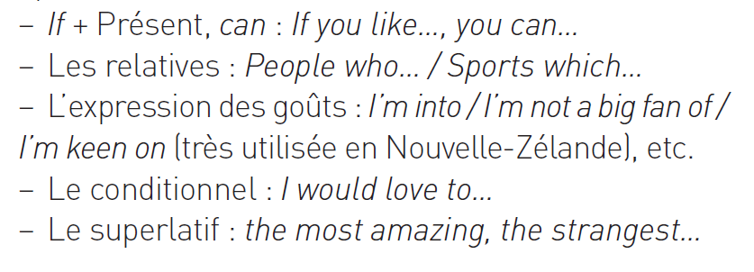
3.
New Zealand is also said to be :
“the place where there is something for everyone”
Do you agree?
Work in groups! Help:

Slide 14
In your copybook:
New Zealand is a place where there is something for everyone:

Slide 15
Time to write!
What would you do in New Zealand?
In your copybook, write 4 sentences to present the activities you would / wouldn't do if you were in NZ and why.
Ex : If I were in New Zealand, I would go canoeing
because I love water sports.

Slide 16
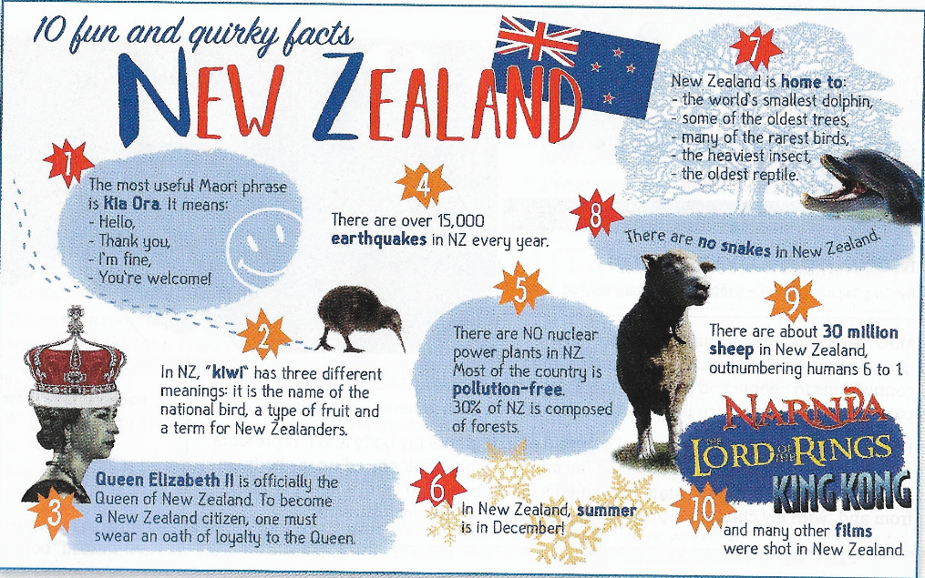
Lesson 2: 10 fun and quirky facts about New Zealand
What does quirky mean?
Read the facts and find your favourite one.

Slide 17
Lesson 2: 10 fun and quirky facts about New Zealand

Slide 18
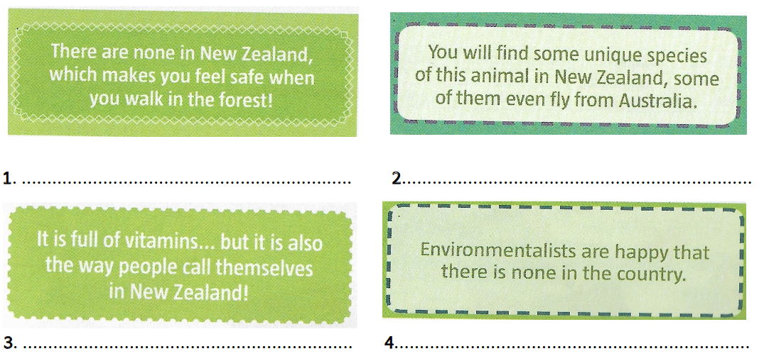
Can you solve these riddles ?
Find the answer of these 8 riddles using to the infographic.
snakes
birds
kiwi
nuclear plants

Slide 19
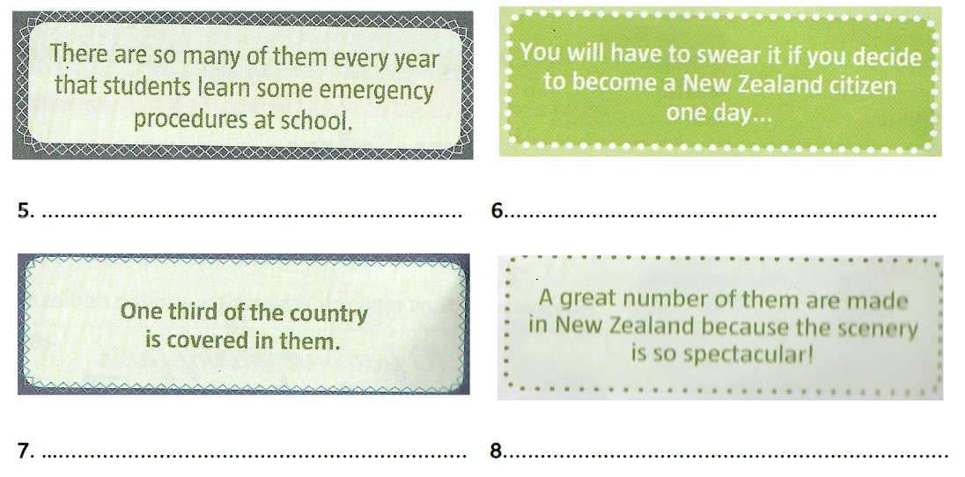
Can you solve these riddles ?
Find the answer of these 8 riddles using to the infographic.
1. snakes – 2. birds – 3. Kiwi – 4. nuclear power plants – 5.
earthquakes – 6. the oath of loyalty – 7. forests – 8. films
earthquakes
the oath of loyalty
forests
films

Slide 20
What are we going to talk about?
rzgzg

Slide 21
What are we going to talk about?
rzgzg

