Slide 1
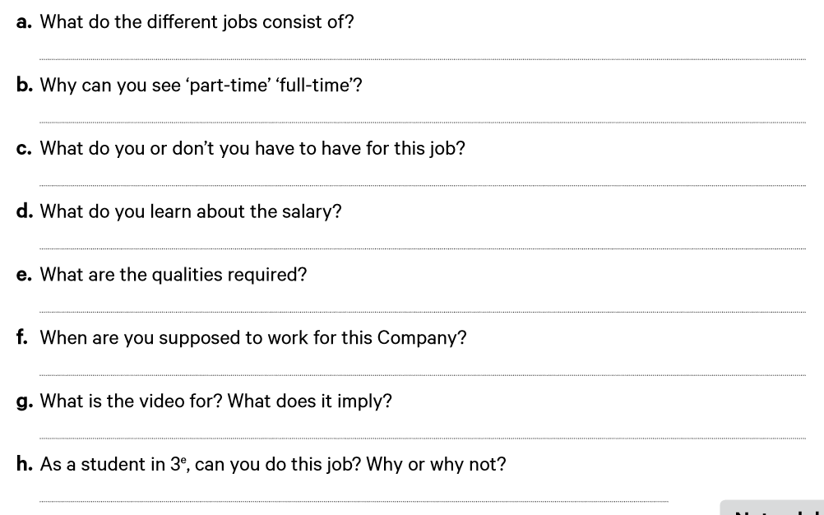
The jobs consist of: cashier, greeter wash attendants.
Because they propose both the options.
The salary is great and you have benefits.
You have to work different shifts, free all the time.
-
-
-

