Slide 1
Lesson 2: Compare Jeremy and Leila! Date?

Slide 2
Lesson 2: Compare Jeremy and Leila! Date?
Jeremy talks about his quiz

Slide 3
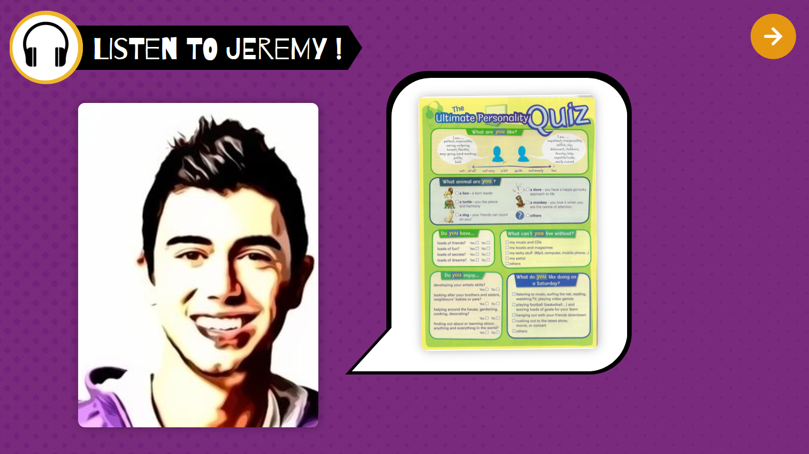


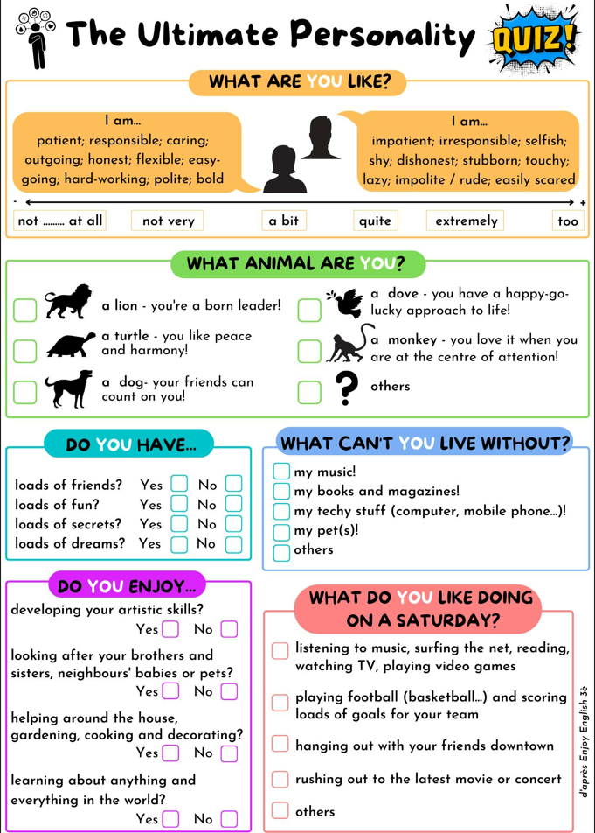

Slide 4
1st listening:
listen and write notes if you can.
(no full sentences, only keywords!)
2nd listening: complete your notes

Slide 5
Lesson 2: Compare Jeremy and Leila! Date?
Jeremy talks about his quiz
My notes:

Slide 6
My notes:
The class:

Slide 7
Speak about Jeremy!
Make full sentences and ay attention to the changes.

Slide 8
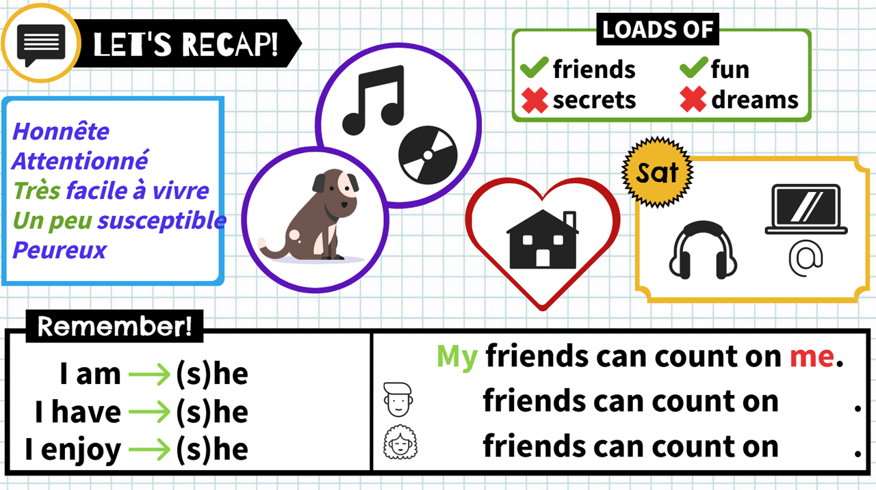
is
His
him
has
enjoys
Her
her

Slide 9






Jeremy is honest, caring, very easy-going, a little bit touchy and easily scared.
He is a dog, his friends can count on him.
He has loads of friends and fun, but he doesn’t have loads of dreams.
He can’t live without his music and CDs.
He enjoys helping around the house.
On a Saturday, he loves listening to music and surfing the net. (Some chilling and me time)

Slide 10
Homework
You must be able to speak about Jeremy
Etre capable de parler de Jérémy.

Slide 12
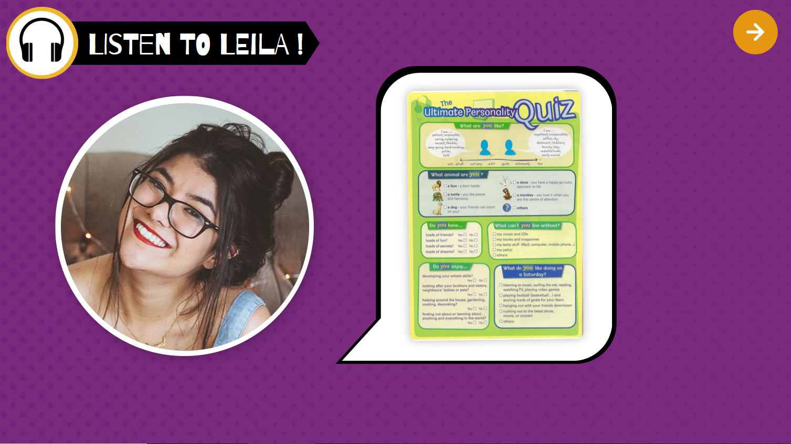
1st listening:
listen and write notes if you can.
(no full sentences, only keywords!)
2nd listening: complete your notes

Slide 13
Leila talks about her quiz
My notes:

Slide 14

Your notes:
About Leila…

Slide 15
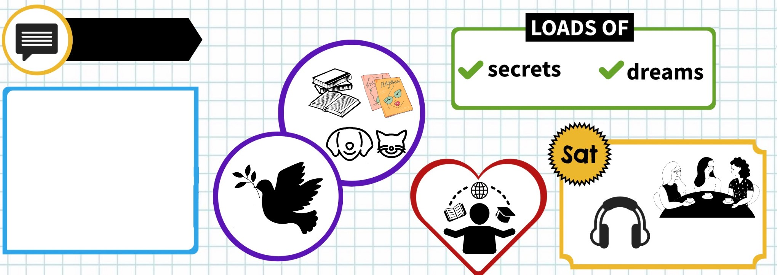
Leila
Assez patiente
Sociable
Pas très travailleuse
Assez irresponsable
Un peu susceptible
is
His
him
has
enjoys
Her
her

Slide 16
Speak about Leila! (Pair work)
One of you has to make a sentence, than the other one, then back at you, etc.
Make a sentence every piece
of information!

Slide 17
Leila
Assez patiente
Sociable
Pas très travailleuse
Assez irresponsable
Un peu susceptible
is
His
him
has
enjoys
Her
her

Slide 18
Comparison using whereas, like, unlike, both

Slide 19
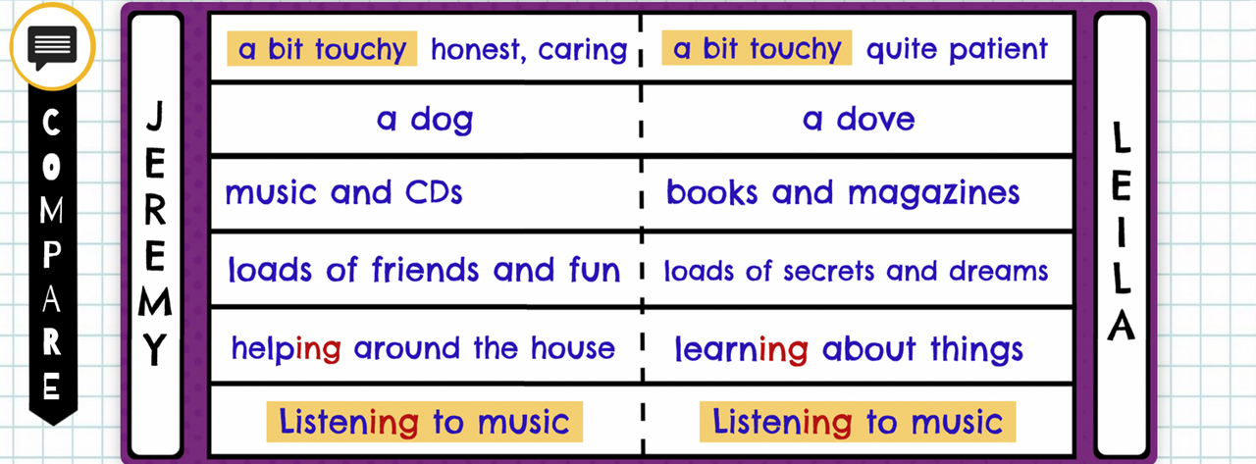
Common points | Differences
Like Jeremy, Leila… They are both… / They both… | Unlike Jeremy, Leila… Jeremy…, whereas Leila …

Slide 20
Grammar point: Comparison using like, unlike, whereas, both
1. Like Jeremy, Leila is a bit touchy.
=> They are both a bit touchy.
Like Leila, Jeremy likes listening to music on a Saturday.
=> They both like listening to music.
2. Unlike Jeremy, Leila can’t live without books and magazines.
3. Jeremy enjoys helping around the house,
whereas Leila enjoys learning about things.

Slide 21
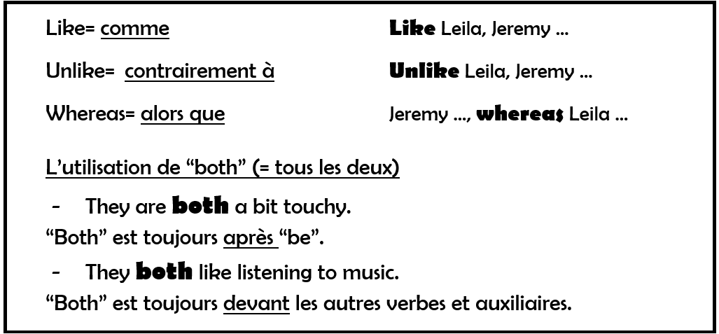

Slide 22
Homework
You must be able to compare Jeremy to Leila.
Etre capable de comparer Jeremy et Leila

Slide 23
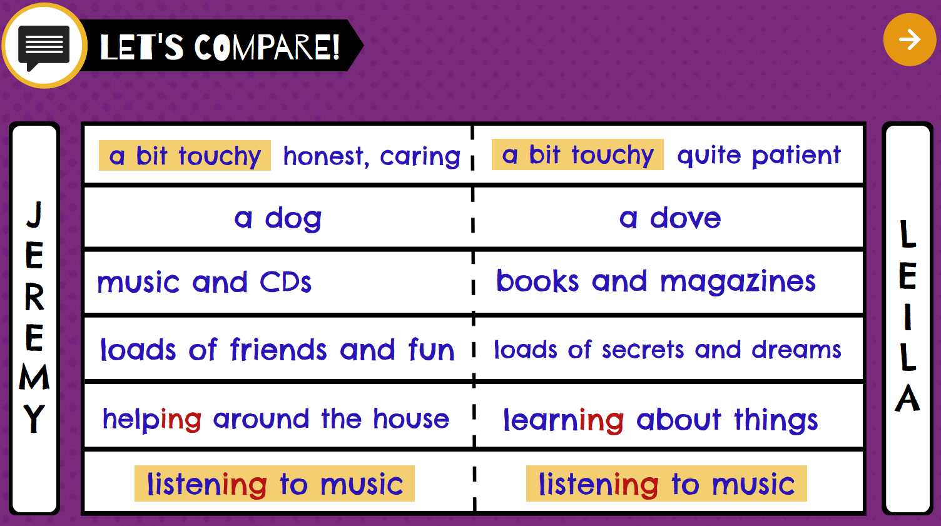

Slide 24
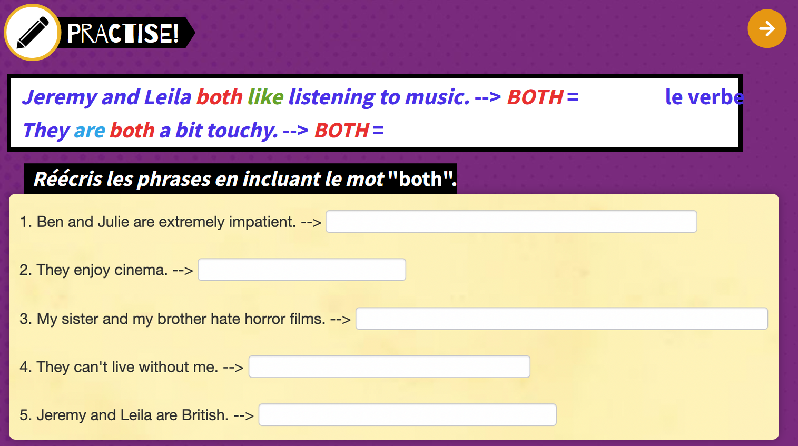
Ben and Julie are both extremely impatient
They both enjoy cinema
My sister and my brother both hate horror films
They both can’t live without me.
Jeremy and Leila are both British.

Slide 25
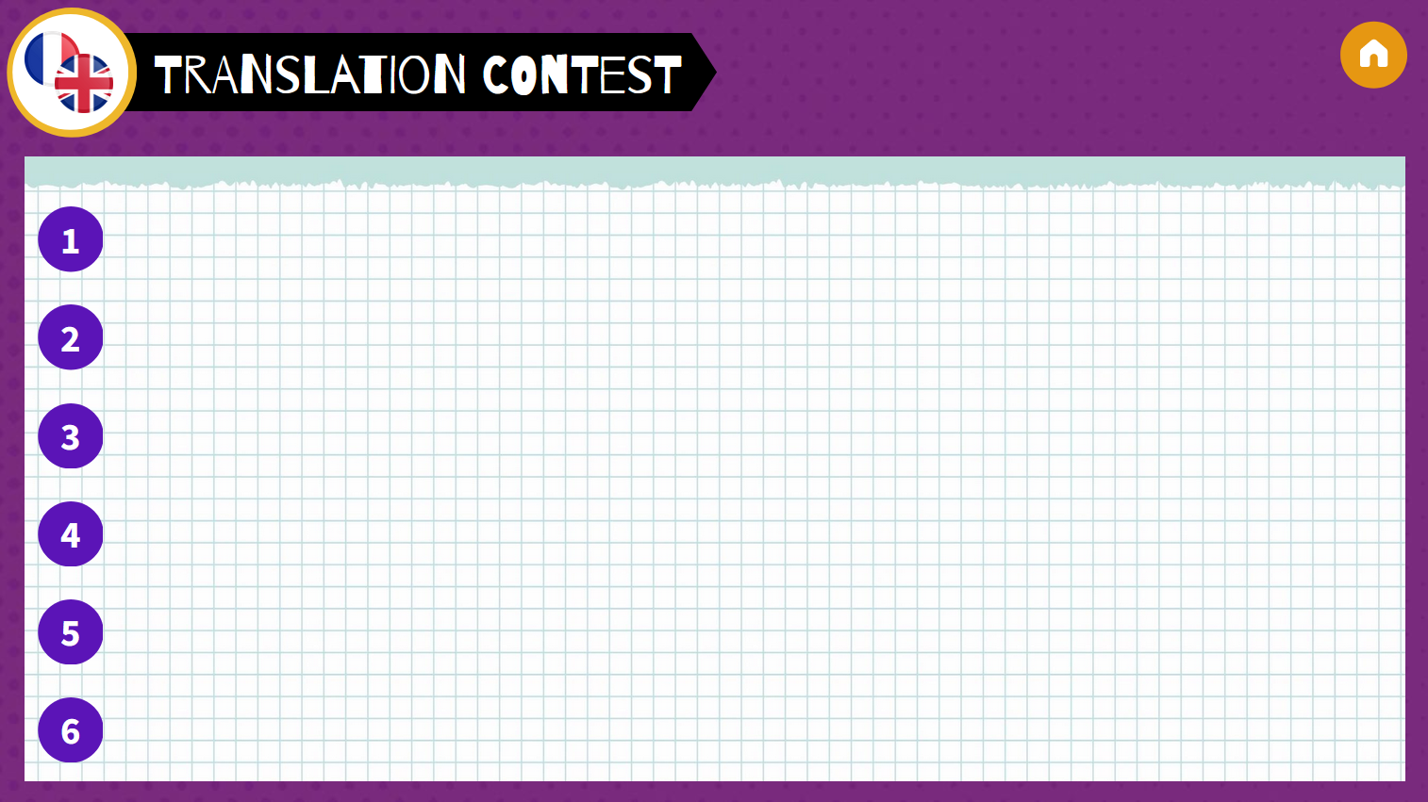
Jérémy pense qu’il est un « chien ».
Jeremy thinks that he’s a “dog”.
Leila n’aime pas s’occuper de son frère.
Leila doesn’t like looking after her brother.
Jérémy et Leila sont tous les deux un peu susceptibles.
Jeremey and Leila are both a bit touchy.
Leila a beaucoup de secrets mais elle n’a pas beaucoup d’amis.
Leila has loads of secrets but she doesn’t have loads of friends.
Unlike Jeremy, I can’t live without my techy stuff.
Contrairement à Jérémy, je ne peux pas vivre sans mes appareils électroniques.
On a Saturday, I like hanging out with my friends, whereas Jeremy likes listening to music.
Le samedi, j’aime traîner avec mes amis, alors que Jérémy aime écouter de la musique.

