Slide 1
Banksy does NEW YORK
Watch and concentrate on what you understand!

Slide 2
Banksy does NEW YORK
In your group discuss the video IN ENGLISH.
What happened?
What was the reaction?

Slide 3
Banksy does NEW YORK
What makes Banksy’s work so appealing, so loveable?

Slide 4
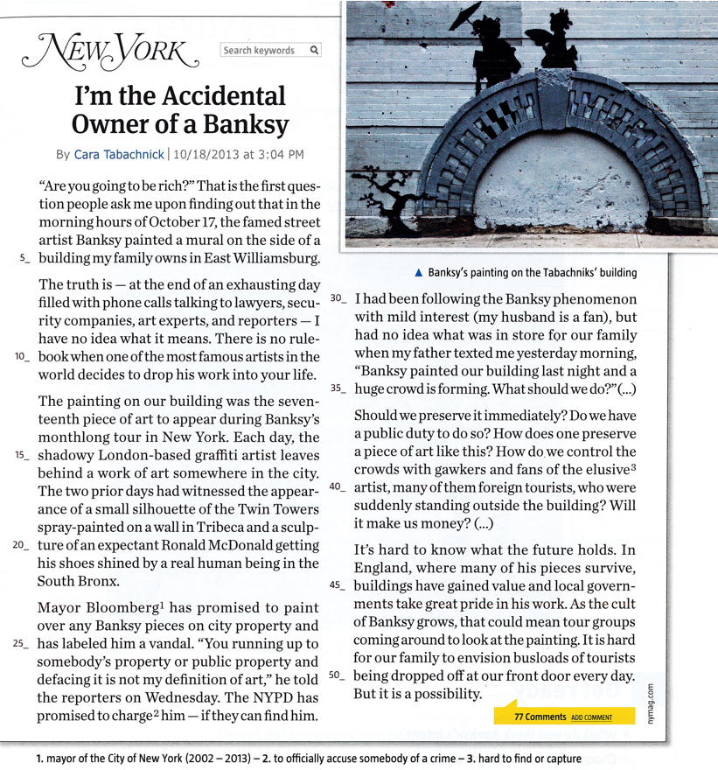
Read the title of the article.

Slide 5
Read the title of the article.
Can you link it to the video?

Slide 6
What do you think:
what happened to
Cara Tabachnik?

Slide 7
How do you think
she reacted?

Slide 8
Read the article.
Pick out information about:
the facts /
the people involved /
their reactions

Slide 9
Places
on Cara Tabachnik’s building/in East Williamsburg
NYC etc.
Dates
on October 17
10/18/2013
Facts
Events
Banksy painted a mural on Cara’s building

Slide 10
Private citizens
Cara Tabachnik
Cara’s father and husband,
fans
Artist
Banksy
People Involved
Officials
The NYPD
Michael Bloomberg, (Mayor of New York)
Professionals
lawyers / security companies / art
experts / reporters

Slide 11
Cara and her family are confused, they don’t know what to do.
Reactions
The Mayor is irritated, he wants to arrest Banksy and charge him with vandalism.
The citizens of NYC are excited, they love the work of Banksy.

Slide 12
Recap:
During his 2013 NYC tour, Banksy painted on Cara Tabachnick’s building.
Cara and her family are perplexed, they don’t know how to react:

Slide 13
Write a short description of Banksy and his work!
Banksy is an anonymous British artist. He does
graffiti at night. In 2013, he stayed in NYC for
a month and created a piece of art every night.
His stencils are very expensive. A lot of people
love him and take pictures, but the mayor of
New York and the NYPD want to arrest him. His
works often have a political or social message.
He tries to denounce things.

