Slide 1
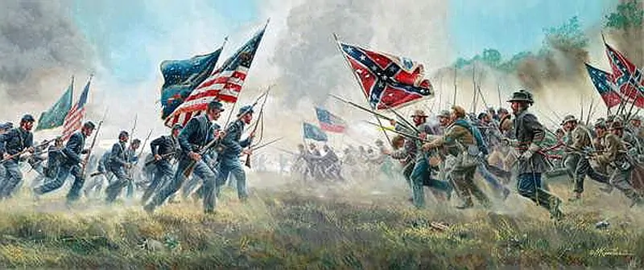
What are we going to talk about?

Slide 2

Write in your copybook:
Lesson 4: American Civil War
1. What was the reason for starting the Civil War?
The South of the United States didn’t want to abolish slavery, so they left and formed a new country.
2. What was a positive outcome of the war?
Slavery was abolished.
3. What happened to Abraham Lincoln?
He was assassinated by John Wilkes Booth.

Slide 3
Recap
Recap: The American Civil War (1861-1865)
The North and the South couldn’t agree about slavery: the North wanted to abolish it while the South needed the free labor to work on the plantations.
After 5 years of fighting the North won, and slavery was abolished by Abraham Lincoln.
Lincoln was assassinated not long after the end of the war.

