Slide 1
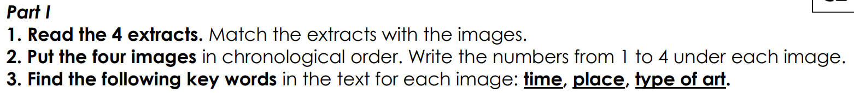
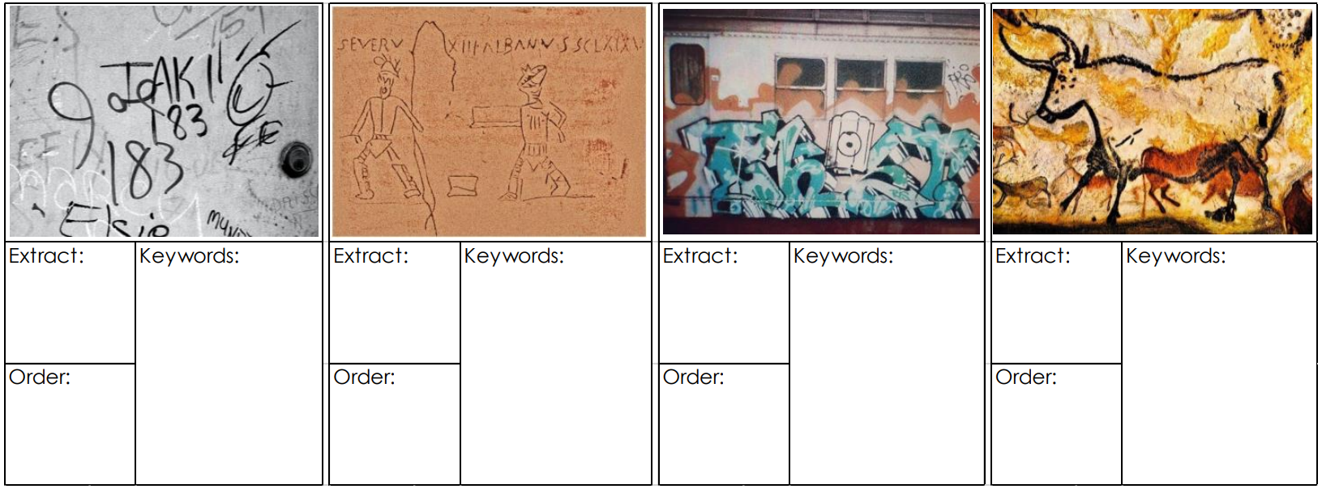
d
Early 1970s
People writing their names on buildings
b
Age of Antiquity, Rome, Greece,
Names and protest poems on buildings
a
Mid 70s
Subway and trians,
Spray paint, graffiti
c
Thousands of years ago
Cave paintings
3
2
4
1

Slide 2
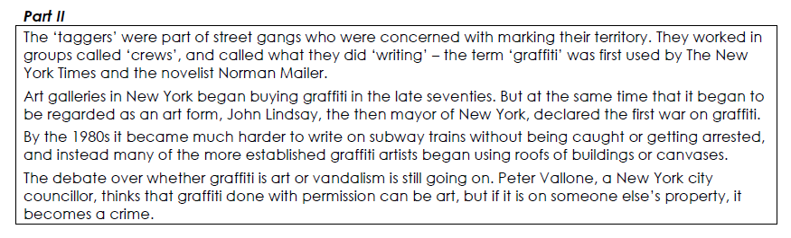
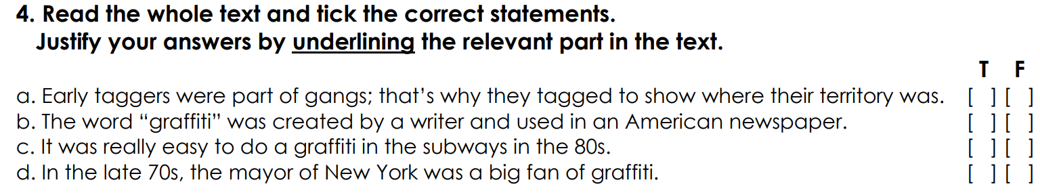

Slide 3
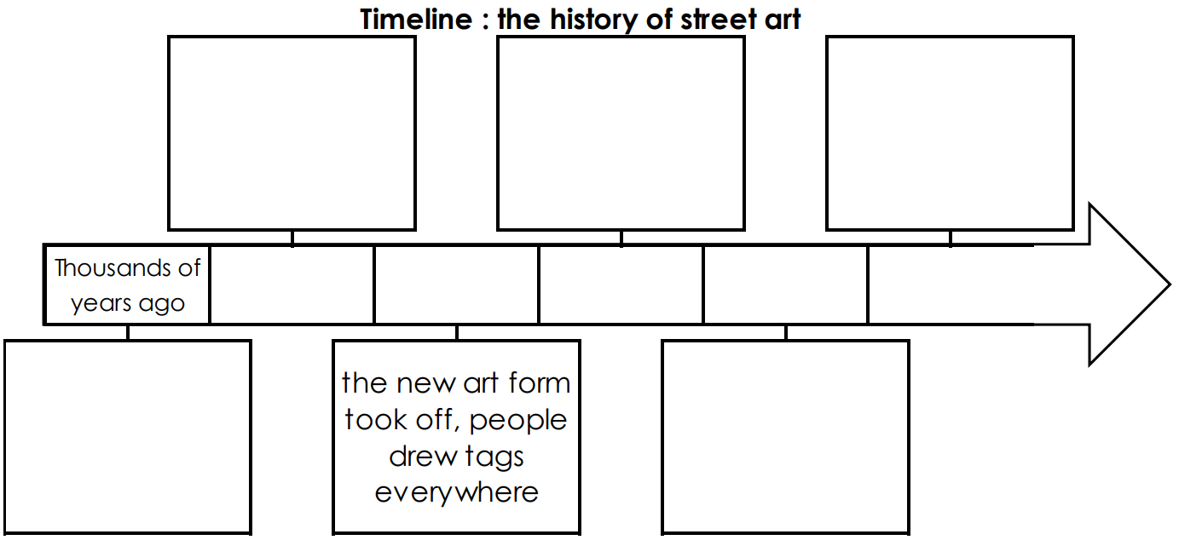
People wrote name protest poems on buildings
Trains covered by spray paintings and graffiti
Became harder to write on subway trains => using roofs as canvases
Age of Antiquity
Early 70s
Mid 70s
Late seventies
1980
First drawings: cave paintings
Art galleries started to buy street art

Slide 4
