Slide 1
Write in your copybook:
What job?
Ben
Present perfect
Padma?
Mrs Recht’s activity
2nd conditional

Slide 2
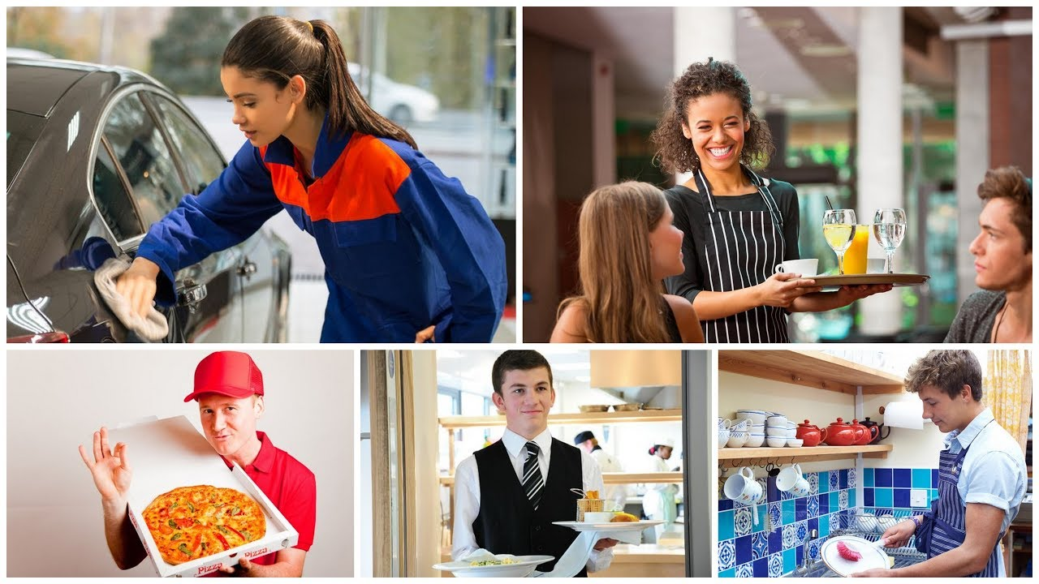
What are we going to talk about?

Slide 3


Slide 4
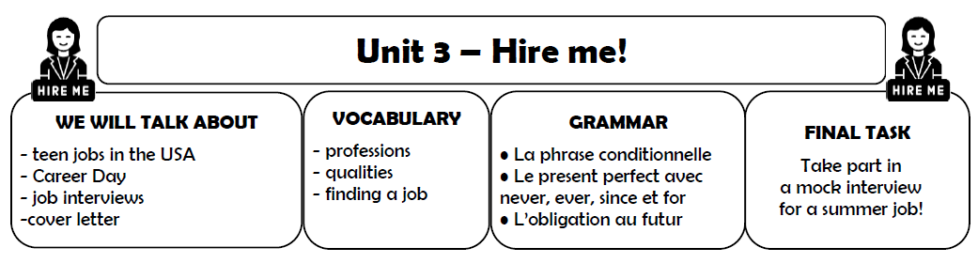
Glue it in your copybook!
+ write the title

Slide 5
Write in your copybook:
Lesson 1: What job?

Slide 6
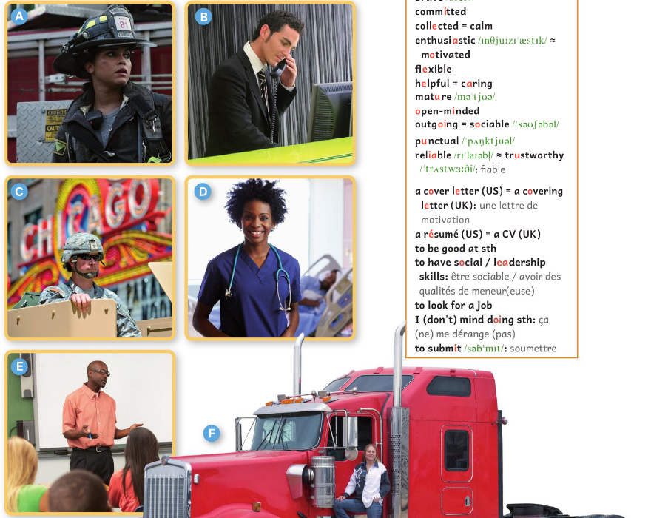
Name the professions!
You will discuss in pairs.
You can ONLY speak English!
“The person in
picture E must be
a … because...”

Slide 7
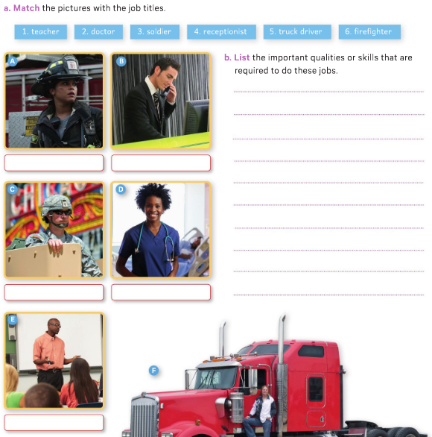
WB p.50 or glue the paper!

Slide 8
Write the job titles under the pictures
firefighter
receptionist
soldier
doctor
truck driver
teacher

Slide 9
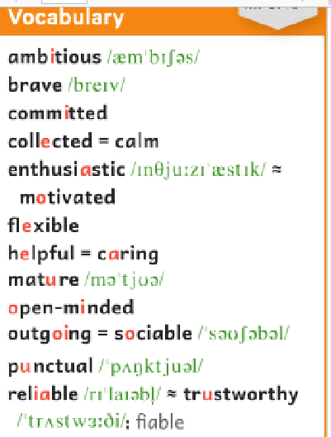
Discuss the qualities or skills that are required to do these jobs!
firefighter
receptionist
“You have to be patient to be a…”
“To be a …, you certainly can’t/must be …!”
soldier
doctor
truck driver
teacher

Slide 10
Discuss the qualities or skills that
are required to do these jobs!

Slide 11
-

Slide 12
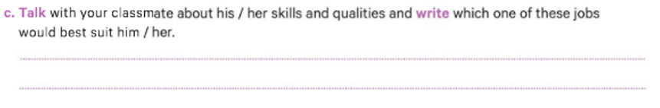
Speaking activity
- What are your qualities?
- My qualities are…
-Since you’re very …, … and … /
When you are an adult, maybe you will be a …”

Slide 13
Write it down!
-Since you’re very …, … and … /
When you are an adult, maybe you will be a …”

Slide 14
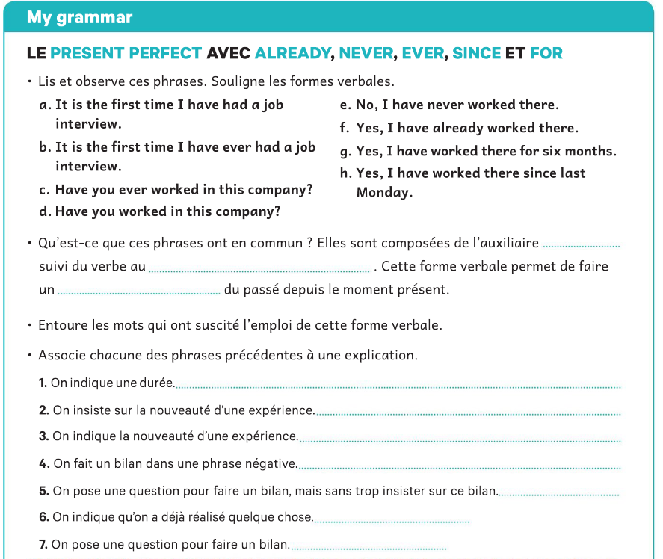
WB p.53 or glue the paper!
have
participe passé
lien /bilan des expériences

Slide 15
g
b
a
e
d
f
c

Slide 16
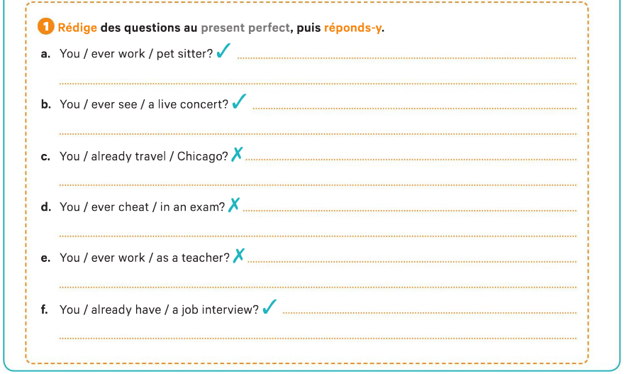
Have you ever worked as a pet sitter?
Yes, I have already worked as a pet sitter.
Have you ever seen a live concert?
Yes, I’ve already seen a live concert.
Have you already traveled to Chicago?
No, I’ve never traveled to Chicago.
Have you ever cheated in an exam?
No, I’ve never cheated in an exam.
Have you ever worked as a teacher?
No, I have never worked as a teacher.
Have you already had a job interview?
Yes, I have already had a job interview..

Slide 17
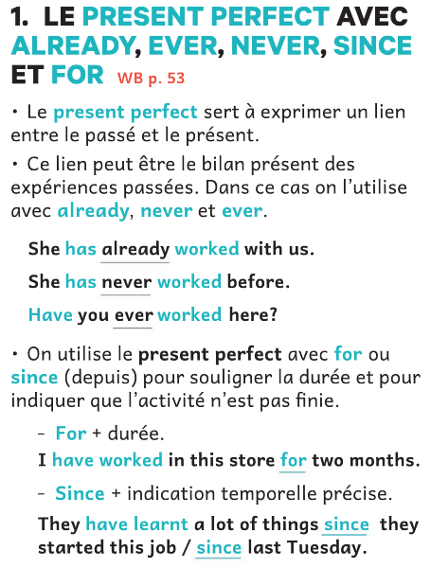
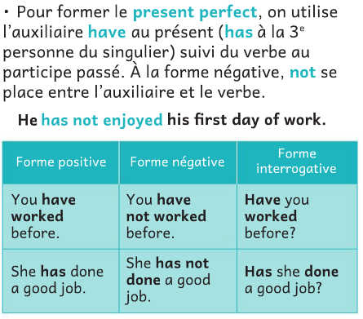
B p.58/ paper

Slide 18
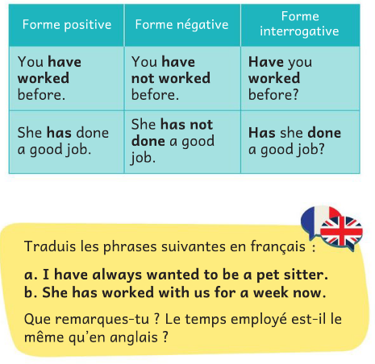
1
a. J’ai toujours voulu être pet sitter.
Elle travaille avec nous depuis une semaine.
Le present perfect correspond souvent au passé composé en français, ou le present simple.

Slide 19
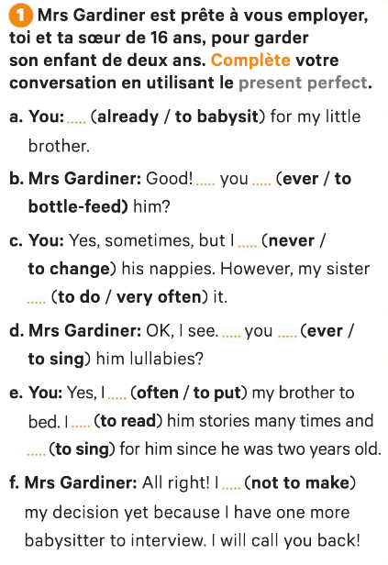
I have already babysat…
Have you ever bottle-fed him?
I’ve never changed his nappies.
My sister has done it very often.
2

Slide 20
Have you ever sung him lullabies?
I’ve often put …
I have read him stories…
I’ve sung for him.
f. I haven’t made my decision yet…

Slide 21
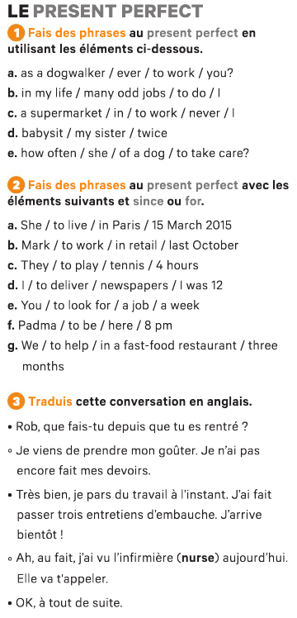
B 127/ paper
3
Have you ever worked as a dogwalker?
I have done many odd jobs in my life.
I have never worked in a supermarket.
My sister has babysat twice.
How often has she taken care of a dog?

Slide 22
4
She has lived in Paris since 15 March 2015.
Mark has worked in retail since last October.
They have played tennis for 4 hours.
I have delivered newspapers since I was 12.
You have looked for a job for a week.
Padma has been there since 8 pm.
We have helped in a fast-food restaurant for three months.

Slide 23
5
1
snack
2
to conduct a job interview
3

Slide 24
Rob, what have you done since you have arrived home?
I have just eaten a snack. I haven’t done my homework yet.
Great, I have just left work.
I have conducted three job interviews.
I’ll be there soon!
Oh, actually, I’ve seen the nurse today.
She will call you.
Okay, see you in a minute.
5

Slide 25
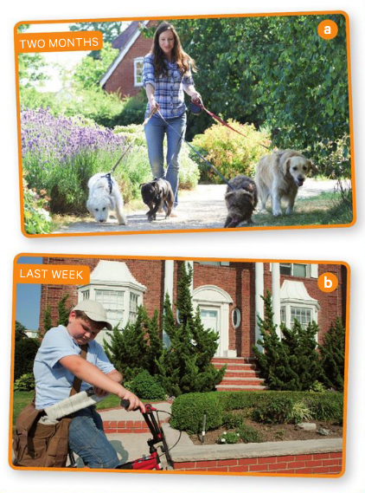
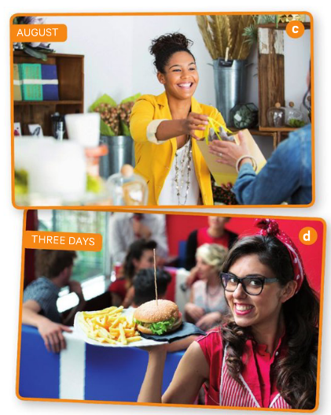
Look at these photos
and say what the teenagers have worked
(since when or for how long).

Slide 27
She has walked dogs for 2 months.
He has delivered newspapers since last week.
She has sold gifts since August.
She has waited tables for three days.

Slide 28
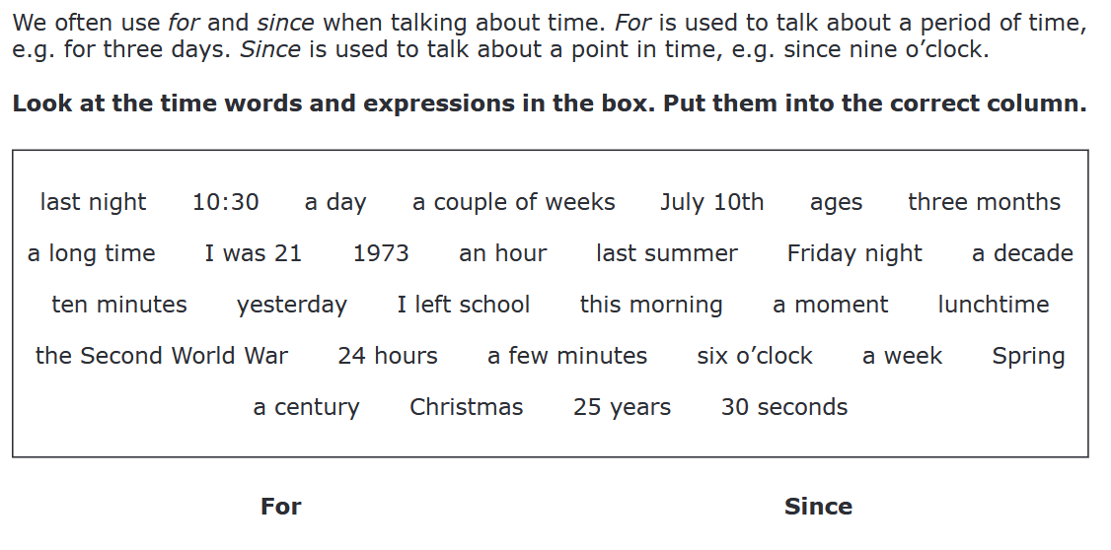

Slide 29
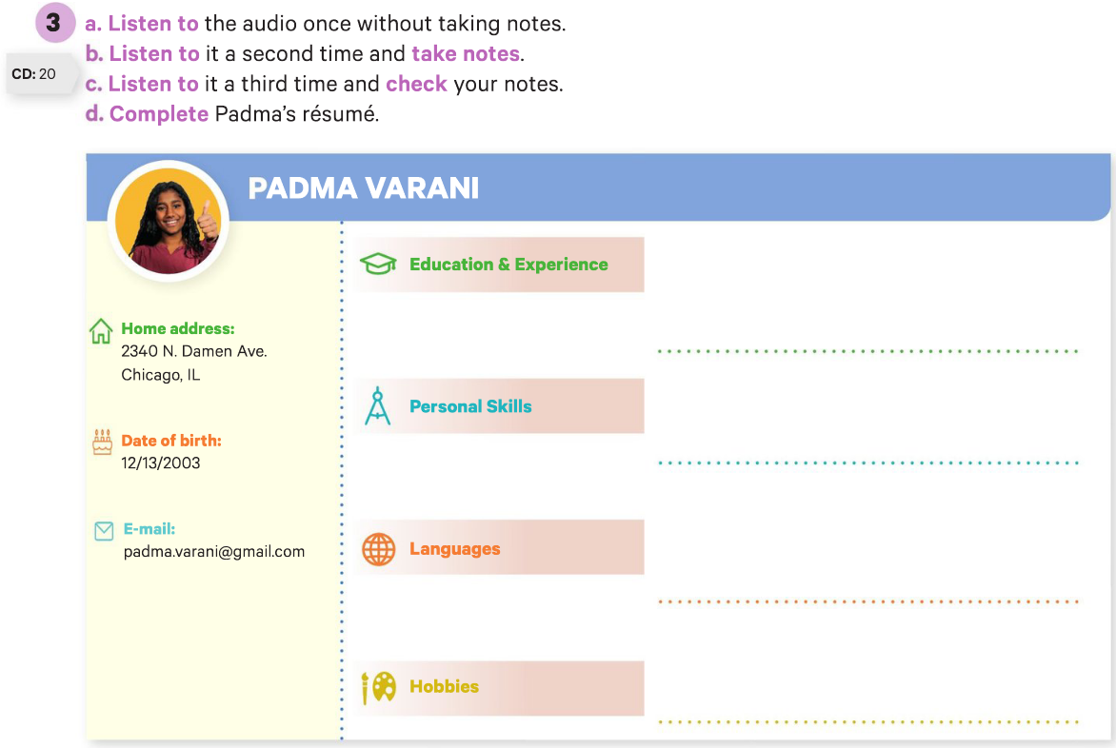
9th grade high school / worked as a bag girl and uncle’s garage / has done babysitting
dynamic / fun to be with / sociable / teamwork / not afraid of work / serious / responsible
Spanish - not fluent but able to carry out a conversation / French - can read and understand a bit)
playing videogames / playing tennis, has participated in tournaments

Slide 30
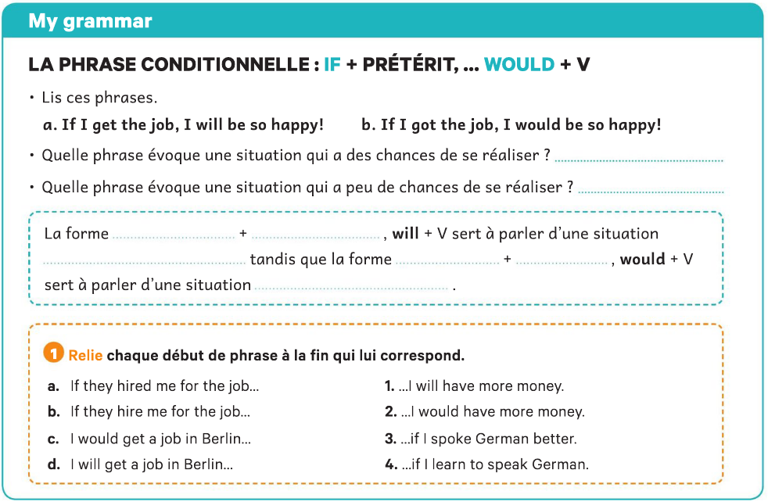
a
b
if
présent
probable
if
prétérit
peu probable
2
1
3
4

Slide 31
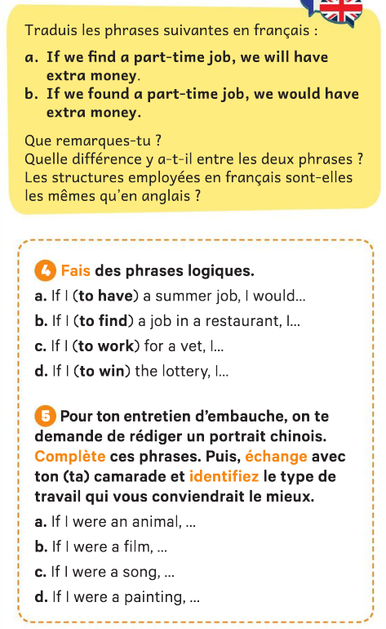
- Si je trouve un petit boulot j'aurais de l'argent en plus.
-Si nous trouvions un petit boulot, nous aurions de l'argent en plus.

Slide 32
-

Slide 33
-

Slide 34
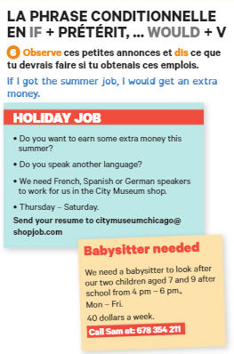
-

Slide 35
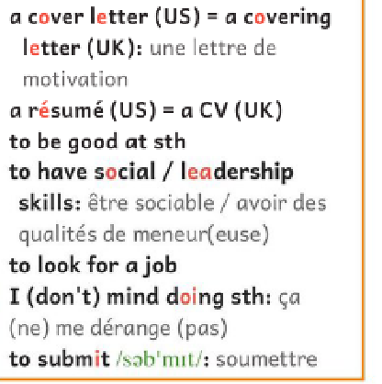
être bon/doué pour quelque chose
chercher un emploi

Slide 36
Eval second conditional

Slide 37
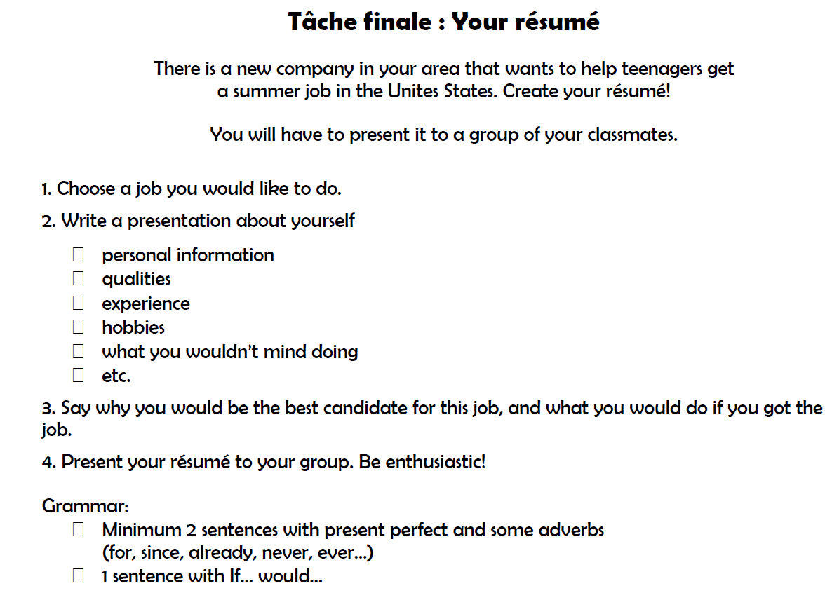

Slide 39
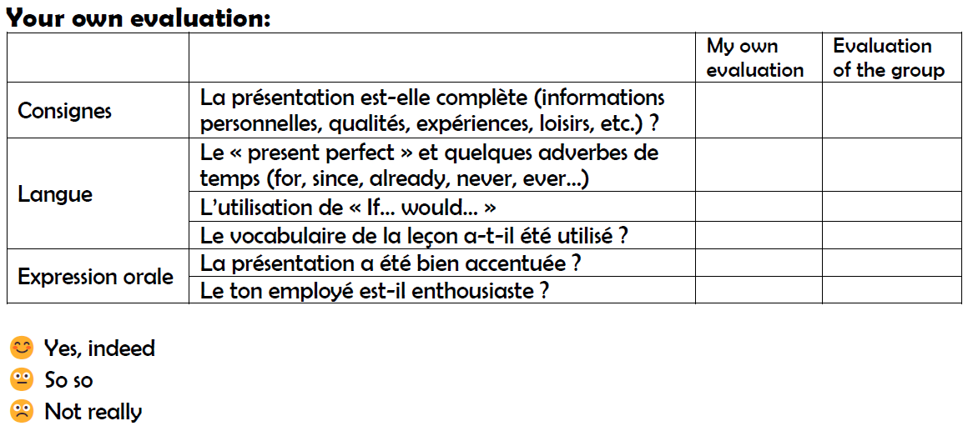

Slide 40
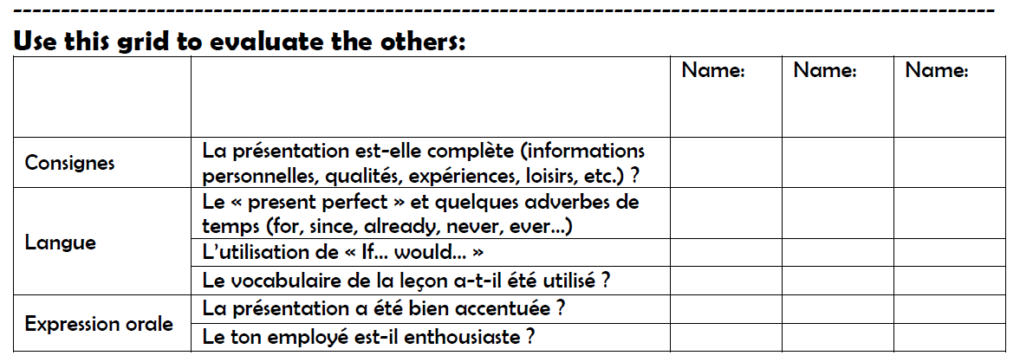

Slide 41
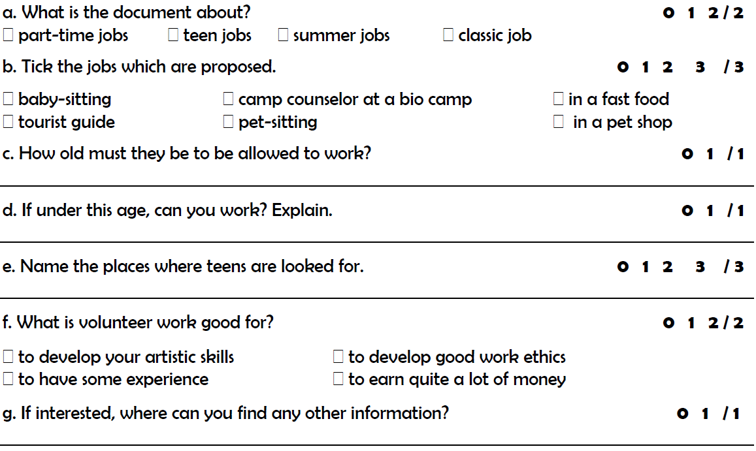
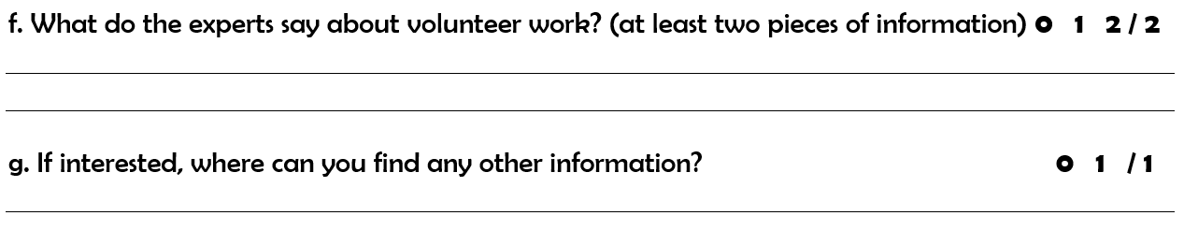
16 years old
Yes. Need a special work permit from the States Deprtment of Labor.
They are looking for teens in golf courses, offices, museums and restaurants
Volunteer Work might not be paid, but is good to have a sense of ethics and to get some experience.
On their website.

Slide 46
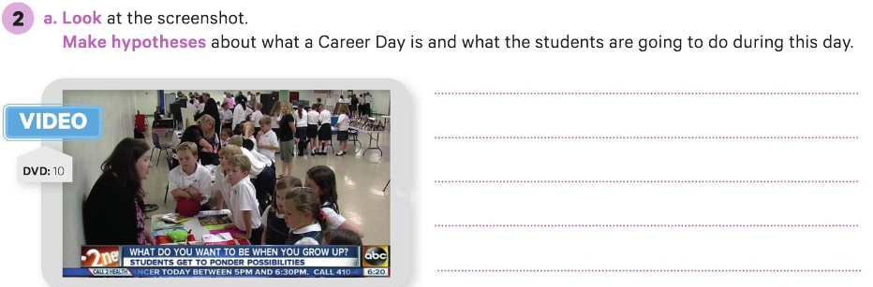
WB p.51 /52 or glue the paper!
-

Slide 47
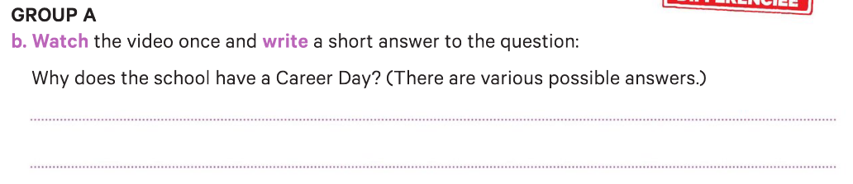
The students can think about their future
and what they want to be when they grow up.

Slide 48
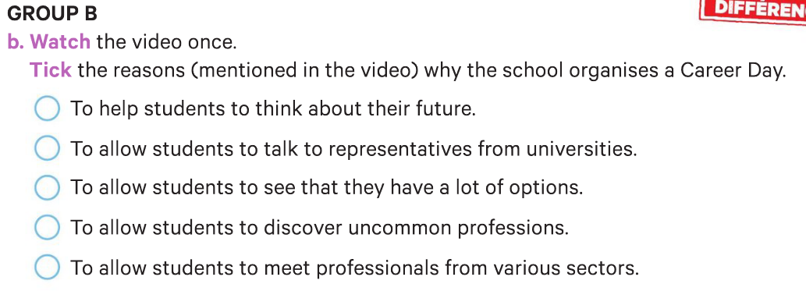
The students can think about their future
and what they want to be when they grow up.

Slide 49
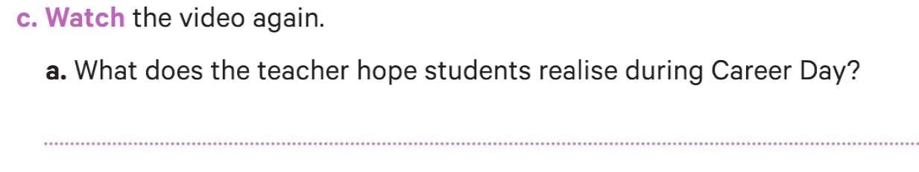
many different avenues, unlimited amount of careers, good foundations in school

Slide 50
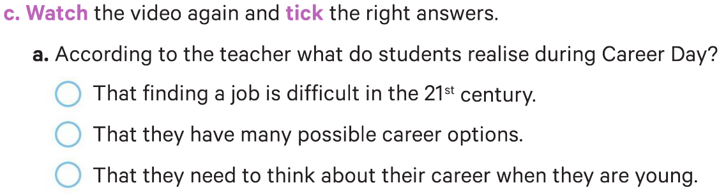
many different avenues, unlimited amount of careers, good foundations in school

Slide 51
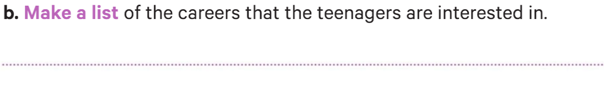
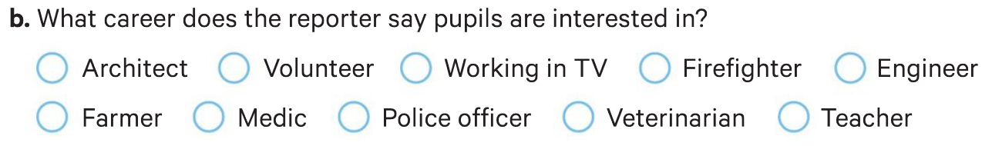
TV business, police officer, medic, organic farmer and
veterinarian.

Slide 52
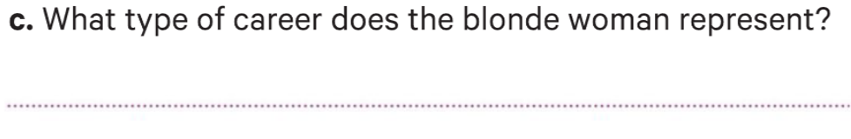
The volunteer sector (Red Cross).

Slide 53
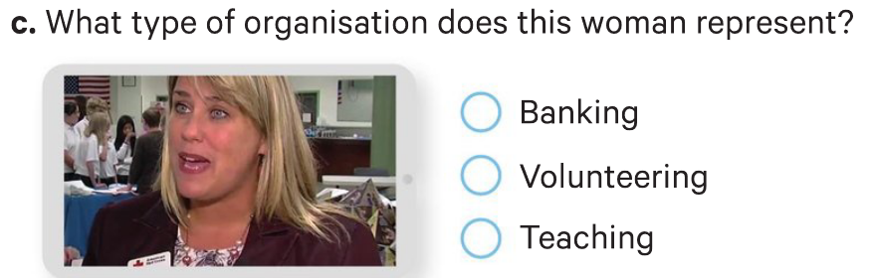
The volunteer sector (Red Cross).

Slide 54
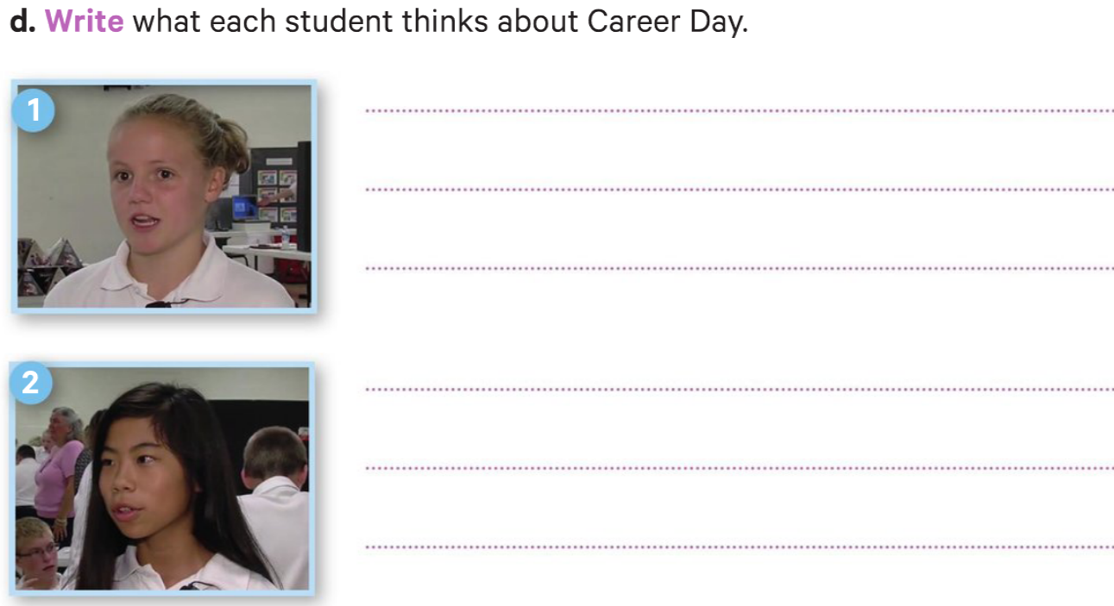
She really likes Career Day because it makes her realize how many choices there are.
Career Day is important because she can have a better idea of what she wants to do when she is older.

Slide 55
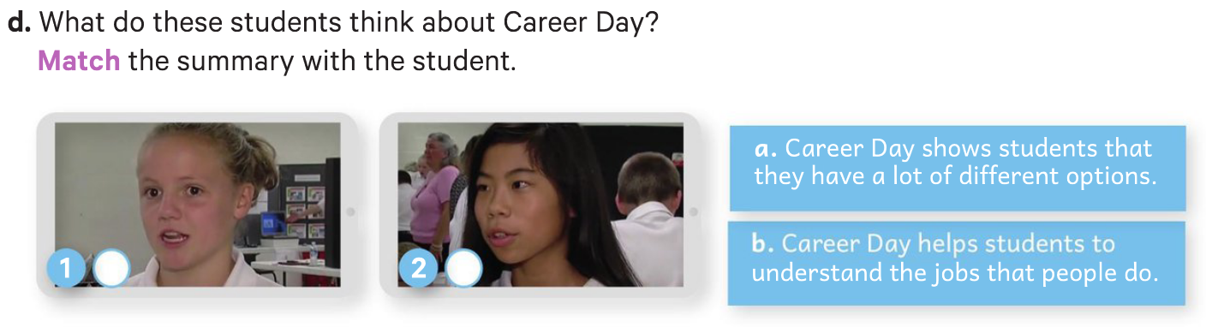
a
b

Slide 56



