Slide 1
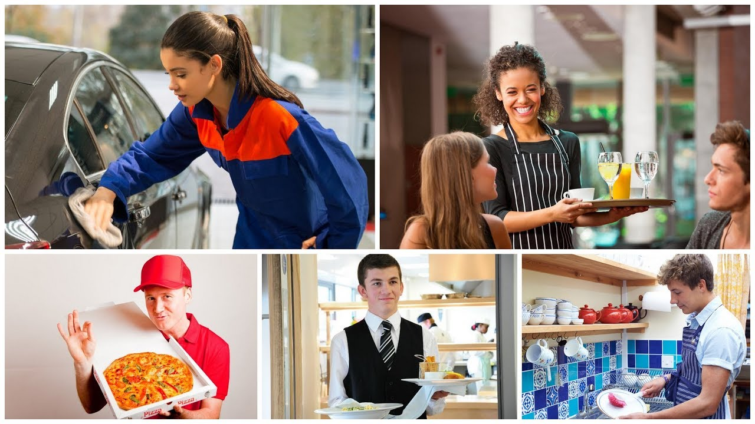
What are we going to talk about?

Slide 2


Slide 3
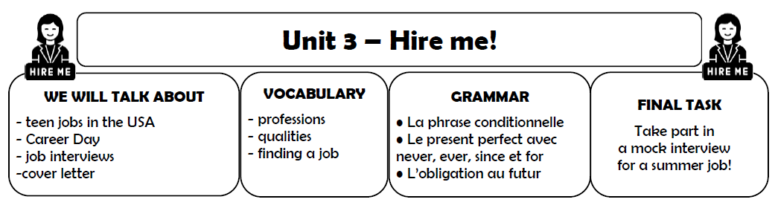
Glue it in your copybook!
+ write the title

Slide 4
Write in your copybook:
Lesson 1: What job?

Slide 5
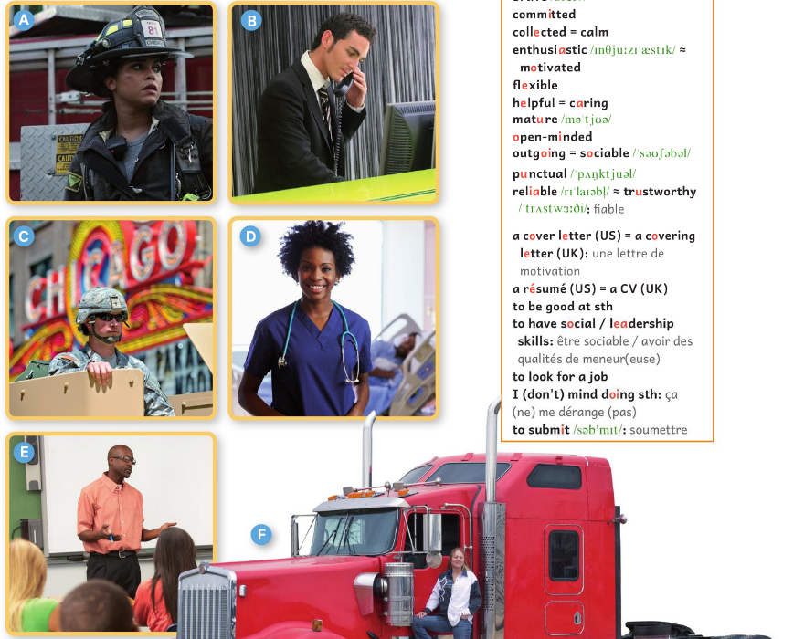
Name the professions!
You will discuss in pairs.
You can ONLY speak English!
“The person in
picture E must be
a … because...”

Slide 6
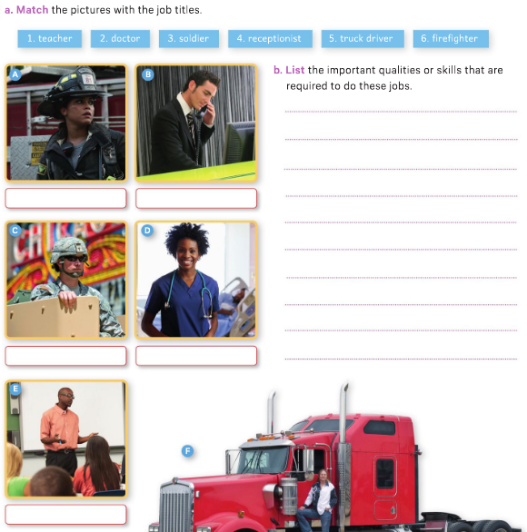
WB p.50 or glue the paper!

Slide 7
Write the job titles under the pictures
firefighter
receptionist
soldier
doctor
truck driver
teacher

Slide 8
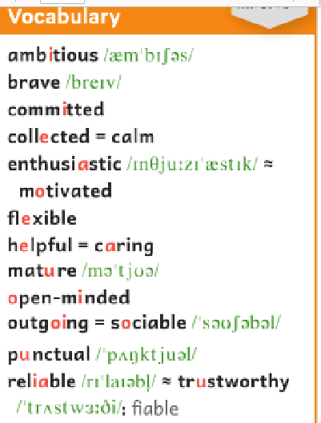
Discuss the qualities or skills that are required to do these jobs!
firefighter
receptionist
“You have to be patient to be a…”
“To be a …, you certainly can’t/must be …!”
soldier
doctor
truck driver
teacher

Slide 9
Discuss the qualities or skills that
are required to do these jobs!

Slide 10
-

Slide 11
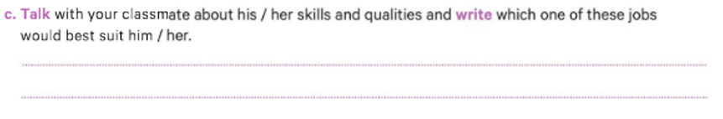
Speaking activity
- What are your qualities?
- My qualities are…
-Since you’re very …, … and … /
When you are an adult, maybe you will be a …”

Slide 12
Write it down!
-Since you’re very …, … and … /
When you are an adult, maybe you will be a …”

Slide 13
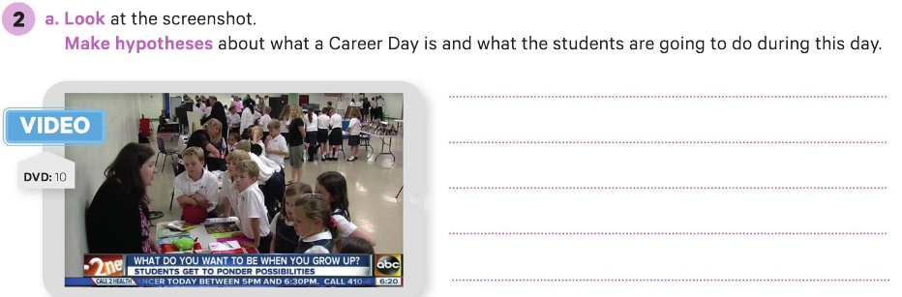
WB p.51 /52 or glue the paper!
-

Slide 14
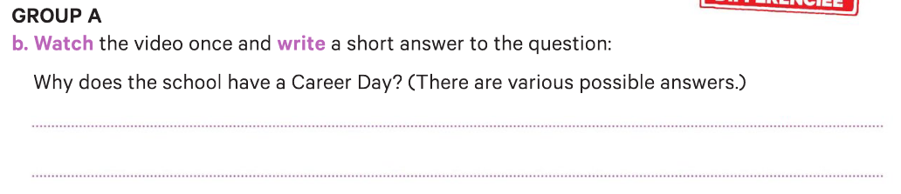
The students can think about their future
and what they want to be when they grow up.

Slide 15
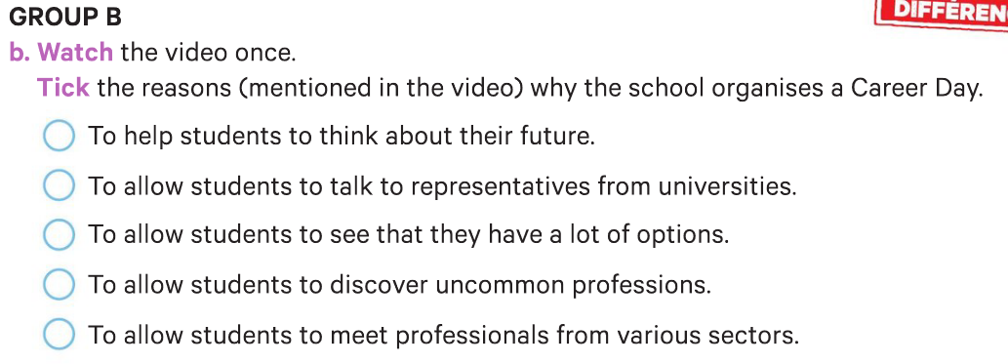
The students can think about their future
and what they want to be when they grow up.

Slide 16
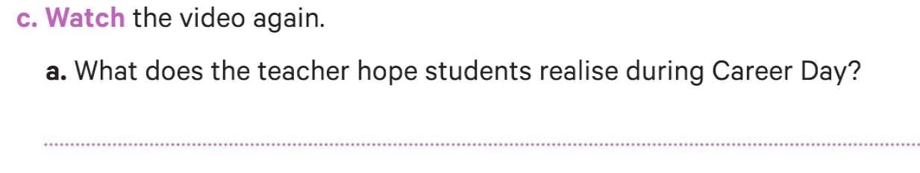
many different avenues, unlimited amount of careers, good foundations in school

Slide 17
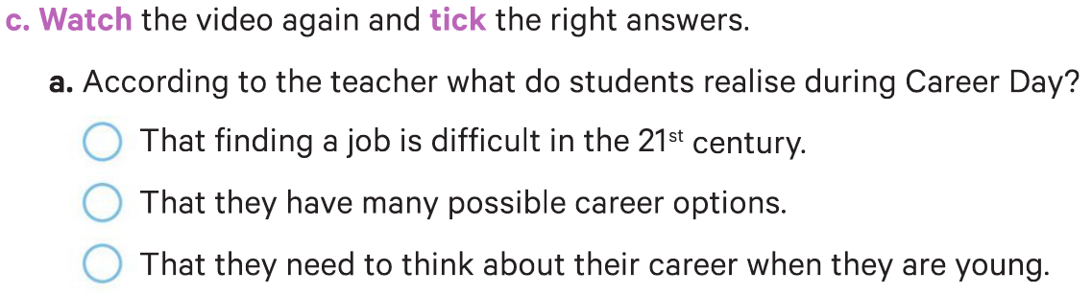
many different avenues, unlimited amount of careers, good foundations in school

Slide 18
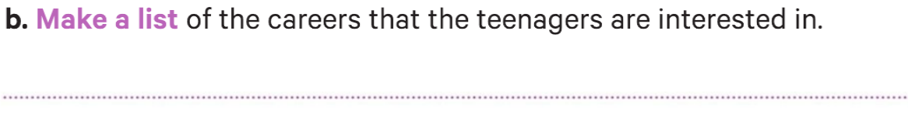
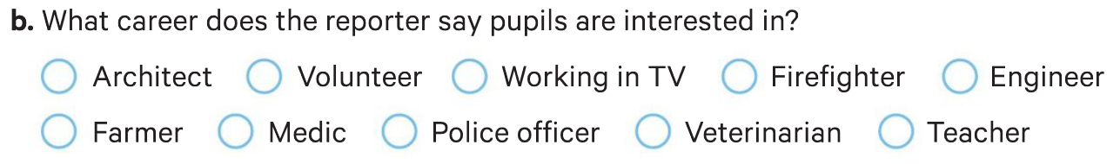
TV business, police officer, medic, organic farmer and
veterinarian.

Slide 19
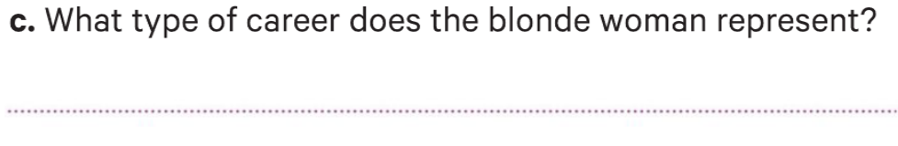
The volunteer sector (Red Cross).

Slide 20
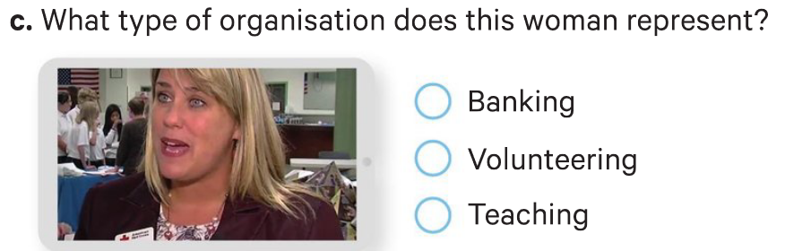
The volunteer sector (Red Cross).

Slide 21
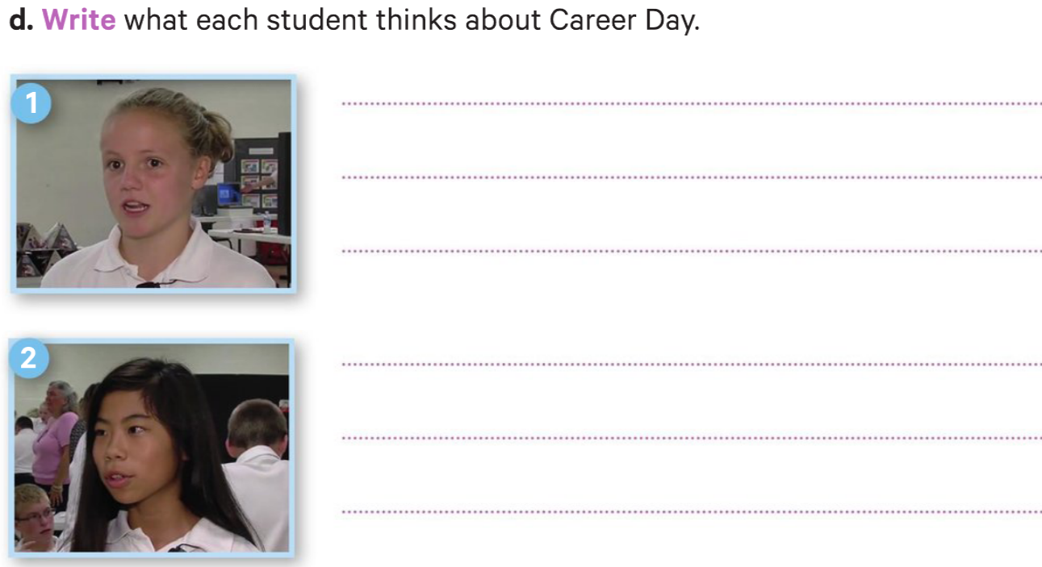
She really likes Career Day because it makes her realize how many choices there are.
Career Day is important because she can have a better idea of what she wants to do when she is older.

Slide 22
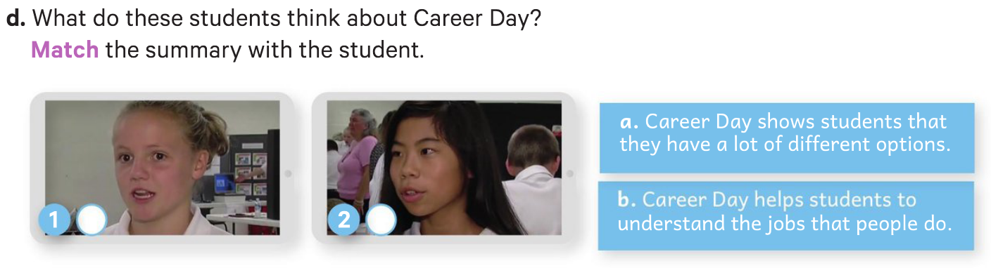
a
b

Slide 23
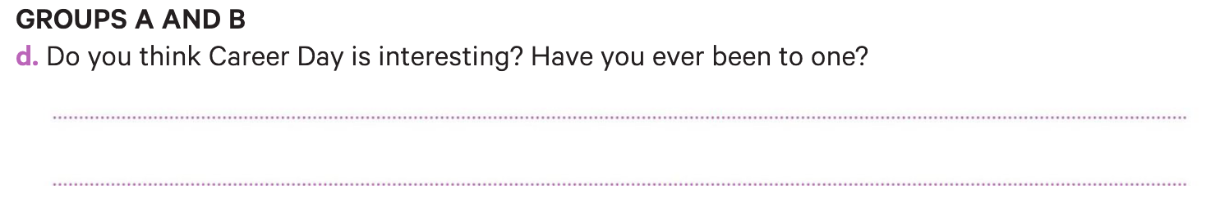
-

Slide 24
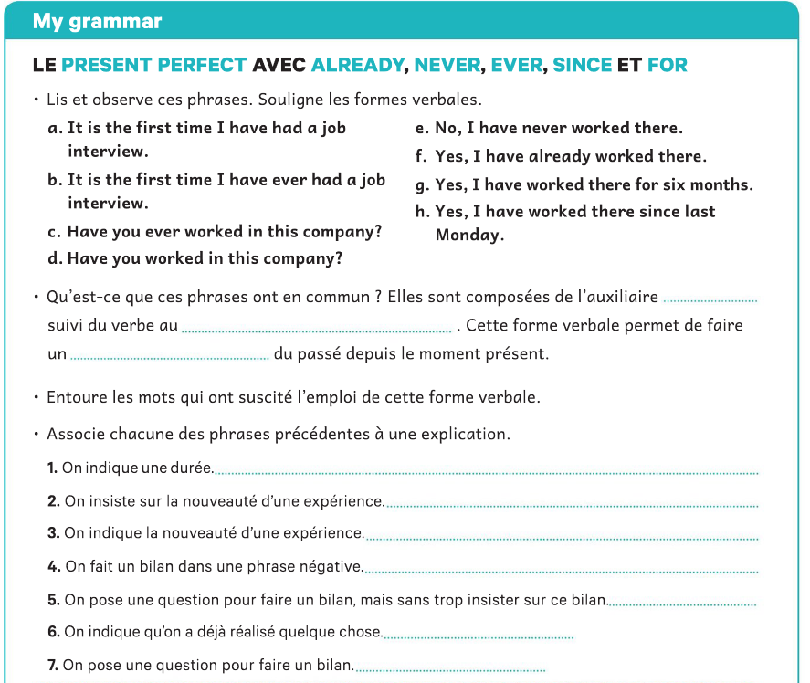
WB p.53 or glue the paper!
have
participe passé
lien /bilan des expériences

Slide 25
g
b
a
e
d
f
c

Slide 26
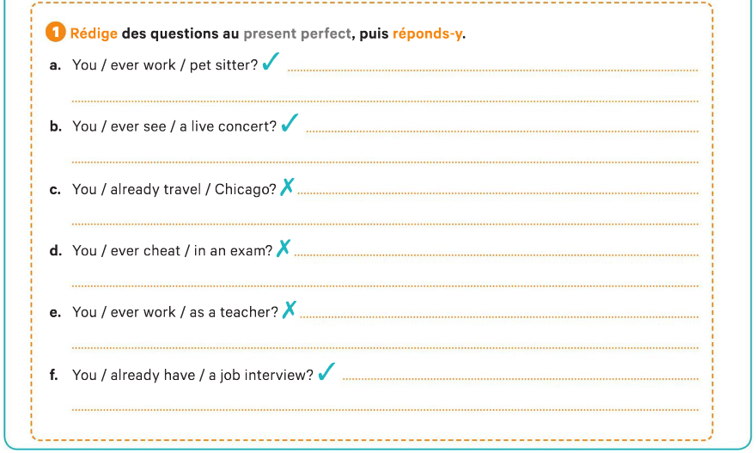
Have you ever worked as a pet sitter?
Yes, I have already worked as a pet sitter.
Have you ever seen a live concert?
Yes, I’ve already seen a live concert.
Have you already traveled to Chicago?
No, I’ve never traveled to Chicago.
Have you ever cheated in an exam?
No, I’ve never cheated in an exam.
Have you ever worked as a teacher?
No, I have never worked as a teacher.
Have you already had a job interview?
Yes, I have already had a job interview..

Slide 27
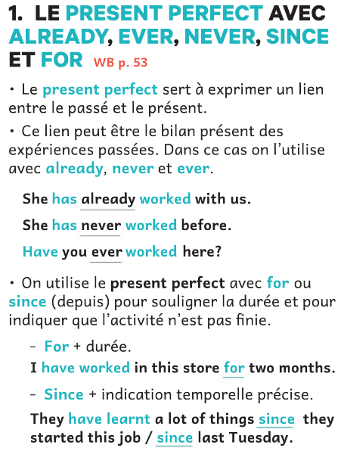
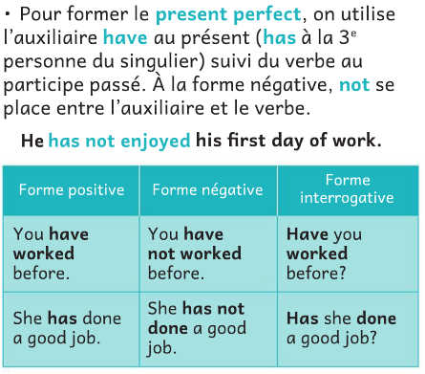
B p.58/ paper

Slide 28
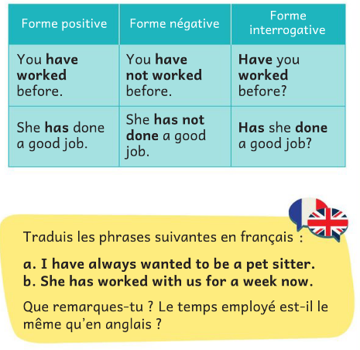
1
a. J’ai toujours voulu être pet sitter.
Elle travaille avec nous depuis une semaine.
Le present perfect correspond souvent au passé composé en français, ou le present simple.

Slide 29
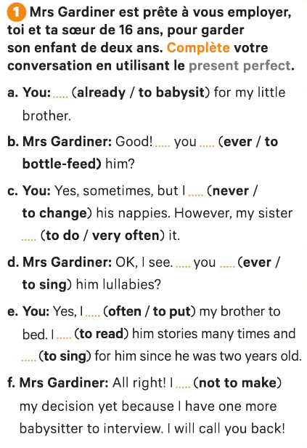
I have already babysat…
Have you ever bottle-fed him?
I’ve never changed his nappies.
My sister has done it very often.
2

Slide 30
Have you ever sung him lullabies?
I’ve often put …
I have read him stories…
I’ve sung for him.
f. I haven’t made my decision yet…

Slide 31
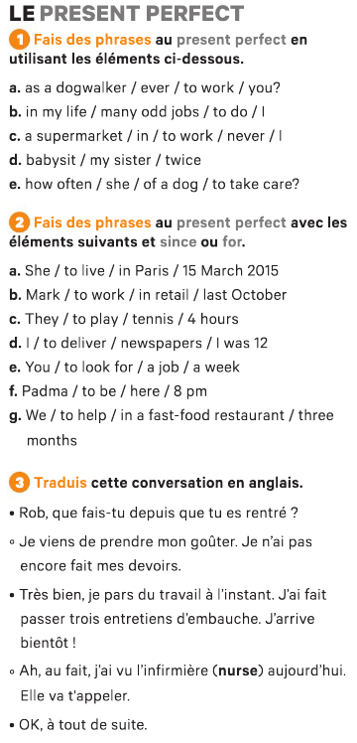
B 127/ paper
3
Have you ever worked as a dogwalker?
I have done many odd jobs in my life.
I have never worked in a supermarket.
My sister has babysat twice.
How often has she taken care of a dog?

Slide 32
4
She has lived in Paris since 15 March 2015.
Mark has worked in retail since last October.
They have played tennis for 4 hours.
I have delivered newspapers since I was 12.
You have looked for a job for a week.
Padma has been there since 8 pm.
We have helped in a fast-food restaurant for three months.

Slide 33
5
1
snack
2
to conduct a job interview
3

Slide 34
Rob, what have you done since you have arrived home?
I have just eaten a snack. I haven’t done my homework yet.
Great, I have just left work.
I have conducted three job interviews.
I’ll be there soon!
Oh, actually, I’ve seen the nurse today.
She will call you.
Okay, see you in a minute.
5

Slide 35
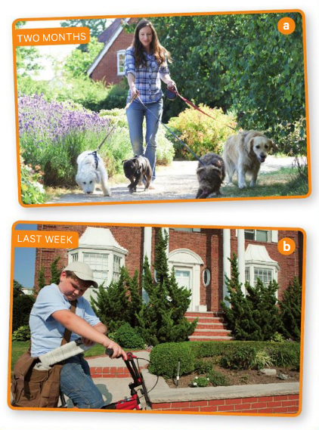
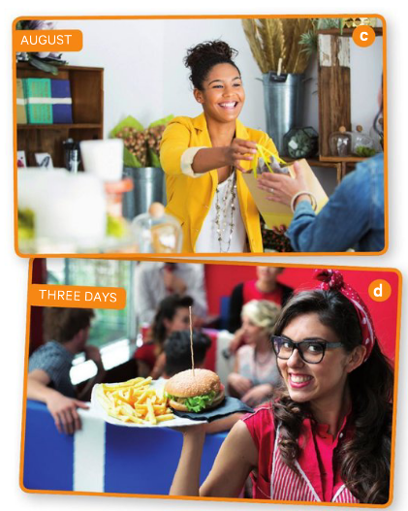
Look at these photos
and say what the teenagers have worked
(since when or for how long).

Slide 37
She has walked dogs for 2 months.
He has delivered newspapers since last week.
She has sold gifts since August.
She has waited tables for three days.

Slide 38
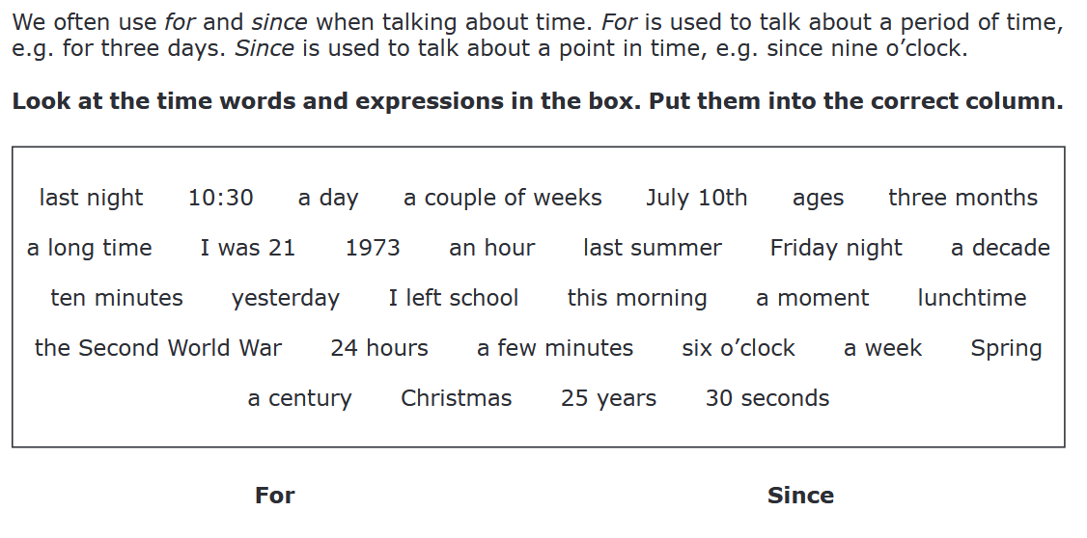

Slide 39


Slide 40
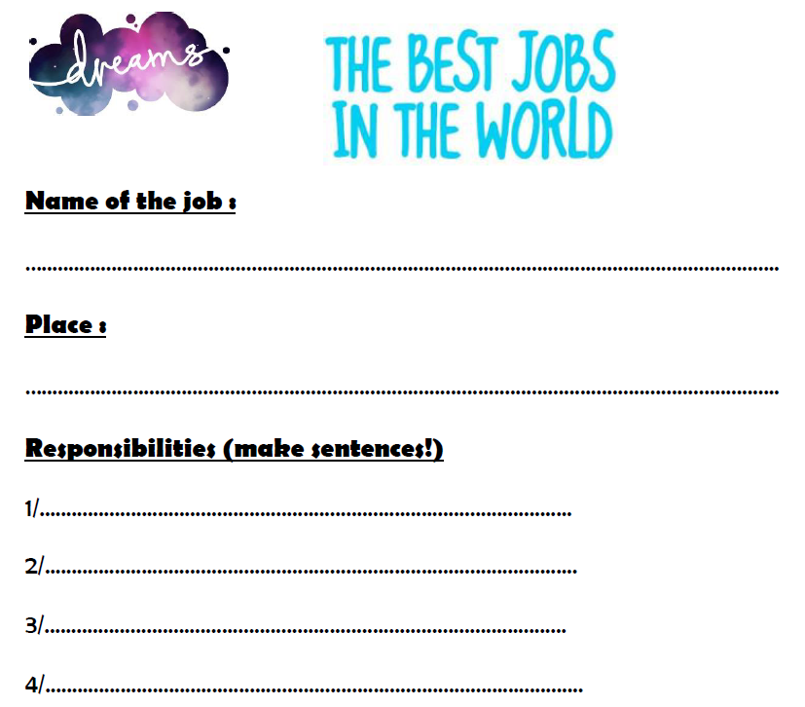
Watch the video and complete the document

Slide 41
island caretaker
Queensland (Australia)
explore the islands and report back
clean the pool
feed the fish
collect the mail

Slide 42
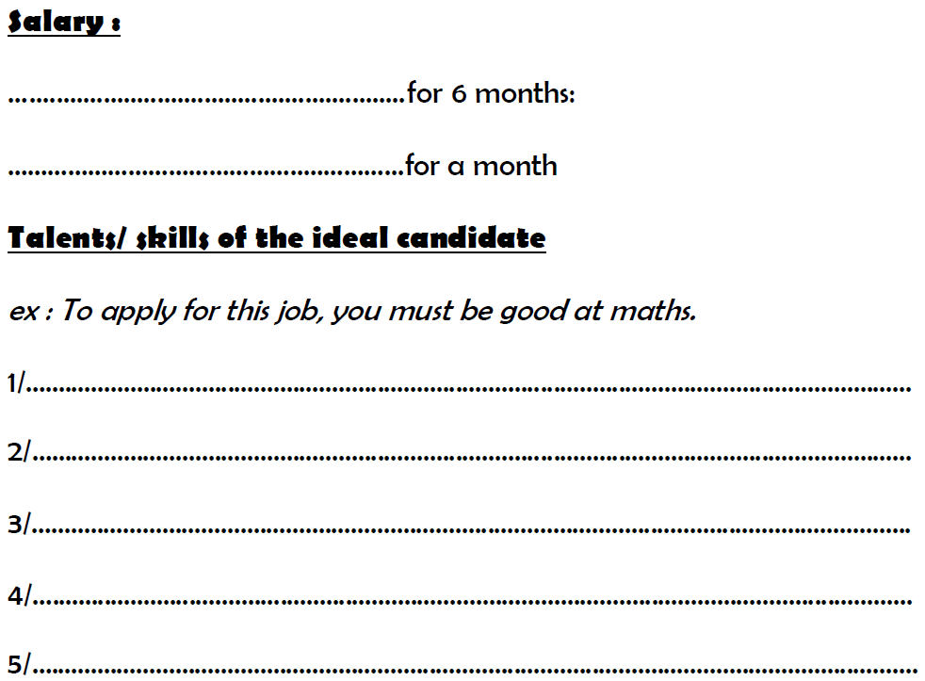
$150,000
$25,000
-
-
-
-
-

Slide 43
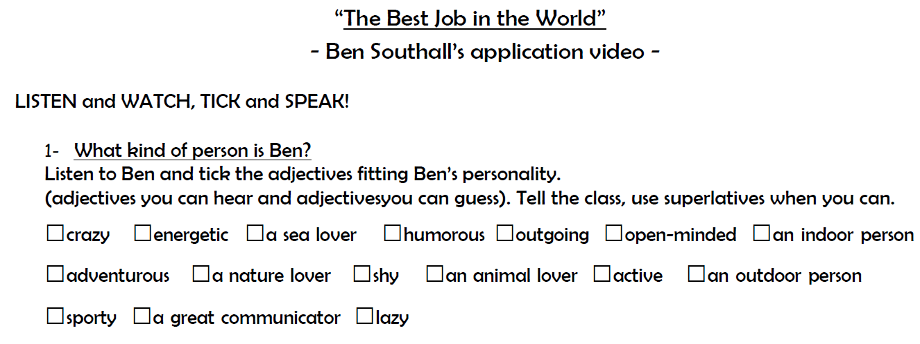

Slide 44
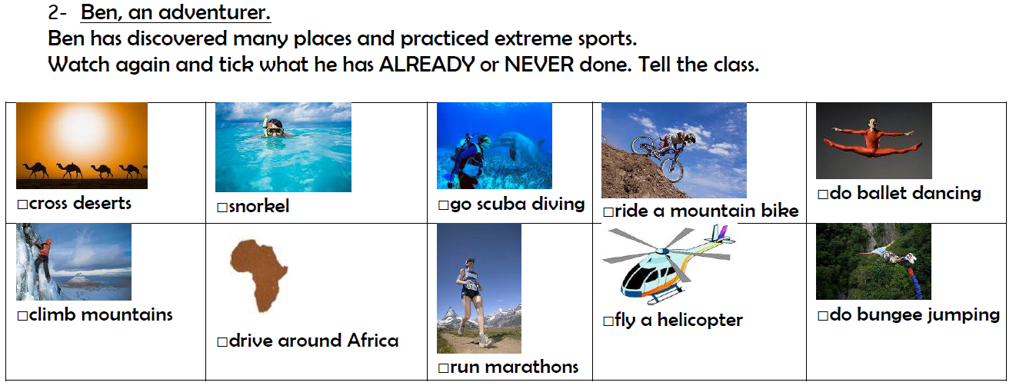

Slide 45
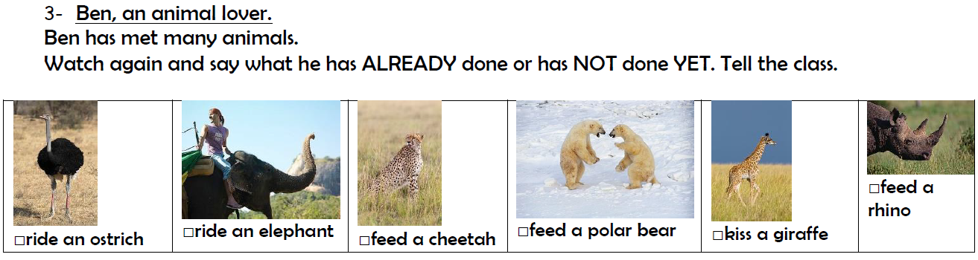

Slide 46
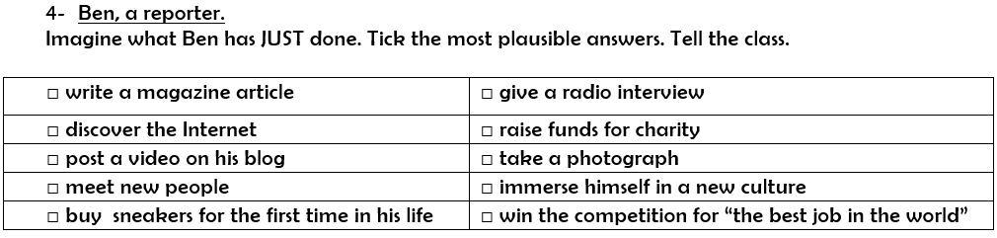

Slide 47
Now write sentences about Ben in your capybook

Slide 48
Write 2 sentences (long and short adjectives, use superlatives)
What kind of person is Ben?
-

Slide 49
Write 3 sentences about what he has ALREADY or NEVER done
2. Ben, an adventurer:
-

Slide 50
Write 3 sentences about what he has ALREADY done or
NOT done YET.
3. Ben, an animal lover:
-

Slide 51
Write 3 sentences about what he has JUST done.
4. Ben, a reporter:
-

Slide 52
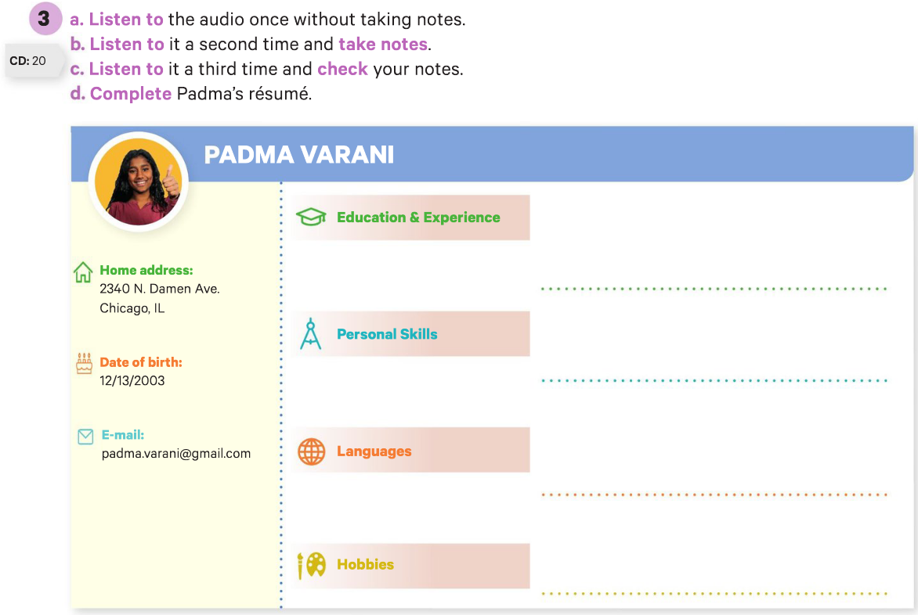
9th grade high school / worked as a bag girl and uncle’s garage / has done babysitting
dynamic / fun to be with / sociable / teamwork / not afraid of work / serious / responsible
Spanish - not fluent but able to carry out a conversation / French - can read and understand a bit)
playing videogames / playing tennis, has participated in tournaments

Slide 53
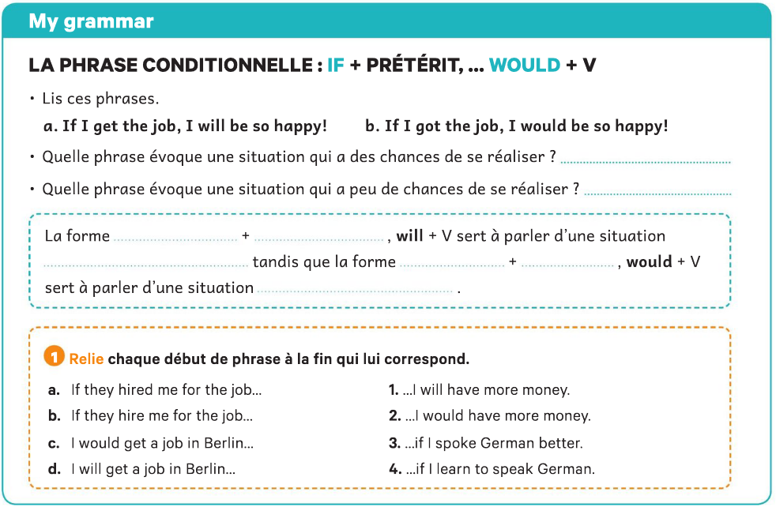
a
b
if
présent
probable
if
prétérit
peu probable
2
1
3
4

Slide 54
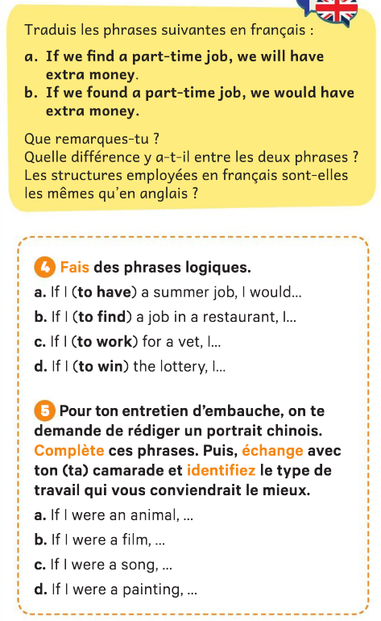
- Si je trouve un petit boulot j'aurais de l'argent en plus.
-Si nous trouvions un petit boulot, nous aurions de l'argent en plus.

Slide 55
-

Slide 56
-

Slide 57
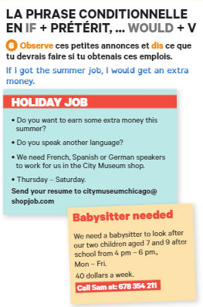
-

Slide 58
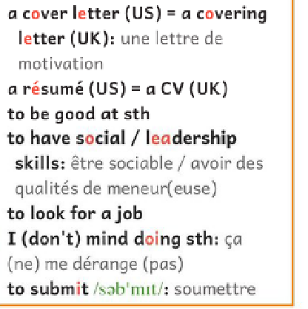
être bon/doué pour quelque chose
chercher un emploi

Slide 59
Eval second conditional

Slide 60
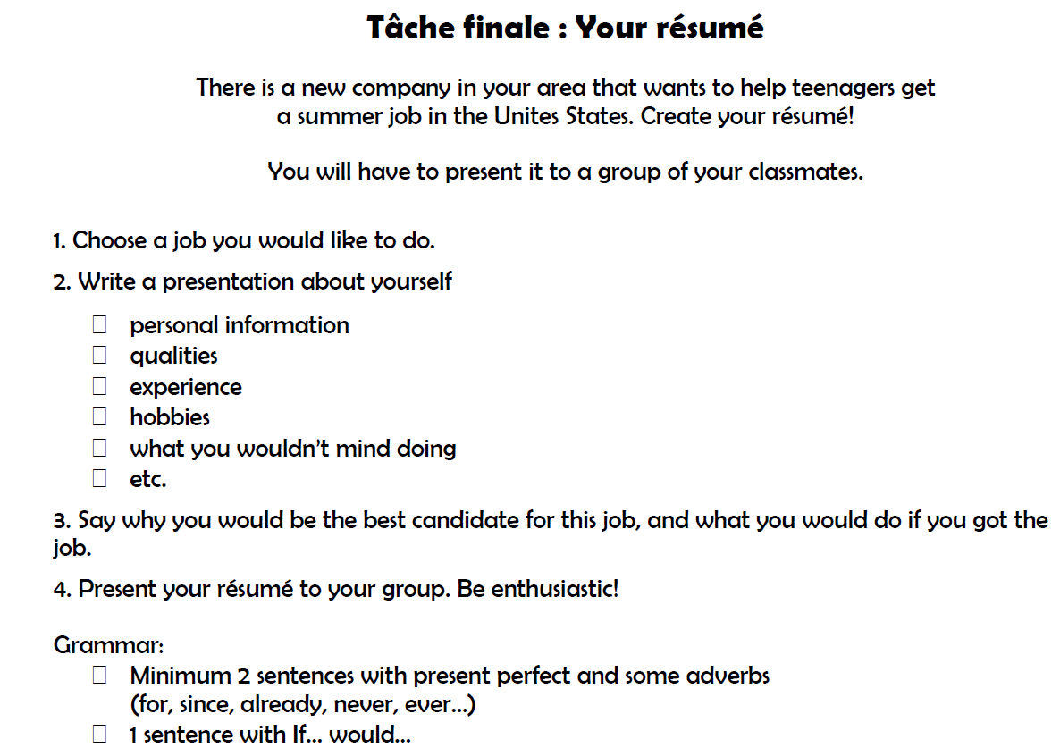

Slide 62
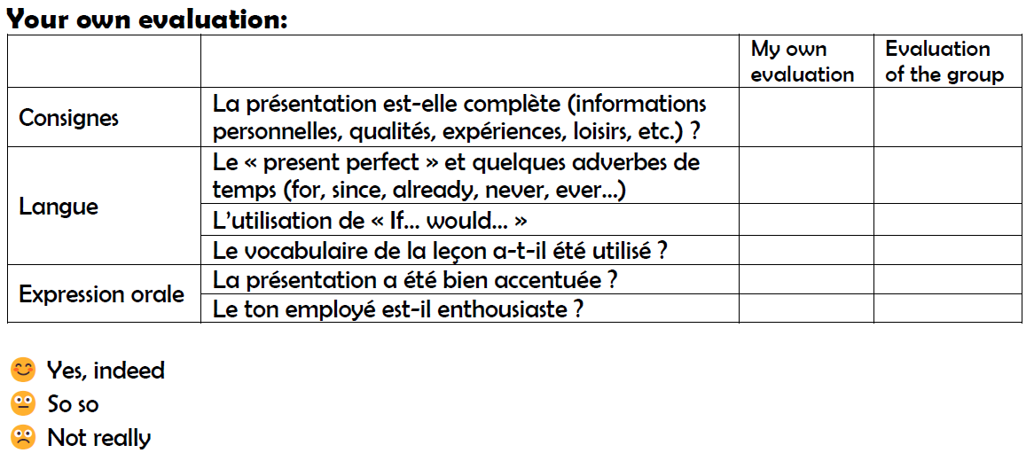

Slide 63
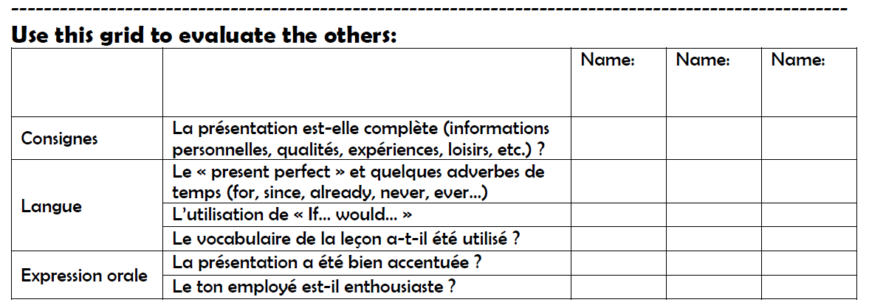

Slide 64
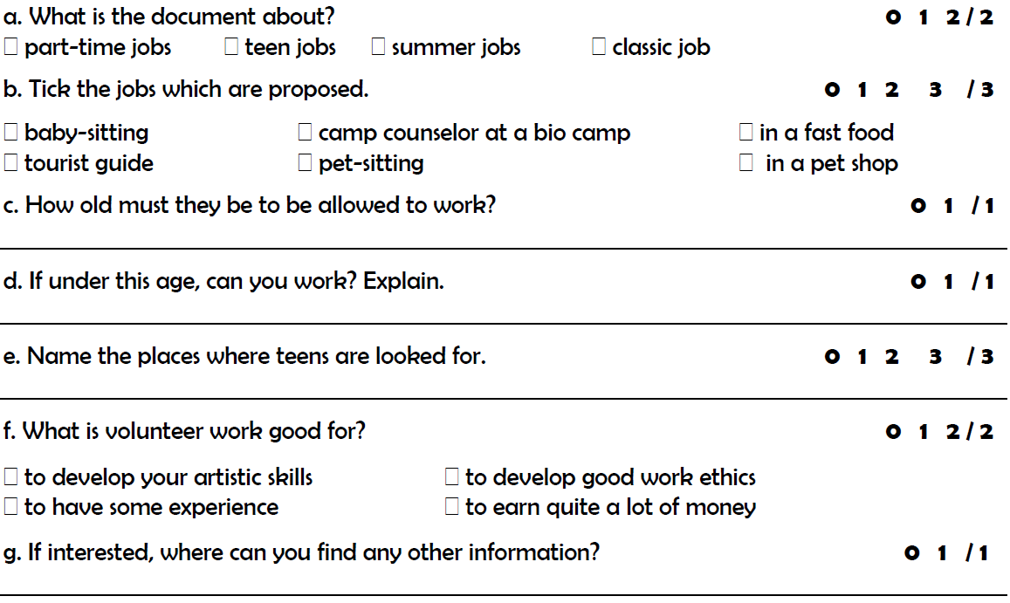
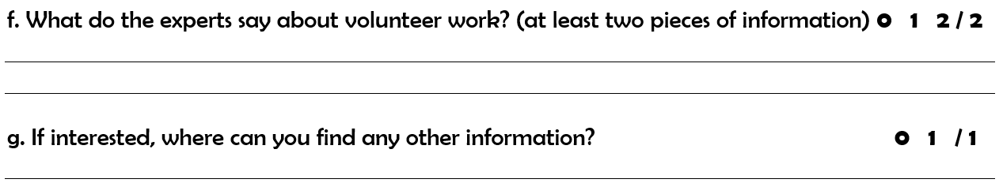
16 years old
Yes. Need a special work permit from the States Deprtment of Labor.
They are looking for teens in golf courses, offices, museums and restaurants
Volunteer Work might not be paid, but is good to have a sense of ethics and to get some experience.
On their website.

