Slide 1

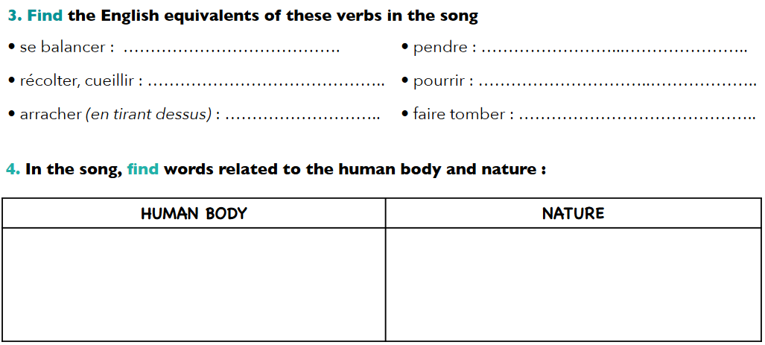
swing
hang
gather
rot
pluck
drop
flesh, blood, mouth, eyes, bodies
crop, poplar tree, sun, magnolias, rain, fruit, roots, wind, leaves, crows

Slide 2
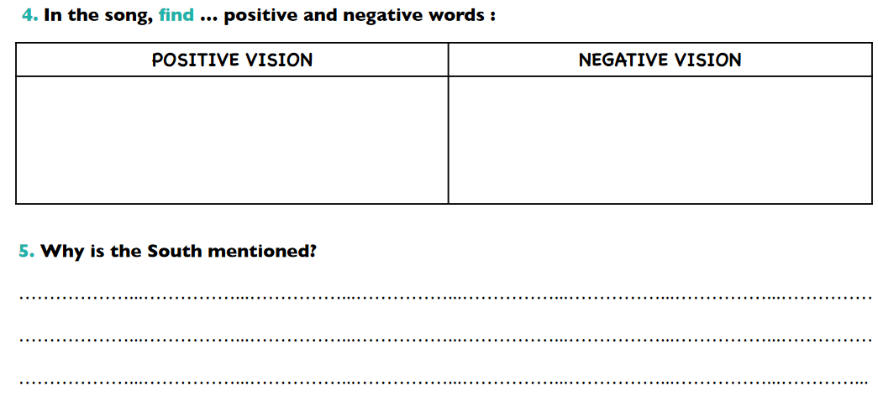
Scent of magnolias sweet and fresh
Pastoral scene of the gallant South
Black bodies swinging
Smell of burning flesh
Bulging eyes and twisted mouth
Because during the period of segregation African-American people were lynched and killed for no reason.

