Slide 1
Banksy does NEW YORK
Watch and concentrate on what you understand!

Slide 2
Banksy does NEW YORK
In your group discuss the video IN ENGLISH.
What happened?
What was the reaction?

Slide 3
Banksy does NEW YORK
What makes Banksy’s work so appealing, so loveable?

Slide 4
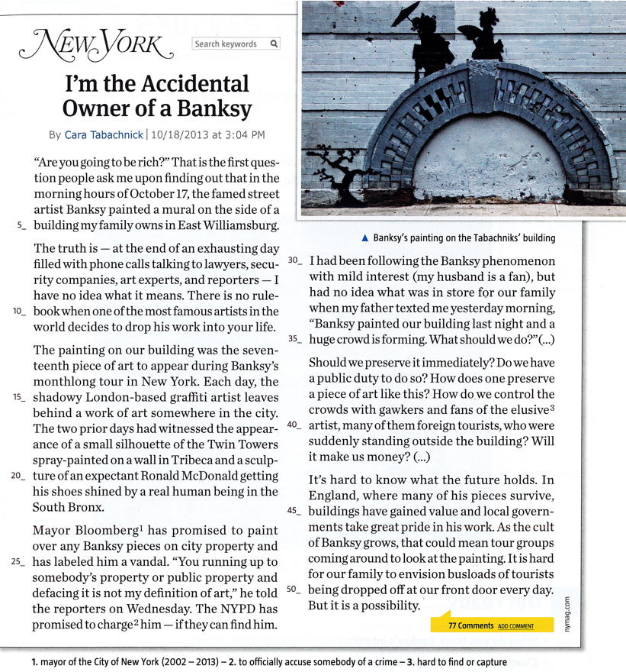
Read the title of the article.

Slide 5
Read the title of the article.
Can you link it to the video?

Slide 6
What do you think:
what happened to
Cara Tabachnik?

Slide 7
How do you think
she reacted?

Slide 8
Read the article.
Pick out information about:
the facts /
the people involved /
their reactions

Slide 9
Private citizens
Cara Tabachnik
Cara’s father
Artist
Banksy
People Involved
Officials
The NYPD
Michael Bloomberg, Mayor of New York
Professionals
lawyers / security companies / art
experts / reporters

Slide 10
Places
on Cara Tabachnik’s building/in East Williamsburg
Dates
on October 17
Facts
Events
Banksy painted a mural

Slide 11
Cara and her family are puzzled, they don’t know what to do. (puzzled = perplexe)
Reactions
The Mayor is irritated, even furious, he wants to arrest Banksy and charge him with vandalism. He also wants to paint over his murals.
-

Slide 12
Write a short description of Banksy and his work!

Slide 13
Write a short description of Banksy and his work!
Banksy is an anonymous British artist. He does
graffiti at night. In 2013, he stayed in NYC for
a month and created a piece of art every night.
His stencils are very expensive. A lot of people
love him and take pictures, but the mayor of
New York and the NYPD want to arrest him. His
works often have a political or social message.
He tries to denounce things.

