Slide 1


Write in your copybook:
Lesson 5 : Bullying – a video (I’ve experienced bullying)

Slide 2

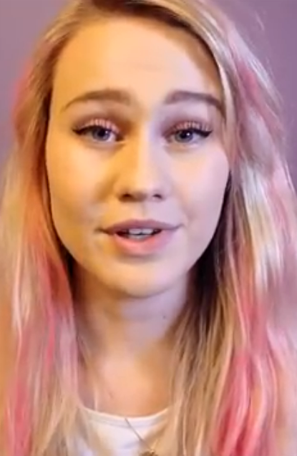
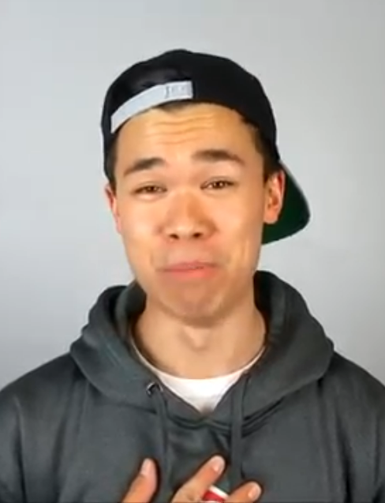

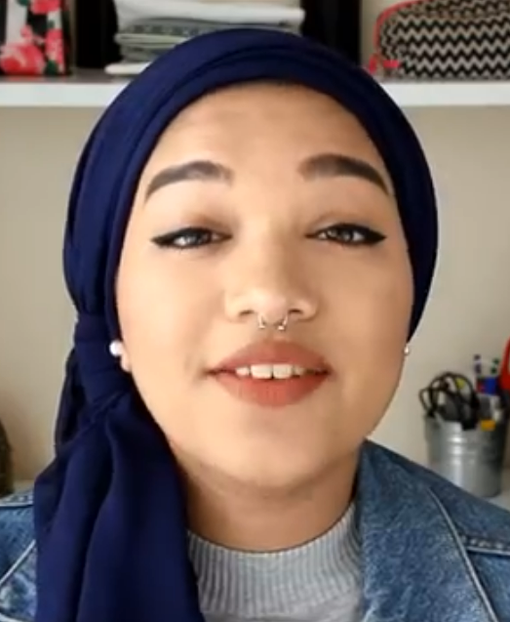
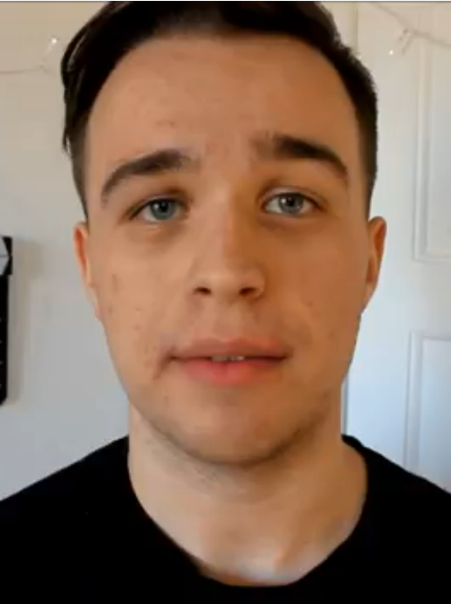
Watch the video and listen!
These young adults will tell us their own experience about being bullied

Slide 3
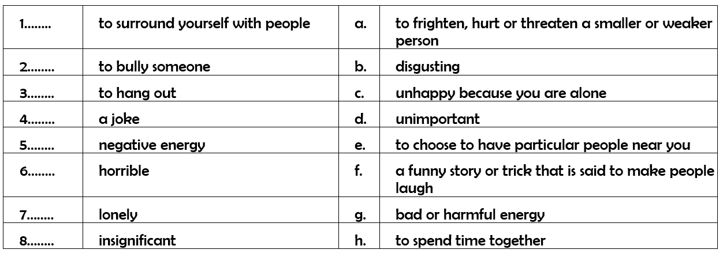
1. Match the vocabulary with the correct definition and write a–h next to the
numbers 1–8.

Slide 4
2. Why were you bullied? -0:14
“Because I looked______________________.”
- “I couldn’t ___________ as fast as the other kids.”

Slide 5
3. What happened to you? -0:20
- “I was __________________ and ___________________ names.”
- “A girl in my class _______________ all my _______________ against me.”

Slide 6
4. How did bullying make you feel? 0:20-0:43

Slide 7
4. What should the bullied students do? 0:44-

Slide 8

Recap
HELP!
Subject:
-The students in the video
-The bullied students/teens
-They/them etc.
It made ________ feel…
It made ________ question…
If you’re experiencing bullying,
you should
you’d better
I advise you to
+ base verbale

Slide 9

Grammar time!
Donner du conseil:
should + BV
You should surround yourself with good friends.
you’d better (you had better) + BV
You’d better talk to your parents.
to advise someone to + BV
I advise you to get support.
Make a sentence: surround yourself with good friends.
Make a sentence: talk to your parents.
Make a sentence: get support.

Slide 10
Homework
Learn how to give advice.
Apprendre le point grammaire.

