Slide 1
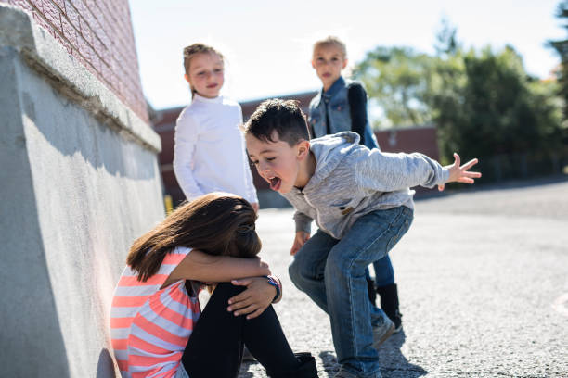
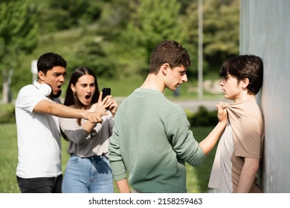
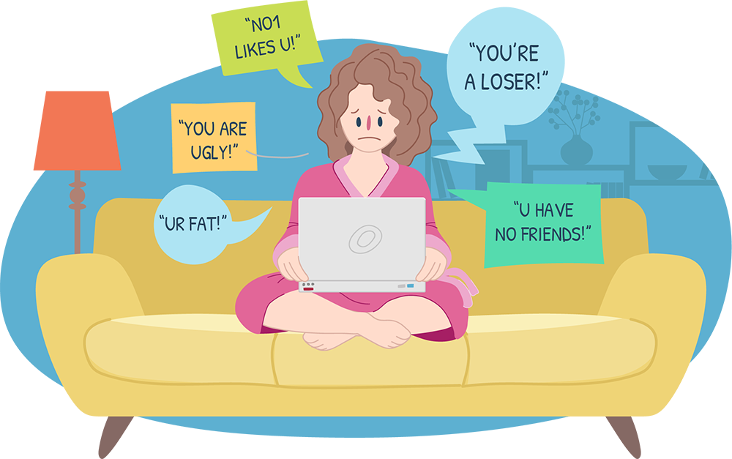

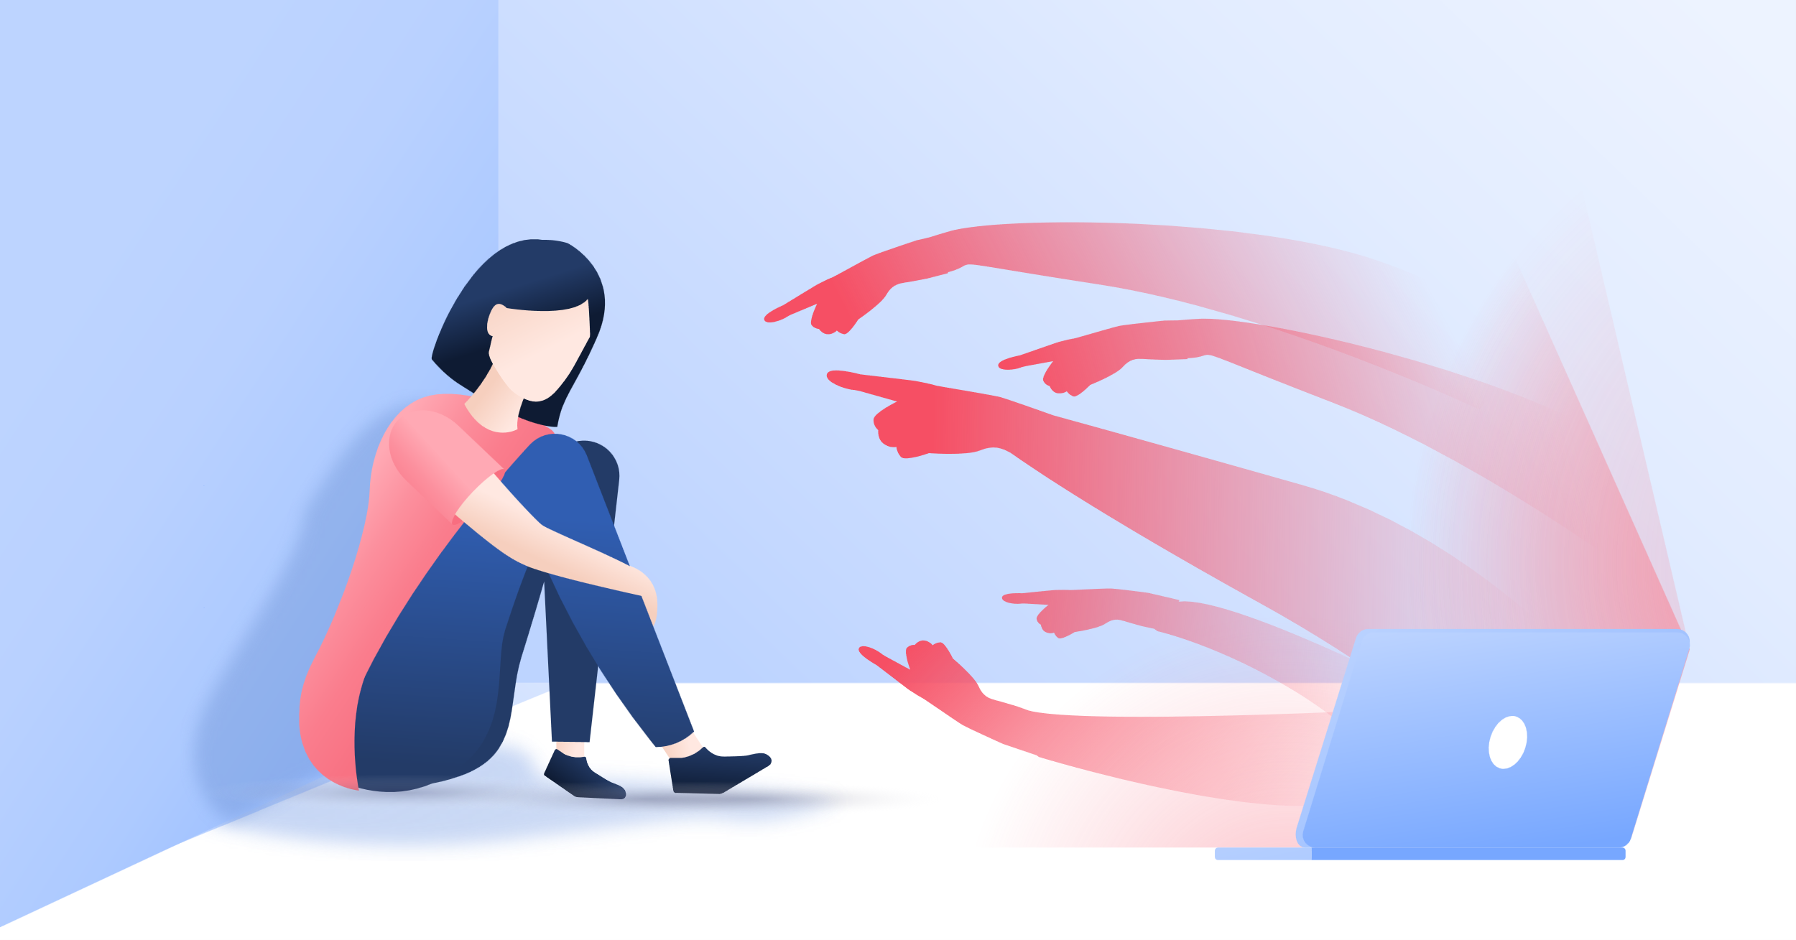
What is our new unit about?

Slide 2

Unit 2

Slide 3
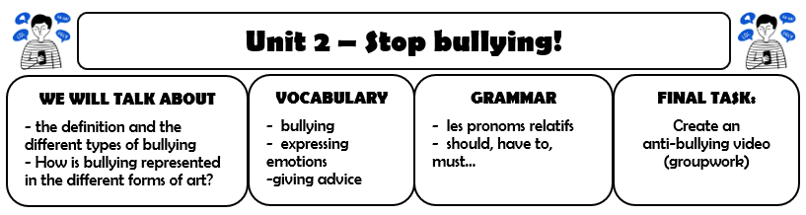
Unit 2

Slide 4


Write in your copybook:
Lesson 1: What is bullying?

Slide 5


Let’s think…
2 minutes
In groups (the writer take notes)
Think about minimum 5 reasons:
Why do people bully?

Slide 6
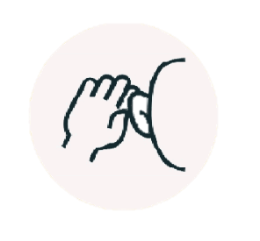
Let’s think in groups…
Why do people bully? (video: -0:36)

Slide 7
Let’s think in groups…
Why do people bully?

Slide 8

Reading and writing
Let’s work on the vocabulary!

Slide 9
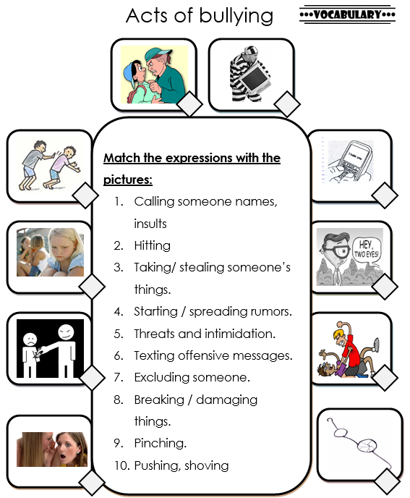
2. Match the expressions with the pictures:
3 minutes

Slide 10
Watch and listen
The four different types of bullying
We will watch the video twice, you will have to take notes.

Slide 11
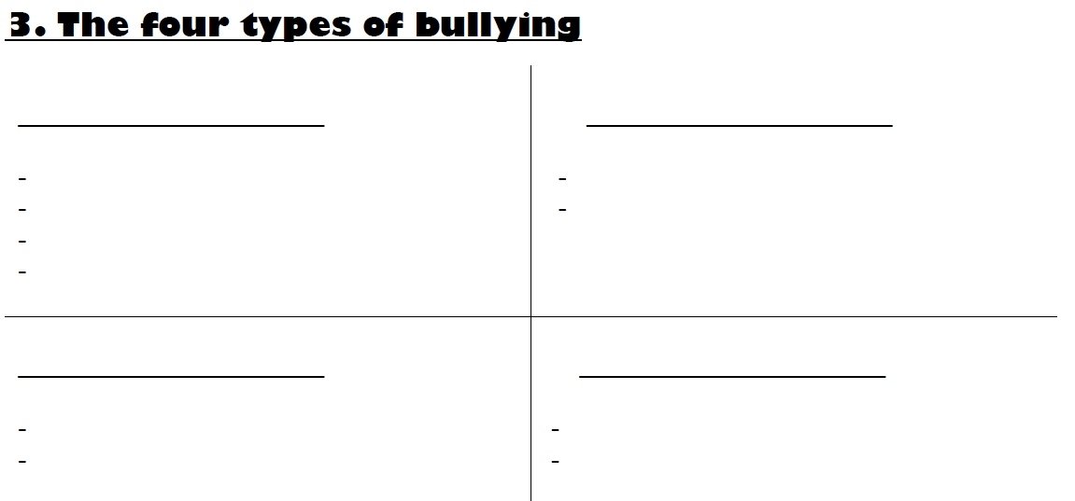
In your copybooks:

Slide 12
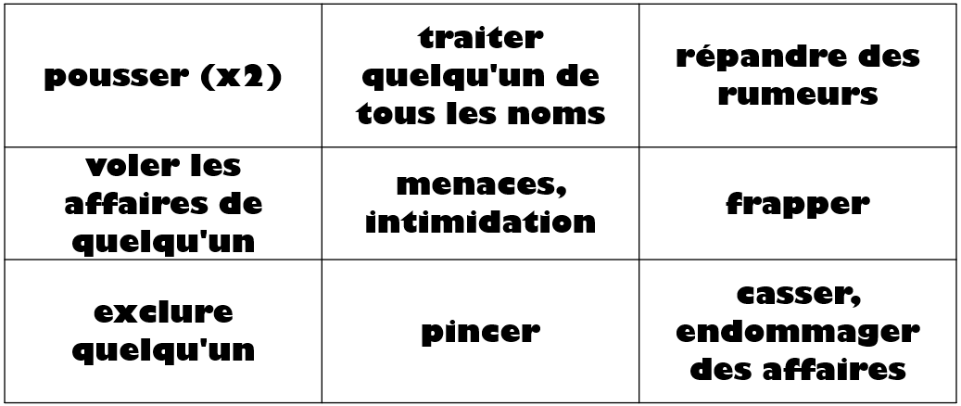
Let’s practise!
Let’s revise the vocabulary!
NOUGHTS (O) AND CROSSES (X)

Slide 13
Homework
Learn the vocabulary.

Slide 14
Fill in the gaps
The definition of bullying

Slide 15
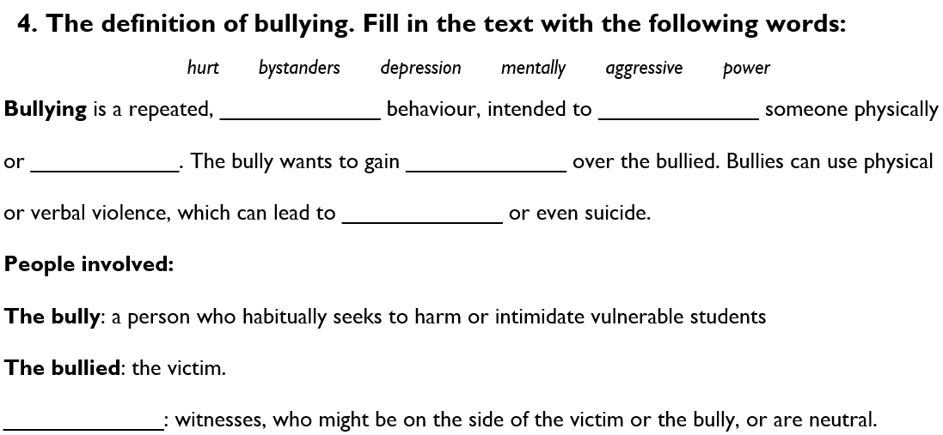
Fill in the gaps

Slide 16
Grammar time!
Observe les deux phrases:
Bullies can use physical or verbal violence, which can lead to depression or even suicide.
The bully: a person who habitually seeks to harm or intimidate vulnerable students.
Trouve les deux pronoms relatifs.
Before I give you the lesson,
let’s remember…

Slide 17
Grammar time!
Quelle est la différence?
WHICH
WHO
THAT
WHOSE

Slide 18
Grammar time!
Quand utiliser les pronoms relatifs?

Slide 19
Grammar time!
I. Pronoms relatifs : rappel (ex. A, B, C)
Le pronom relatif remplace un groupe nominal qu’on appelle son antécédent
(humain : personne ou animal familier ; ou neutre : un animal, une chose ou une idée).
Il est soit sujet, soit complément, c’est qu’on appelle sa fonction. (cf. partie II.)
WHICH: Pour un antécédent neutre - sujet ou complément
The dog, which was in the office today, is very friendly.
WHO: Pour un antécédent humain - sujet ou complément
The girl, who I wanted you to meet, is called Sarah.
THAT: Tous les antécédents, sujet ou complément - Peut remplacer « who » et « which »
The dog, that was in the office today, is very friendly.
The girl, that I wanted you to meet, is called Sarah.
WHOSE : Tous les antécédents - pour indiquer la possession (génitif)
This singer, whose name I don't remember, has a beautiful voice.

Slide 20
I. Pronoms relatifs : rappel
A, Complète les phrases avec le pronom relatif qui convient.
I have finished the book which / that I bought yesterday.
The actor who / that played the lead in the film was a revelation.
There is the plane which / that has just landed.
The writer, whose new book has had great success, is really talented.
Can you see the girl who/that is sitting on the bench?

Slide 21
I. Pronoms relatifs : rappel
B, A l’aide d’un pronom relatif, relie les deux phrases afin de faire qu’une.
My mother has a cat. Her fur is grey.
My mother has a cat whose fur is grey.
2. Robinson Crusoe is a book. It was written by Daniel Defoe.
Robinson Crusoe is a book which/that was written by Daniel Defoe.
3. I’ve just hired a secretary. She was a teacher before.
I’ve just hired a secretary who/that was a teacher before.

Slide 22
I. Pronoms relatifs : rappel
C, Traduis les phrases suivantes en utilisant des pronoms relatifs.
M Bell est l’homme qui inventa le téléphone.
Mr Bell is the person who / that invented the telephone.
2. Le téléphone que nous utilisons a beaucoup changé.
The telephone, which/ that we use today, has changed a lot.
3.Toutes les personnes qui utilisent le téléphone sont satisfaites.
All the people, who/that use the telephone, are satisfied.
4. Mais les PDG dont le téléphone ne marche pas sont furieux.
But the CEOs, whose telephone doesn’t work, are furious.

Slide 23
Grammar time!
Pronom relatif sujet ou complément ?
Les pronoms relatifs who/which/that peuvent avoir deux fonctions dans la proposition relative : sujet ou complément.
Voici quelques règles qui vous permettront de trouver la fonction du pronom relatif :
S’ils sont suivis d’un article, d’un nom ou d’un pronom, ils sont compléments.
Exemples :
our neighbour, who the car belonged to
the car, which the man had parked on a hill
a traffic sign that someone had put on the street
Si les pronoms relatifs who/which/that sont suivis d’un verbe, ils sont sujets.
Exemples :
the man, who was in a hurry
the car, which was parked on a hill
a traffic sign, that stood on the street

Slide 24
11. Pronoms relatifs : pour aller plus loin
D, Le pronom relatif souligné a-t-il une fonction de sujet ou de complément ?
Exemple : The train, that goes to Amsterdam, leaves at 10.35. => S / C
The man, who helped me, is a really nice person. S / C
The languages that they speak are hard to understand. S / C
Look, there is the machine that makes boxes. S / C
The house, which you bought, is really well designed. S / C
The movie, that I saw yesterday, was quite shocking. S / C
The boy, who lost his cap, is absent-minded. S / C

Slide 25
Grammar time!
III. Pronom relatif zéro (Ø) (ex. E, F, G, H)
Dans le langage courant, il arrive souvent que l’on voie des propositions subordonnées relatives sans pronom relatif pour relier les propositions.
Quand le pronom relatif est complément, (il est suivi d’un nom ou pronom), la phrase aura un sens même sans écrire le pronom relatif. Dans ce cas on applique le pronom relatif zéro (Ø), sans rien écrire.
This is the dress which I was thinking of. → This is the dress I was thinking of. OK
The party, that I’m invited to, is cancelled → The party I’m invited to is cancelled OK
Quand le pronom relatif est sujet (il est suivi d’un verbe) la présence du pronom relatif est essentielle à la signification de la phrase et son absence en change ou annule le sens :
I like your friend who is always polite. → I like your friend is always polite NOT OK!
The man, who gave me his shoes, was generous. → The man, gave me his shoes, was generous. NOT OK!

Slide 26
III. Pronom relatif zéro
E, Mets le pronom relatif entre parenthèse s’il n’est pas indispensable.
Exemple : Everybody (that) I know likes this song.
I didn’t like the music (that) they played at the concert yesterday.
A bat is an animal (that) flies at night
My favorite jewel is a ring with a diamond (that) belonged to my grandmother.
The taxi, (that) hit me, was yellow.
The hotel (that) we stayed in was old.

Slide 27
F, Entoure la bonne solution. Plusieurs réponses sont souvent possibles.
The girl, which / who / that / Ø / whose I saw, lives at N° 10 is a famous singer.
I’ve lost my necklace which / who / that / Ø / whose John gave me.
Athena, which / who / that / Ø / whose name was changed into Minerva by the Romans, was the goddess of Athens.
I really like the new colleague which / who / that / Ø / whose works with me.

Slide 28
G, A l’aide des pronoms relatifs (which/who/that/Ø) relie les deux phrases.
Exemple : He is going out with a girl. I like her. => I like the girl Ø/that he is going out with
You wanted a cake. The cake is on the table.
The cake, which/ that/ Ø you wanted, is on the table.
2. A man is at the door. The man looks angry.
The man, who / that is at the door, looks angry.
3. A boy is looking at us. I don’t know him.
I don’t know the boy who / that is looking at us.
4. Children eat a lot of candy. They often get bad teeth.
Children, who / that eat a lot of candy, often get bad teeth.
5. I was reading a book. It was very interesting.
The book, that / which / Ø I was reading, was very interesting.

Slide 29
H, Dis-le en anglais, en utilisant des pronoms relatifs. Ecris toutes les réponses possibles.
Regarde ! C’est la banque qui a été cambriolée (rob – voix passive) hier.
  Look! That is the bank which/ that was robbed.
2. Les hommes qui ont volé (steal, stole, stolen) l’argent avaient des armes (guns).
The men, who/that stole the money, had guns.
3. Les gens qui étaient dans la banque avaient peur (be afraid).
The people, who/that were in the bank, were afraid.
4. L’homme qui portait un masque (wear a mask) s’est enfui (run away).
The man, who/that was wearing a mask, got away.
5. L’autre homme qui était dans une voiture a été arrêté (arrest – voix passive) par la police.
The other man, who/that in the car, was arrested.
6. C’est un jour que je n’oublierai jamais.
That is a day which/ that/ Ø I’ll never forget.

Slide 30
Homework
Learn how to use the relative pronouns.
Apprendre l’utilisation des pronoms relatifs.

