Slide 1


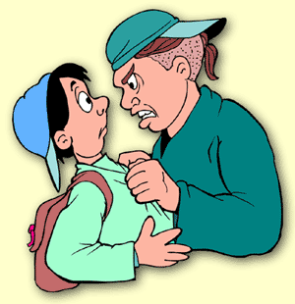
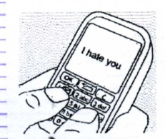
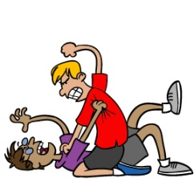

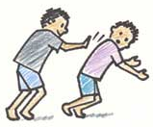
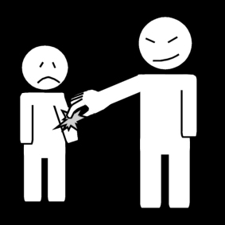
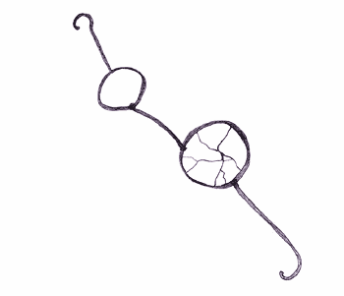
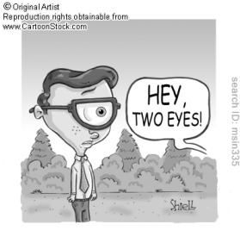
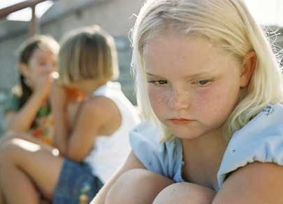
Remember: how do you say in English?

Slide 2


Write in your copybook:
Lesson 2: Bullying: a comic (Calvin and Moe)

Slide 3

Observe and describe!

Slide 4
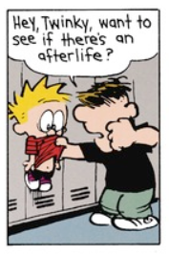
In the picture,
I can see…

Slide 5
Describe his expression!
I guess, he looks…

Slide 6
Describe his expression!
I guess, he looks…
WHY?

Slide 7
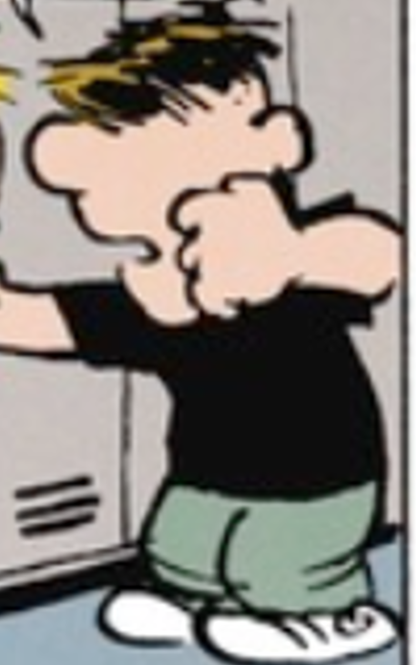
Describe the picture!

Slide 8

What is he doing? Give your opinion.
In my opinion…
I guess…
I think…
In my point of view…

Slide 9

Calvin
Compare the two boys!
Use:
Big, tough, small, scary
Comparatif:
adj+er than
more+ adj. than
Moe
HELP!

Slide 10
Calvin
What is happening?
Make hypotheses!
Moe
In my opinion…
I guess…
I think…
In my point of view…

Slide 11
Were you right?

Slide 12
Where are they?
Desribe the place!

Slide 13
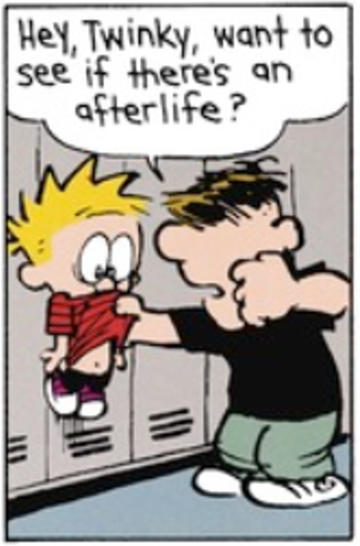
What is this?
In my opinion…
I guess…
I think…
In my point of view…

Slide 14
Work in groups:
Imagine what he is saying!

Slide 15
Prepare for reading:
Remember the reading strategies:
Nomme les mots que tu comprends afin de deviner ceux que tu ne comprends pas.
Décompose les mots en plusieurs parties que tu comprends.

Slide 16
Read in your head!

Slide 17
Come up with a translation with your group!

Slide 18
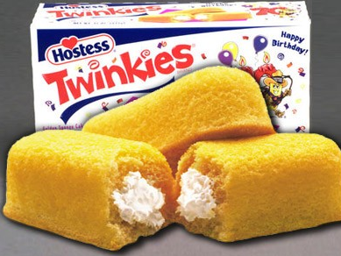
Why Twinky?

Slide 19
Why is Moe threatening Calvin?
In my opinion…
I guess…
I think…
In my point of view…

Slide 20
Recap
Type of document
What do we see?
Hypotheses
In the foreground
In the background

