Slide 1

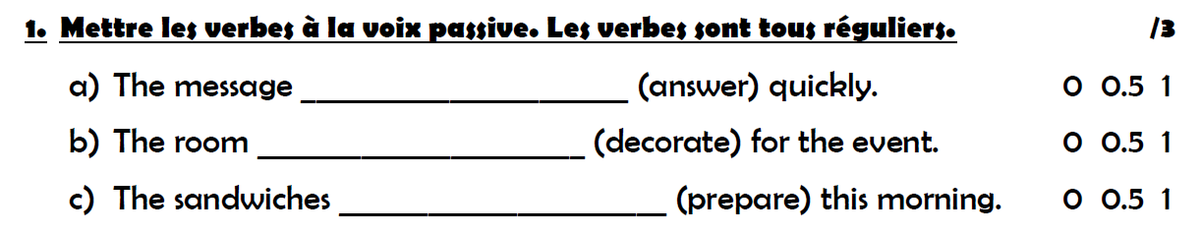
Group A
0,5
0,5
was answered
0,5
0,5
was decorated
0,5
0,5
were prepared

Slide 2
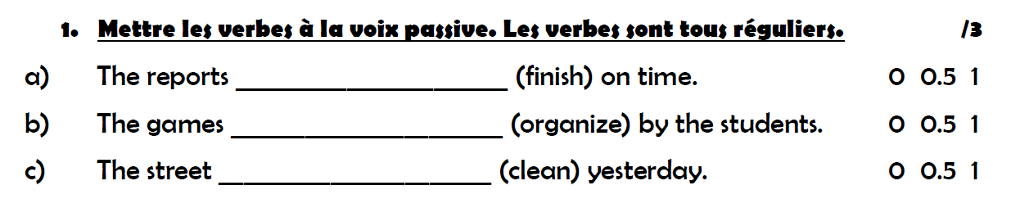
Group B
0,5
0,5
were finished
0,5
0,5
were organized
0,5
0,5
was cleaned

Slide 3
Group A
Active=>passive
The sailors threw the rebels in the ocean.
The rebels were thrown in the ocean by the sailors.
The Europeans didn’t feed the captives on the ships.
The captives weren’t fed by the Europeans on the ships.
Did the Americans buy African people?
Were the African people bought by the Americans.
Passive=> active
The slaves were chosen by the owners.
The owners chose the slaves.
0,5
0,5
0,5
0,5
0,5
0,5
1
0,5

Slide 4
Group B
Active=>passive
The Europeans took the captives from Africa.
The captives were taken by the Europeans from Africa.
The sailors didn’t bring the African people to Europe.
The African people weren’t brought to Europe by the sailors.
Did the sailors torture the captives?0 0.5 1 1.5
Were the captives tortured by the sailors?
Passive=> active
The rebels were thrown in the ocean by the traders.
The traders threw the rebels in the ocean.
0,5
0,5
0,5
0,5
0,5
0,5
0,5
0,5
0,5
1
0,5

Slide 5
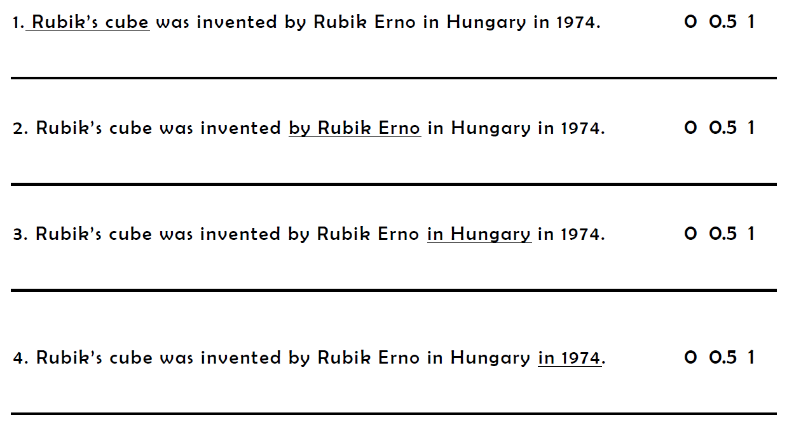
0,5
0,5
What was invented by Rubik Erno?
What was invented by Laszlo Biro?
0,5
0,5
Who was Rubik’s cube invented by?
Who was the ballpoint pen invented by?

Slide 6
0,5
0,5
Where was Rubik’s cube invented?
Where was the ballpoint pen invented?
0,5
0,5
When was Rubik’s cube invented?
When was the ballpoint pen invented?

