Slide 1
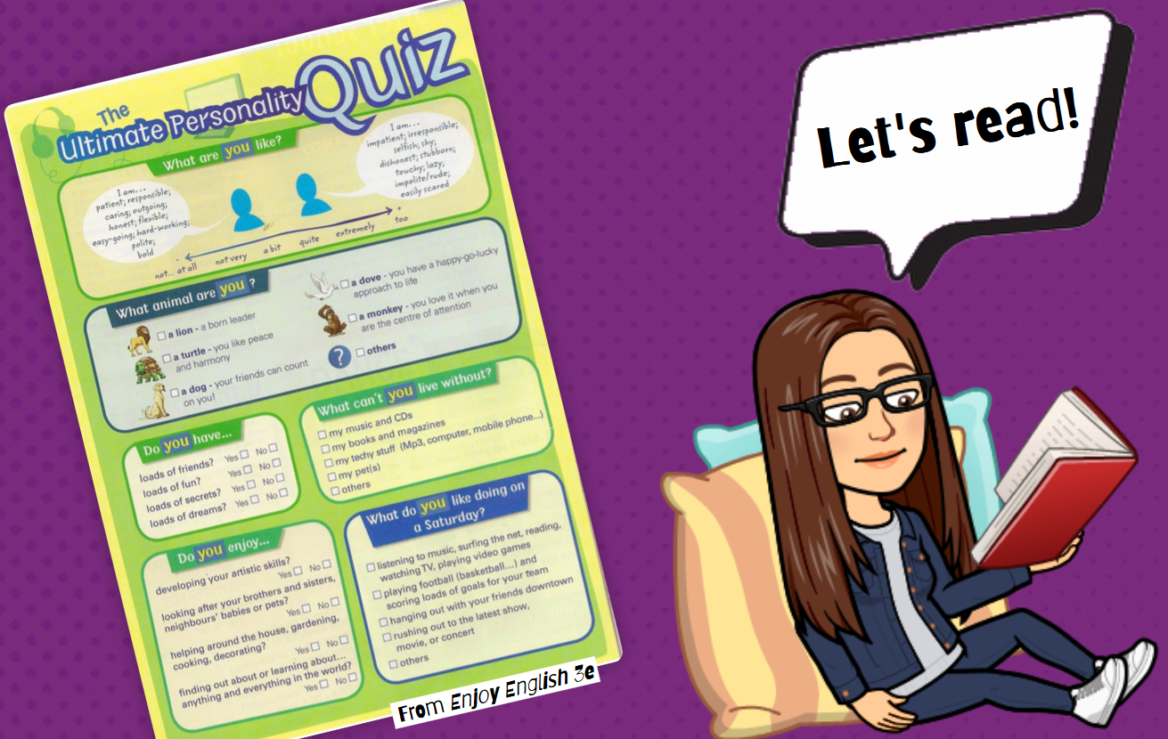
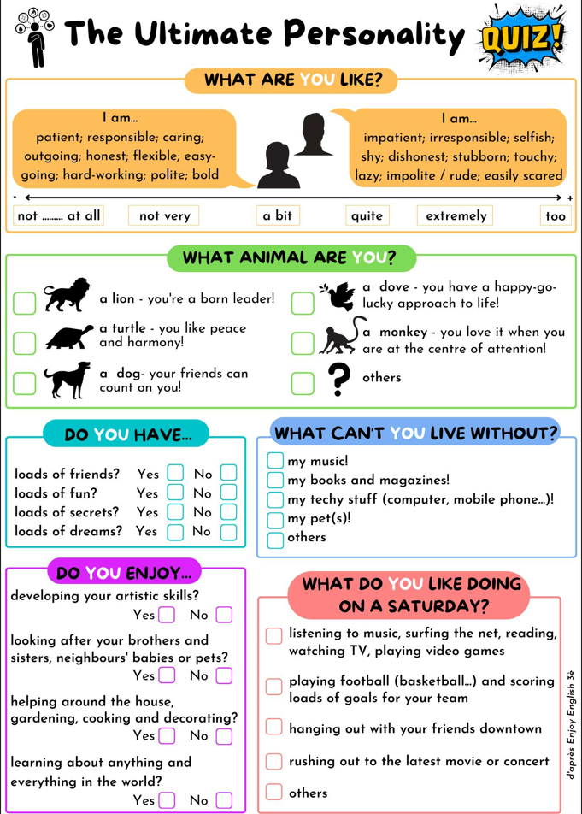

What is this?

Slide 2
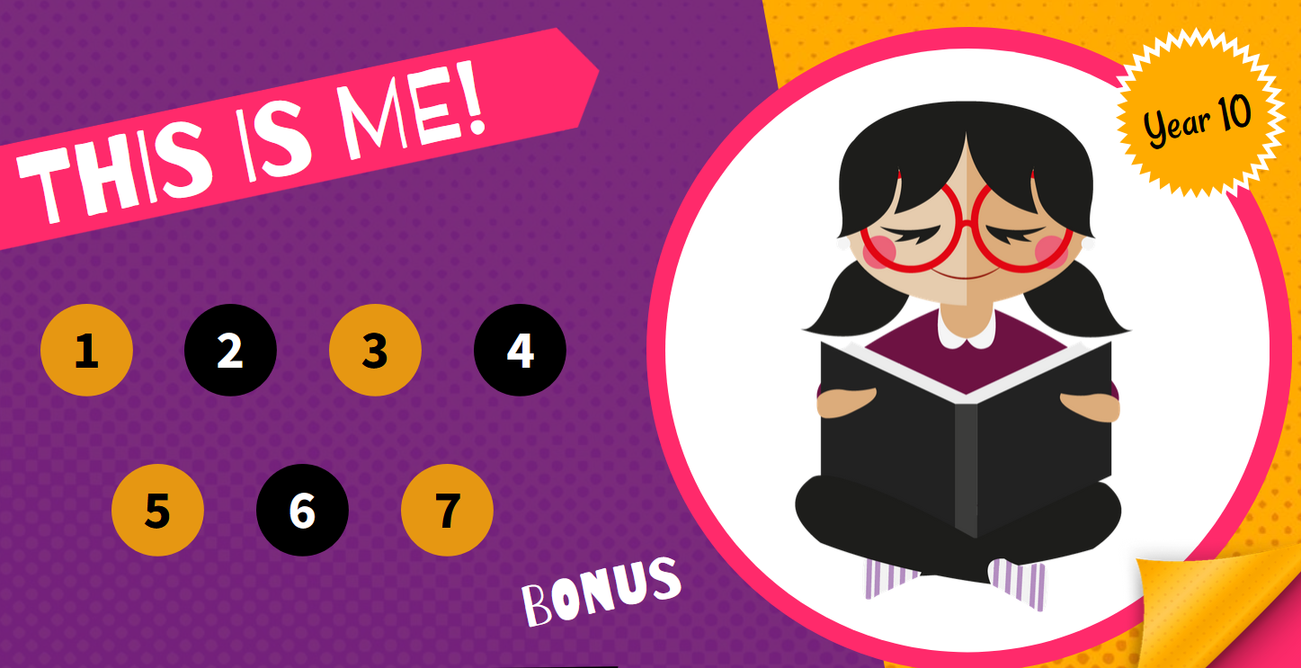



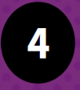





8

Slide 3
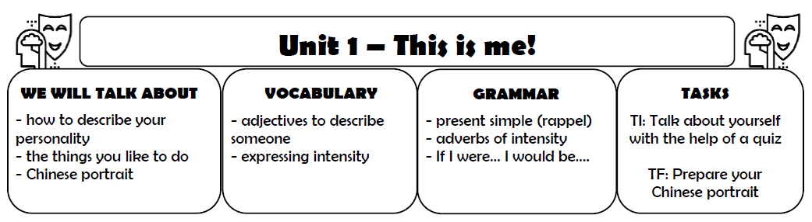
Glue it in your copybook!

Slide 4
Part 1: A personality quiz Date?

Slide 5
Lesson 1
What do the different categories mean?

Slide 6


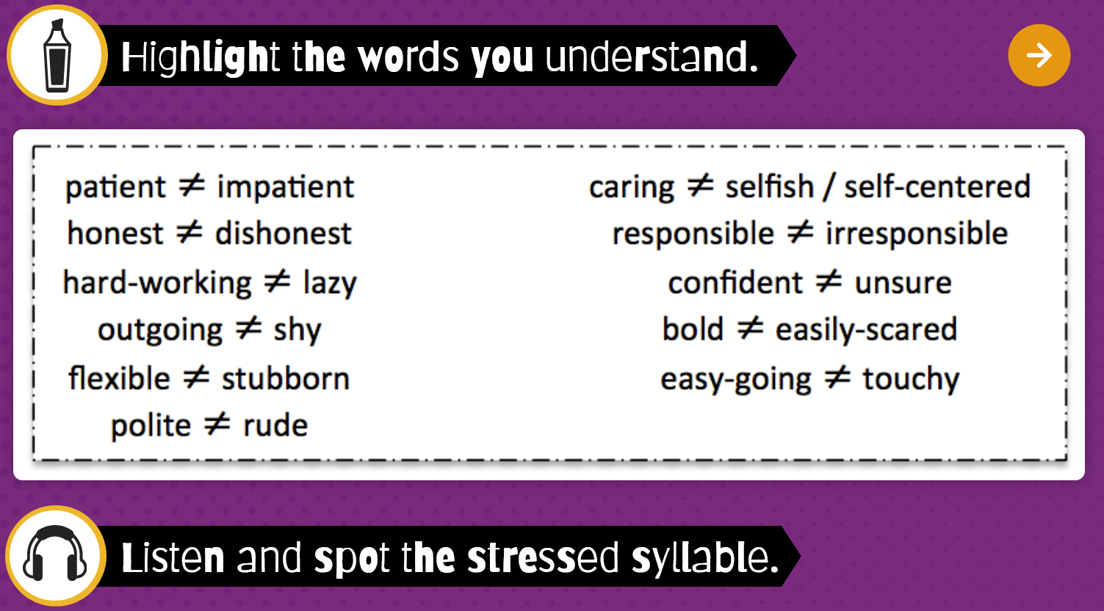
How are the adjectives categorized?

Slide 8
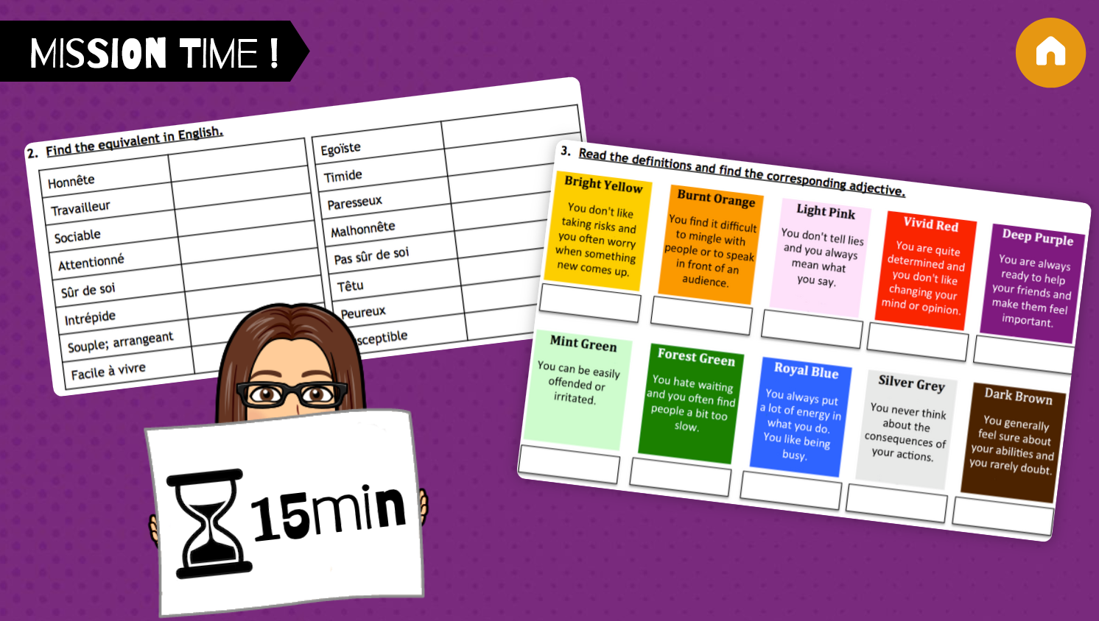



Work in groups.
First do exercise 2.
If you’re ready, call me and I will check.
If OK=> you can continue with ecercise 3

Slide 9
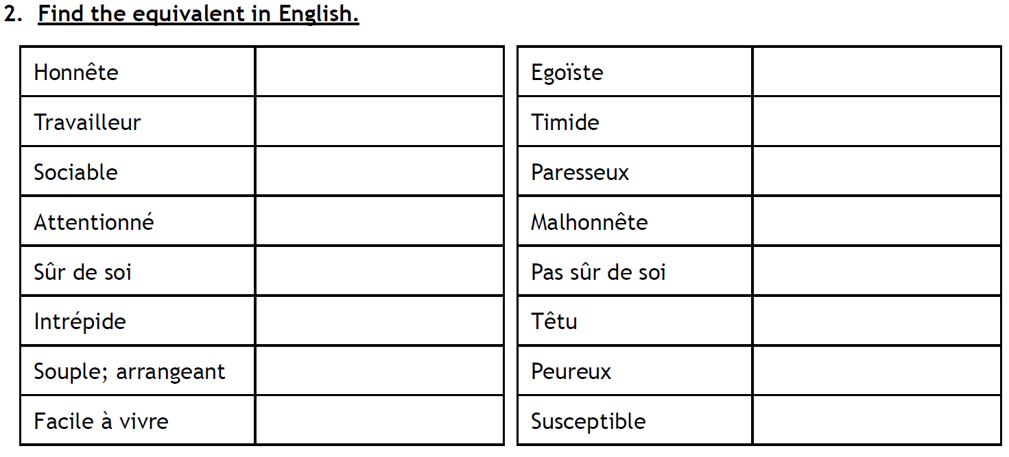
Correction
honest
selfish/ self-centered
hard-working
shy
outgoing
lazy
caring
dishonest
confident
unsure
bold
stubborn
flexible
easily scared
easy-going
touchy

Slide 10
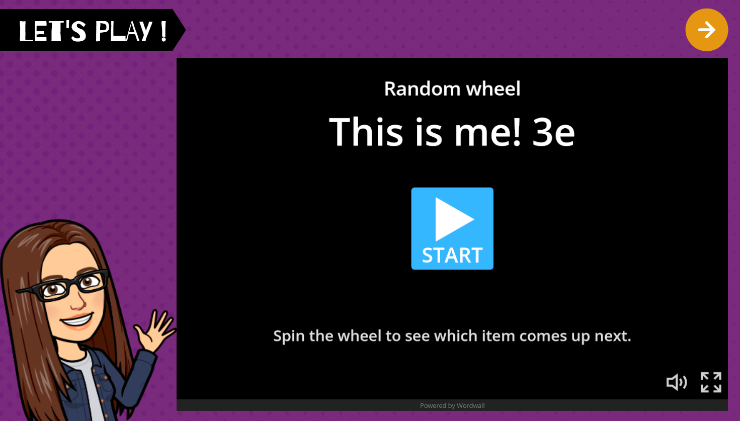

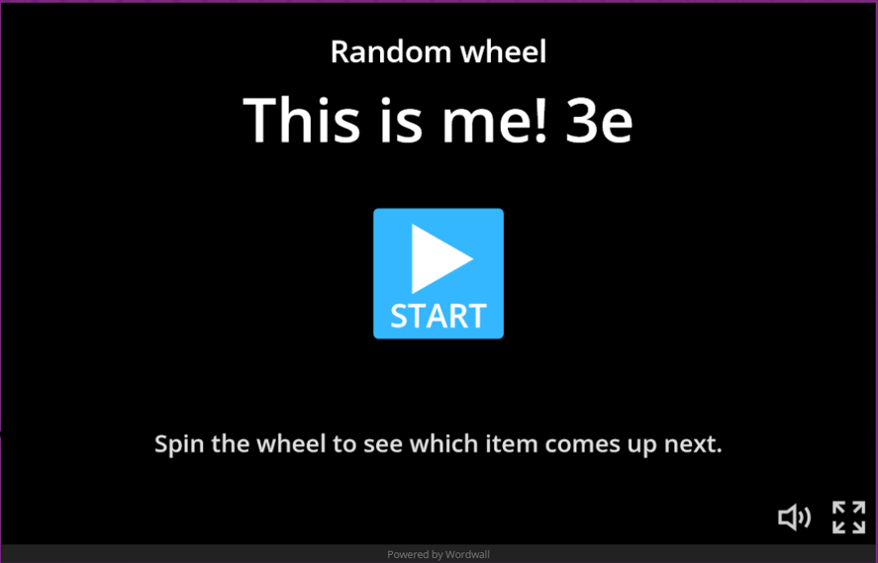


Slide 11


Slide 12
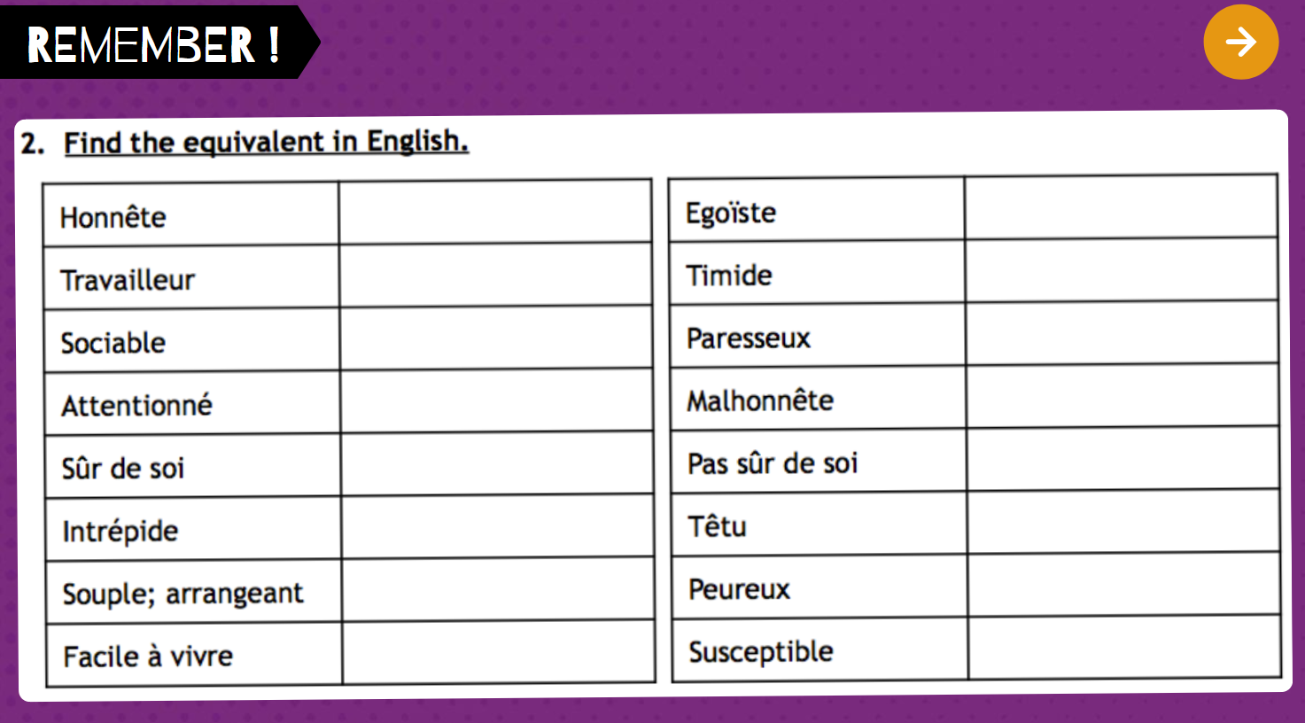
Groupwork
honest
selfish/ self-centered
hard-working
shy
outgoing
lazy
caring
dishonest
confident
unsure
bold
stubborn
flexible
easily scared
easy-going
touchy

Slide 13
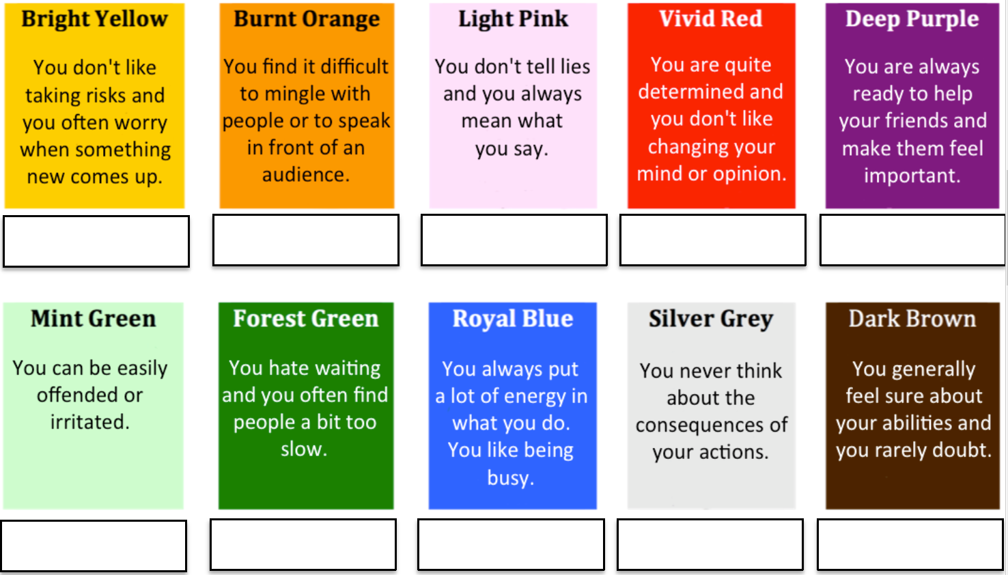
easily scared
shy
honest
stubborn
caring
HELP?
touchy
impatient
hard-working
irresponsible
confident

Slide 14
Vocabulary: find the words in ex. 3!

Slide 15
Homework
Learn the adjectives
(Vocabulary 1.)
Apprendre les adjectifs.

Slide 16
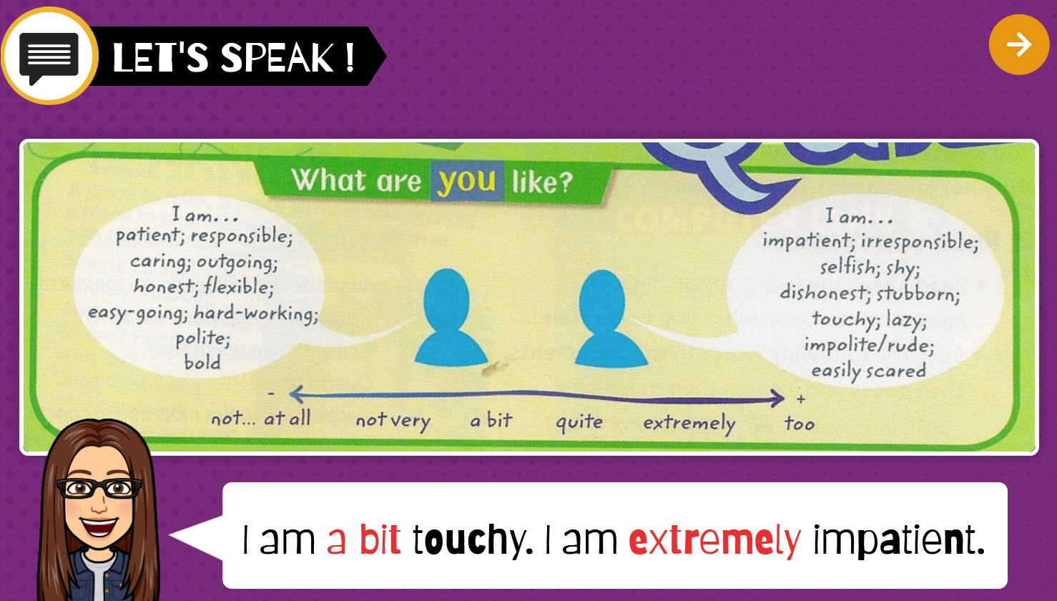


Slide 17
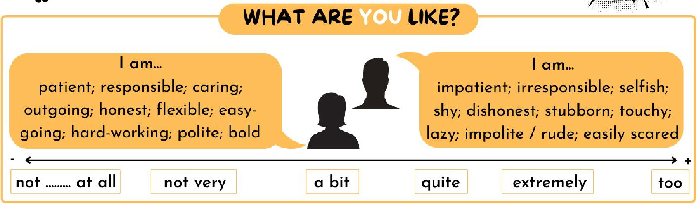
First individually, then in groups

Slide 18
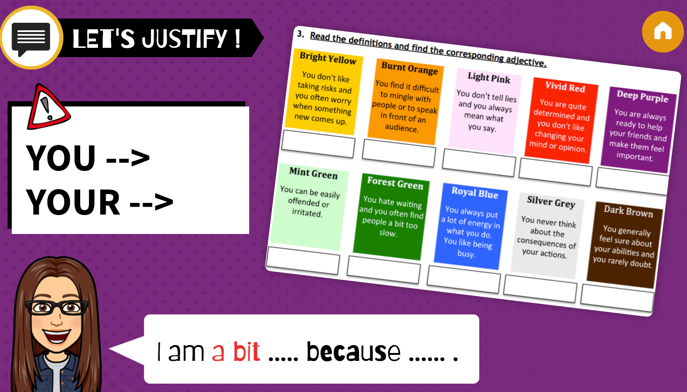
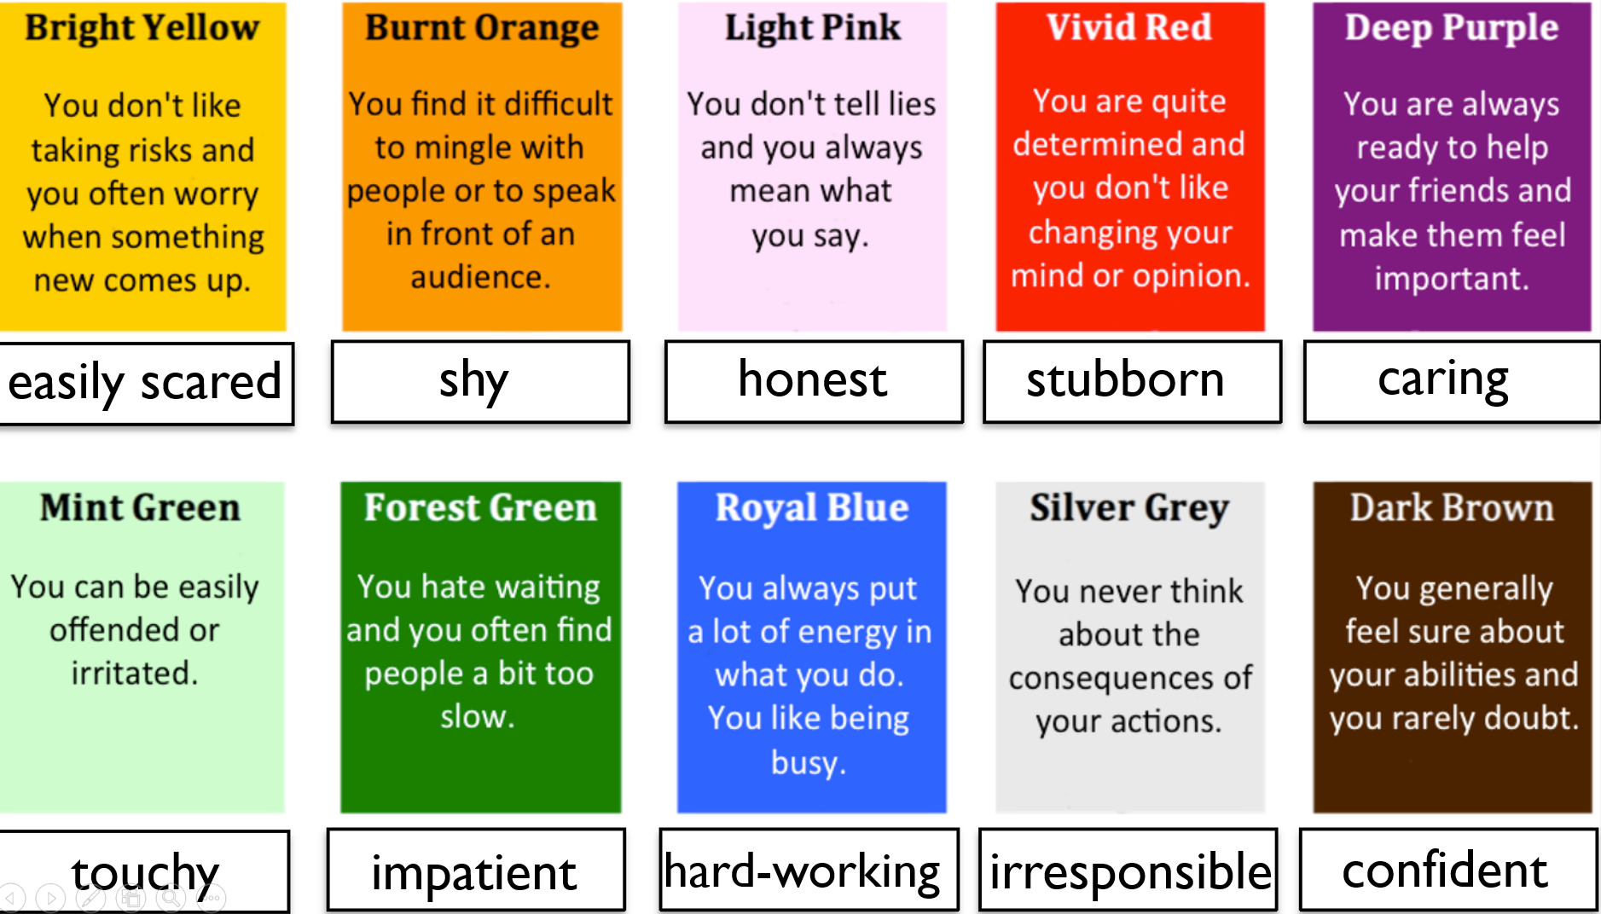
What are you like?

Slide 19
What are you like?
Write one sentence using an example from the exercise, and one sentence that you invent.
Recap:
What are you like?
e.g.

Slide 20
Homework
You must be able to speak about your personality and
justify at least two personality traits
Etre capable de parler de sa personnalité et
de justifier au moins deux traits de caractère.

Slide 21
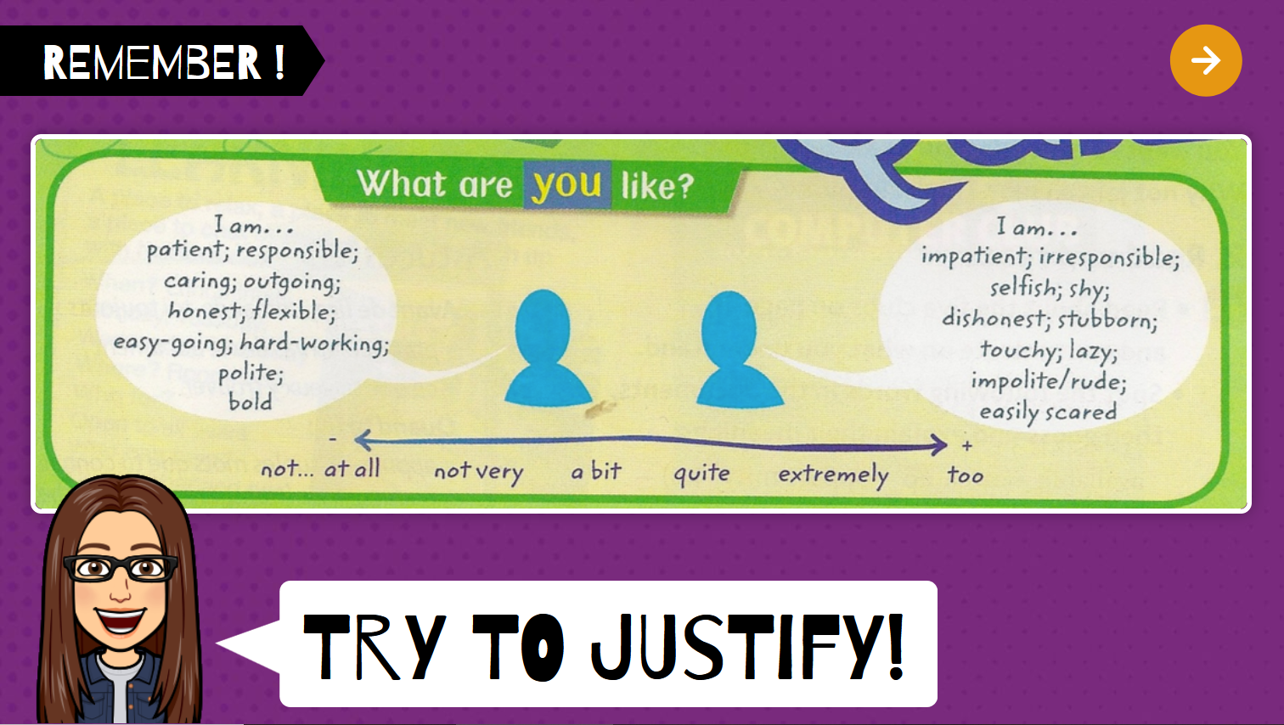
Lesson 3
x3

Slide 22

How can you express your opinion?

Slide 23
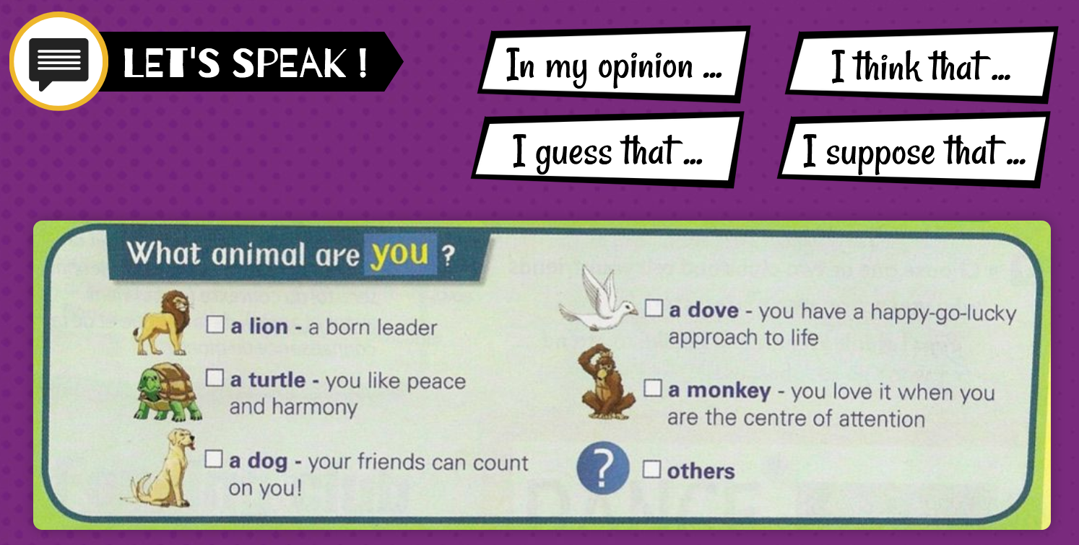
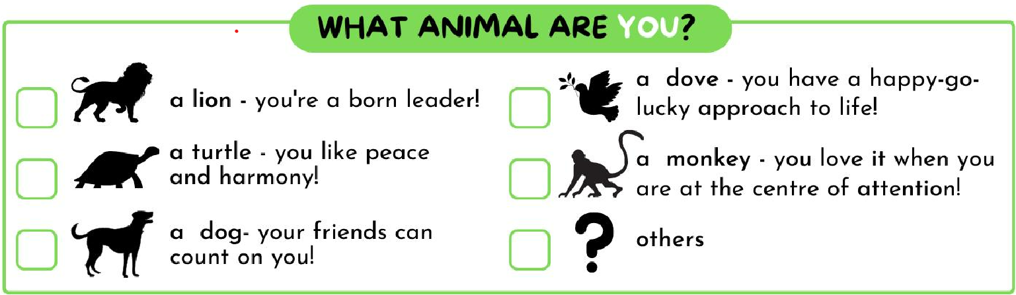
Is there a word you don’t know?

Slide 24
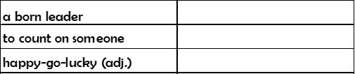
Vocabulary
un leader né
compter sur quelqu’un
insouciant

Slide 25
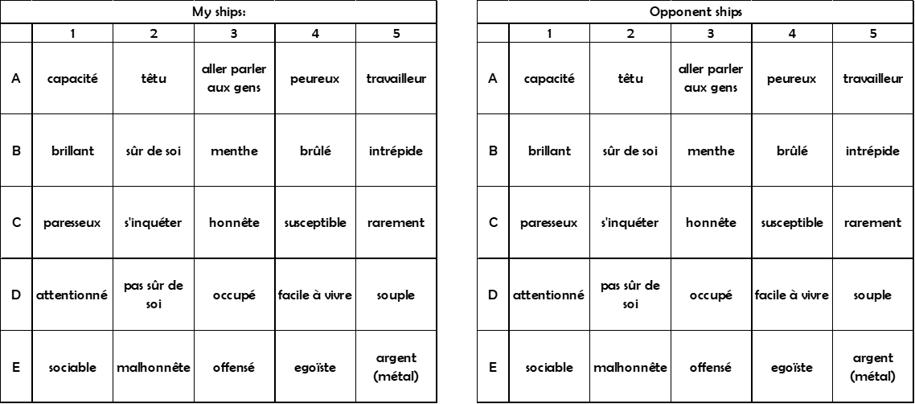
Practise: Battleship

Slide 26
Rules
Objective:
Sink all of the other player’s ships before they sink yours. You can sink a ship by saying the word in English

Slide 27
Rules
The ships are different sizes:
2 squares x 2 (destroyer)
3 squares x 2 (submarine)
4 squares x 1 (battleship)

Slide 28
Rules
Placing ships:
Ships can go up/down (vertical) or side to side (horizontal), but they can't be outside the grid.

Slide 29
Rules
Taking turns:
  "Hit" - touché
  "Miss" - pas touché
  “Sunk” - coulé
.

Slide 30
Make a sentence!
Try using your own words!!

Slide 31
What animal are you?
Write one sentence using an example from the exercise, and one sentence that you invent.
Level 1: copying
Level 2: inventing
What animal are you?
e.g.

Slide 32
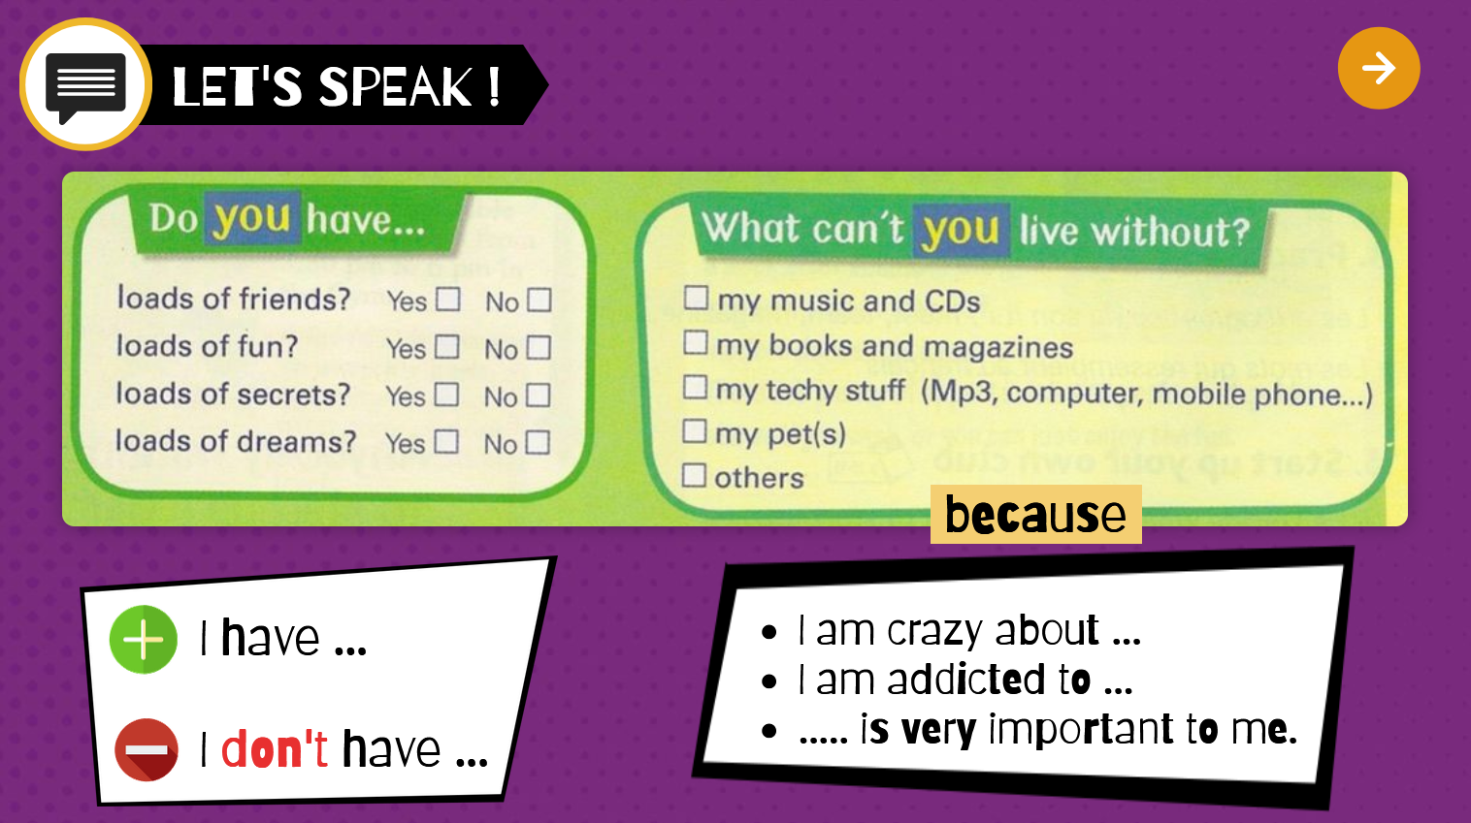
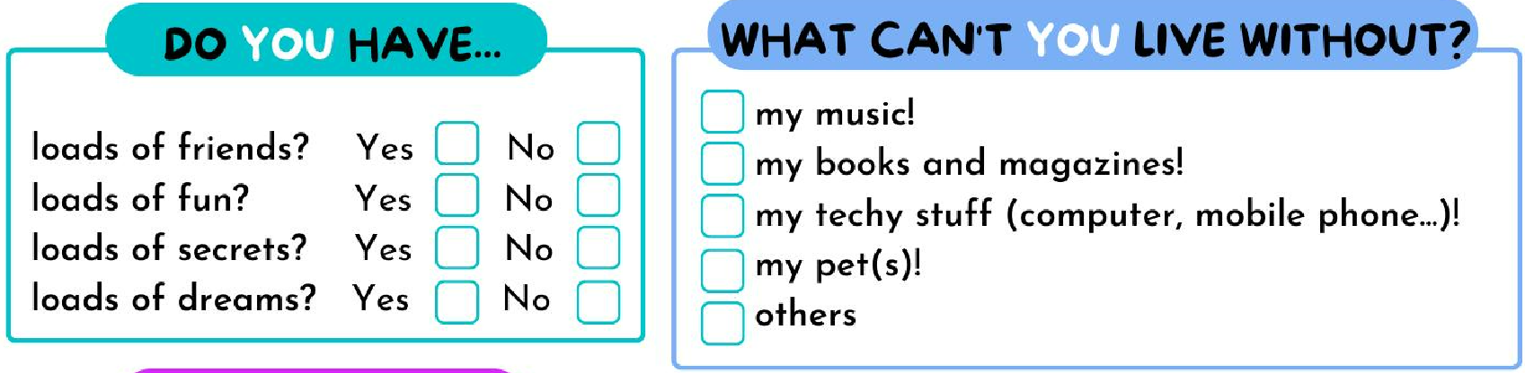
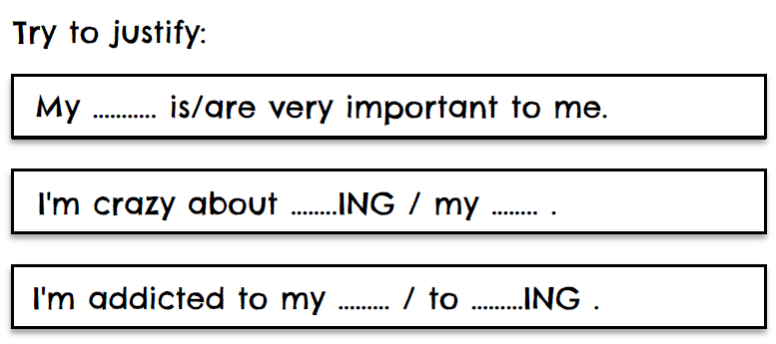
Because

Slide 33
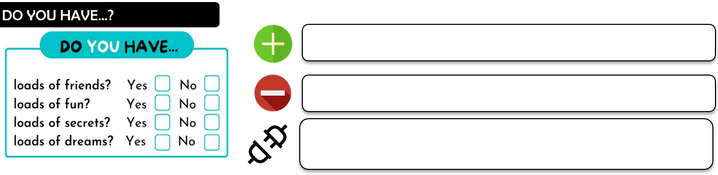
Notes:
33

Slide 34
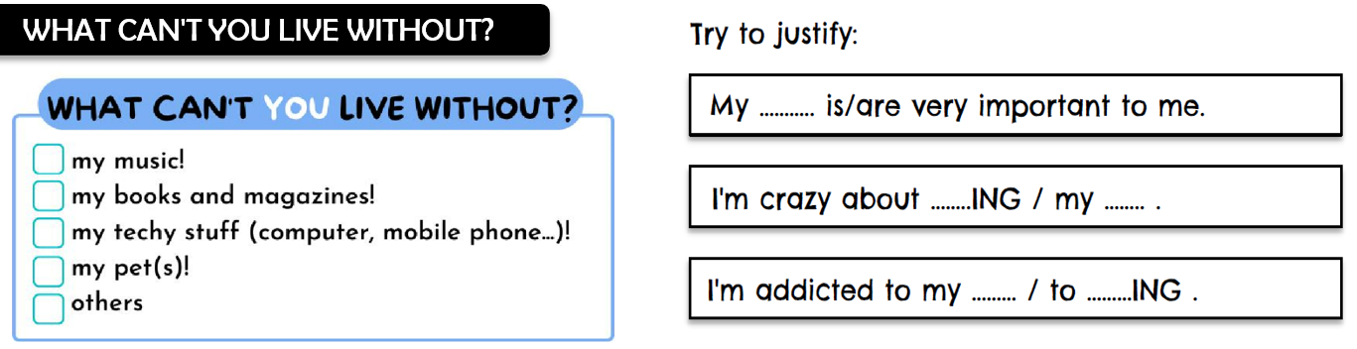
Notes:
34

Slide 35
Write two sentences, always justify (using the examples or invent.)
Do you have… ?
e.g.
What can’t you live without?
e.g.

Slide 36
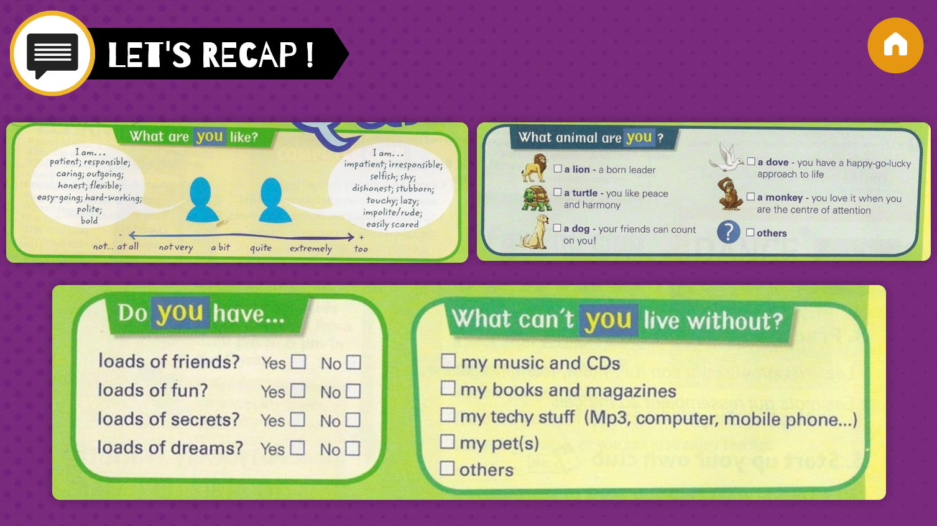
Work in groups:
Talk about yourself!

Slide 37
Homework
You must be able to speak about your personality with the new categories too
Etre capable de parler de soi
avec les rubriques vues en classe.

Slide 38
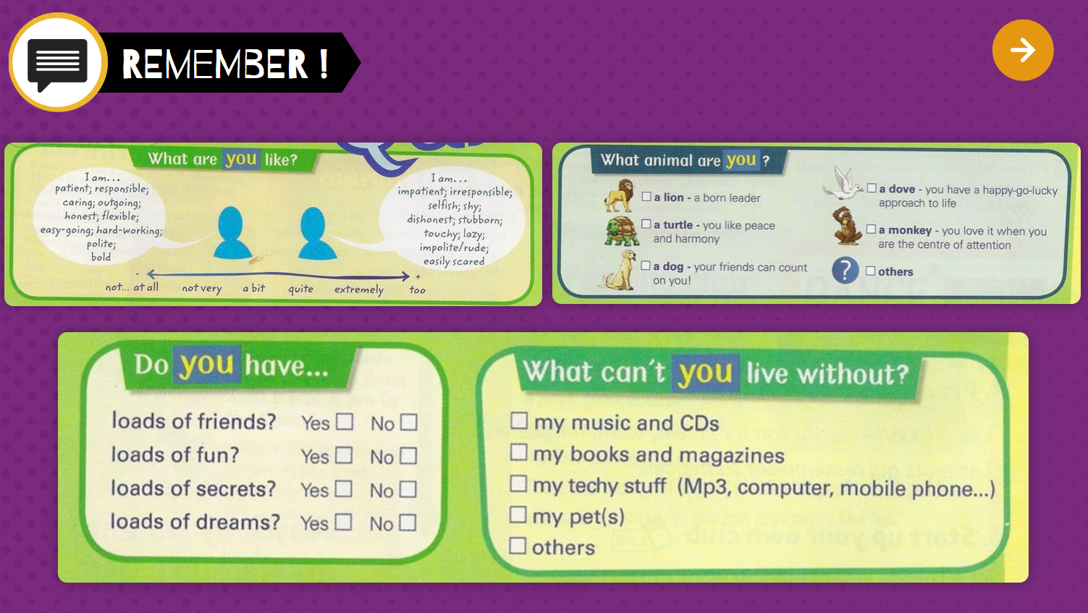
Lesson 4

Slide 39
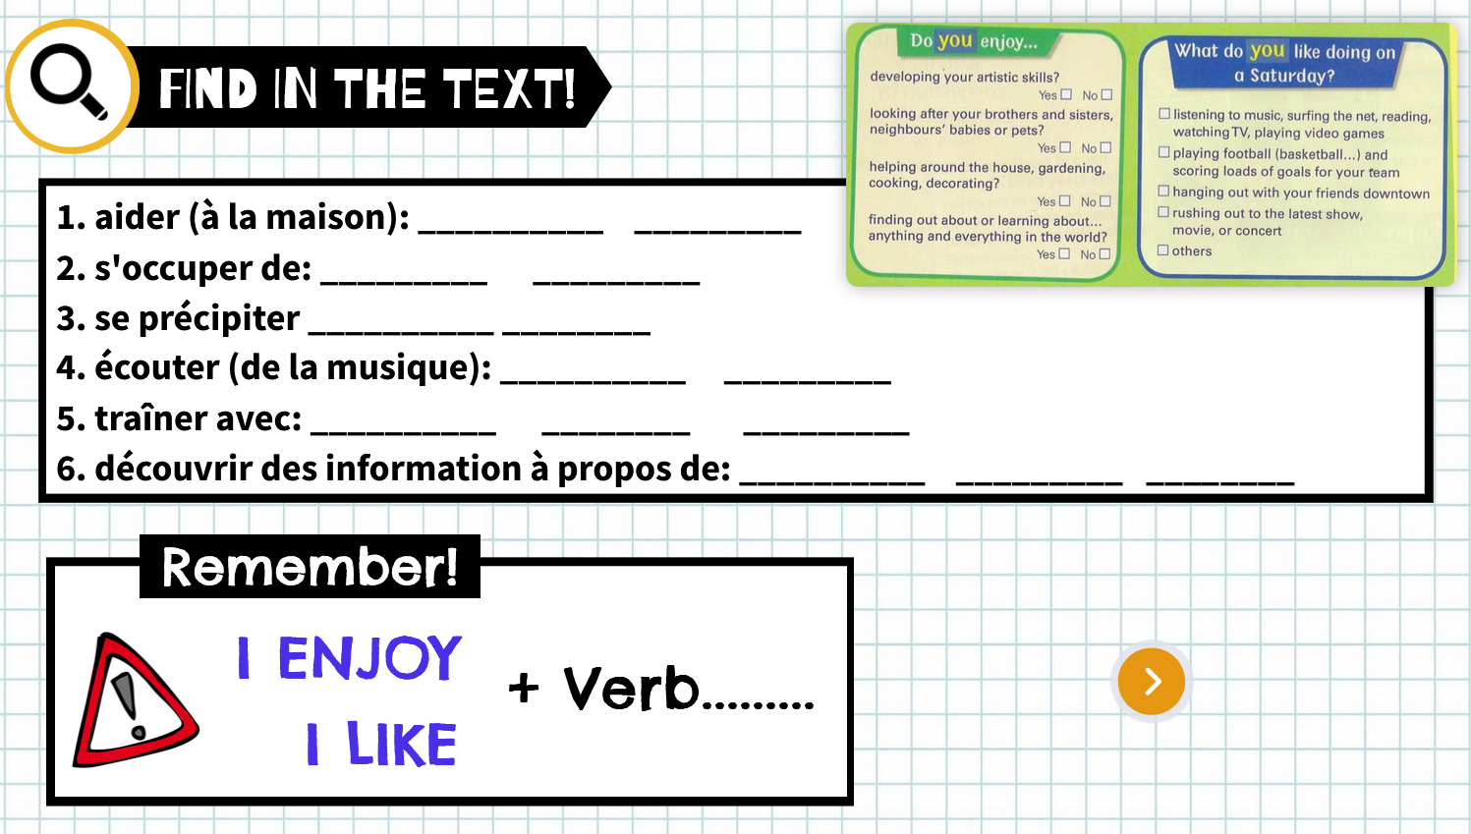
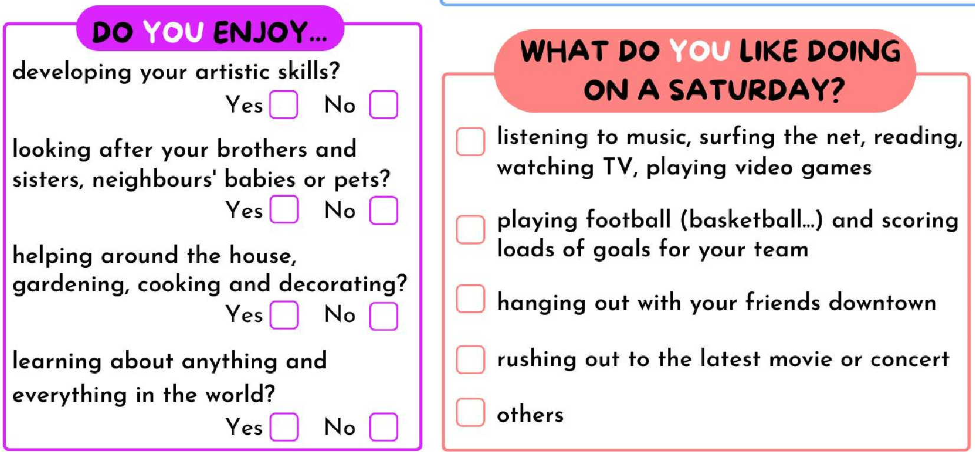
neighbour
+ ing

Slide 40
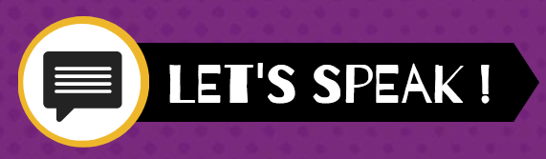
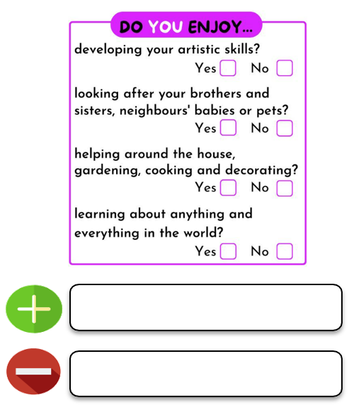
I enjoy V + ing
I don’t enjoy V + ing
V = verb

Slide 41
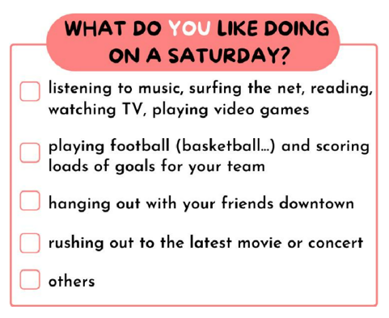
What do you like doing on a Saturday?
Write one sentence using an example from the exercise, and one sentence that you invent.
On a Saturday, I like + V-ing…
Or
I like V-ing … on a Saturday

Slide 42
Write two sentences, always justify (using the examples or invent.)
Do you enjoy…?
e.g.
What do you like doing on a Saturday?
e.g.

Slide 43
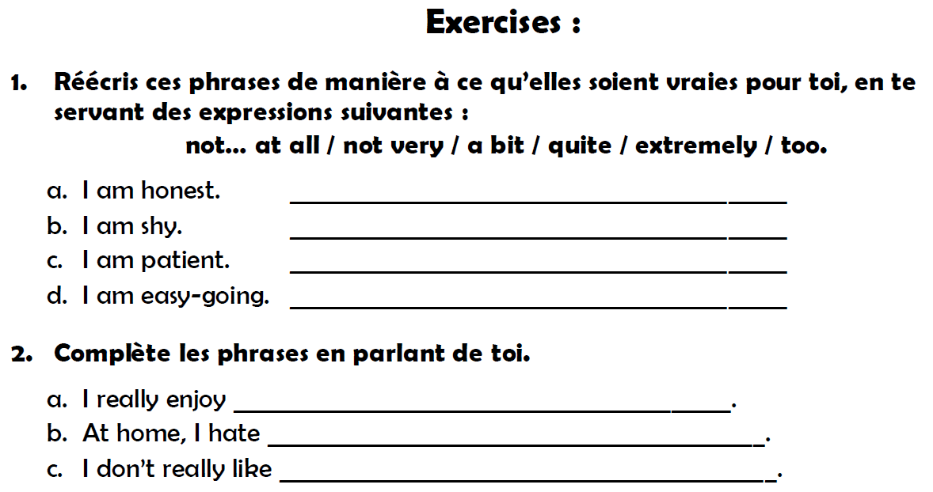

Slide 44
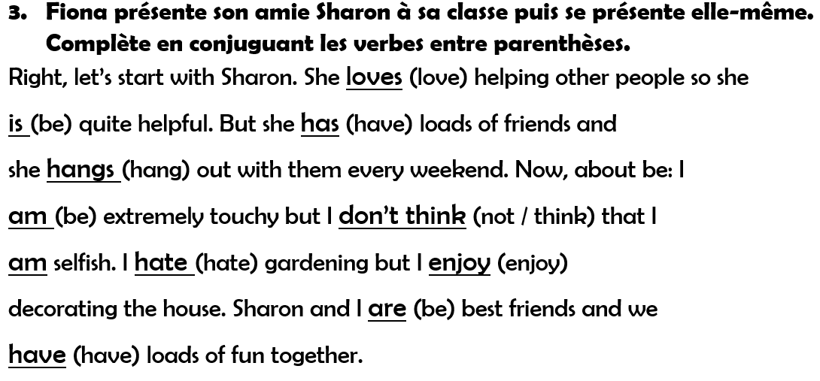
me:
(be)

Slide 45
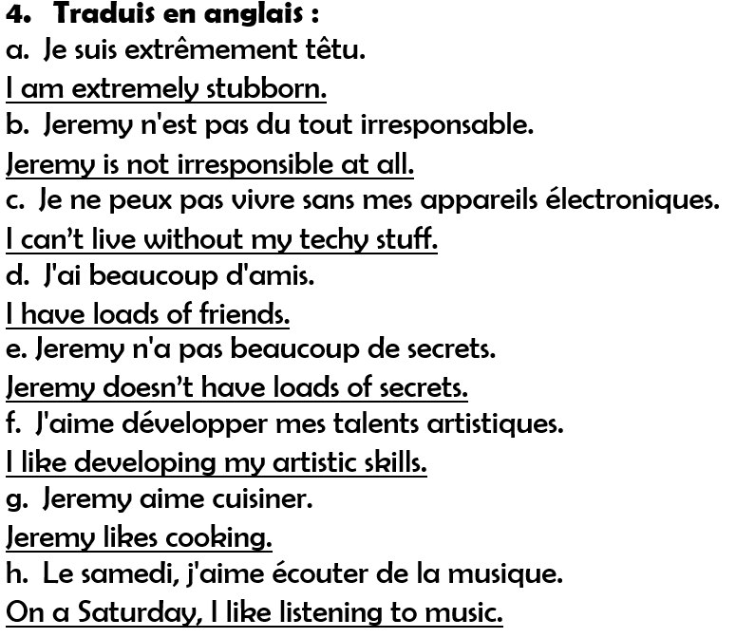

Slide 46
TI: present yourself!
To your group, and some students in front of the class

Slide 47
Tâche intermédiaire: Date?
Present yourself with the quiz!

Slide 48
Part 2: Jeremy talks about his quiz Date?

Slide 49
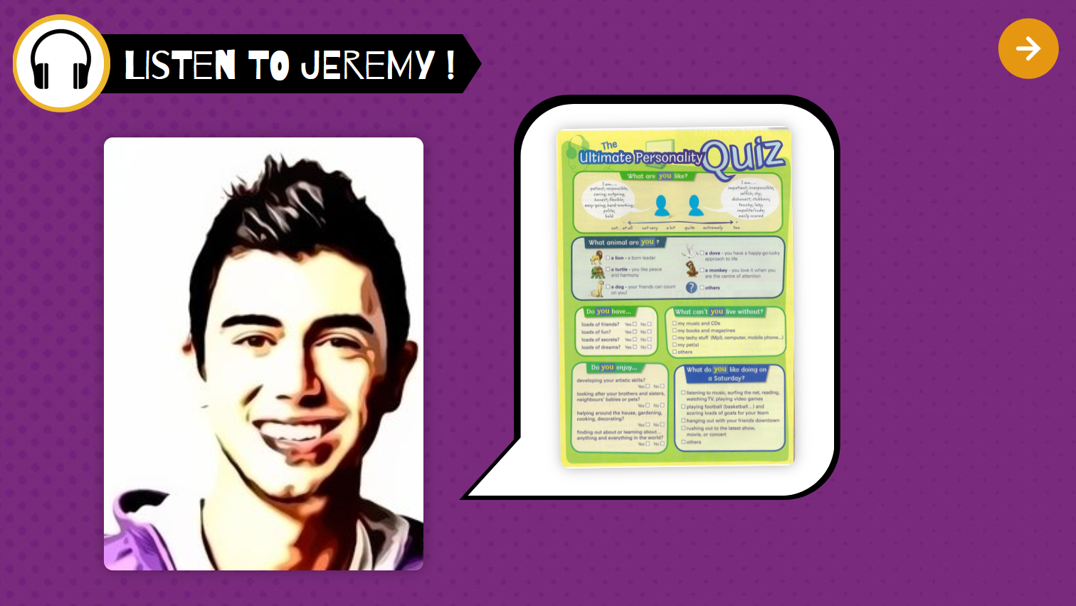


Slide 50
1st listening:
listen and write notes if you can.
(no full sentences, only keywords!)
2nd listening: complete your notes

Slide 51
Part 2: Jeremy talks about his quiz
My notes:

Slide 52
My notes:
The class:

Slide 53
Speak about Jeremy!
Make full sentences and ay attention to the changes.

Slide 54
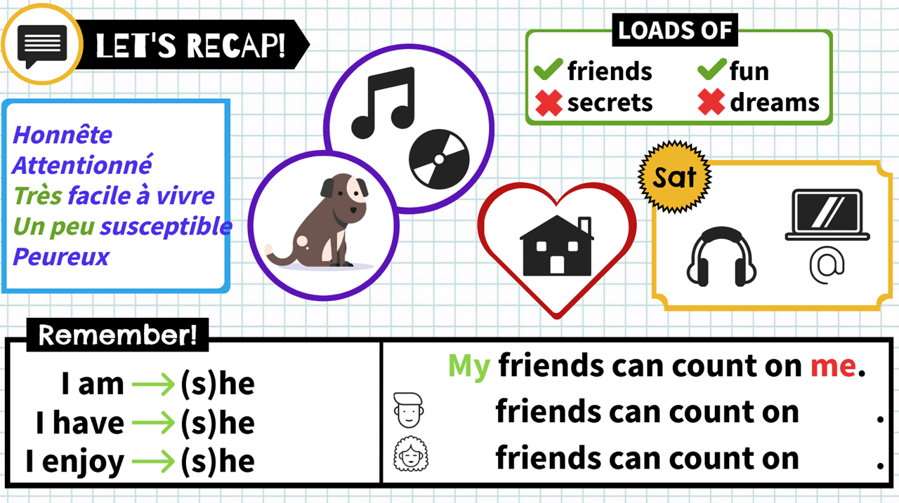
is
His
him
has
enjoys
Her
her

Slide 55






Jeremy is honest, caring, very easy-going, a little bit touchy and easily scared.
He is a dog, his friends can count on him.
He has loads of friends and fun, but he doesn’t have loads of dreams.
He can’t live without his music and CDs.
He enjoys helping around the house.
On a Saturday, he loves listening to music and surfing the net. (Some chilling and me time)

Slide 56
Homework
You must be able to speak about Jeremy
Etre capable de parler de Jérémy.

Slide 58
Part 3 Chinese Portrait Date?
Watch the video and write down what the colors symbolize!
My notes:

Slide 59

Watch the video! What do the colors symbolize?
Lesson 8
Notes:
59

Slide 60
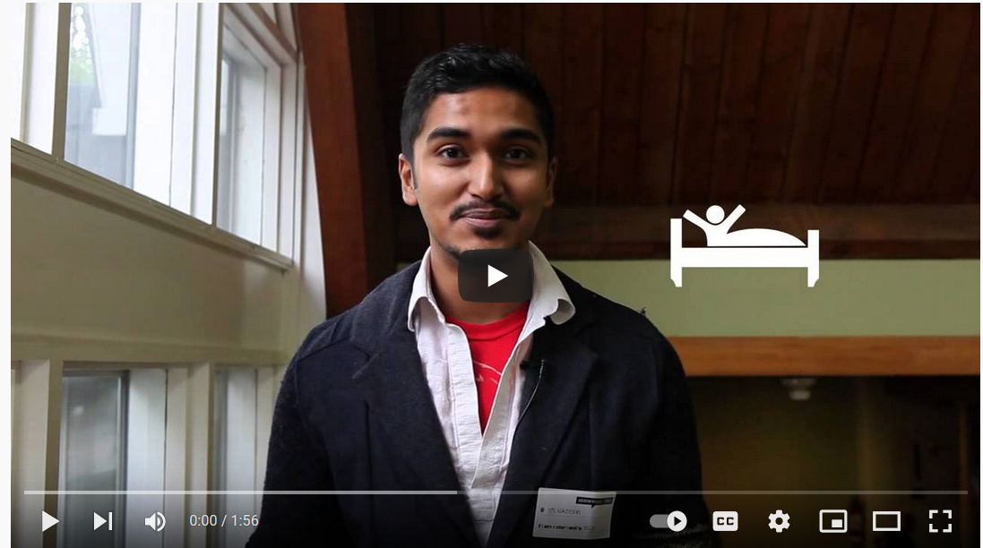

Slide 61

Let’s speak!
What do the colors symbolize?

Slide 62
Let’s speak!
Can you think of any other questions to ask?
What would you be, if you were
?
What would you be, if you were
?
What would you be, if you were
?
What would you be, if you were
?
What would you be, if you were
?

Slide 63
My Chinese portrait:

Slide 64



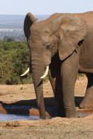
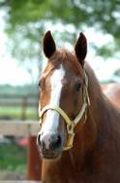


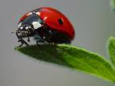
Let’s answer!
If I were an
animal,
I would be a/an
etc.
because…

Slide 65


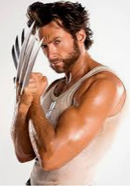
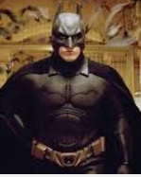
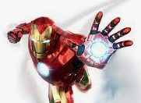

Let’s answer!
If I were a
superhero,
I would be a/an
etc.
because…

Slide 66



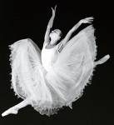

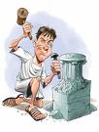
Let’s answer!
If I were
a type of art,
I would be a/an
etc.
because…

Slide 67
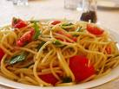

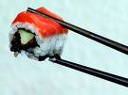
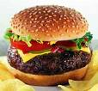


Let’s answer!
I would be
etc.
If I were a
type of cuisine,
because…

Slide 68




Let’s answer!
I would be
If I were a
natural element,
because…

Slide 69
Listen to Rebecca!
1st listening:
Take notes in your copybook

Slide 70
Listen to Rebecca!
If I were a… | I would be… | Because…

Slide 71
Listen to Rebecca!
1st listening:
Take notes in your copybook
2nd listening:
Organize your notes + complete them

Slide 72
Listen to Rebecca!
1st listening:
Take notes in your copybook
2nd listening:
Organize your notes + complete them
3rd listening:
Finalize your notes

Slide 73
Listen to Rebecca!
If I were a… | I would be… | Because…
drink | a nice cup of tea | there’s nothing like a cup of tea.
food | chocolate | I love chocolate, I could eat it all day
season | winter | I love snow
day | Friday | it means it’s the end of the week.
month | it would be in the summer | I like being warm
date | 5 of March | it’s my birthday
sport | football | watching, not playing
film | Dirty Dancing | romantic film, with a few songs

Slide 74
Make sentences about her!
If I were a… | I would be… | Because…

Slide 75
Work in pairs.
Interview your partner using “Chinese portrait” questions.
Take notes about their answers.
Then, write and present a short oral introduction about your partner using the third person singular.
(Let me introduce... If he/she were..., he/she would be... because...)
Describe your partner with two adjectives with adverbs of intensity.
You will present your partner to the class (or to a group)

Slide 76
Questions:
If you were a city, what would you be? Why?
If you were a singer, who would you be? Why?
…

Slide 77
For example:
Let me introduce David.
If he were an animal, he would be a lion because ...
If he were a season, he would be summer because …
If he were a movie, he would be Avengers because …
David is a very energetic and creative person!

Slide 79

Create your own Chinese portrait!

Slide 80
Big test
Compréhension orale
Vocabulaire
Décrire quelqu’un
Comparer deux personnes
Chinese portrait

Slide 81

While you’re waiting
Go on Youtube and search:
12 types of people in classe.
Do the exercises. If ready, ask for another document to do.

Slide 82


In Firefox or else write this adress:
  shorturl.at/oBJR2
in the adress bar (not in Google!!!)
LET'S VISIT THE UNITED STATES!
Pick 3 sheets randomly and do the Genially that goes with it.
Steven Spielberg:
Do the sheet with the Genially.

Slide 83


flexible
to count on (someone)
touchy
skill
shy
busy
stubborn
neighbor/ neighbour
easy-going
easily scared
to hang out with (someone)
hard-working
neighbor/ neighbour
selfish
burnt
bold
to worry
caring

Slide 84


David is not selfish at all.
Victoria doesn’t enjoy/like helping around the house, but she enjoys/likes listening to music.
Kate likes hanging out with her friends in downtown.
Sarah is too stubborn.
William can’t live without his pets.
Luke has loads of friends, but he doesn’t have loads of secrets.
Luke has got loads of friends, but he hasn’t got loads of secrets.

