Slide 1

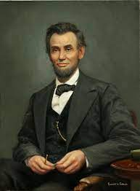
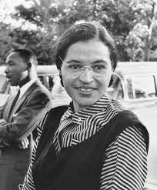
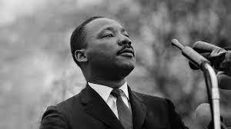
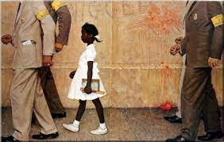
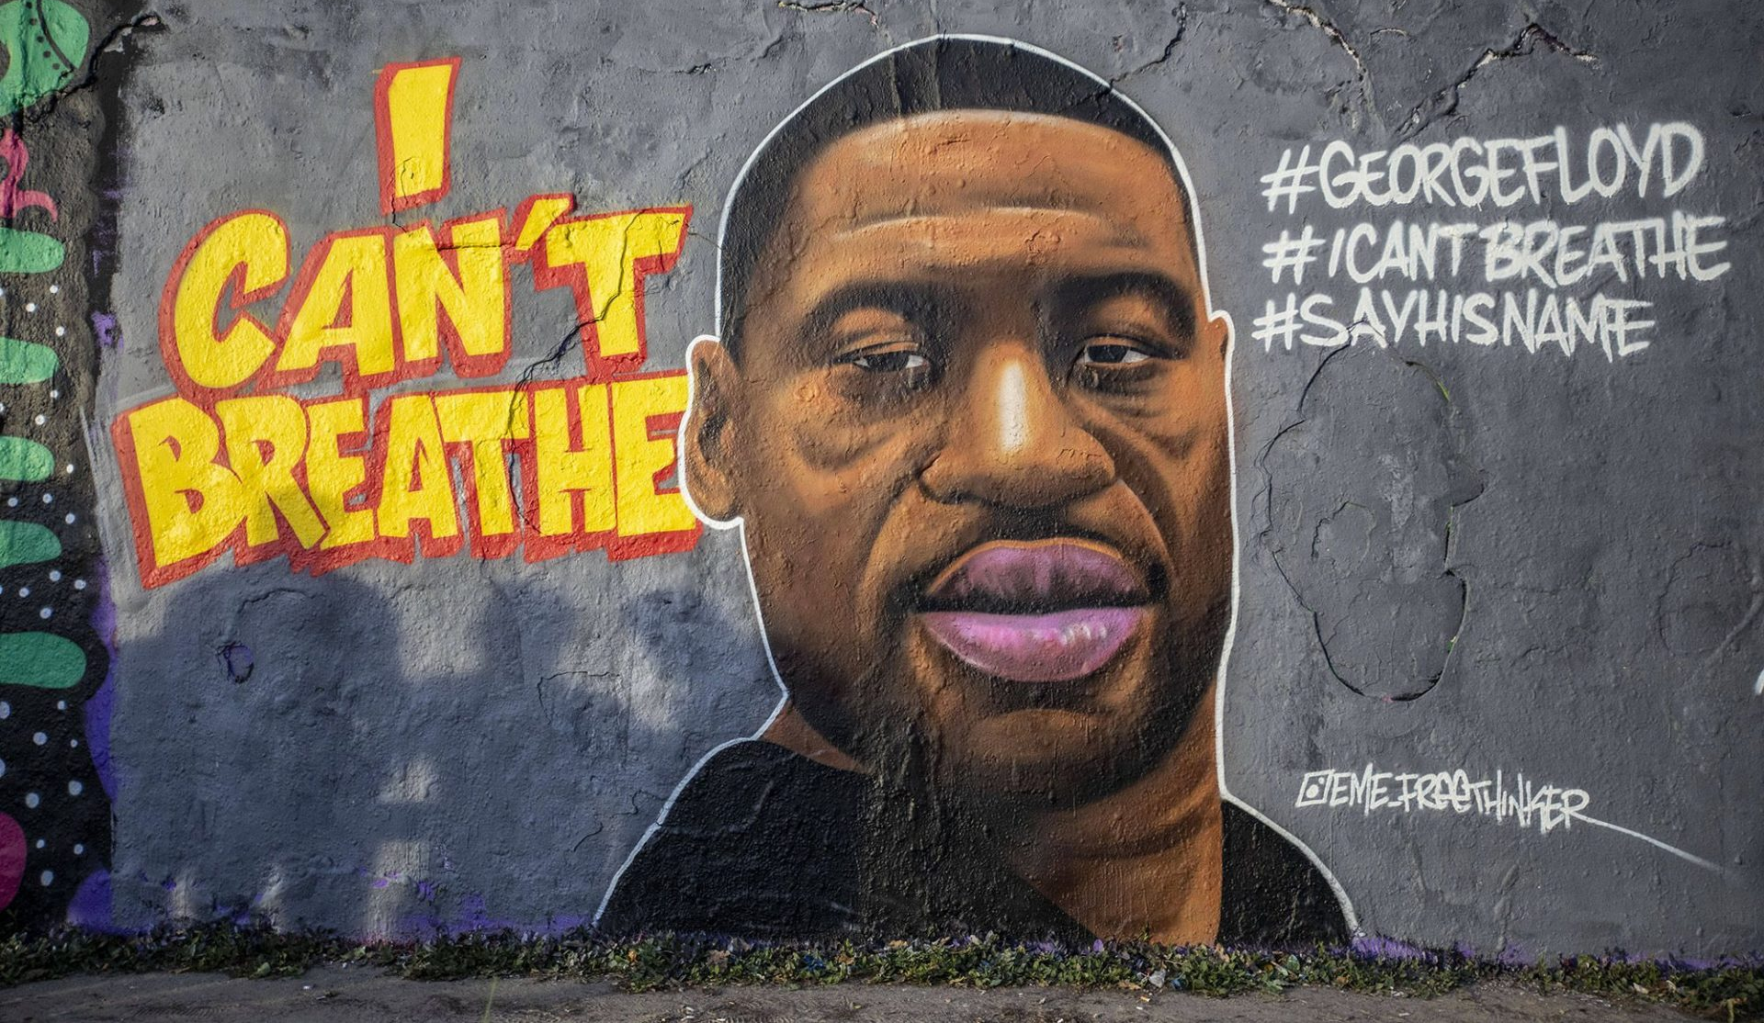
Who do you recognize?

Slide 2
BLACK
HISTORY
IN THE USA

Slide 3
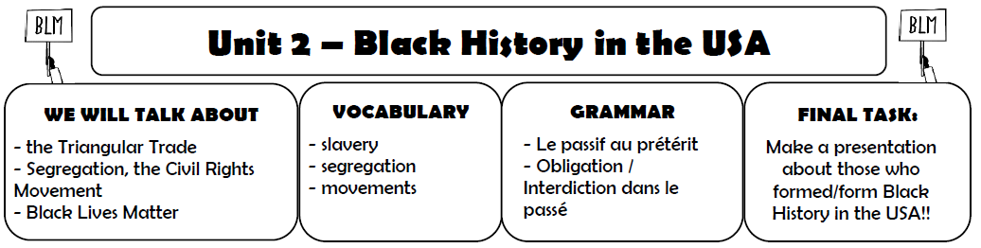

Glue it in your copybook!

Slide 4

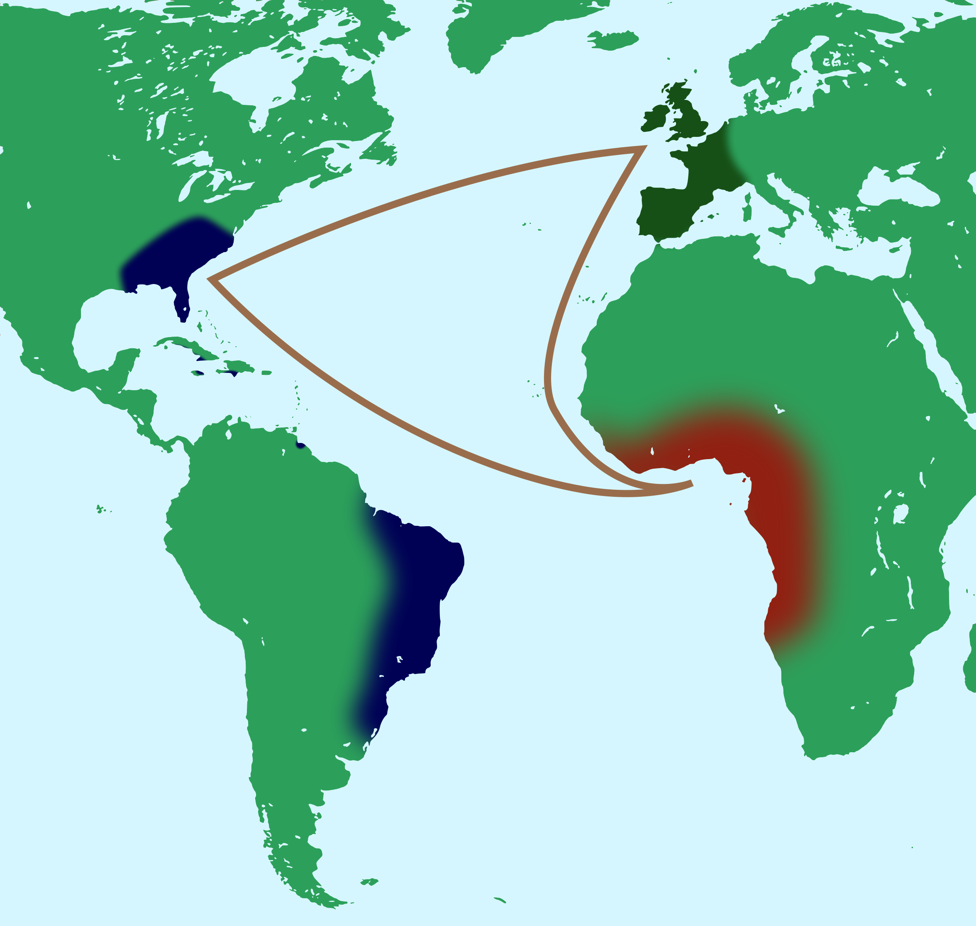
What are we going to talk about?

Slide 5
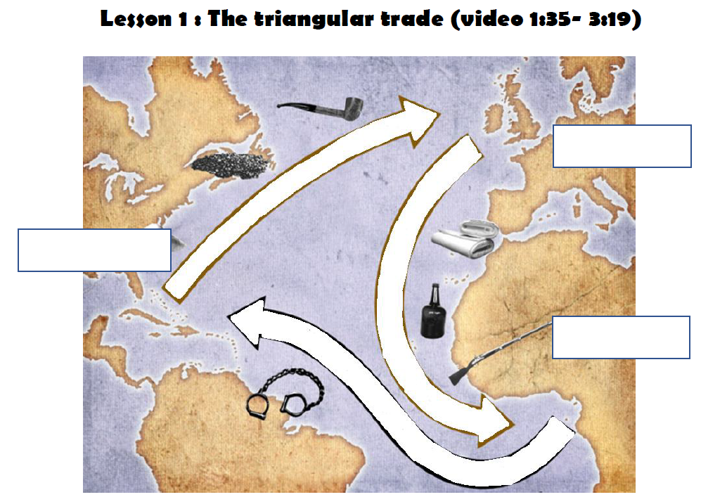
Underline the title in red
(or highlight it)

Slide 6
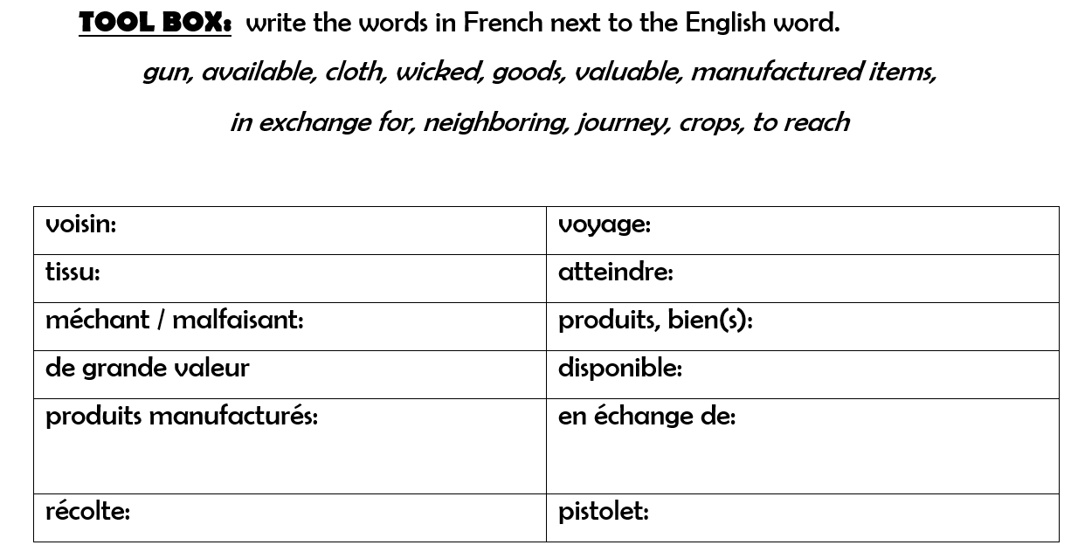
neighboring
journey
cloth
to reach
wicked
goods
valuable
available
in exchange for
manufactured items
crops
gun

Slide 7
Lesson 1: The triangular trade
Watch the video about the triangular trade to understand how it worked.
a, Write captions on the map above (continents, goods)

Slide 8
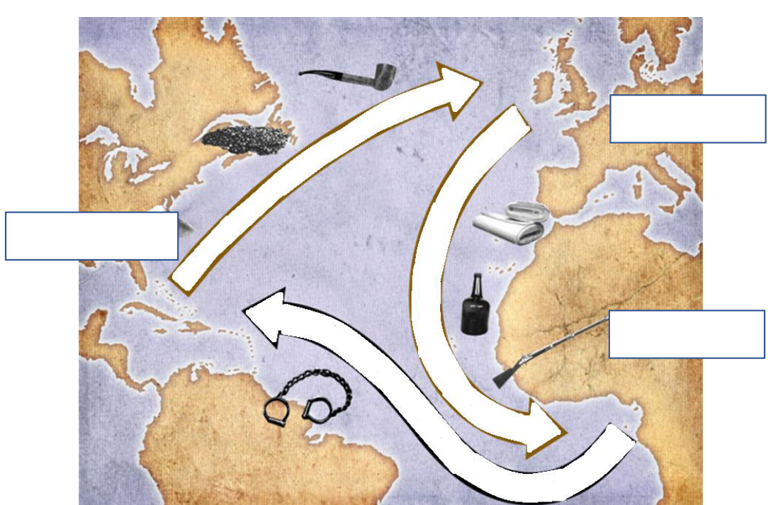

Slide 9
b, Explain the triangular trade
My notes:
When:
Where:
Who:
What:
Why:

Slide 10


Prepare the recap together
with your group!
You have 6 minutes.

Slide 11
Class: Triangular trade (recap)

Slide 12
What are we going to talk about?

Slide 13
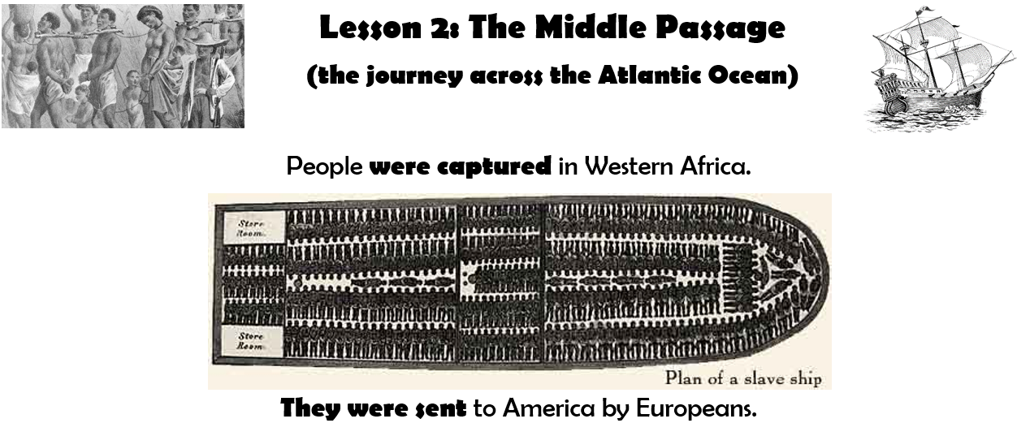
Underline the title in red
(or highlight it)

Slide 15
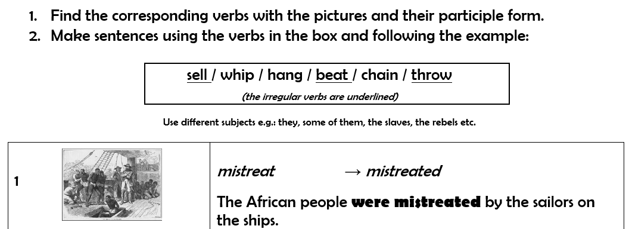

Slide 16
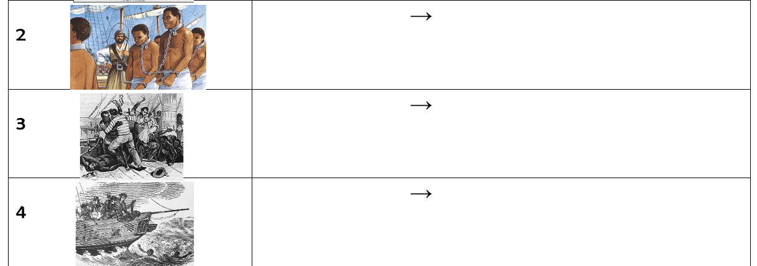
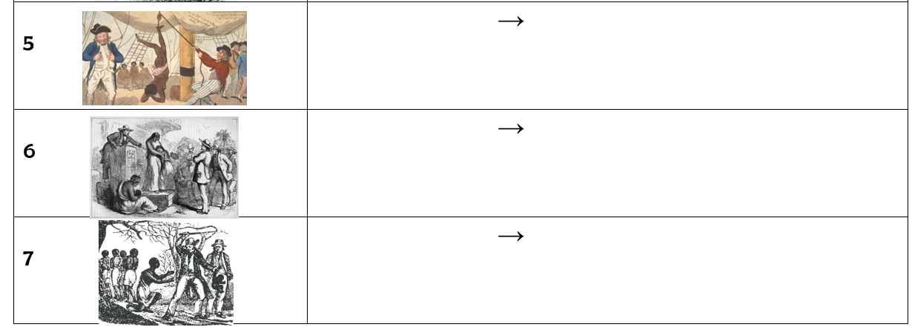

Slide 17
chain
chained
-
beat
beaten
-
throw
thrown
-

Slide 18
hang
hung
-
sell
sold
-
whip
whipped
-

Slide 20
chain
chained
-
beat
beaten
-
throw
thrown
-

Slide 21
hang
hung
-
sell
sold
-
whip
whipped
-

Slide 22
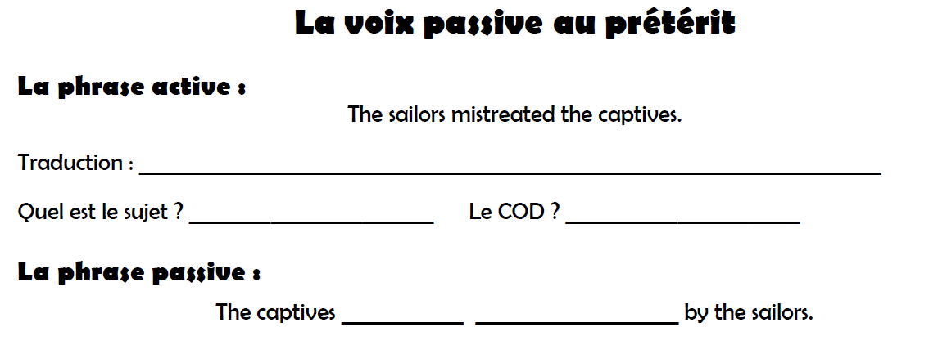
Les marins ont maltraité les prisonniers (captifs).
the sailors
the captives
were
mistreated

Slide 23
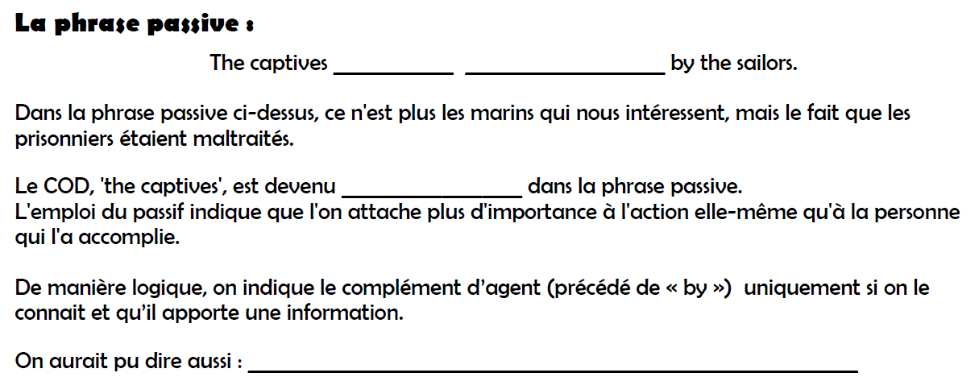
were
mistreated
sujet
The captives were mistreated.

Slide 24
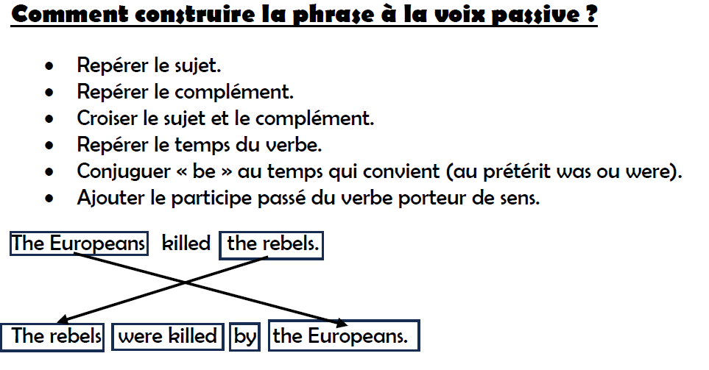
01 lifeonplantation acces au sense UNE FOIS

Slide 25
Practice!
Turn the following sentences into the passive form:
The European sailors brought manufactured items to Africa.
Manufactured items were brought to Africa by the Europeans.
2. The American traders exchanged people for tobacco.
People were exchanged for tobacco by the American traders.
3. Lincoln won the war against slavery.
The war against slavery was won by Lincoln.
Did the sailors hang the rebels?
Were the rebels hanged (hung) by the by the sailors?
The sailors didn’t treat the African people well.
The African people weren’t treated well by the sailors.
BUILDx2, PAINT, WIN, ELECT, DISCOVER x2, FIGHT, WRITE, HOLD, DESIGN

Slide 26
Practice!
Turn the sentences into the active form:
1. The African people were bought by the Americans.
The Americans bought the African people.
2. The captives were tortured by the Europeans.
The Europeans tortured the captives.
3. Goods were given to the tribes by the traders.
The traders gave goods to the tribes.
4. Why were the slaves whipped by their owners?
Why did the owners whip the slaves?
5. The rebels weren’t treated well by the sailors.
The sailors didn’t treat the rebels well.
BUILDx2, PAINT, WIN, ELECT, DISCOVER x2, FIGHT, WRITE, HOLD, DESIGN

Slide 27
Pdf :The worksheet was completed

Slide 28
Practice!
Activity to practice the past simple passive voice
Famous Inventions and Discoveries
You will work in pairs; there are 2 types of documents. (Student A & B)
You will work with several partners.
You will have to ask questions using the past simple passive voice.

Slide 29
Practice!
Penicillin was discovered by Alexander Fleming in Scotland in 1928.
What was discovered by Alexander Fleming?

Slide 30
Practice!
Penicillin was discovered by Alexander Fleming in Scotland in 1928.
Who was penicillin discovered by?

Slide 31
Practice!
Penicillin was discovered by Alexander Fleming in Scotland in 1928.
Where was penicillin discovered?

Slide 32
Practice!
Penicillin was discovered by Alexander Fleming in Scotland in 1928.
When was penicillin discovered?

Slide 33
Practice!
What was discovered by _________?
Who was _______ discovered by?
Where was ___________ discovered?
When was ___________ discovered?

Slide 34
Practice!
Make sentences in the passive voice in the past.
You have to use the following verbs:
Eg. The Titanic was directed by James Cameron in 1997.
BUILDx2, PAINT, WIN, ELECT, DISCOVER x2, FIGHT, WRITE, HOLD, DESIGN
BUILDx2, PAINT, WIN, ELECT, DISCOVER x2, FIGHT, WRITE, HOLD, DESIGN

Slide 35
Practice!
Speaking activity: Make sentences in the passive voice:
BUILDx2, PAINT, WIN, ELECT, DISCOVER x2, FIGHT, WRITE, HOLD, DESIGN

Slide 36
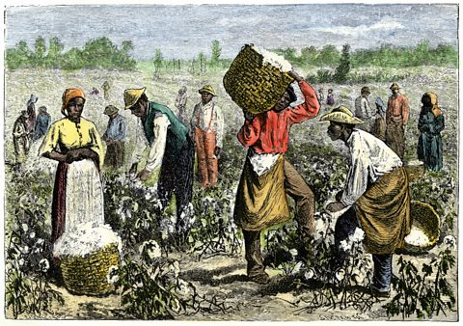
What are we going to talk about?

Slide 37
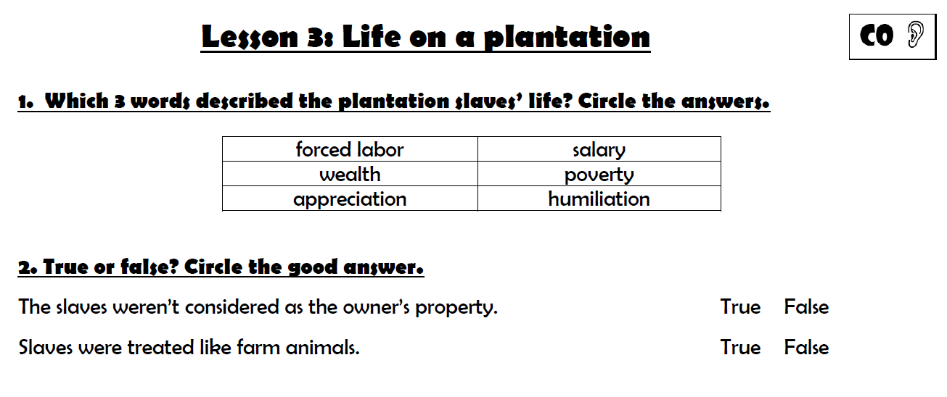
Underline the title in red
(or highlight it)

Slide 38
Before watching the video

Slide 39
Check your answers!

Slide 40
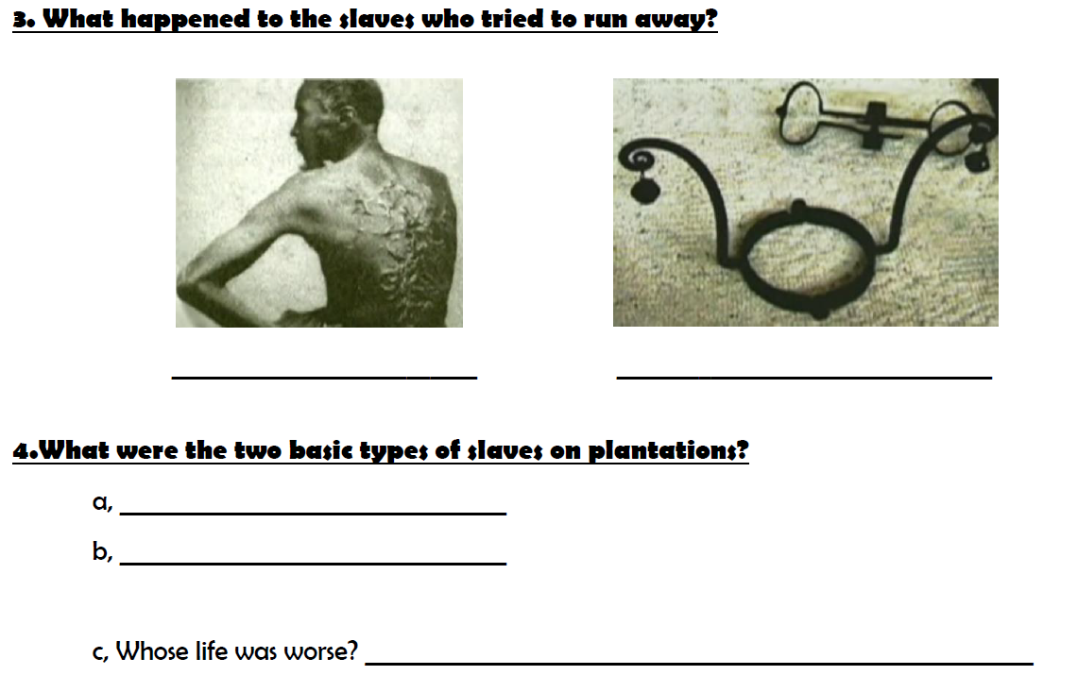
They were whipped
They had to wear a slave’s collar
house slaves
field slaves
The field slaves’ life.

Slide 41
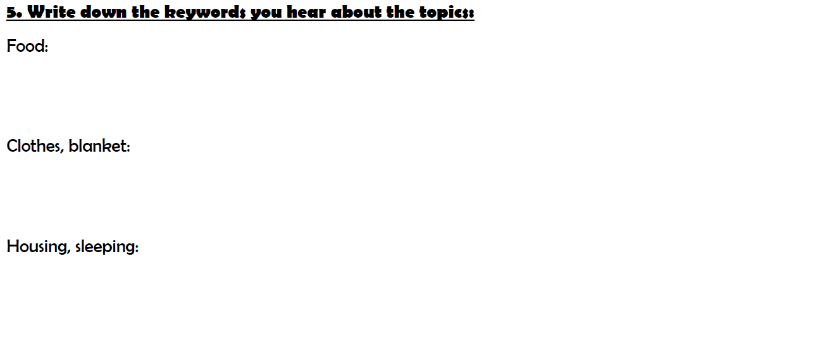
pork, cornmeal (semoule de maïs), maigre rations, molasses (mélasse)
They received a new set of summer and winter clothes and a
blanket each year.
They had to share a small cabin with 10-12 people, they slept straw (paille)
on the floor.

Slide 42
Write in your copybook.
Listen to the audio en complete!
Prohibitions
Obligations
-
-

Slide 43
Write in your copybook.
Listen to the audio en complete!
Prohibitions
Obligations
receive an education
vote
marry
own property
testify in court
earn their freedom through work
take care of the house and
the family
work from sunrise to sunset with
a 15 minute break

Slide 44
Write in your copybook.
Listen to the audio en complete!
Prohibitions
Obligations
To receive an education
To vote
To marry
To own property
(posséder des biens)
To testify in court
(témoigner devant un tribunal)
To earn their freedom
through work (gagner leur liberté
par le travail )
take care of the house and
the family
work from sunrise to sunset with
a 15 minute break

Slide 45
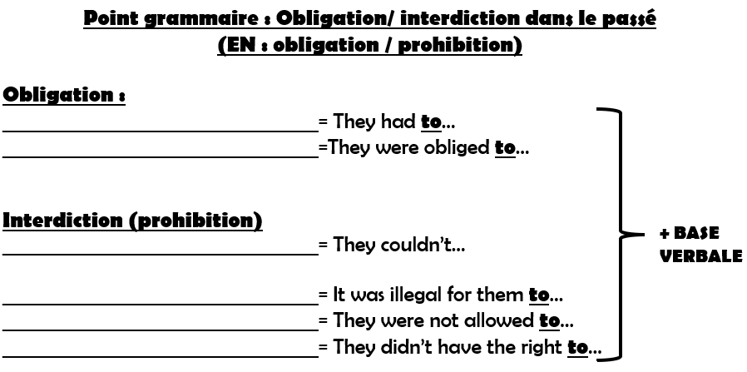
Ils devaient…
Ils étaient obligés de…
Ils ne pouvaient pas…
C’était illégal pour eux de…
Ils n’étaient pas autorisés à…
Ils n’avaient pas le droit de…

Slide 46
Make full sentences with the obligations and prohibitions
from ex. 6! Use all the six expressions!
7. Make sentences:
-

Slide 47
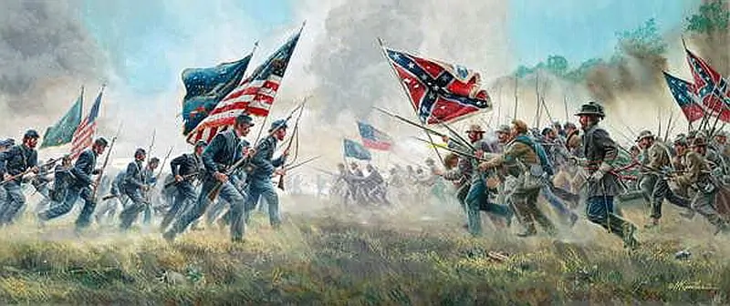
What are we going to talk about?

Slide 48
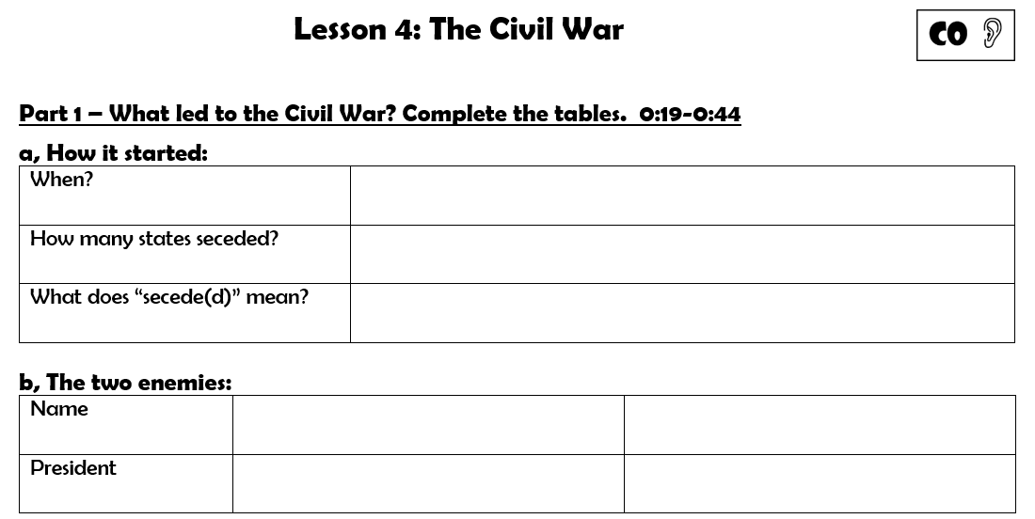
Underline the title in red
(or highlight it)

Slide 49
In 1860 and 1861
11 Southern states seceded.
They left the United States to make their own country.
the Confederacy
the Union
Jefferson Davis
Abraham Lincoln

Slide 50
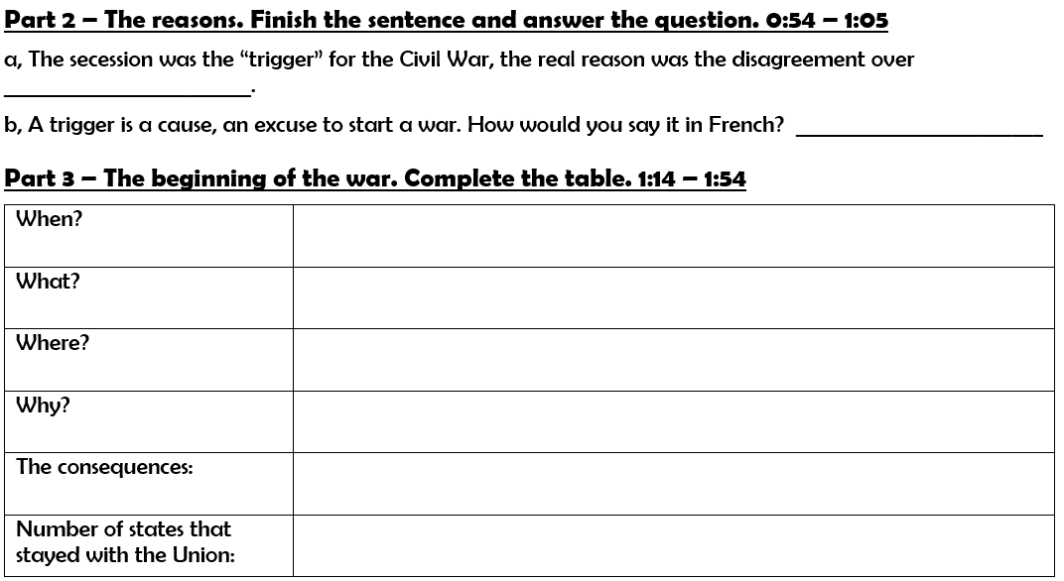
slavery
déclencheur
in April 1861
Confederate soldiers fired on Fort Sumter.
Fort Sumter, a US army outpost in South Carolina
Confederate soldiers wanted Fort Sumter for their own military use.
President Lincoln declared the South in rebellion.
The Civil War began.
24

Slide 51
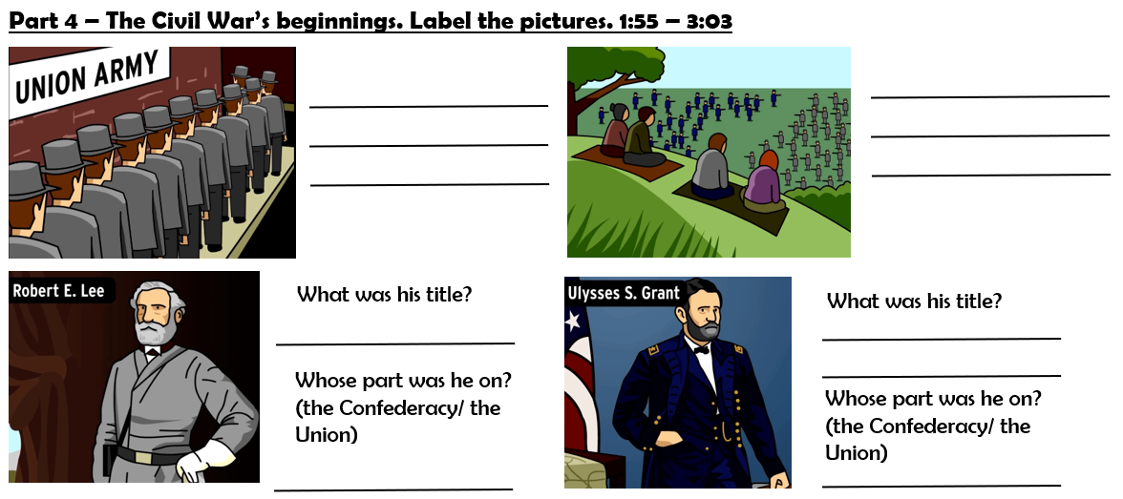
people lined up to join the army
people had picnics watching the battles
commander
General/ commanding officer
the Confederacy
the Union

Slide 52
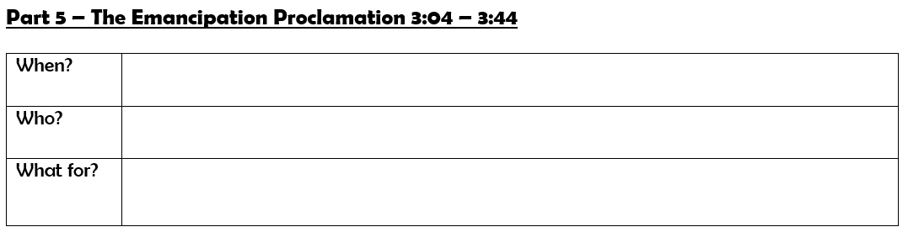
In 1863
(Abraham) Lincoln
To free all slaves

Slide 53
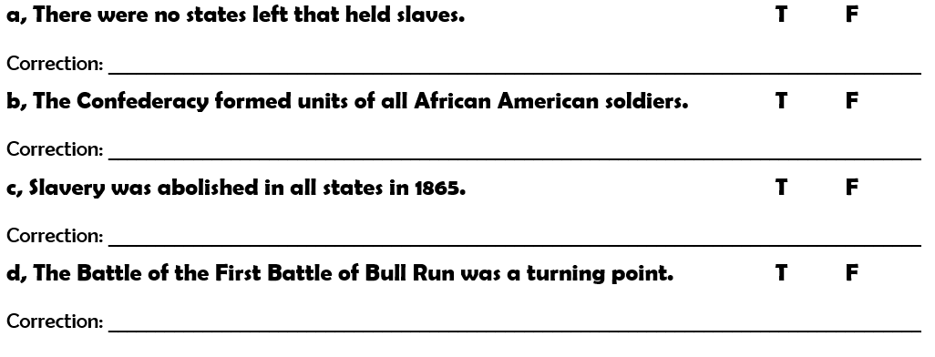
Some border states (like Maryland) still
The Union
Gettysburg

Slide 54
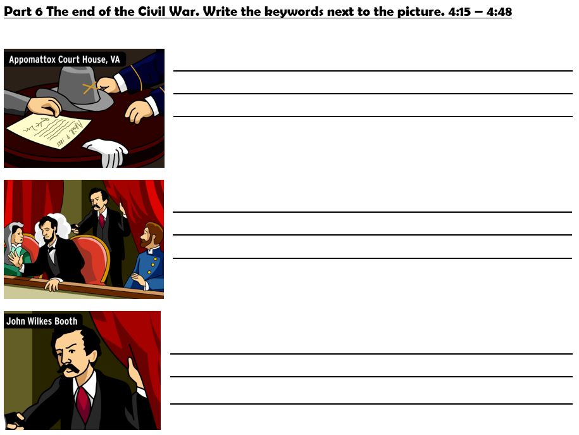
On April 9th 1865, Commander Lee surrendered to General Grant. The war was over.
On April 14th 1865 Abraham Lincoln was assassinated in Washington DC in a theater.
His killer was John Wilkes Booth, an actor from Maryland who was angry at Lincoln for abolishing slavery.

Slide 55
Recap: The American Civil War (1861-1865)
In the United States the North and the South couldn’t agree about slavery: the North (the Union) wanted to abolish it while the South (the Confederacy) needed the free labor to work on the plantations.
When the Confederate soldiers attacked Fort Sumter in 1861, Abraham Lincoln declared the South in rebellion, so the war began.
After 5 years of fighting the North won, and slavery was abolished in all states.
Lincoln was assassinated not long after the end of the war by John Wilkes Booth in a theater in Washington DC.

Slide 56
What are we going to talk about?

Slide 57
Write in your copybook:
Lesson 4: American Civil War
1. Why was the Civil War started?
The South of the United States didn’t want to abolish slavery, so they left and formed a new country.
2. Which good thing happened during the Civil War?
Slavery was abolished.
3. What happened to Abraham Lincoln?
He was assassinated by John Wilkes Booth.

Slide 58
Recap
Recap: The American Civil War (1861-1865)
The North and the South couldn’t agree about slavery: the North wanted to abolish it while the South needed the free labor to work on the plantations.
After 5 years of fighting the North won, and slavery was abolished by Abraham Lincoln.
Lincoln was assassinated not long after the end of the war.

Slide 59
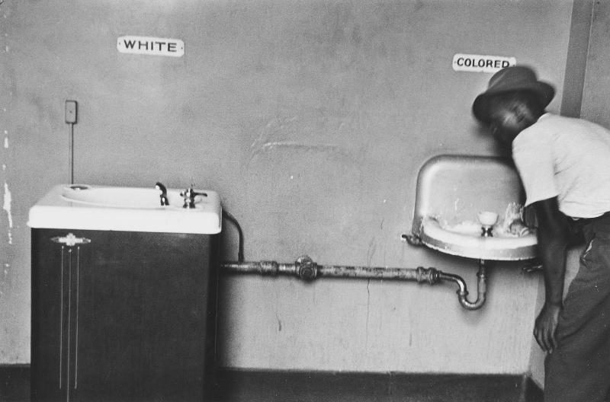
What are we going to talk about?

Slide 60
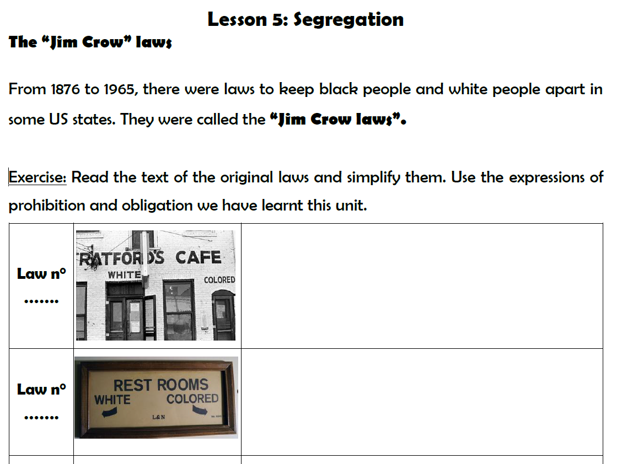
Underline the title in red
(or highlight it)

Slide 61
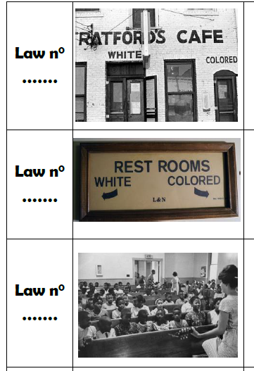
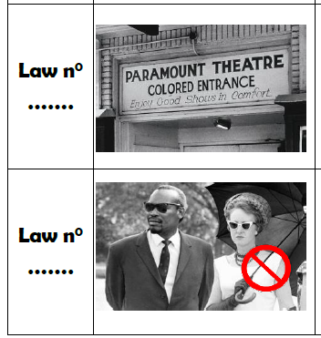
First, find the right numbers!
4
1
5
3
2

Slide 62
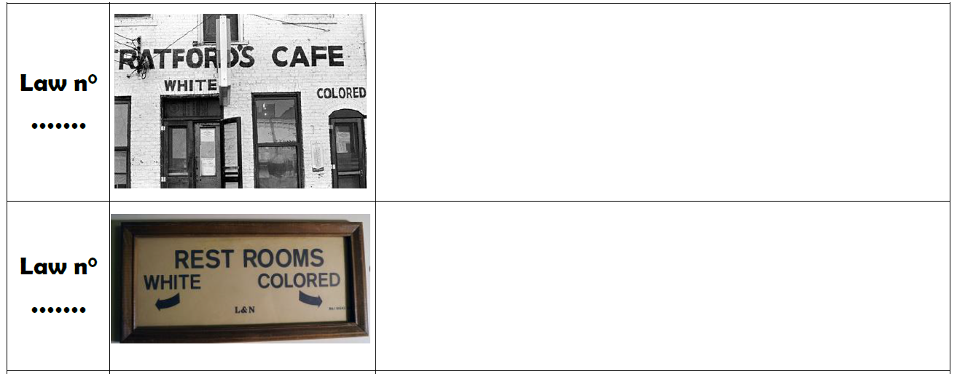
Now, let’s simplify!
Use the expressions we have learnt!
-
4
-
-
5

Slide 63
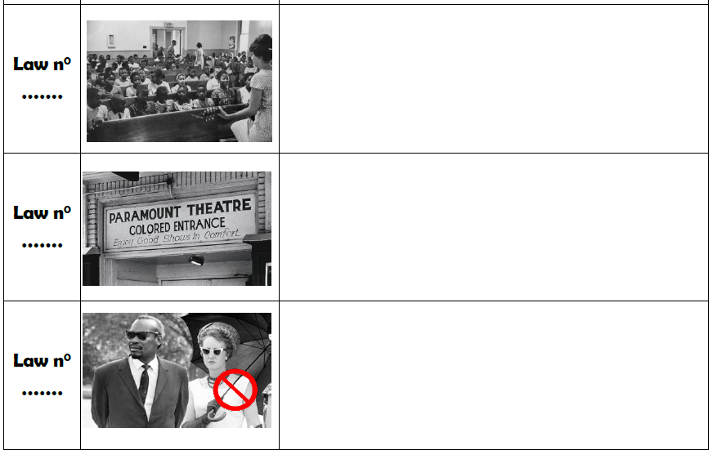
-
2
-
1
-
3

Slide 64
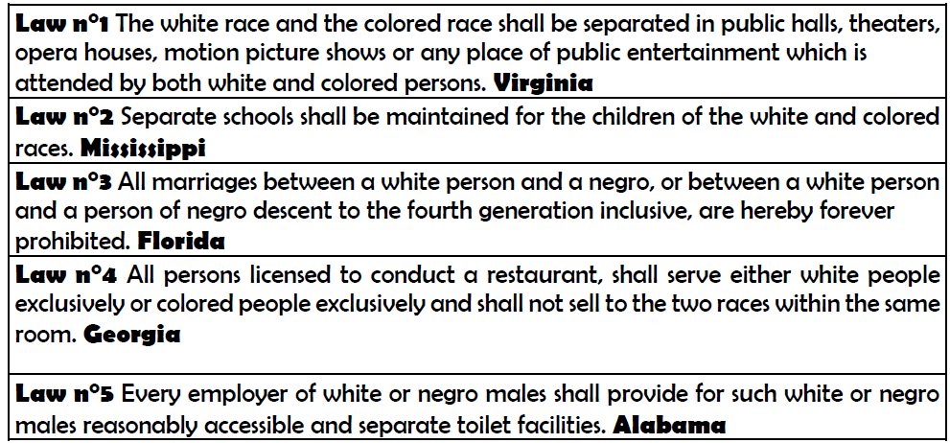

Slide 65
Recap

Slide 66
Recap
During the period of segregation in the United States African American and white people had to be separated in public places as schools, theaters, restrooms, etc.
These laws were called the Jim Crow laws.

Slide 67
Look at the film poster and imagine what the film is about.

Slide 68
Write in your copybook:
Segregation: Rosa Parks (1913-2005)
Watch the extract and answer the questions:
Where?
When?
Who?
What?

Slide 69
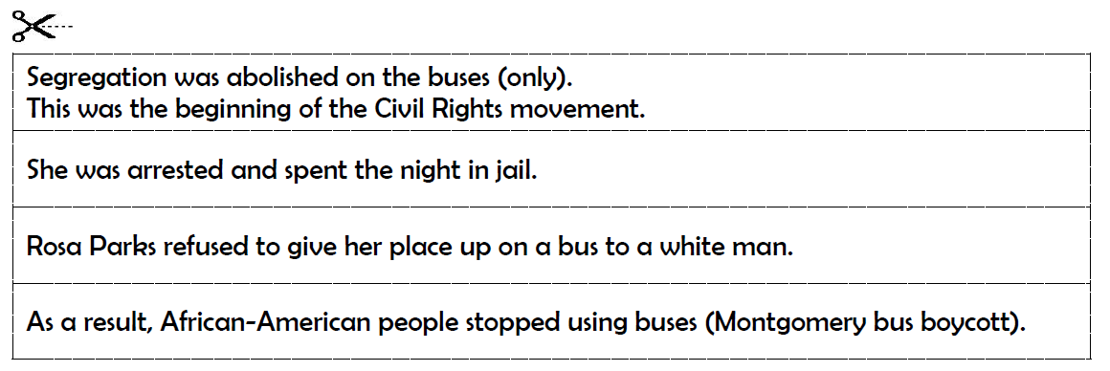
Recap
Cut the pieces and put them in the right order!

Slide 70
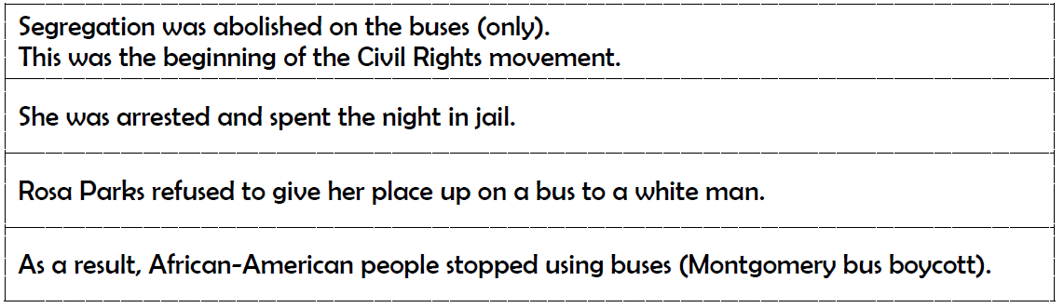
Recap
Recap: Rosa Parks and the Civil Rights Movement (1955)

Slide 71
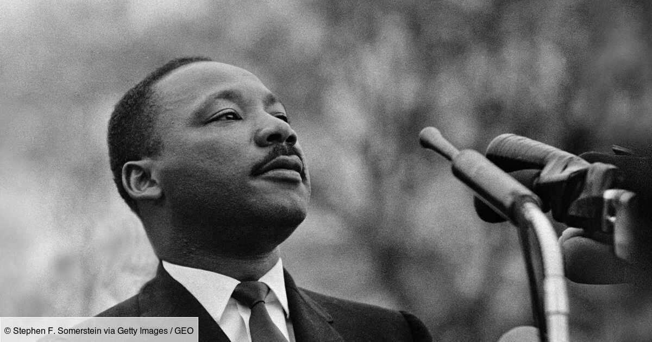
Who is he? What is he famous for?

Slide 72
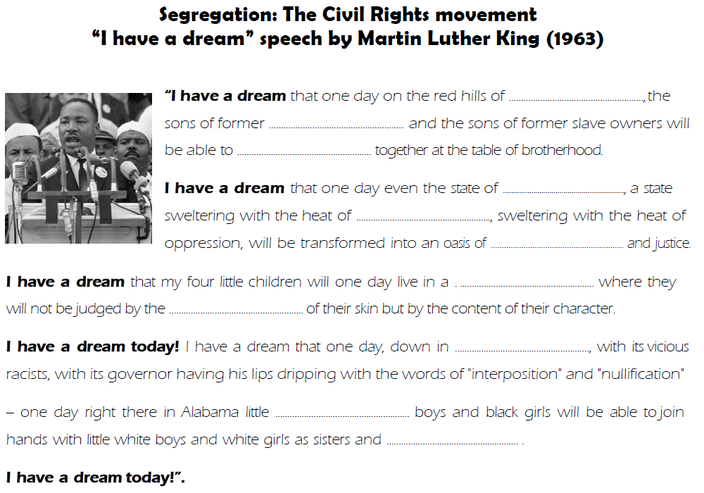
Underline the title in red
(or highlight it)

Slide 73
Georgia
slaves
sit down
Mississippi
injustice
freedom
nation
color
Alabama
black
brothers

Slide 74
Recap
Recap: Martin Luther King: “ ” speech (1963)
In his speech Martin Luther King denounced ____________________, ____________________ and ____________________ in the ____________________ states.
He hoped that his children could live in a world where _______________________________________________________________________________.
A year after his speech in _____________________ segregation was __________________ in 1964.
He was ____________________ in 1968 by James Earl Ray.
I have a dream
injustice
segregation
racism
southern
they are accepted for who they are
Washington D.C.
abolished
assassinated

Slide 75
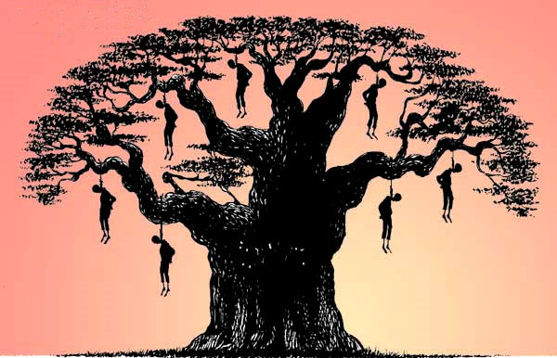

Slide 76
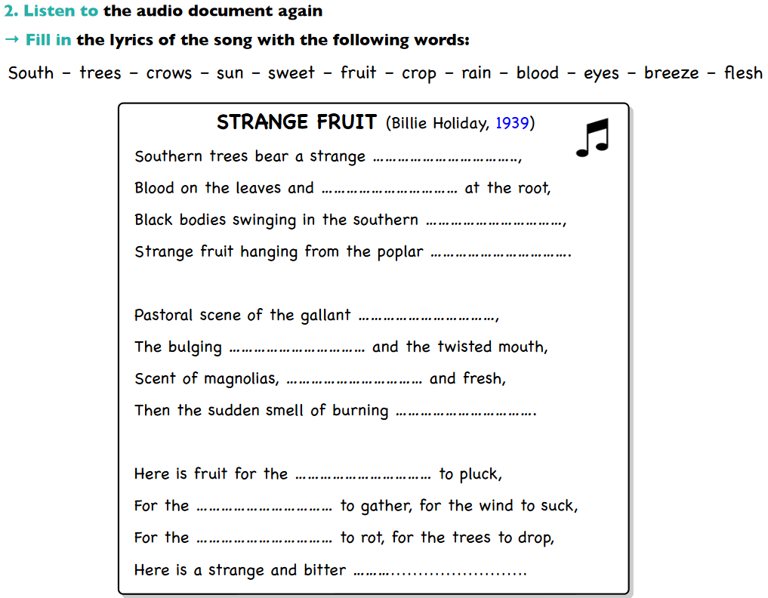
fruit
blood
breeze
trees
South
eyes
sweet
flesh
crows
rain
sun
crop

Slide 77
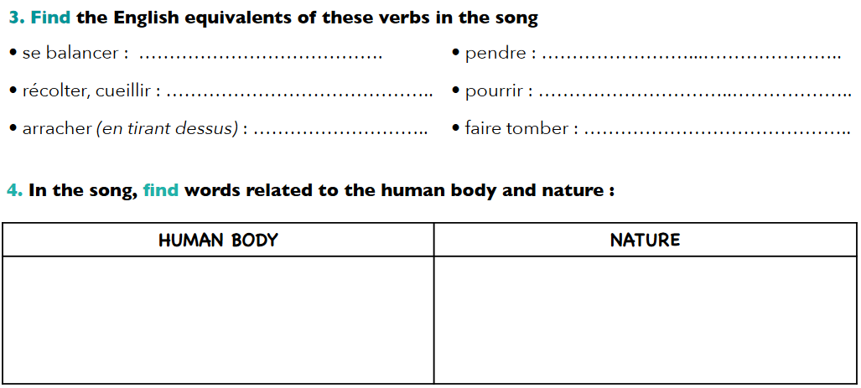
swing
hang
gather
rot
pluck
drop
-
-

Slide 78
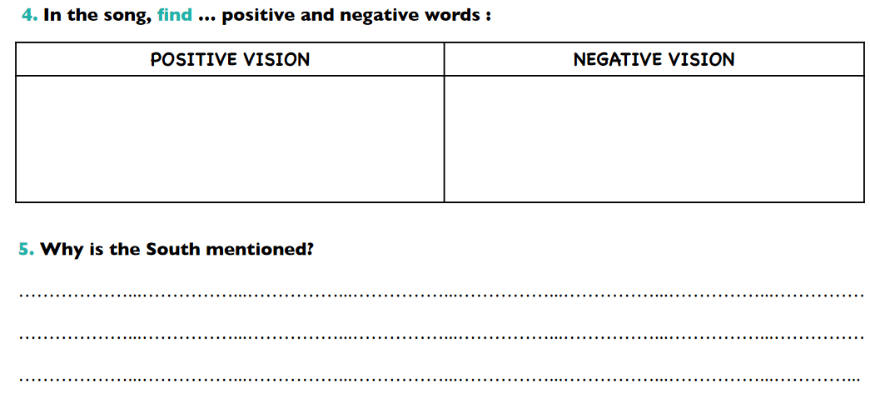
-
-
-

Slide 79
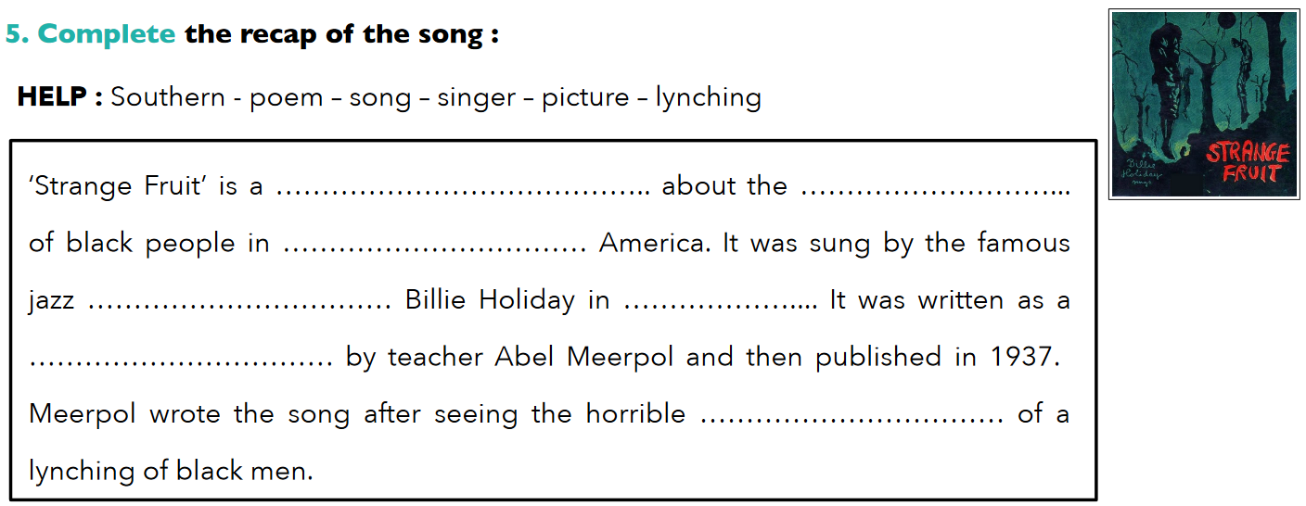
poem
lynching
Southern
singer
1939
song
picture

Slide 80
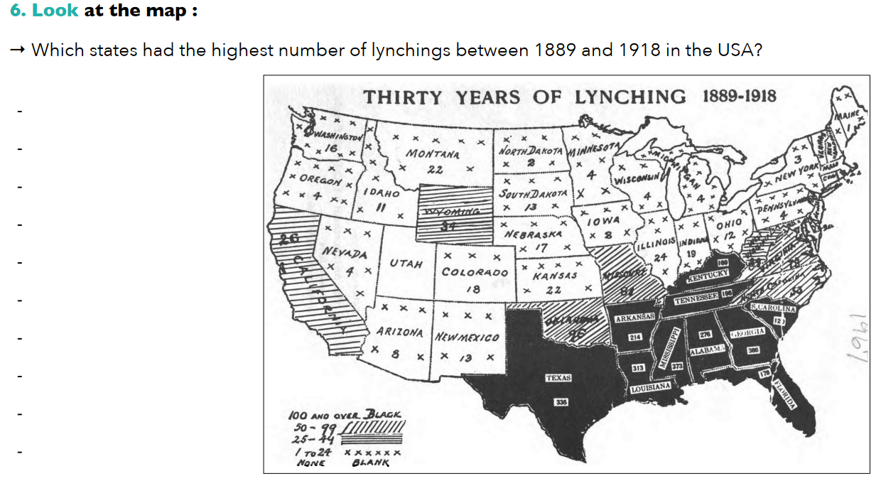
-
-
-
-
-
-
-
-
-
-

Slide 81
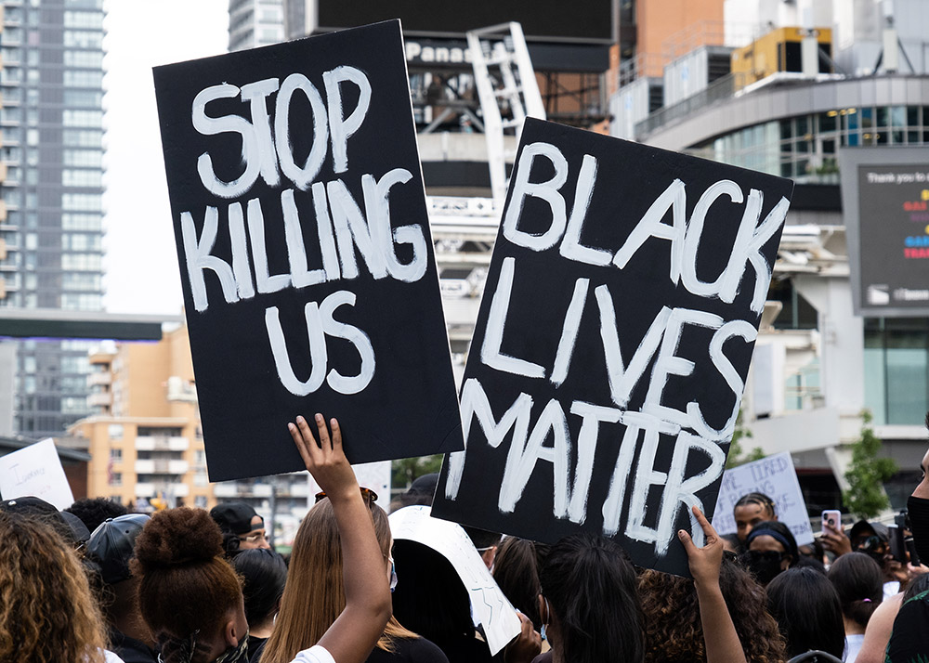
What are we going to talk about?
What do you know about it?

Slide 82
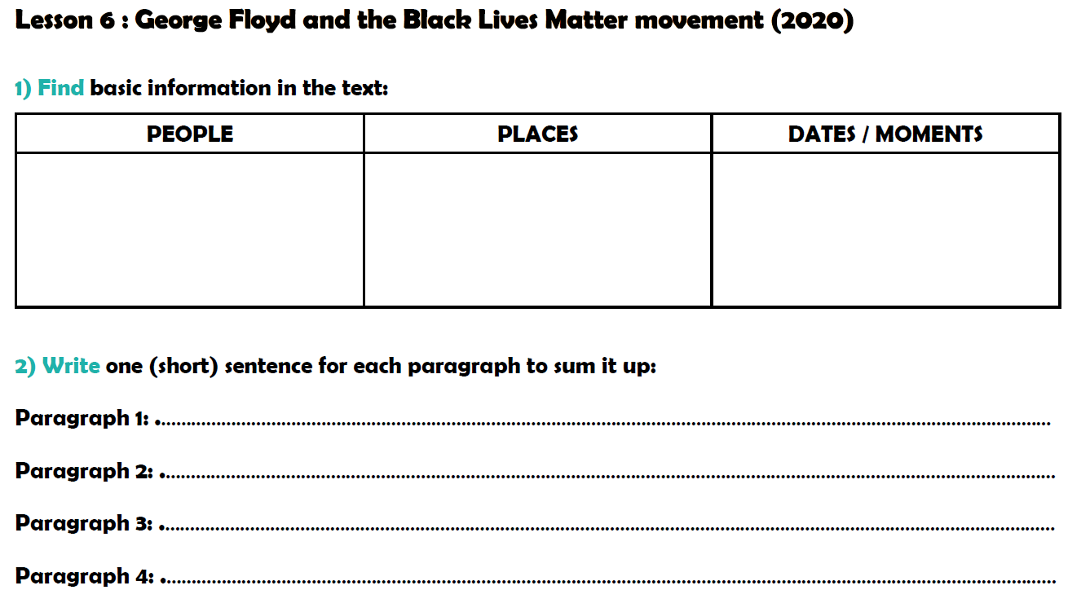
Underline the title in red
(or highlight it)

Slide 83
George Floyd, Derek Chauvin, Eric Garner, protesters, police officers
Minneapolis, Minnesota, New York, Staten Island
25th May, 2014, 2020, 2013-2019

Slide 84
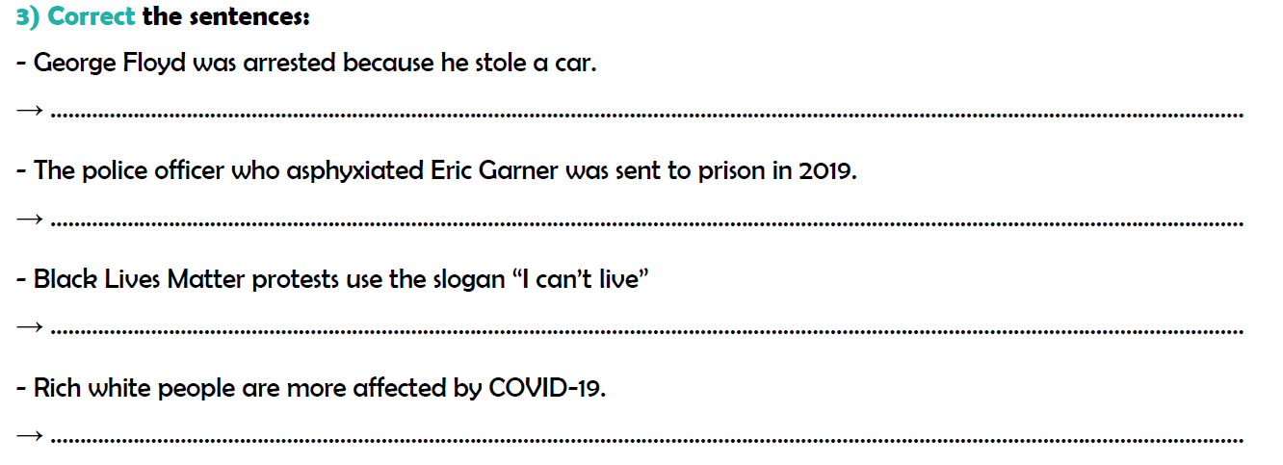

passed fake money.
dismissed
breathe
less

Slide 85
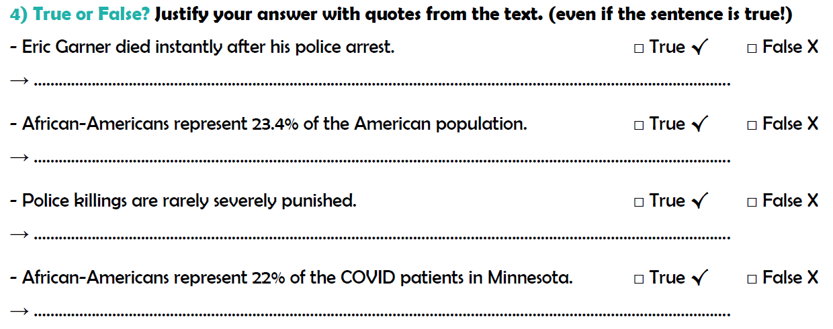

X
He protested 11 times that he couldn’t breathe.
X
African Americans only represent 13.4% of the population
X
99% of killings by police have not resulted in police officers being charged with a crime.
X
They account for 22% of the COVID patients.

Slide 86

-
-
-
-

Slide 87
Your turn: write a recap!
Write a recap about what happened to George Floyd and
how it started the Black Lives Matter movement.
Use the following expressions (optional)
African American man
for the suspicion of passing fake money
for nearly 9 minutes
became the slogan

Slide 88
Recap
Recap: George Floyd and the Black Lives Matter movement (2020)
George Floyd was an African American man, who was arrested for the suspicion of passing fake money.
A police officer, Derek Chauvin knelt (agenouillé) on his neck for nearly 9 minutes. Floyd said several (plusieurs) times that he couldn’t breathe.
The sentence (I can’t breathe) became the slogan of the Black Lives Matter movement. Derek Chauvin was sentenced to 21 years in prison for involuntary manslaughter.

Slide 89

Correct the definition using your copybook.

Slide 90
Group A
Active=>passive
The sailors threw the rebels in the ocean.
The rebels were thrown in the ocean by the sailors.
The crew didn’t feed the captives on the ships.
The captives weren’t fed by the crew on the ships.
Did the Americans buy African people?
Were the African people bought by the Americans.
Passive=> active
The slaves were chosen by the plantation owners.
The plantation owners chose the slaves.

Slide 91
Groupe B
Active=>passive
The Europeans beat the rebels.
The rebels were beaten by the Europeans.
The sailors didn’t treat the captives well.
The captives weren’t treated well by the sailors.
Did the owners whip the slaves?
Were the slaves whipped by the owners?
Passive=> active
The slaves were given to the slave owners by the sailors.
The sailors gave the slaves to the slave owners.

Slide 92
Group C
Active=>passive
The Europeans took the captives from Africa.
The captives were taken by the Europeans from Africa.
The sailors didn’t bring the African people to Europe.
The African people weren’t brought to Europe by the sailors.
Did the sailors torture the captives?0 0.5 1 1.5
Were the captives tortured by the sailors?
Passive=> active
Some of the captives were thrown in the ocean by the crew.
The crew threw some of the captives in the ocean.

Slide 93

La première élève 0,5
africaine américaine 0,5
à intégrer (aller) 0,5
une école blanche 0,5
1960 1
La Louisiane 1
Mouvement des droits civiques 1
Ségrégation (raciale) 1

Slide 94

6 ans 1
Les parents ont retiré leurs enfants 1
de l’école
(500 enfants ont quitté l’établissement)
Sa professeure 1
(Elles sont devenues meilleures amies)
Qu’on ne devrait pas (il faut pas) 0,5 juger une personne 0,5
pour la couleur de sa peau 0,5
mais pour son caractère 0,5
(personnalité).

Slide 95

The problem we all live with 1
Le problème avec lequel on vit 1
1963 1
62 1
Maison Blanche 1
La peinture était exposée 1

Slide 96

Merry-Go-Round
by Langston Hughes

Slide 97
Merry-Go-Round
by Langston Hughes
Where is the Jim Crow section
On this merry-go-round,
Mister, cause I want to ride?
Down South where I come from
White and colored
Can't sit side by side.
Down South on the train
There's a Jim Crow car.
On the bus we're put in the back—
But there ain't no back
To a merry-go-round!
Where's the horse
For a kid that's black?

Slide 98
What is a merry-go-round?

Slide 99
“Where is the Jim Crow section
On this merry-go-round,
Mister, cause I want to ride?”
What was a “Jim Crow section”?

Slide 100
“Down South where I come from
White and colored
Can't sit side by side”
What does he mean by
“down South”?

Slide 101
“Down South on the train
There's a Jim Crow car.”
Vocabulary:
what is a “car” in this context?

Slide 102
“On the bus we're put in the back
But there ain't no back
To a merry-go-round!”
What events does this part evoke?

Slide 103
“Where's the horse
For a kid that's black?!”
What is the child’s dilemma? What are his/her emotions?

Slide 104
Why did Hughes choose a merry-go-round in the poem?
What does is represent?

Slide 105
What does the
merry-go-round represent?

Slide 106

x
x
x
x

Slide 107

pink
white
blue
red
yellow
green
grey

Slide 108

was
was
am
were
were
are

Slide 109

x
x
x
x
x
x

Slide 110

born
nurse
write
prison
future
collection
poet
inspired
humour
medal
brutality

