Slide 1
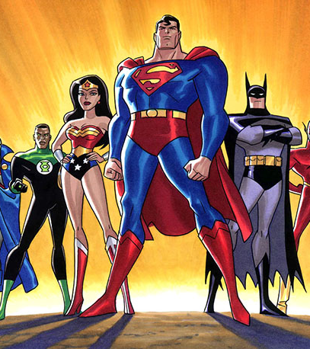
SUPERHEROES
OUTFIT

Slide 2
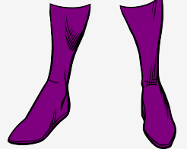
BOOTS

Slide 3

A CAPE

Slide 4

A MASK

Slide 5

GLOVES

Slide 6
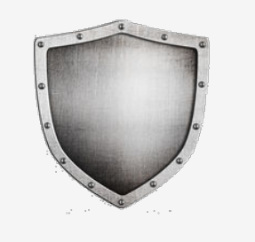
A SHIELD

Slide 7
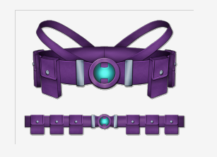
A BELT

Slide 8
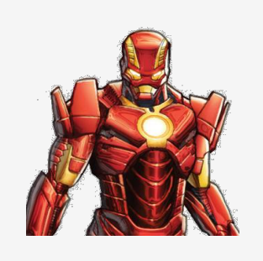
AN ARMOUR

Slide 9
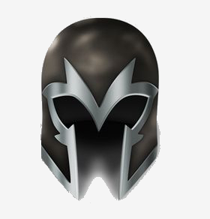
A HELMET

Slide 10
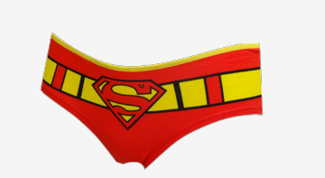
BRIEFS

Slide 11
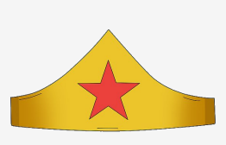
A TIARA

Slide 12
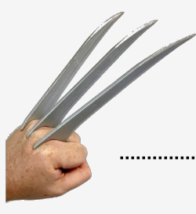
CLAWS

Slide 13
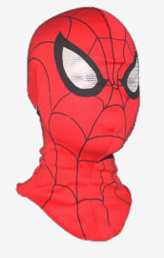
A HOOD

Slide 14
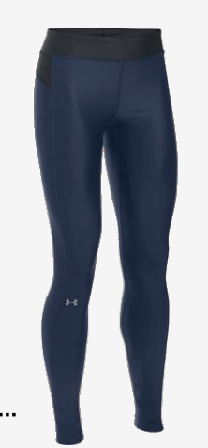
LEGGINGS

Slide 15
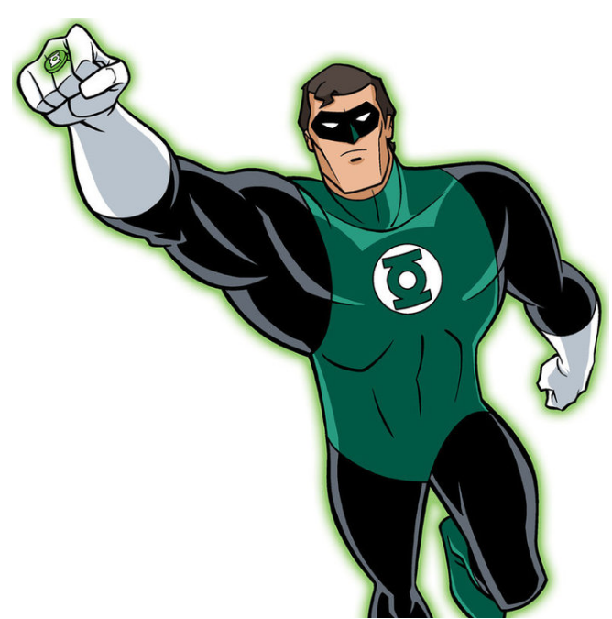
GREEN LANTERN

Slide 16
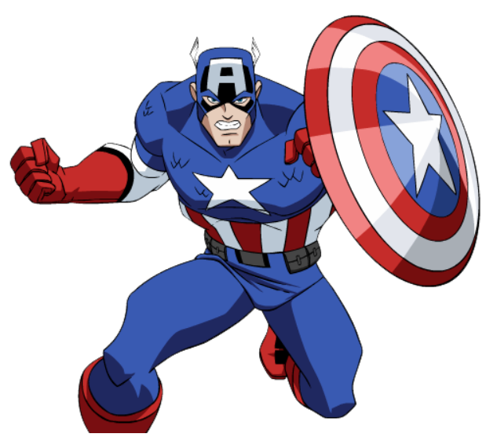
CAPTAIN AMERICA

Slide 17
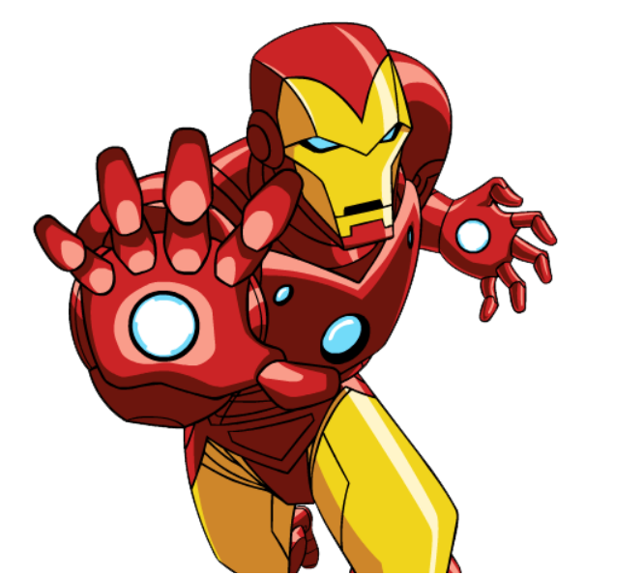
IRONMAN

Slide 18
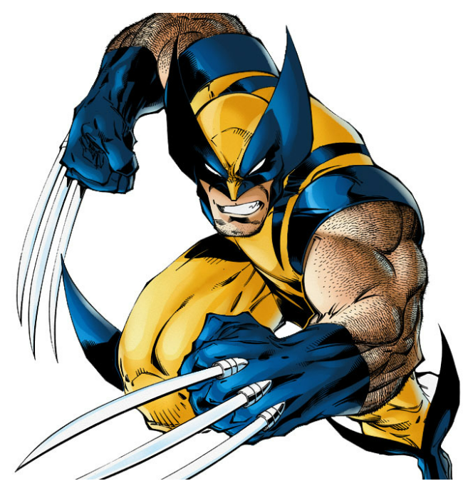
WOLVERINE

Slide 19

WONDER WOMAN

Slide 20
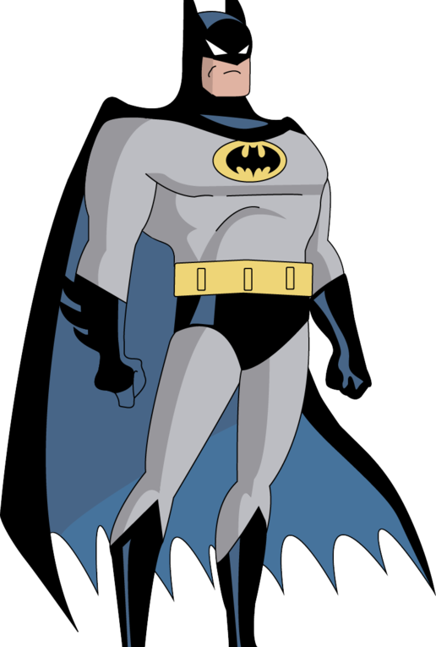
BATMAN

