Slide 1
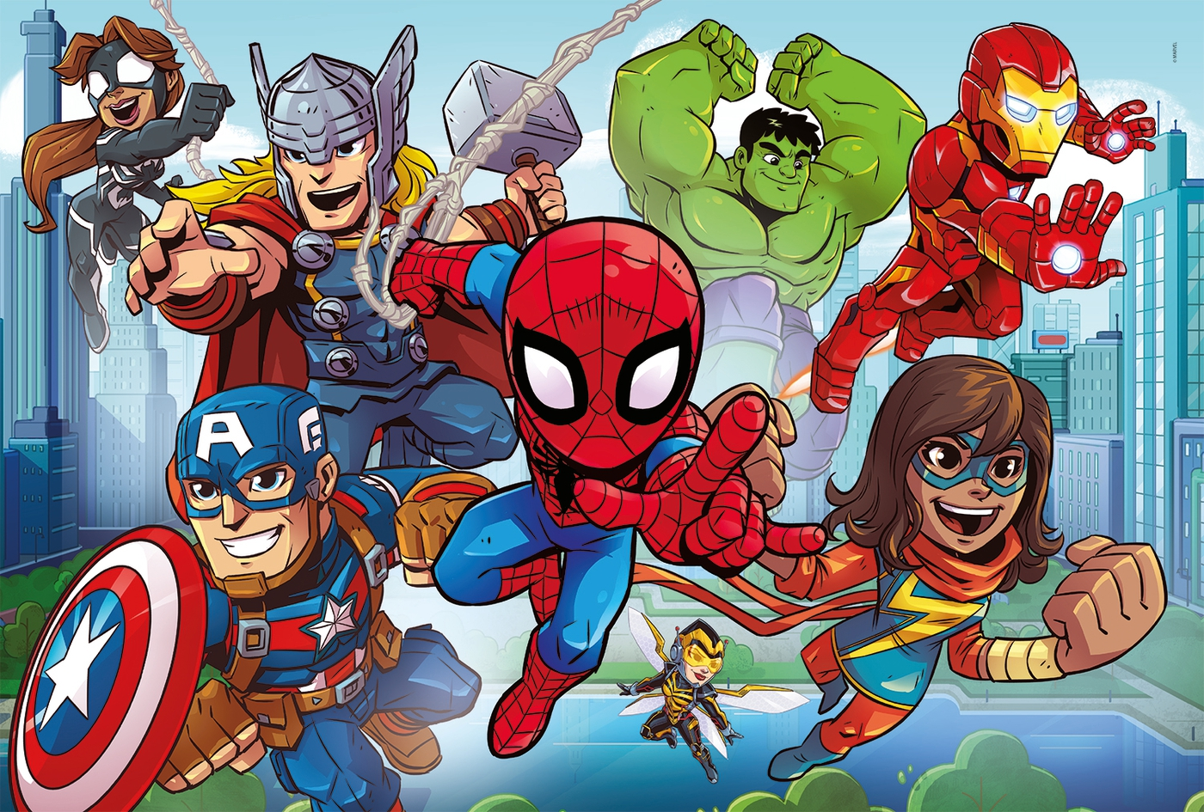


Slide 2

BLACK WIDOW

Slide 3
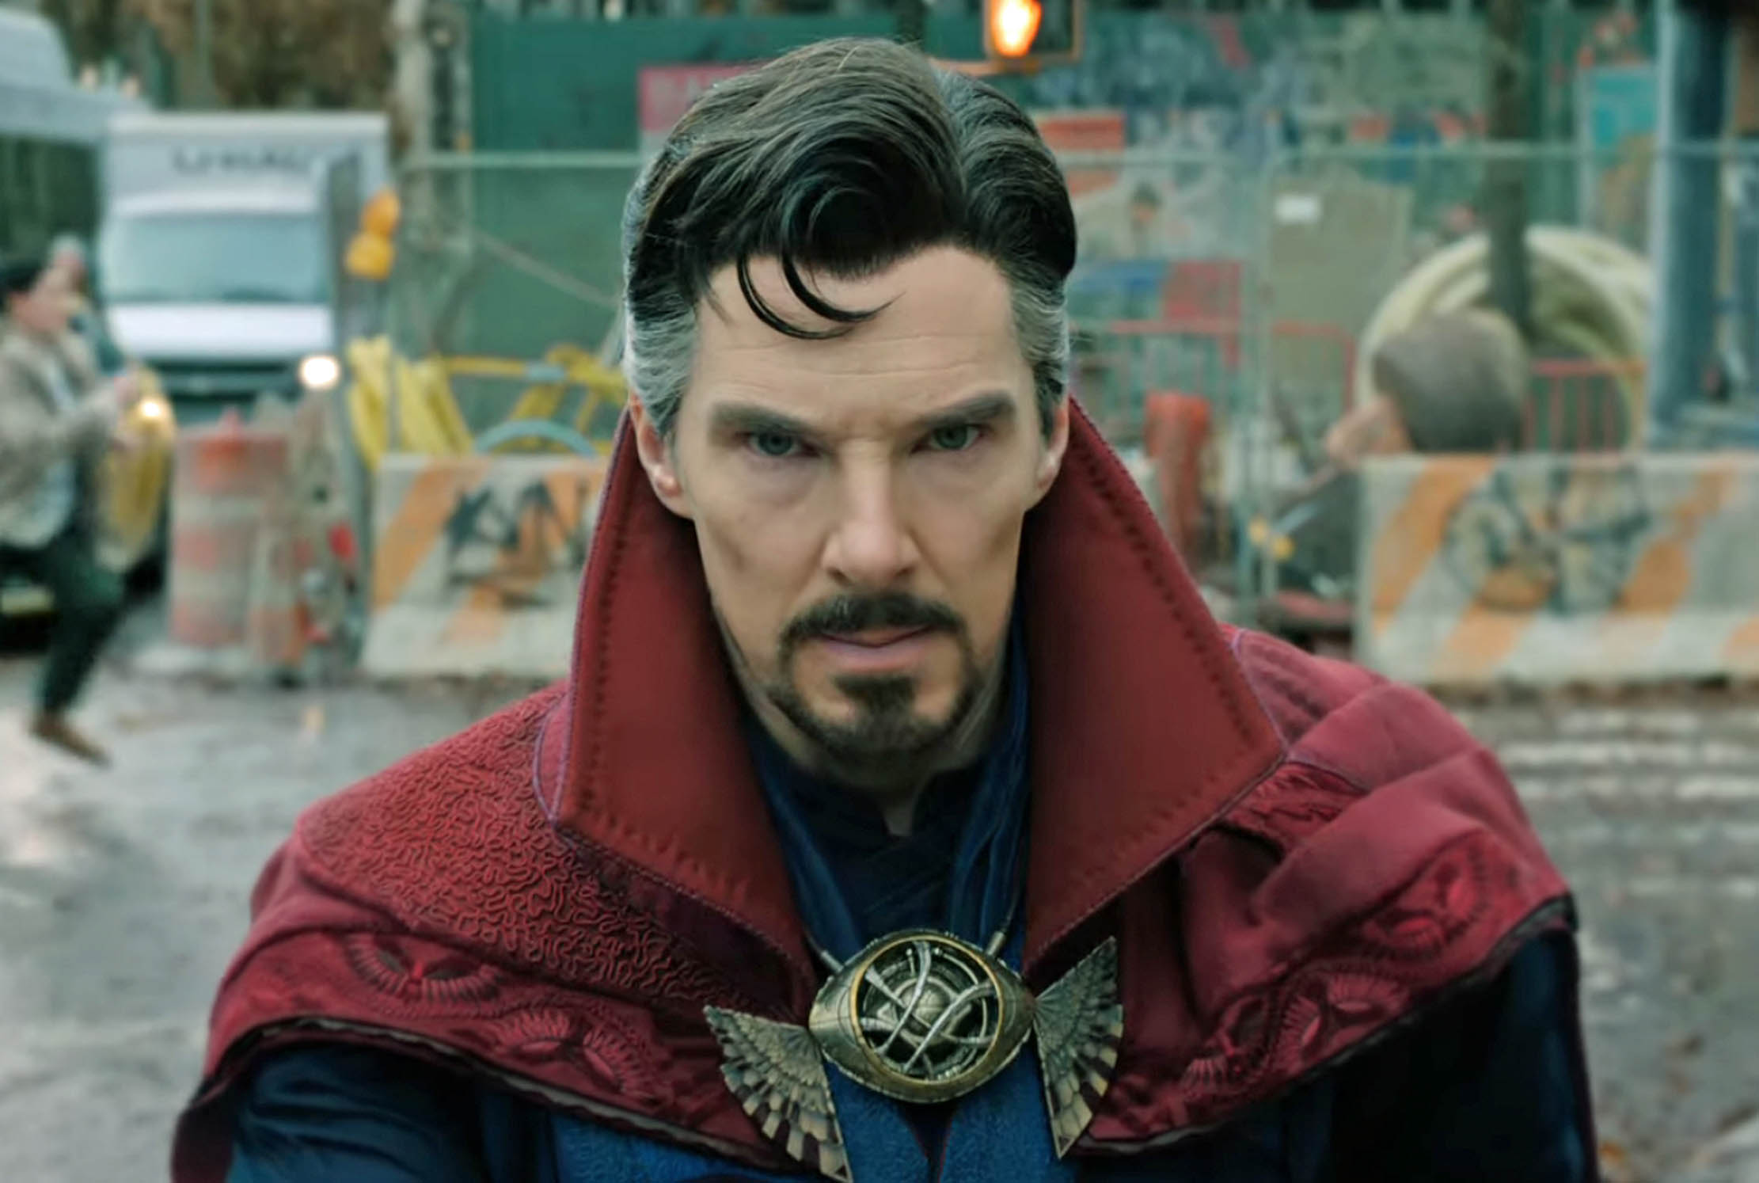
DOCTEUR STRANGE

Slide 4
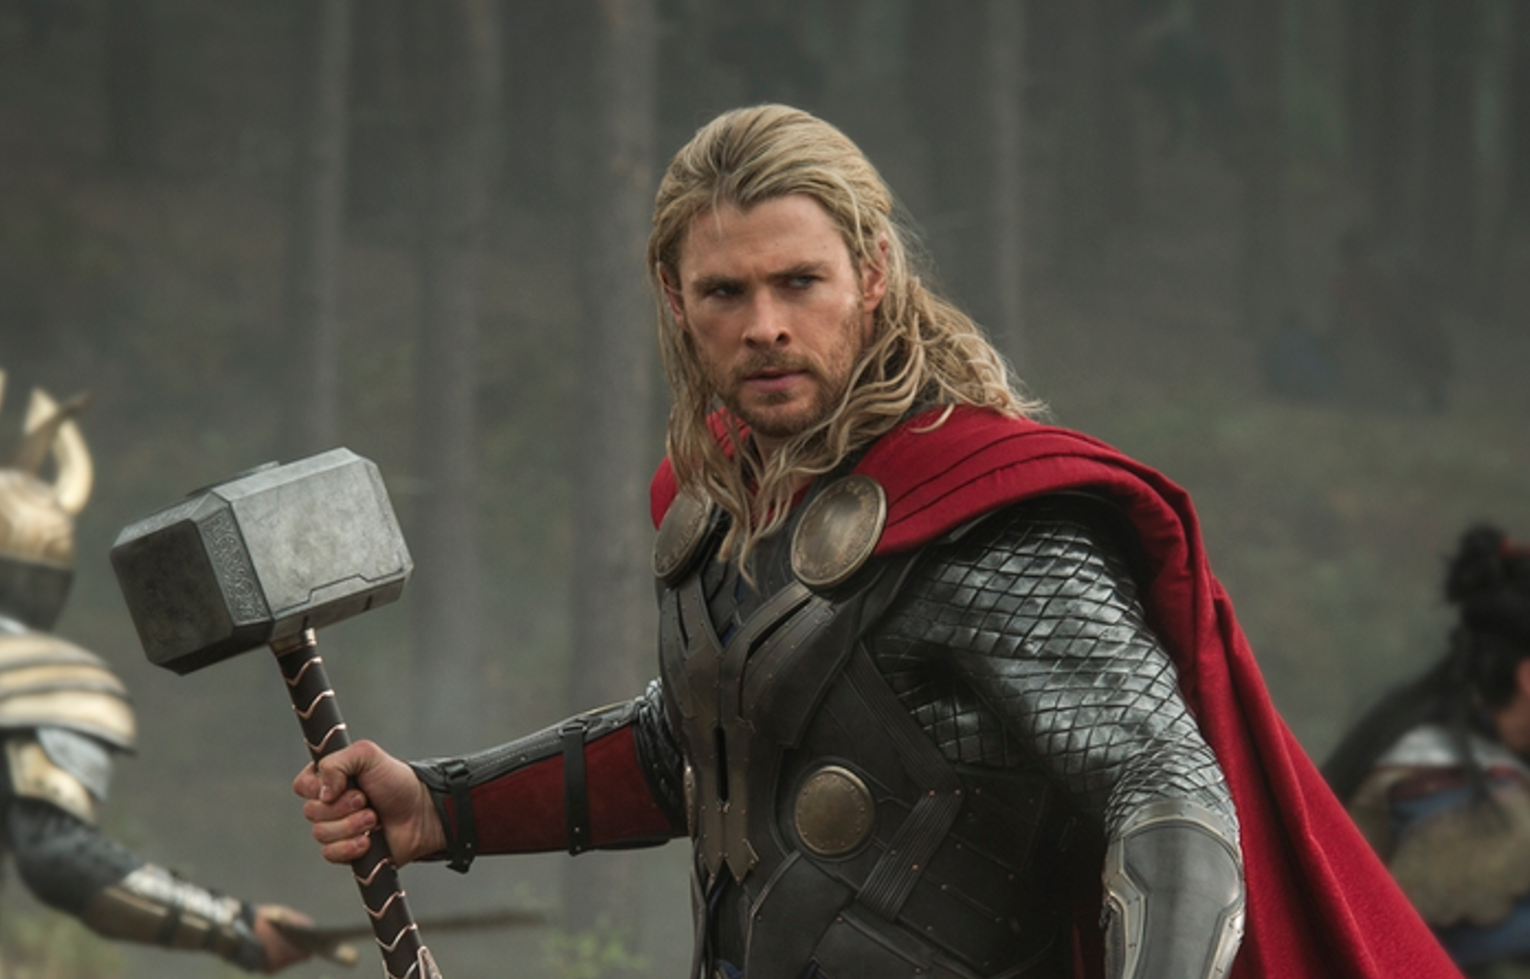
THOR

Slide 5
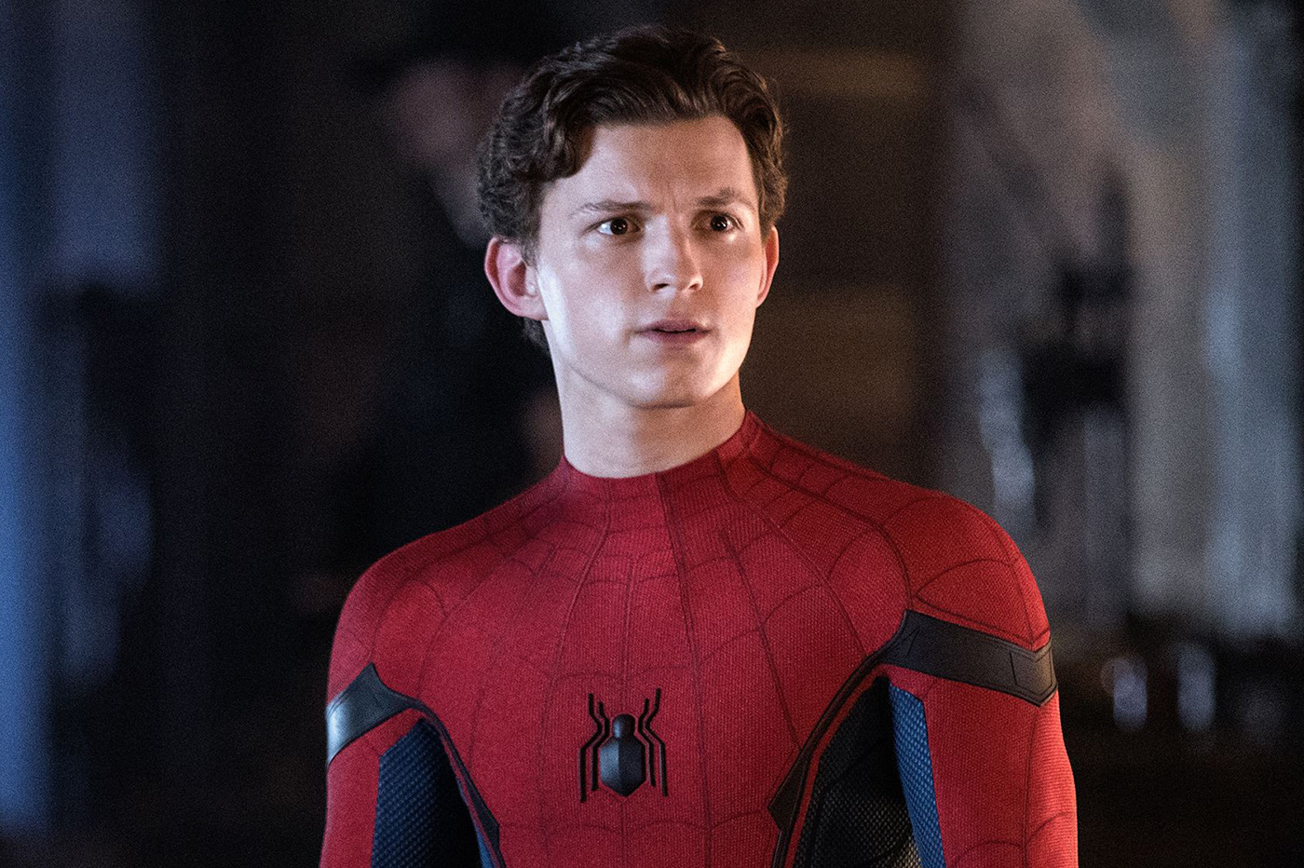
SPIDERMAN

Slide 6

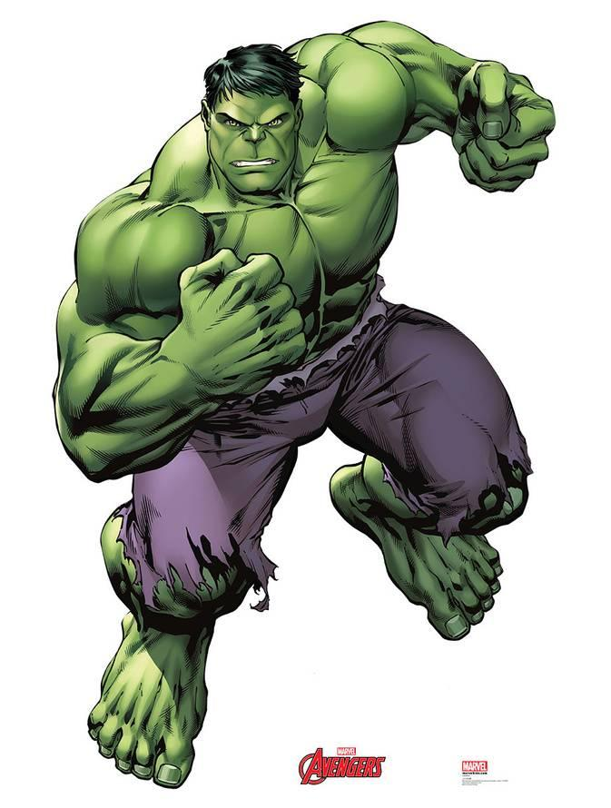
HULK

Slide 7
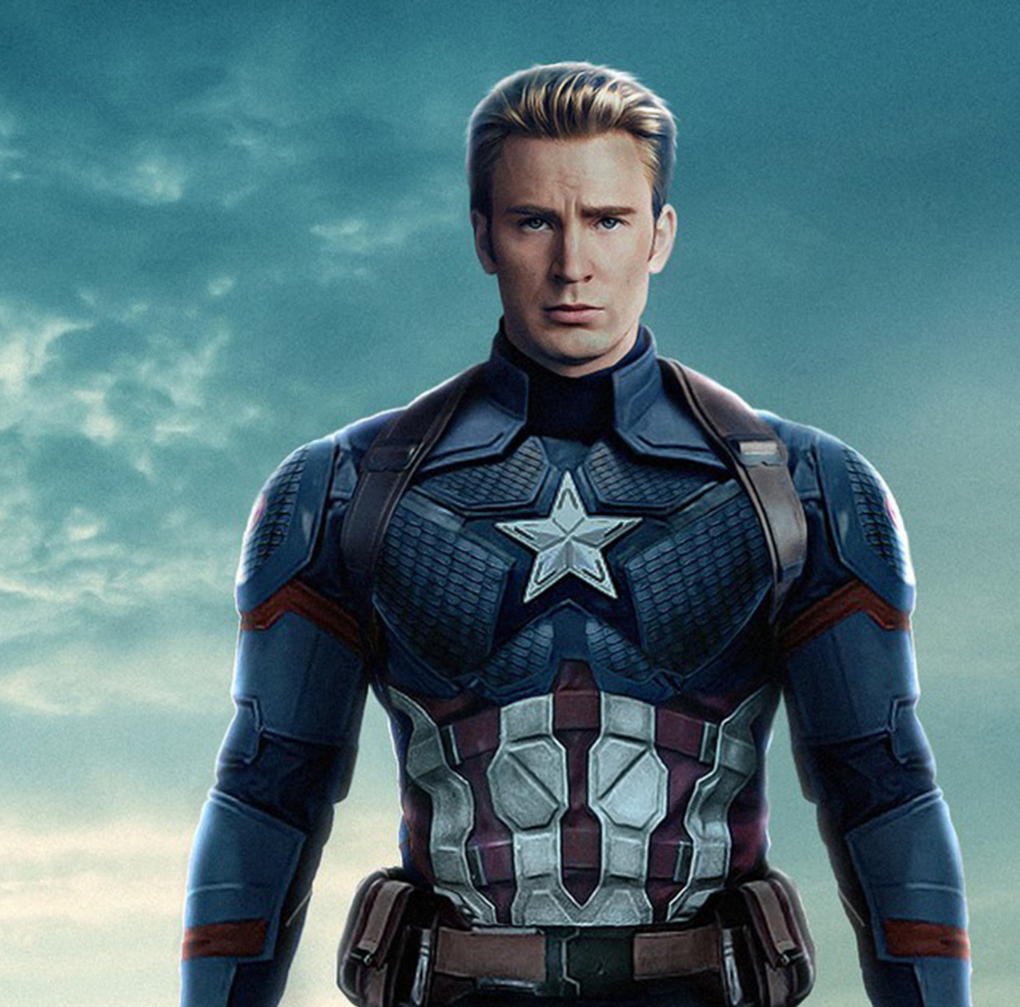
CAPTAIN AMERICA

Slide 8
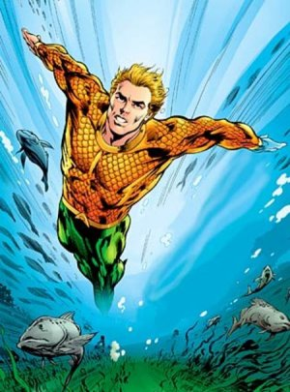
breathe under water

Slide 9
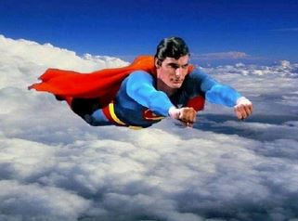
fly

Slide 10
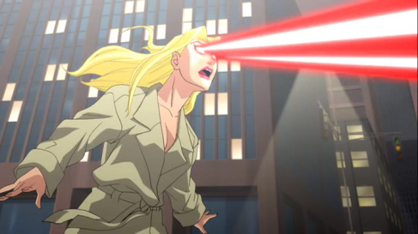
shoot lasers

Slide 11
become invisible

Slide 12
see through walls

Slide 13
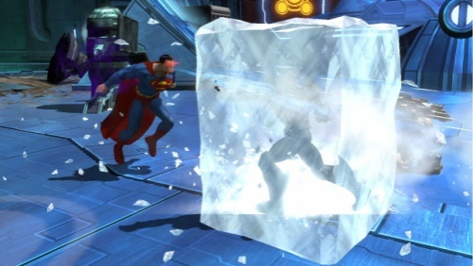
Freeze things

Slide 14


run fast

Slide 15
Talk to animals

Slide 16
Iift a car

Slide 17
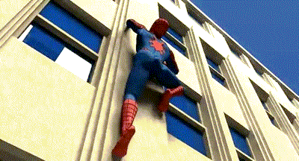
climb walls

Slide 18
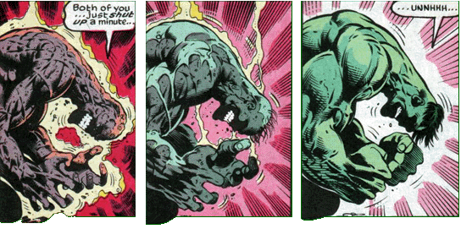
regenerate

Slide 19
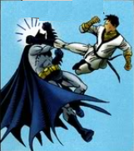
breathe under water
fly
shoot lasers
become invisible
see through walls
freeze things
run fast
talk (speak) to animals
lift a car
climb walls
regenerate
do martial arts

Slide 20
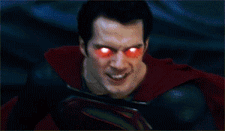
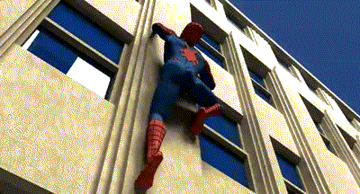
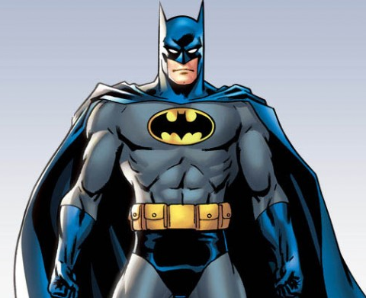
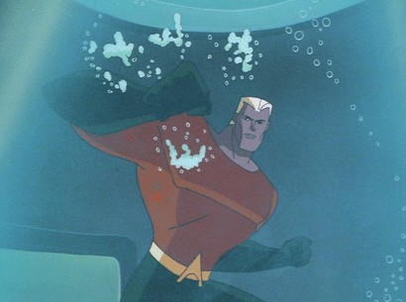
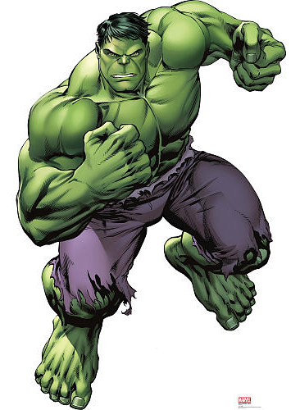

WHAT CAN THEY DO ?

Slide 21



