Slide 1
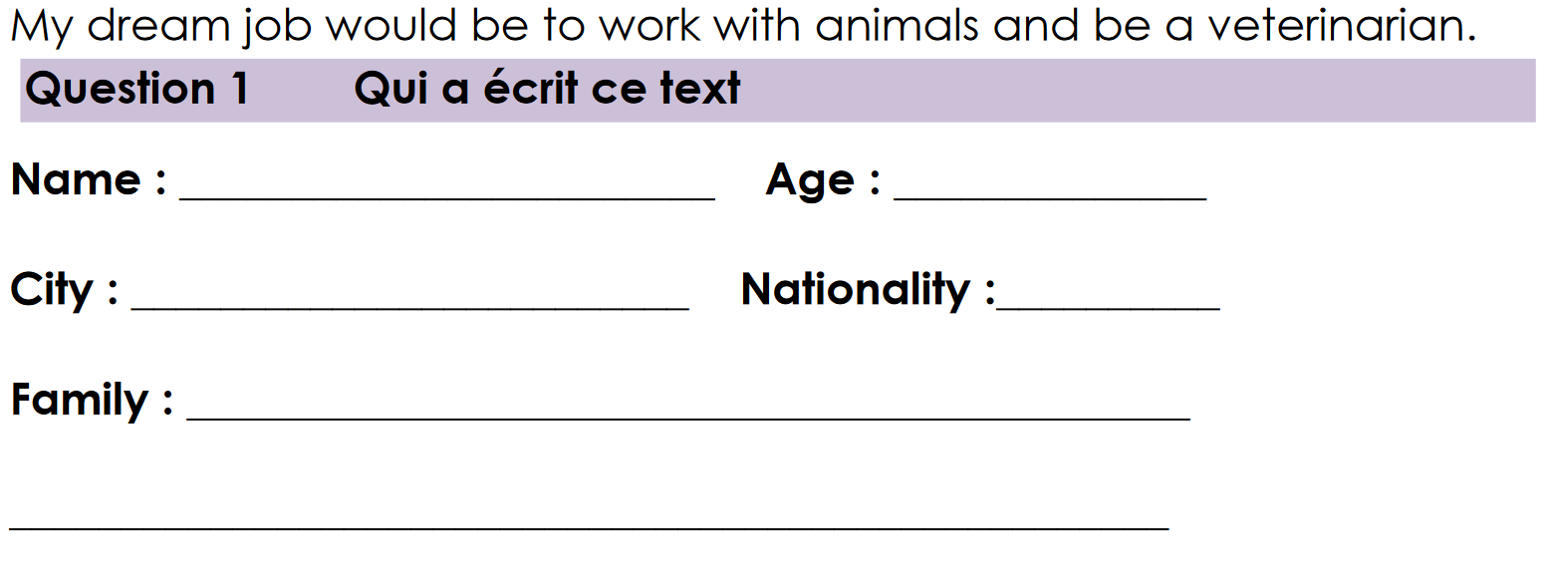
Joshua Perry
Sixteen (16)
Manchester
English
Parents, one sister Ally, and a dog.

Slide 2
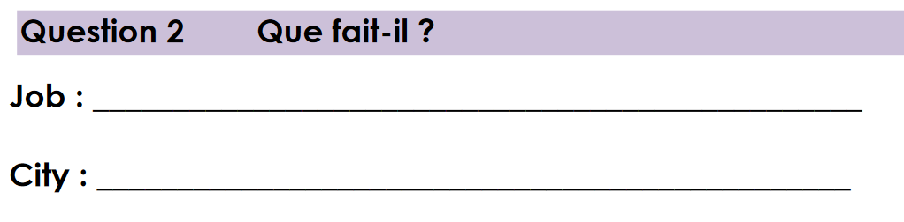
Cashier in a supermarket (Tesco)
Manchester

Slide 3
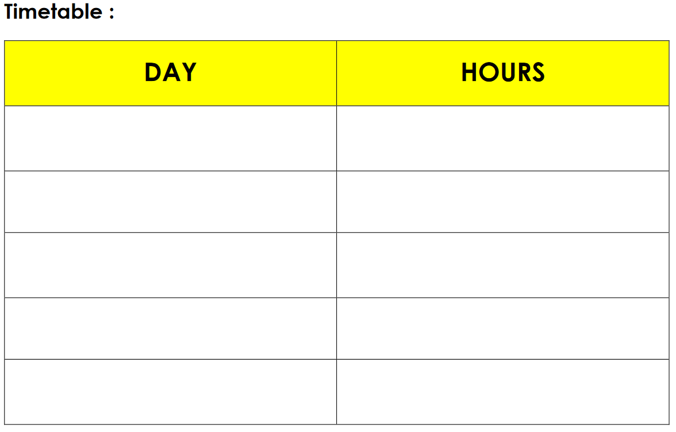
Monday
4:00 pm to 6:00 pm
Thursday
4:00 pm to 6:00 pm
Friday
4:00 pm to 6:00 pm
Wednesday
1:00 pm to 5:00 pm
Saturday
12:00 pm to 6:00 pm

Slide 4
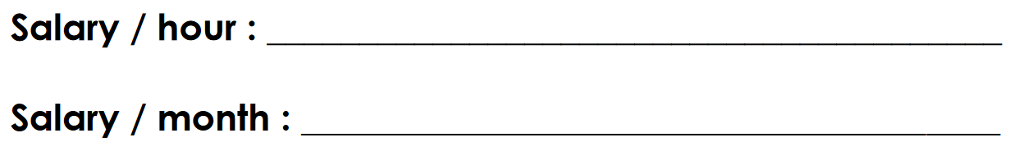
£3.80 (£7.5)
£315 (£675)

