Slide 1
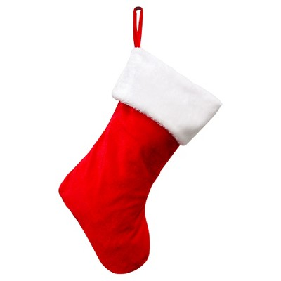

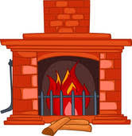
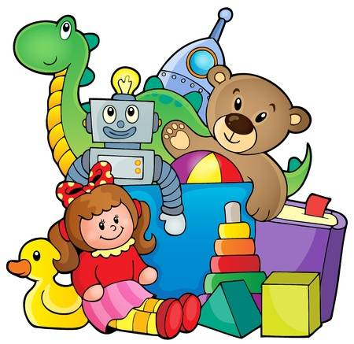
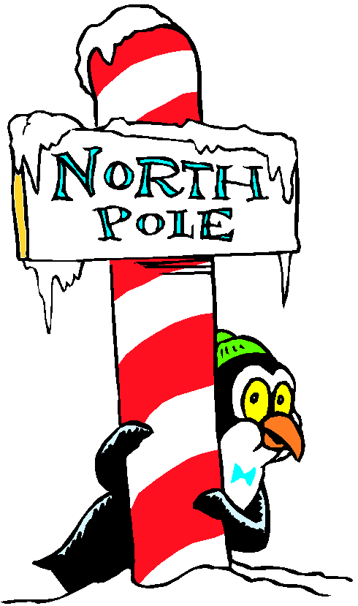
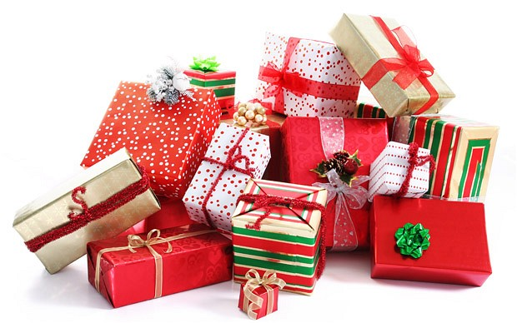
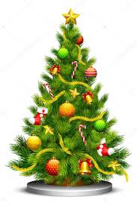

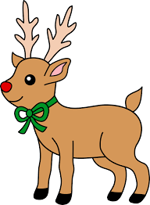
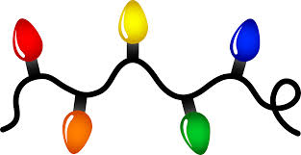


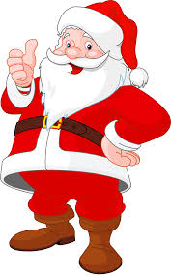

Christmas
Find the words corresponding to the pictures below
___________________
___________________
___________________
___________________
___________________
___________________
___________________
___________________
___________________
___________________
___________________
___________________
___________________
___________________

Slide 2
Words
Fireplace
North Pole
Stocking
Snow
Bells
Presents
Lights
Toys
Children
Wish
Santa (Claus)
Reindeer
Mistletoe
Christmas Tree

