Slide 1

Classroom English
Useful expressions for the English class

Slide 2


What the teacher says

Slide 3

Be quiet/ Shush

Slide 4


Open your copybook
Close your copybook

Slide 5

Read

Slide 6

Look at the picture/video

Slide 7


Repeat (after me)

Slide 8

Listen

Slide 9
Turn (a)round

Slide 10

Take a pen/pencil/glue stick…

Slide 11

Raise your hand

Slide 12

Stick on your copybook

Slide 13

Write in your copybook

Slide 14

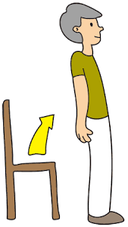
Sit down
Stand up

Slide 15


What the students/ pupils say

Slide 16

I didn’t hear. Can you repeat please ?

Slide 17


Can I close/open the window ?
Can I open/close the door ?

Slide 18
Sorry I’m late

Slide 19


What’s the English for … ?
How do you say … in English?

Slide 20
What’s the French for … ?
How do you say … in French?

Slide 21
I can’t see the board. Can you step aside please ?

Slide 22
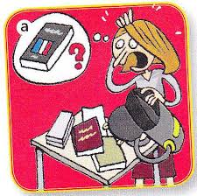
Sorry, I forgot my copybook

Slide 23

Sorry, I don’t understand

Slide 24
I don’t know,
I have no idea,

Slide 25

Can I ask for glue/a tissue/a pen… ?
Can I borrow glue/ a tissue / a pen… ?

