Slide 1

Halloween activities

Slide 2
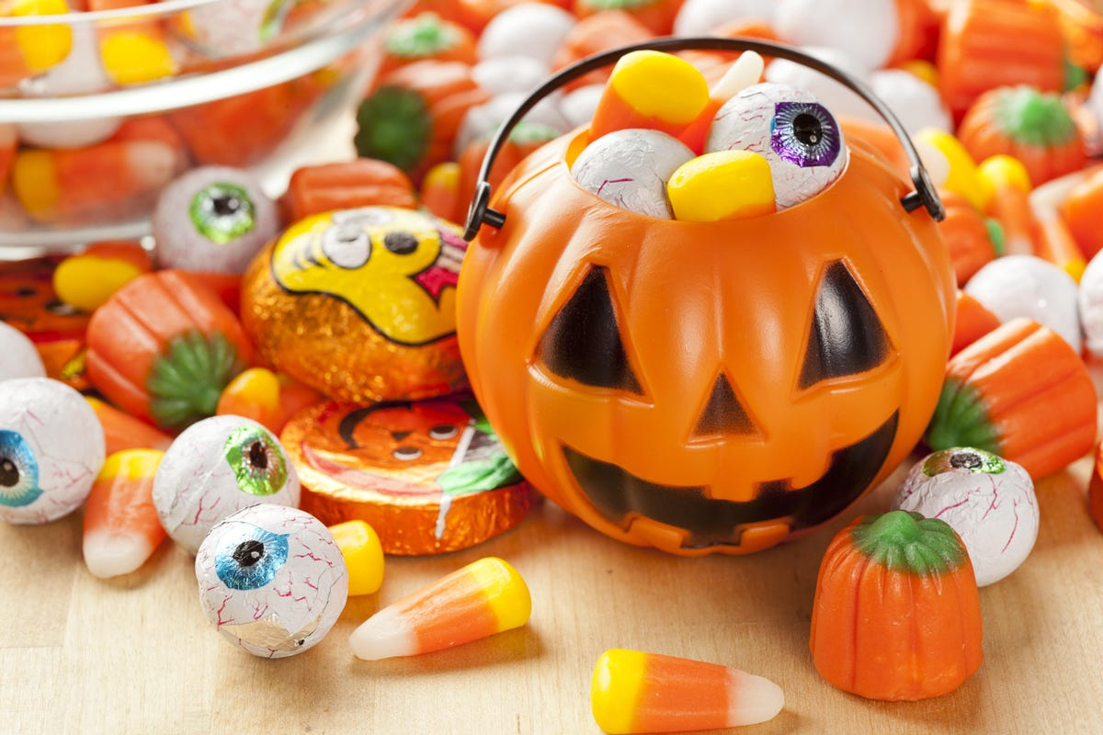
Eat candies/sweets

Slide 3
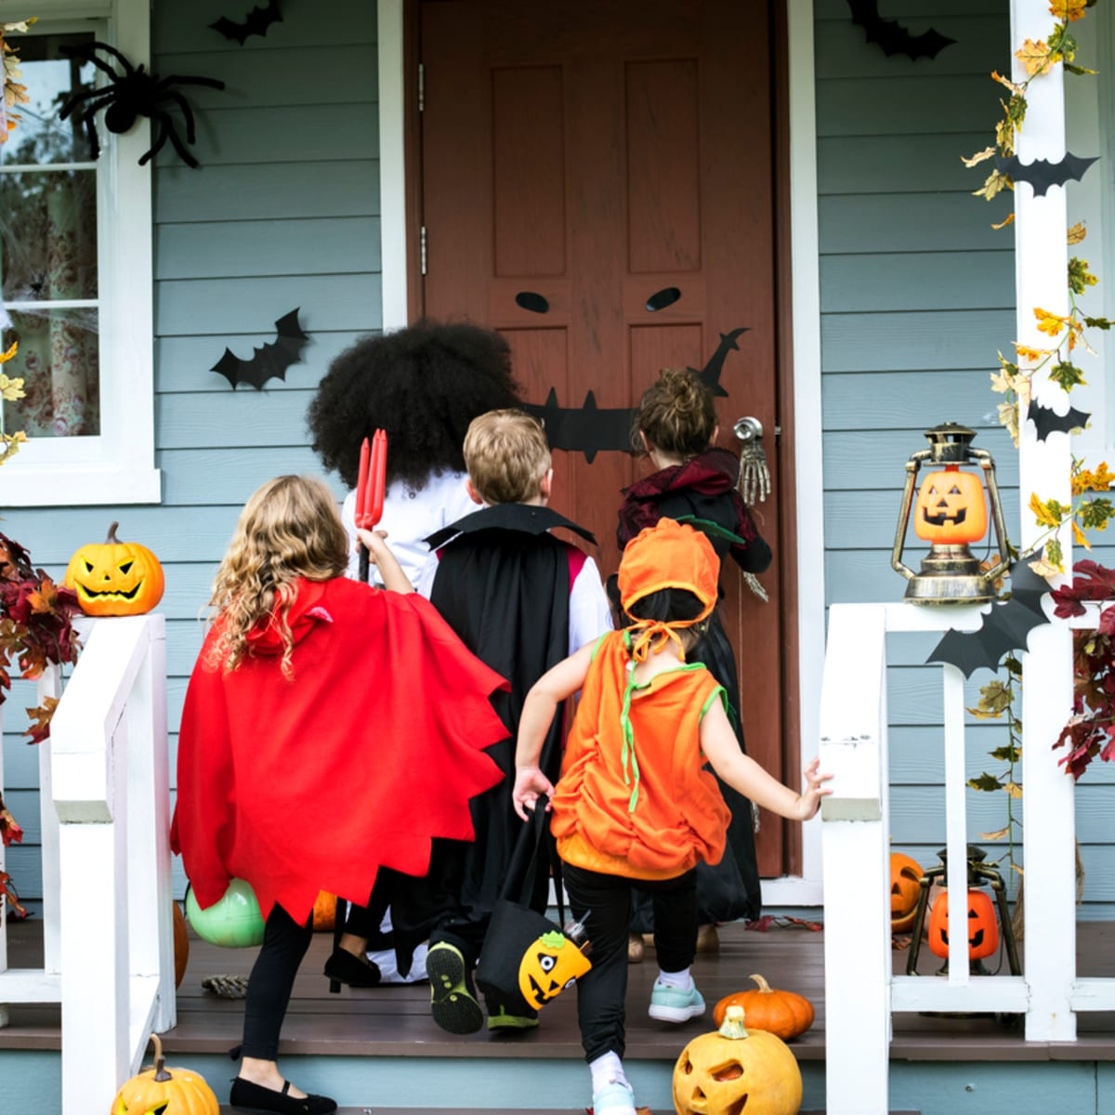
Go trick-or-treating

Slide 4
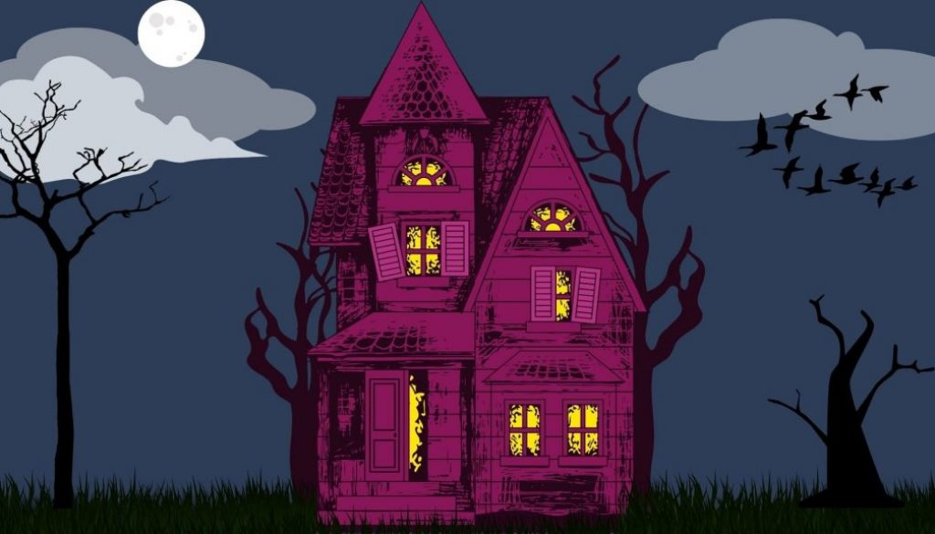
Visit a haunted house

Slide 5
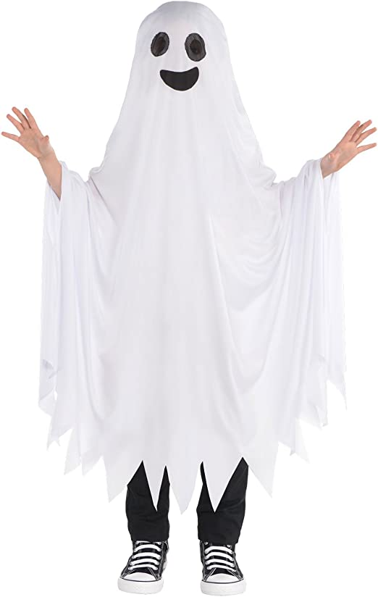
Dress up

Slide 6
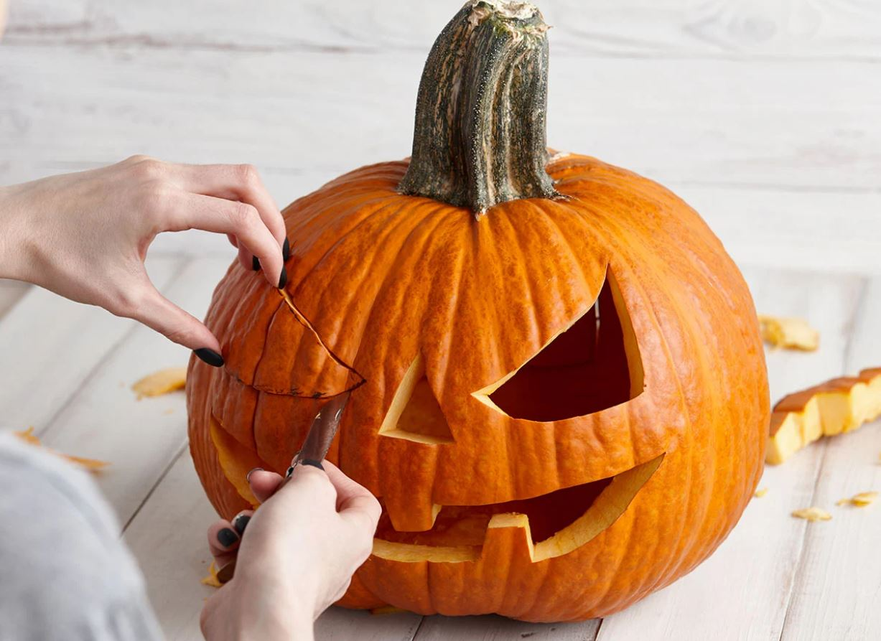
Carve a Pumpkin

Slide 7
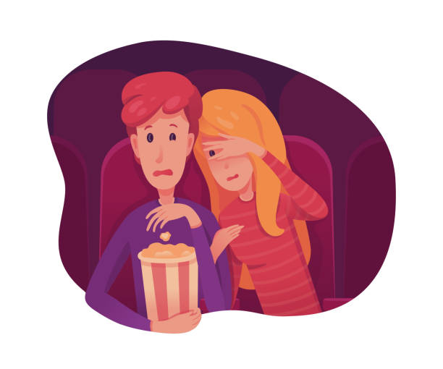
Watch horror movies

Slide 8
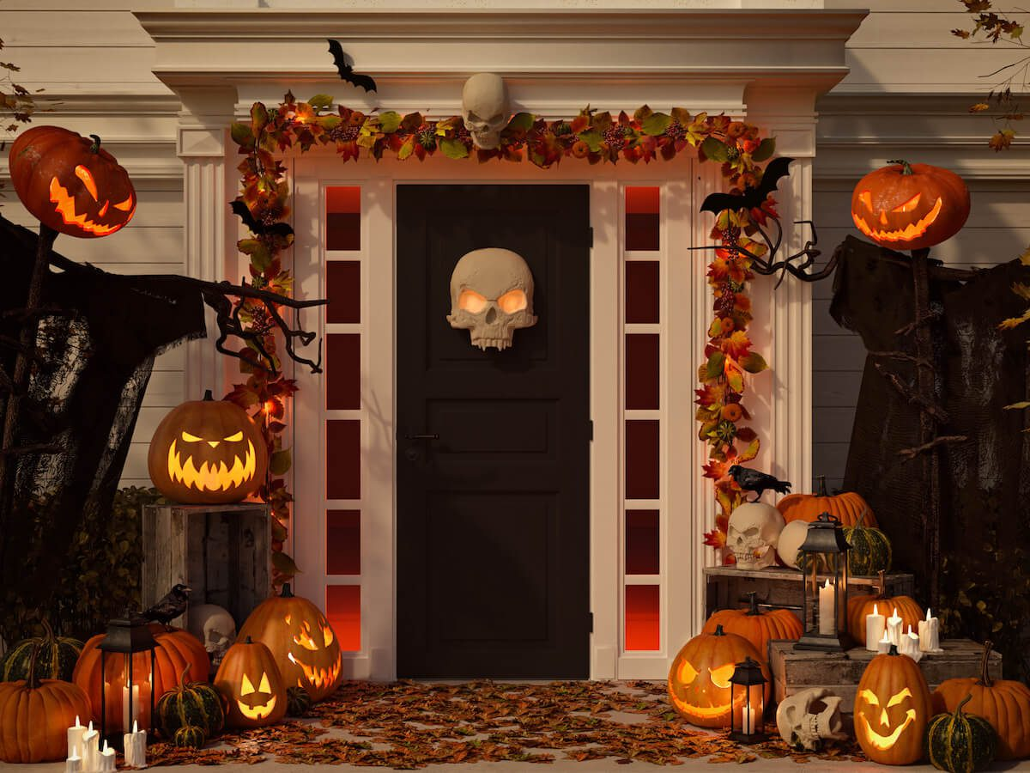
Decorate the house

Slide 9

Tell scary stories

