Slide 1






New America School—Colorado
Working with Non-Traditional Refugee and Immigrant Students
Annie Trujillo

Slide 2
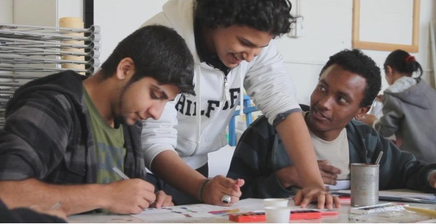
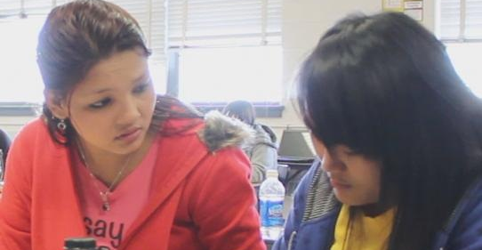
About NAS
The New America School is a system of publicly funded charter high schools throughout Denver, Colorado. The mission of The New America School is to empower new immigrants, English language learners, and academically underserved students with the educational tools and support they need to maximize their potential, succeed and live the American dream.
Notes:
IMPORTANT TO MENTION REALITY HERE. EVERYONE IS PAINFULLY AWARE THAT WE ARE ON THE CUSP OF TRUMP’S AMERICA, WHICH WASN’T PARTICULARLY RECEPTIVE TO OR SUPPORTIVE OF THIS MISSION STATEMENT TO BEGIN WITH.
It is important to acknowledge that alternative schools in Colorado operate in a climate of hostility and suspicion. In addition to widespread racism and classism, our students are subject to the xenophobic suspicions that characterize public sentiment in the U.S. today.
More specifically, even allies of our students cannot escape their own deep-seated fears and suspicions. Policies and programs for alternative education, while enacted in support of marginalized students, are built on the same assumptions as conventional schools – the world-view of individualism and personal success, competition, and standardized expectations enforced by centralized, high-stakes exams. In short, if you are not doing well in school it is your fault; you are probably lazy or playing the system. If, as an educator, you argue that conventional high schools are organized to capitalize on middle-class values, nuclear families with ample resources, and a multi-generational history of academic achievement – an environment that does not reflect the realities of our students – you are accused of whining, and of making excuses for students when you should be bearing down more forcefully on them and requiring more work and diligent application of achievement values. In other words, you need to be “more rigorous.”

Slide 3

Lowry Campus
Chartered under the Colorado Charter School Institute, our students have to meet the graduation requirements and expectations as other high schools and receive an accredited high school diploma.
Approximately 40% of our student body are refugees or recently arrived immigrant students; about 75% are English language learners.
450-500 non-traditional high school students, ages 14-21, 70% are ages 17 -21
Ethnicities:
  77% Hispanic
  15% Asian/Pacific Islander
  7% Caucasian
Classes offered 8:00a – 10:00p
18 teachers, 14 support staff
Unique opportunity for older, English language learners. One of three area high school’s that will accept students over the age of 17 through 21.

Slide 4
About NAS
We recruit and support staff members whose dedication to the Lowry population is clear, and who are willing to work on their own learning as they adjust to the students’ realities.
We provide training and support for teachers to support their instruction as language teachers, regardless of course content.
We adapt programs such as Facing History and Ourselves to deliver a culturally and personally relevant curriculum to our diverse student body.
We have modified the bell schedule and teaching responsibilities to permit staff to utilize student data to drive instruction, and collaborate on NAS best practices.
We recognize that staff development is the core of all our work: We emphasize that, regardless of formal training and certification, everyone must adjust their assumptions about their roles and responsibilities to meet the needs of the students.

Slide 5
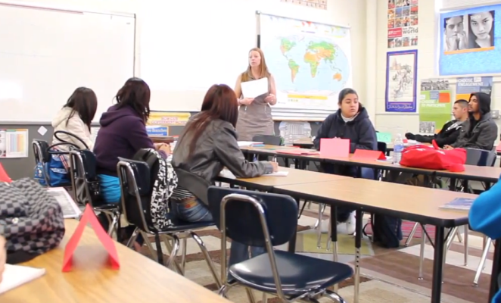
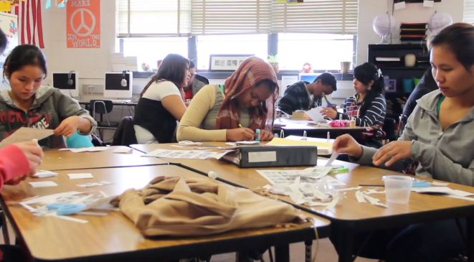
Newcomers & ELA
Our newcomer English program consists of a four-hour block of English language development each day.
Students are transitioned slowly so they can continue to improve their English alongside their content classes. ELA 2 and ELA 3 students receive two hours of English classes each day, focused on academic English acquisition and content preparation.
All NAS teachers are required to have or be working towards a Linguistically Diverse Education endorsement to their licenses.
Notes:
Many of our students enroll at Lowry because conventional high schools do not provide the academic programs or specialized support they need to earn a high school diploma. We serve students from around the world as well as local students with special needs. Students come from a wide variety of backgrounds and experiences. We currently have 500 students enrolled from 43 countries. Students range in age from 14 to 21. Sixty-seven percent are English Language Learners and more than 65% of our students qualify for free or reduced meals. More than 95% of the students qualify in at least one Colorado statutory high-risk category (e.g., homelessness, domestic abuse, drug abuse, etc.).

Slide 6
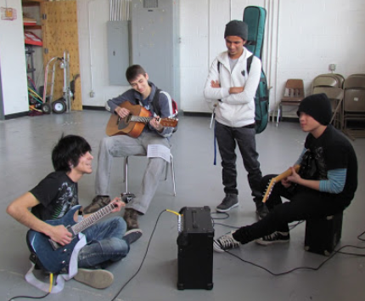
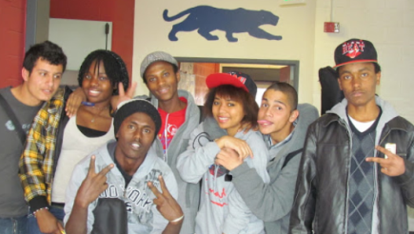
Supporting Older Students
Flexible scheduling within a four-day school week permits supportive teacher –student relationships, focused student placement in content and English courses based on students’ interests, abilities, and progress.
Staffing decisions are made to provide smaller class sizes and collaboration among teachers.
Additional tutoring and homework help is provided daily after school
Students can attend a four-week summer school and take additional classes on Fridays, accelerating their credit accumulation towards graduation.
Licensed counselors and support staff provide support for social-emotional development.
Individual interventions and ongoing support for students that are at-risk of dropping out and/or not graduating.

Slide 7
Extra Supports
Students can earn bus passes to help with transportation.
Young mothers are eligible to receive financial help to offset the cost of childcare.
Strong partnerships with local organizations allow for engaging clubs and activities to be delivered to students at no cost.
All staff – including office and security personnel – are recruited because of their commitment to this population, and they receive training to support their continuing development of skills and insights.

Slide 8
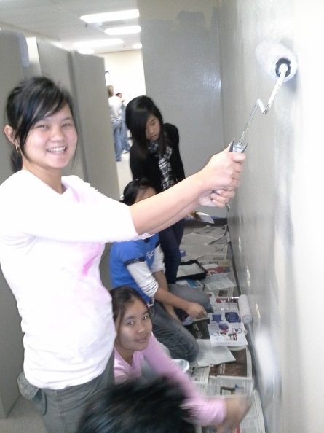
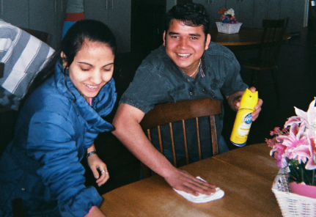
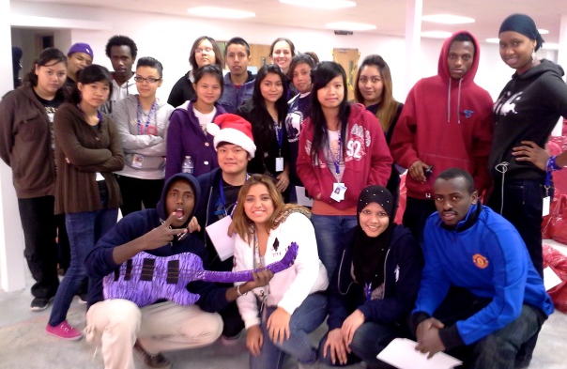
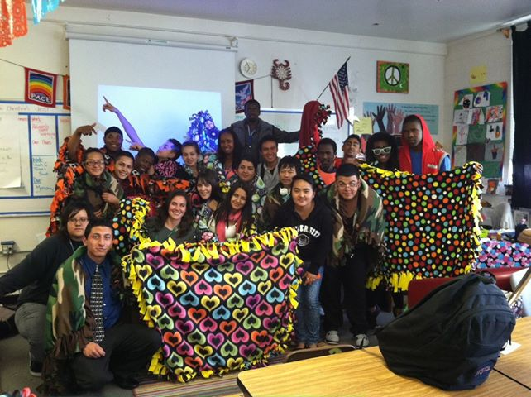
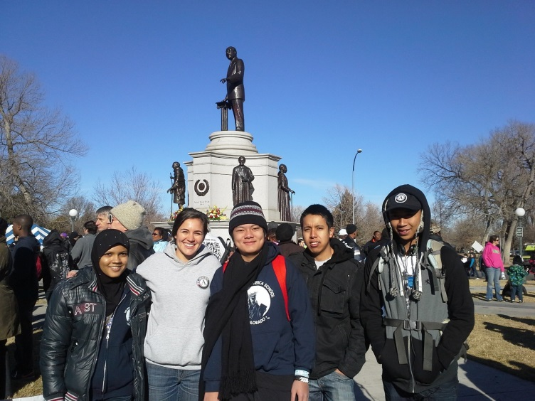
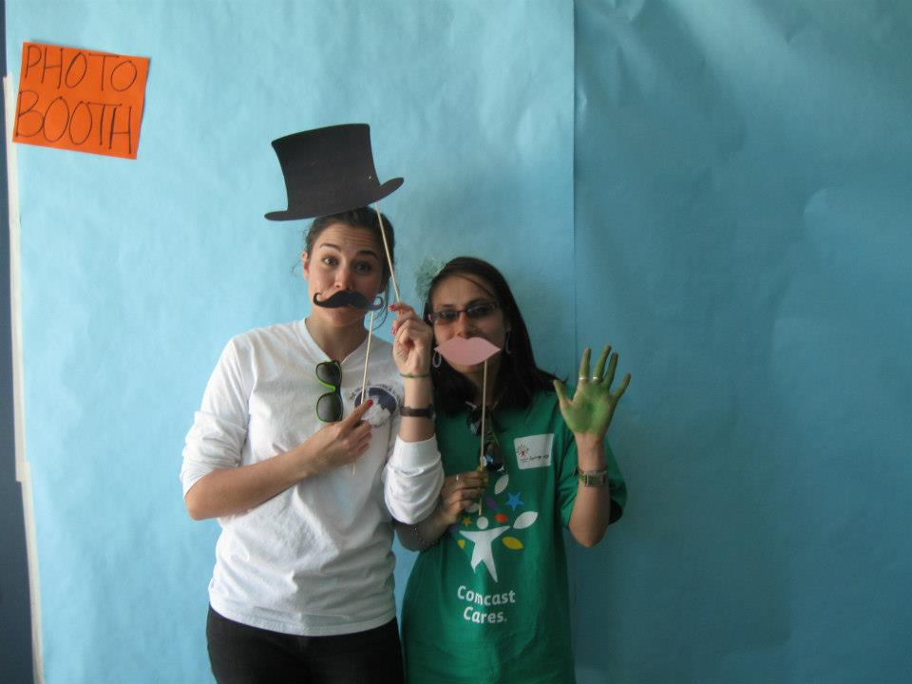
Extra Opportunities
Service Projects

Slide 9

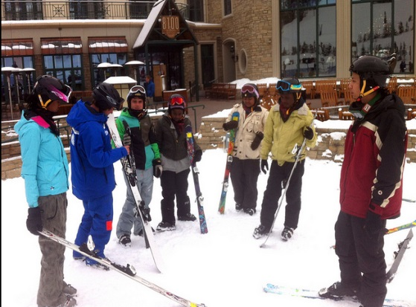
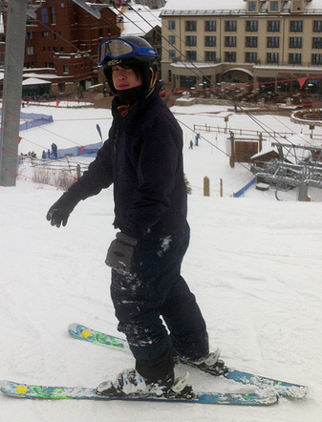
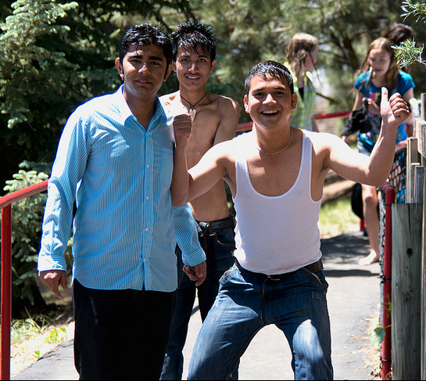

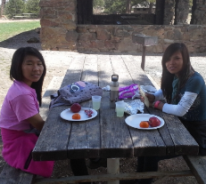
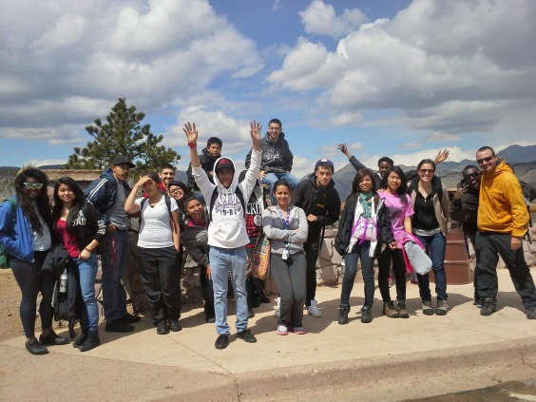
Field Trips
Elitch Gardens
SOS Ski Trip
Big City Mountaineers Day Hike

Slide 10
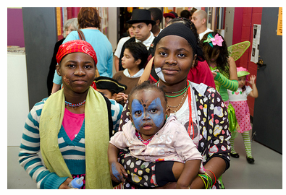
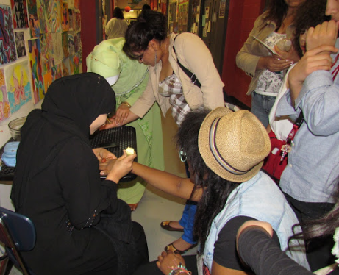
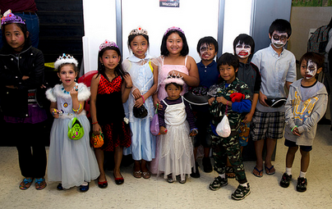
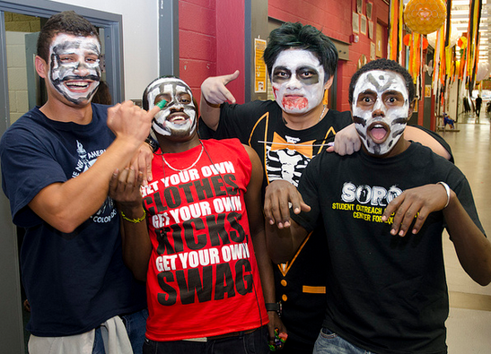
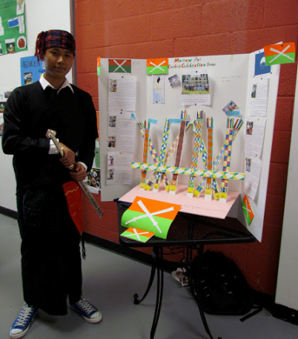

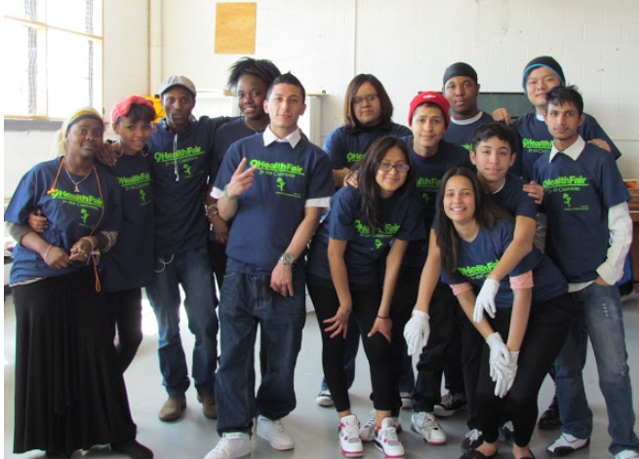
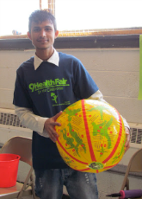
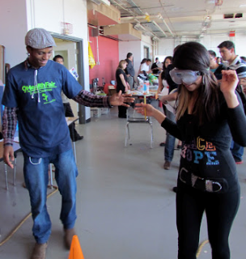
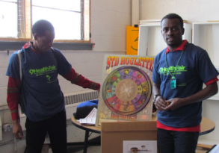
Festivals
Celebrate NAS Diversity
Fall Celebration
9 Health Fair

Slide 11

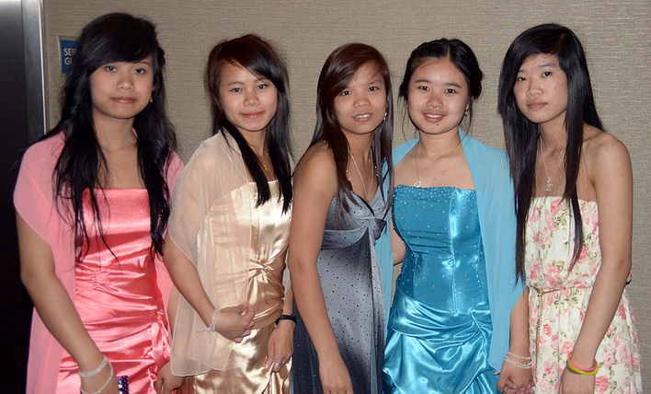
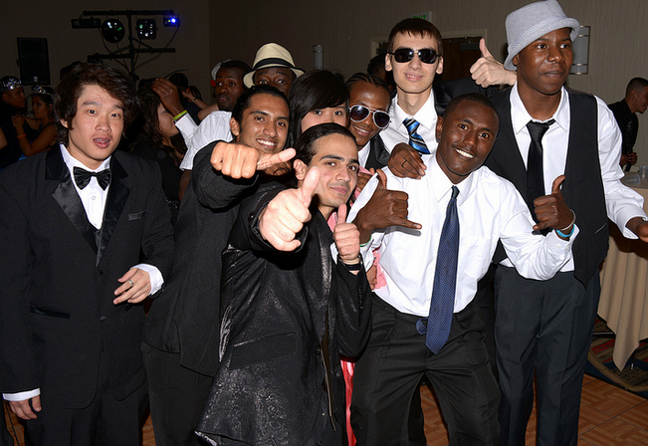
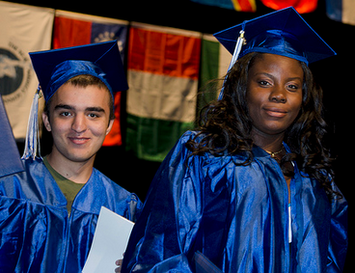
Events
Screening of the
NAS Movie
Prom
Graduation

Slide 12

What our students say . . .

Slide 13
Questions:
Annie Trujillo
atrujillo@newamericaschool.org

