Slide 1
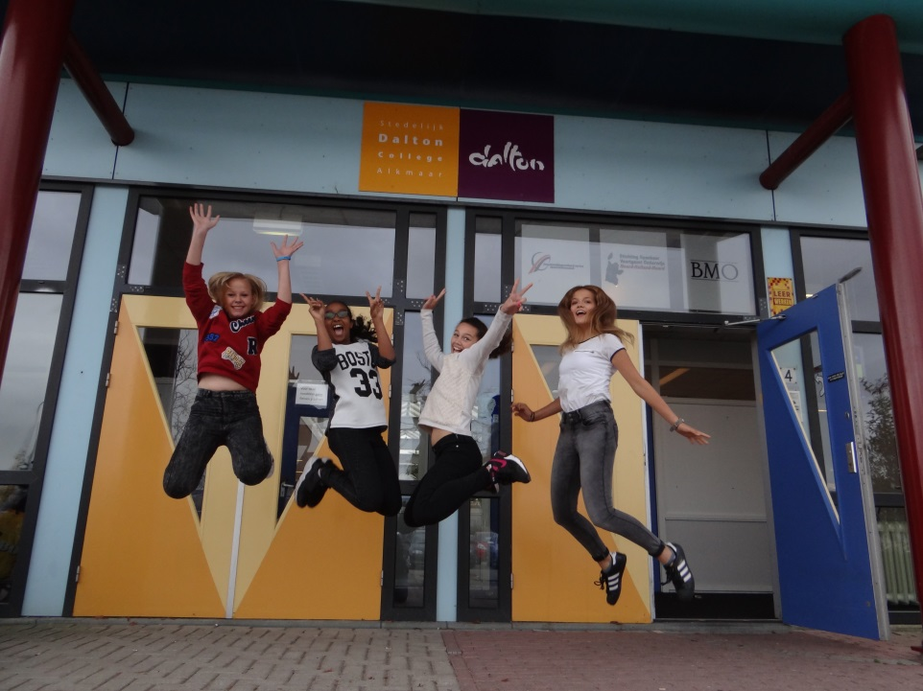
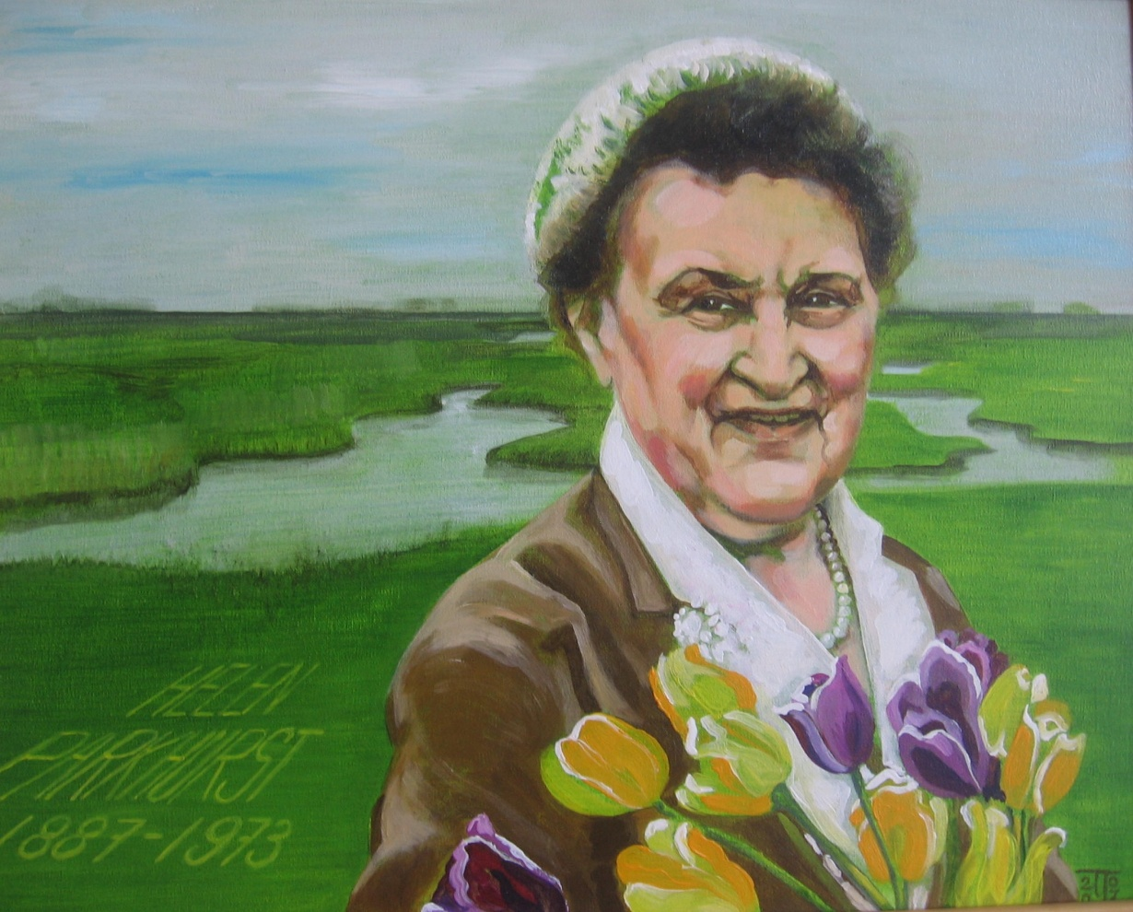
Dalton Alkmaar

Slide 2
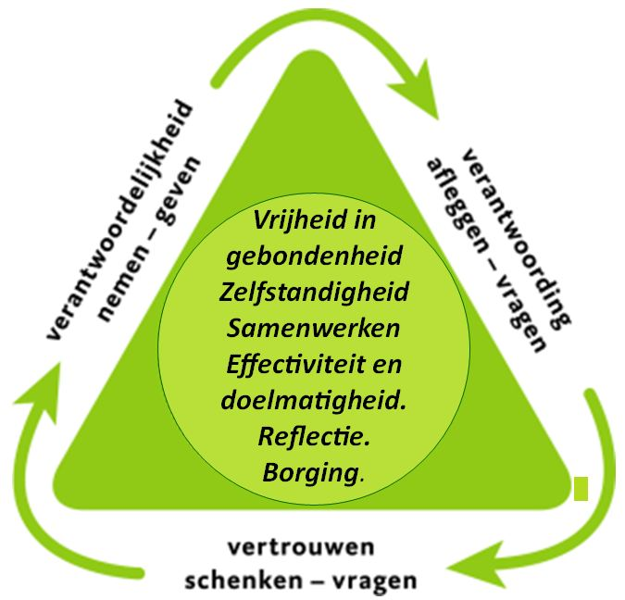
Dalton values

Slide 3
Dalton values
Freedom and responsability
Independance
Collaboration: Work together
Efficiency: do what works…
Reflection
Consolidation

Slide 4
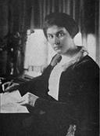
Exploring the child’s world
“The child’s world is very real. Those who inhabit it have a radically different point of view from that of adults”
Helen Parkhurst

Slide 5
What does the school want to achieve?
from a didactic point of view …….”Pupils should be given the chance to acquire the art of study before they can be expected to learn”
from an educational point of view …… “The true business of school is not to chain the pupil to preconceived ideas, but to set him free to discover his own ideas…”
Helen Parkhurst – Education on the Dalton Plan, 1922
Notes:
Education means educating a pupil (transfer of knowledge), but it also means raising a child (transfer of culture). What does a specific child need to learn reading, writing, making a paper, getting socially more able? That’s the starting point of Dalton.

Slide 6
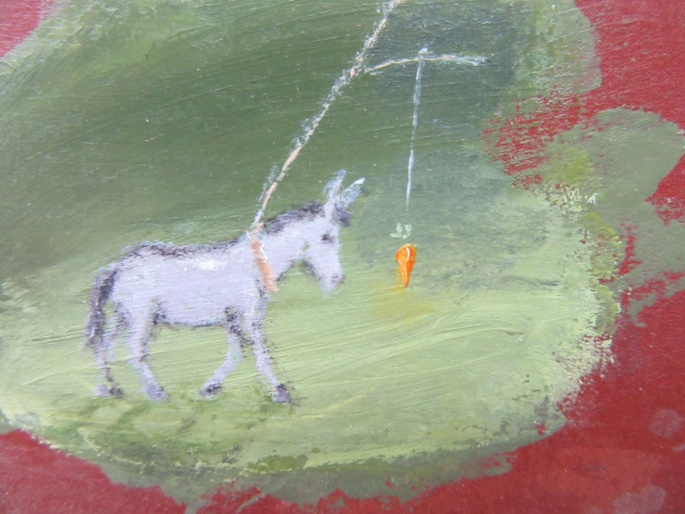
Flow?
“The goal to be aimed at is to the child like a carrot to a donkey – it keeps him moving onwards”

Slide 7
Consciously, we teach what we know; unconsciously, we teach who we are.
D. Hamachek (1999) - Effective teachers: What they do,
how they do it, and the importance of self-knowledge.

Slide 8
“Good teaching cannot be reduced to technique, good teaching comes from the identity and integrity of the teacher.”
P.J. Palmer (1998) – The courage to teach

Slide 9
Mission statement of
Dalton Alkmaar
All children are different!
Develop their talents
Personal growth, self knowledge and reflection
Critical and social citizens
Entrepeneurship and creativity

Slide 10
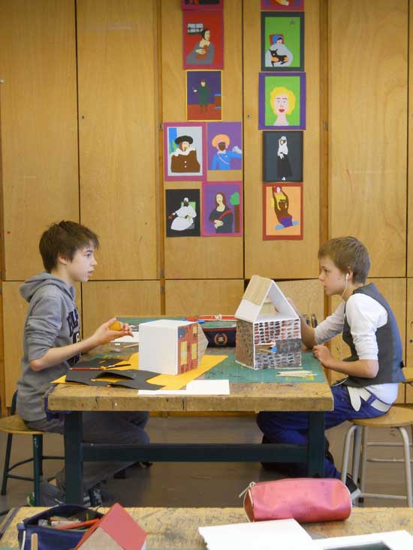
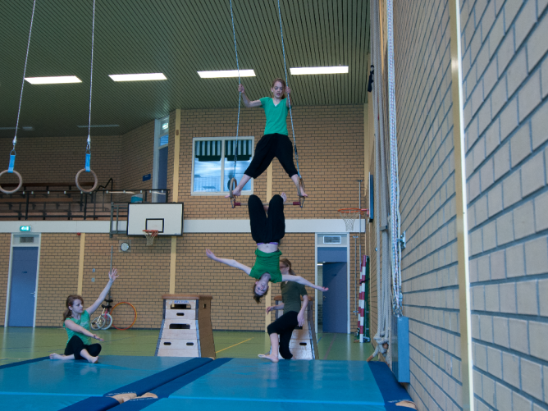
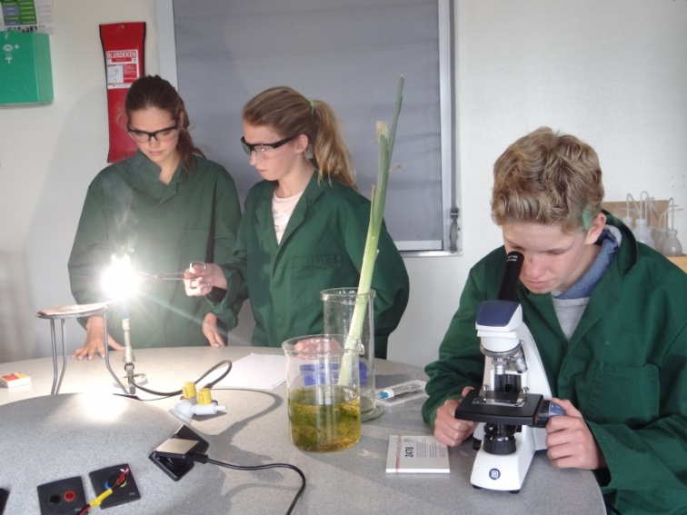
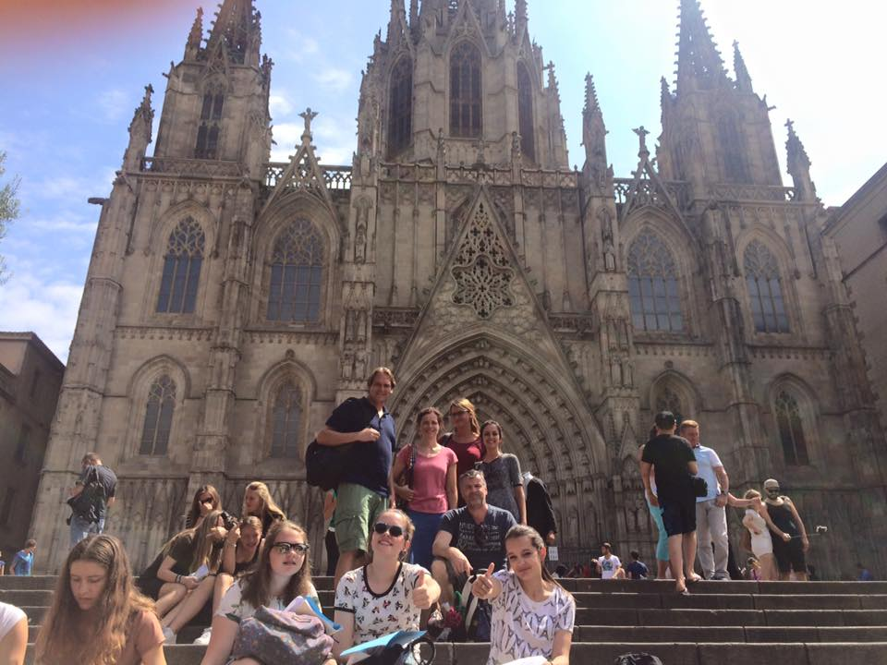
Dalton Original

Slide 11
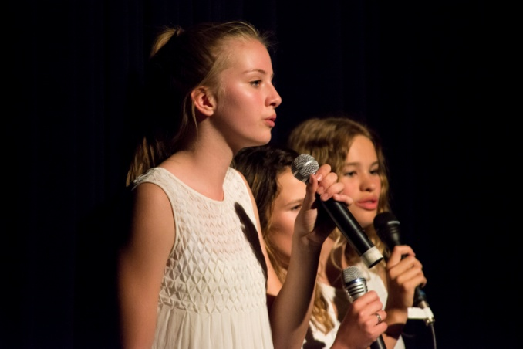
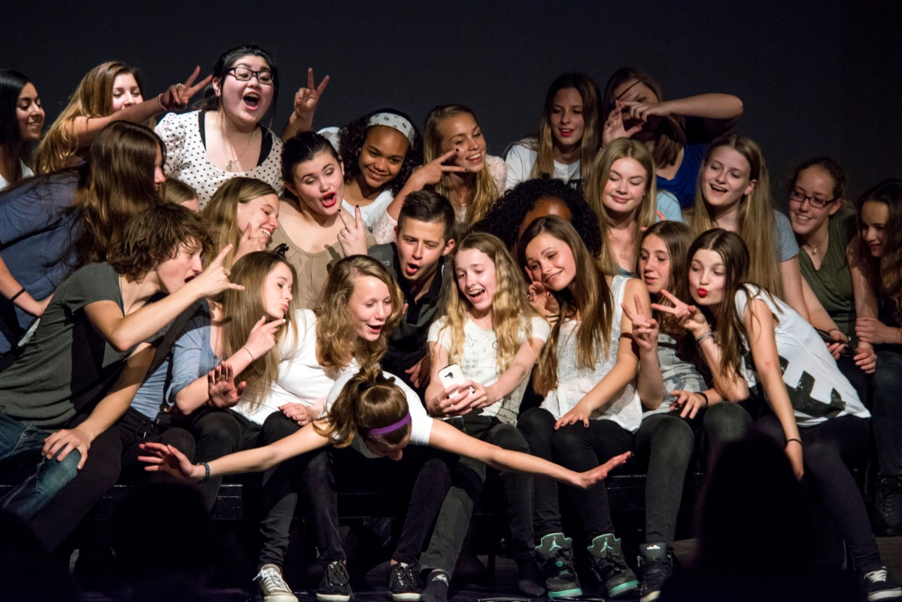
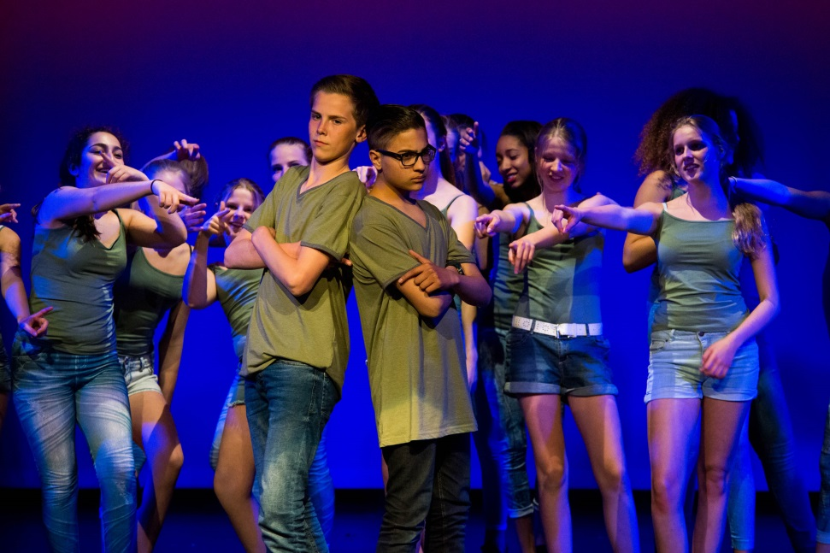
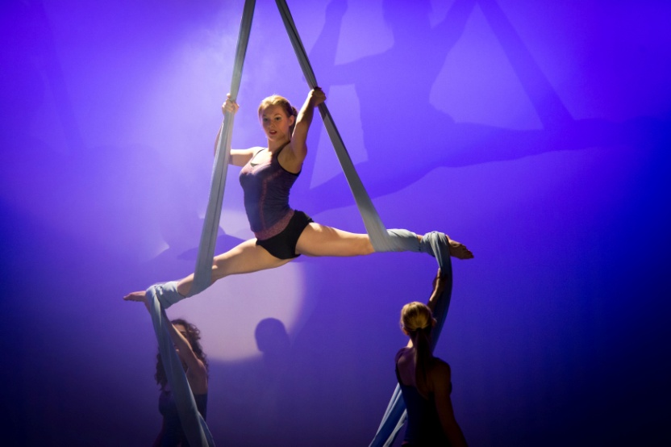
Dalton on Stage

Slide 12
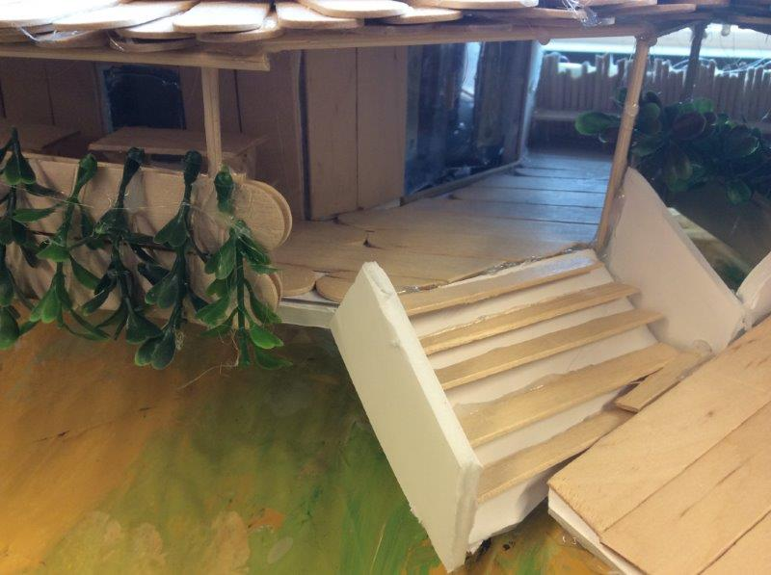
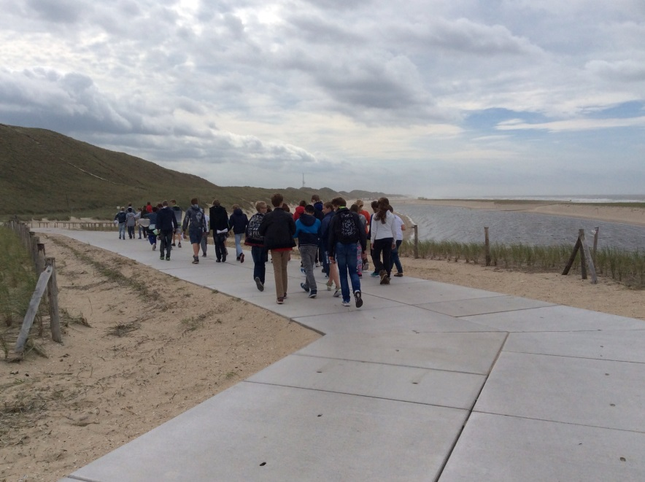
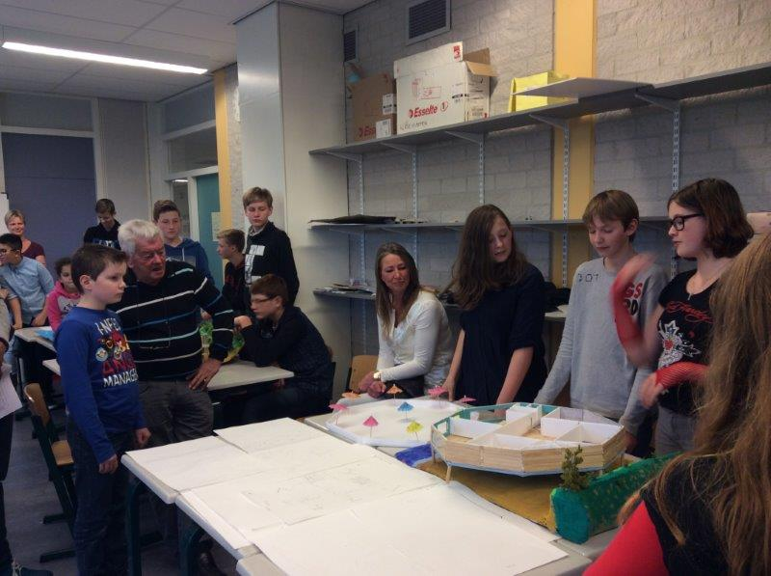
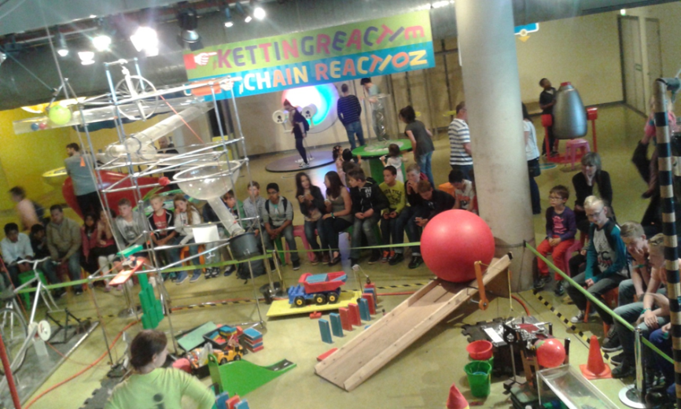
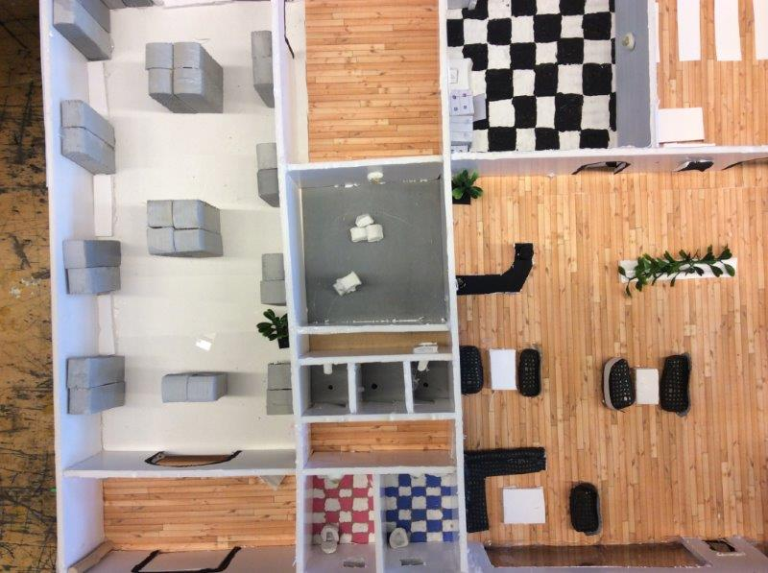
Dalton Tech(nasium)

Slide 13
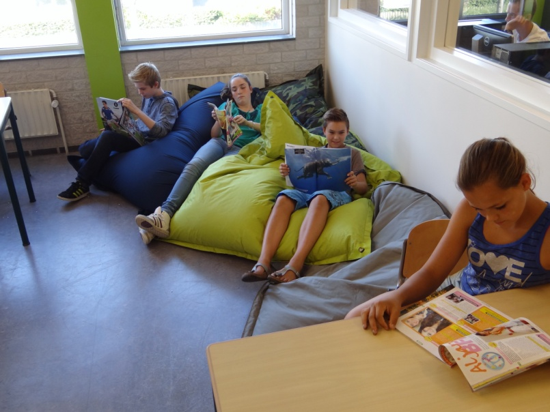
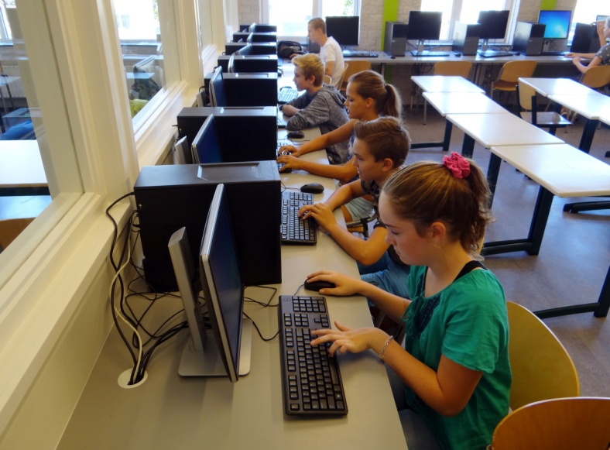
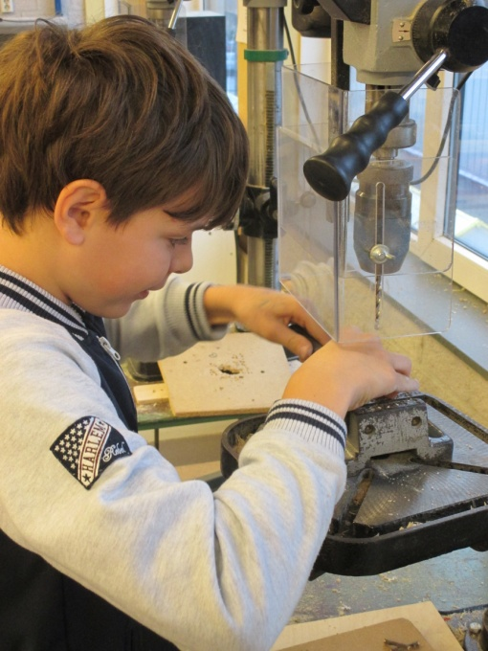
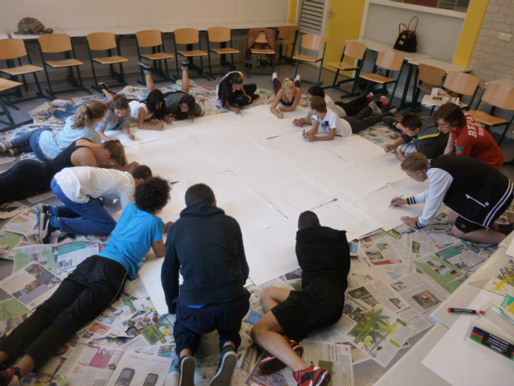
Dalton Skills

Slide 14
School-wide PBS
A system approach for establishing the social culture and individualized behavioral supports needed for schools to achieve both social and academic success for all students.

Slide 15
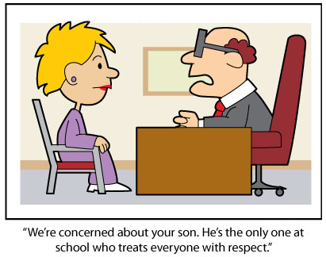

Slide 16
Evidence-based features of SW-PBS
    Prevention
    Define and teach positive social expectations
    Acknowledge positive behavior
    Arrange consistent consequences for problem behavior
    On-going collection and use of data for decision-making
    Continuum of intensive, individual interventions
    Administrative leadership and Team-based implementation

Slide 17
Tertiary Prevention:
Specialized
Individualized
Systems for Students with High-Risk Behavior
SCHOOL-WIDE
POSITIVE BEHAVIOR
SUPPORT
~5%
Secondary Prevention:
Specialized Group
Systems for Students with At-Risk Behavior
~15%
Primary Prevention:
School-/Classroom-
Wide Systems for
All Students,
Staff, & Settings
~80% of Students

Slide 18
Do what works….
Positive feedback
Teach what you want to see
Pay attention to positive behaviour
Neglect negative behaviour
Choose your issues based on study
Start with a small goal: for example “we keep our school clean”.

Slide 19
