Slide 1
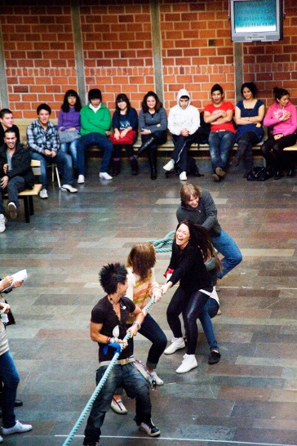
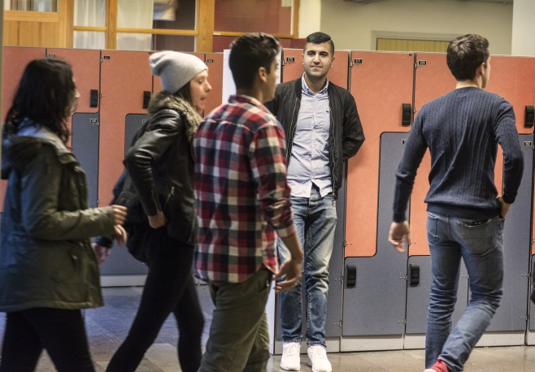
Sweden
Immigrant, refugee and at-risk youth integration (inclusion)

Slide 2
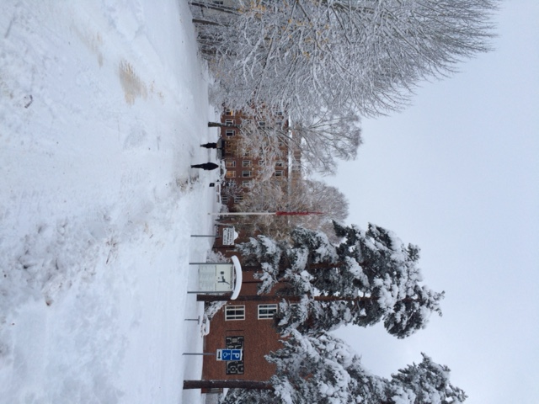
BLACKEBERGS
GYMNASIUM
Stockholm, Sweden

Slide 3
Blackebergs gymnasium
Upper secondary school (age 16-18)
1060 students in national programs
140 newcomers in special programs
70 teachers
2 social workers, 3 nurses, 3 student counsellors
4 weeks summerschool for 900,
newcomers (with other staff)

Slide 4
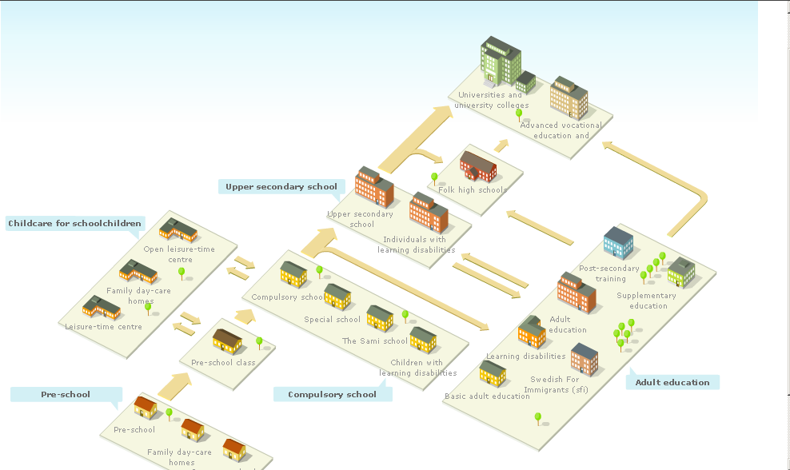
Swedish school system

Slide 5
The economy
Public funding
The school gets paid for each student
irrespectively of resultats, the principal decides
how to use the money
But – succesfull schools appeal to more
students and since the students have a
free choice of school that means more students
and more money
The amount of money depends on the program
Students in special programs generate more

Slide 6
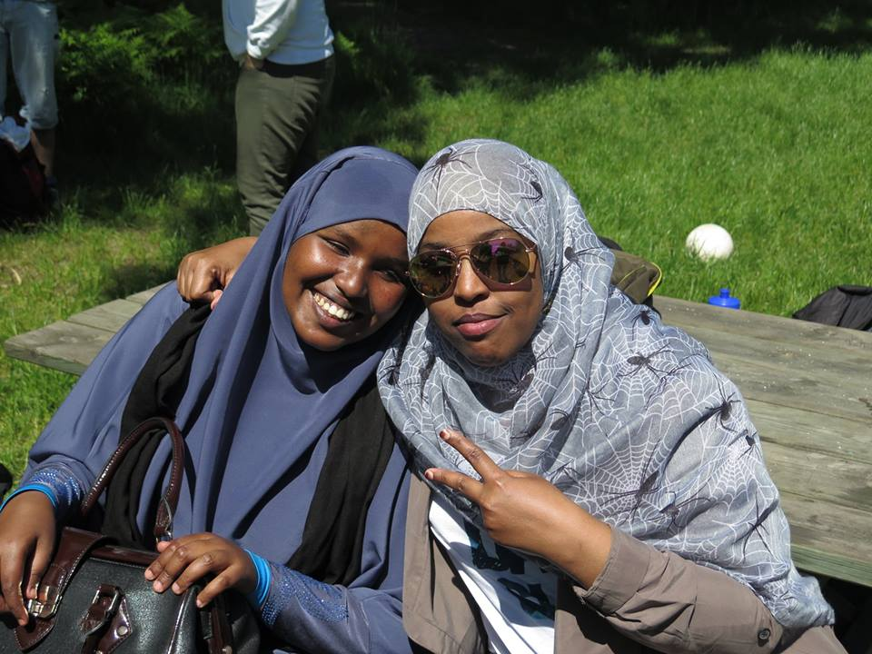
Immigration in Sweden
In general: a highly regulated
responsibility of
the society
Little cooperation with the community and other organisations

Slide 7
Newcomers in the
Compulsory school
(age 7-15)
Testing
Since april 2016 it is obligatory to test newcomers (within 2 months) with material from The Swedish National Agency for Education
* The pupils language and experiences
* Literacy och numeracy
* Knowledge in 15 of the compulsory
schools subjects

Slide 8
Compulsory school
Preparation classes - form and content differs from city to city and from school to school
but
as soon as possible and as much as possible with ordinary classes

Slide 9
Upper secondary school
Age 16 – 18 (22)
Each municipality is obliged to offer upper secondary school
Free of charge (education, books, lunch, material)
It is voluntary– apply able until the age of 20 year (nearly everyone attend)
Curriculum - 2011

Slide 10
18 national programs with specific degree targets
From which 6 are Preparatory university programs
and 12 Preparatory professional (vocational) programs
and also 5 introductory programs

Slide 11
Upper secondary school
National programs
Each program consists of 2 500 credits
Subjects are divided into courses
Each course has an amount of 50 ,100 or 150 credits. Most courses have 100
Grading scale – E, D, C, B A – where A is highest

Slide 12
National programs
Specialization
courses
450
T
H
E
S
I
S
100
Common
subjects
1150
Immersion
courses
300
Program
Common
subjects
300
Individual options
200

Slide 13
Admission requirements for national programs
Vocational programs
Pass grades in
Swedish or Swedish as a second language
(CEFR B2)
English
Mathematics
Five other compulsory school subjects.
Higher education preparatory programs
Pass grades in
Swedish or Swedish as a second language
(CEFR B2)
English
Mathematics
Eight other compulsory school subjects.
CEFR=Common European Framework of Reference

Slide 14
Introductory programs – for those who don’t accomplish the requirements
  Preparatory education
  Programme oriented individual options
  Vocational introduction
  Individual alternative
  Language introduction

Slide 15
Language introduction
For eveyone who dont pass grades in Swedish as second language – which means nearly all newcomers
Length: 1-3 years, individually – but in a groupframework
Minimum 22 hours a week (Stockholm). The principals decision how to use them.
Swedish as second language and other subjects (mathematics, english and 5 or 8 more)
For some: Study guidance in native language
For those who want: Native language (credits!)

Slide 16

The students 2016-2017
Language introduction in Sweden
33 000 students (the fourth largets program, an 77 % increase since the year before)
Around 80 % boys (Stockholm), most of them unaccompanied minors
Some without documents
Biggest groups
Afghanistan (Dari)
Eritrea (Tigrinja)
Syria (Arabic)
Somalia (Somali)

Slide 17
Organisation in Stockholm
Welcoming school with continuos intake
Testing of the students (in and out)
In august transfer to ordinary upper secondary schools, from the welcoming school and from the compulsory schools
Between 40 and 200 language introduction students in each public school
Around 20 students in each group
Placed after schoolbackground, progression and knowledge in swedish

Slide 18
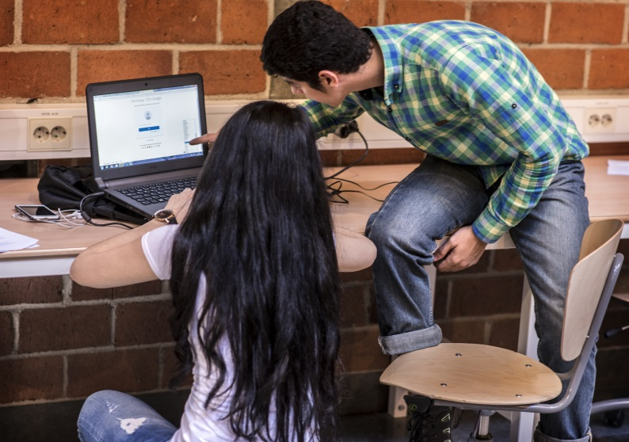
Important facts about students
Schoolbackground (when, where, how and what)?
Translatable credits?
Abilitys in nativ language (reading, writing)?
Knowledge of other
languages?

Slide 19
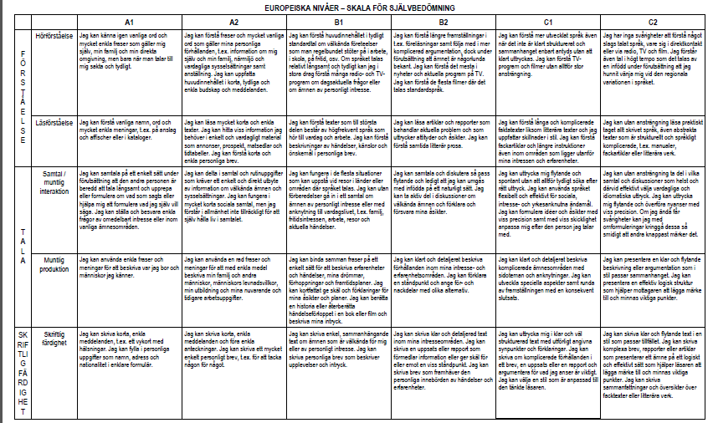
CEFR(Common European Framework of Reference)

Slide 20
Biggest Challenges 2017
Deportation of students (at the age of 18) – the impact on friends, schoolmates, teachers and the whole organisation
Increased mental illnes (trauman - the mediterraneantrip), the need of nurses, social workers, psychologist and prepared teachers
(the school as a safe place)
How to adjust an organisation made up for a big amount of new students to the few newcomers coming now (because of the changed immigrationpolicy in EU and Sweden)
The opinion and the inreasing polarisation

Slide 21
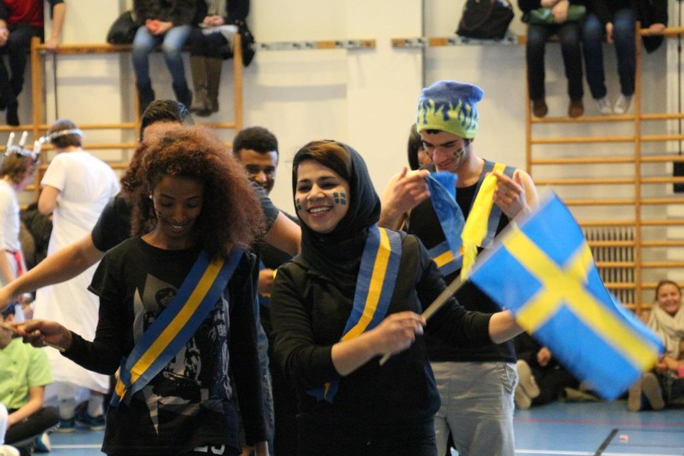

And of course – inclusion
In the school and in the society

Slide 22
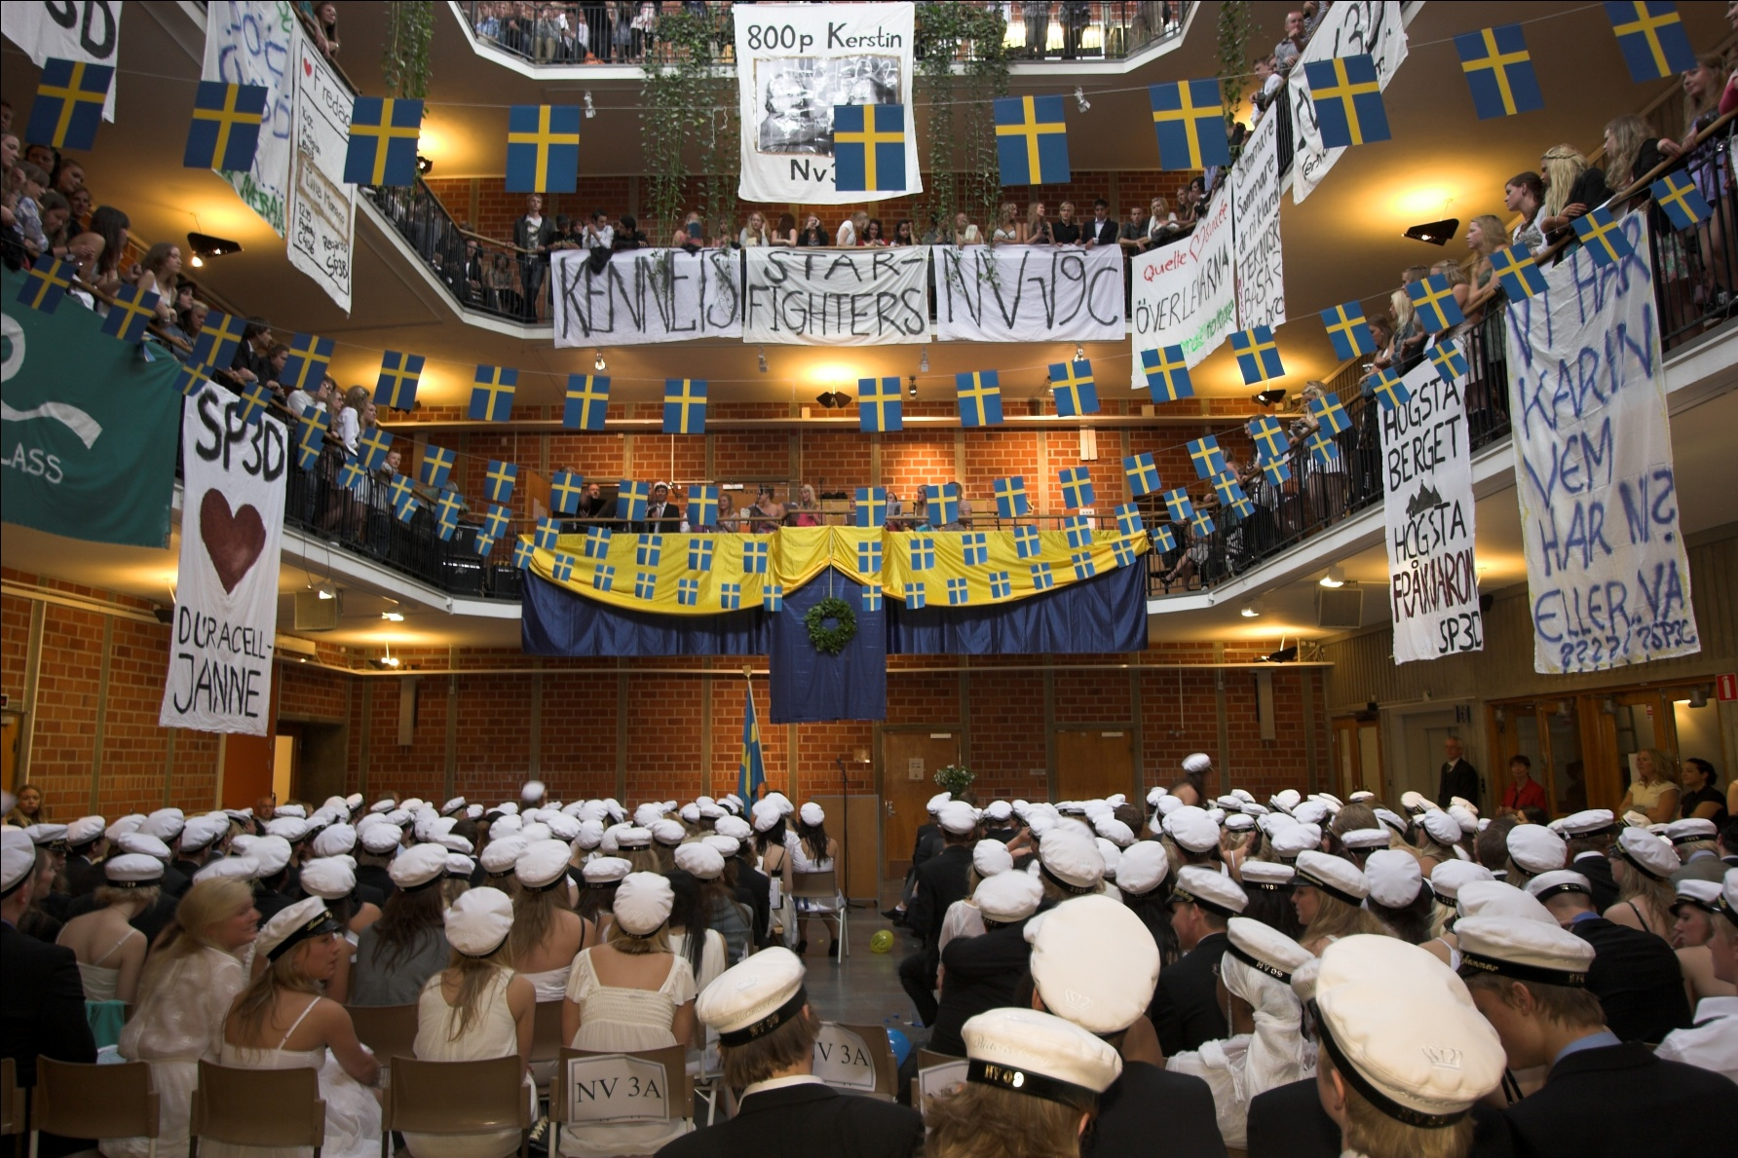
Goal: wellbeing, education and a good and possible future in Sweden – for all students

