Slide 1


Slide 2
Before:
Mastery Charter-Shoemaker Campus
West Philadelphia (born & raised)
2nd most dangerous school in the state of Pennsylvania
90% receive free/reduced lunch from federal government
90% of our students are considered “at-risk”
6% of the community have college degrees
50% drop out rate in Philadelphia

Slide 3
After:
Mastery Charter-Shoemaker Campus
“Turnaround”
  Same students
  Different adults
  Different expectations & supports
100% of our students are accepted to college
80% attend day 1
Recognized by President Obama, US Department of Education & Oprah

Slide 4
Trauma Informed:
Strategies and Self Care for Schools Serving Immigrants & Refugees

Slide 5
Agenda
Trauma review
Practice and plan for challenging situations
Safety plan

Slide 6
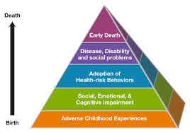
Trauma Review

Slide 7

ADVERSE CHILDHOOD EXPERIENCES
INDIVIDUAL
MALTREATMENT
EMOTIONAL NEGLECT
HOUSEHOLD
SEPARATION
SUBSTANCE ABUSE
DOMESTIC VIOLENCE
CHRONIC UNCERTAINTY
SEXUAL ABUSE
PHYSICAL ABUSE
EMOTIONAL ABUSE
PHYSICAL NEGLECT
INCARCERATION
MENTAL ILLNESS
--Sandra L. Bloom, MD
Notes:
Scores range from 0-10.
ACEs predict many different adverse outcomes, up to 50 years after people experienced trauma. Outcomes predicted include adulthood high-risk health behaviors such as smoking, alcohol and drug abuse, promiscuity, and severe obesity, and correlated with ill-health including depression, heart disease, cancer, chronic lung disease and shortened lifespan. Compared to an ACE score of zero, having four adverse childhood experiences was associated with a seven-fold increase in alcoholism, a doubling of risk of being diagnosed with cancer, and a four-fold increase in emphysema; an ACE score above six was associated with a 30-fold increase in attempted suicide.
Recent research in Washington state looked at how ACES affect current students. They found that students with 3 or more ACES were 3 times more likely to experience academic failure and 6 times more likely to have severe behavior problems than students with no ACES.

Slide 8
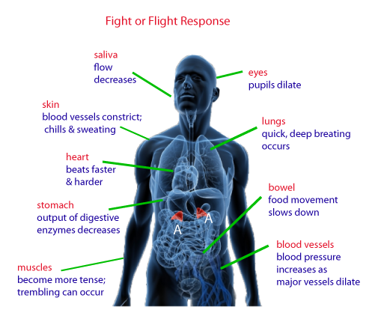
Human Stress Response
State of high alert
Inability to think clearly
Extreme thoughts
Attention to threat
Intense and prolonged anxiety
Drive to take action
--Sandra L. Bloom, MD

Slide 9
What might a Traumatized child look like in school?
YOU MIGHT SEE
REASON
Difficulty retaining info
Distractible, not paying attention
Poor social skills; lack of trust
Causing chaos; provoking others
Hair trigger temper
Aggression, bullying, fighting
Only paying attention to things tagged for danger
Trauma causes hypervigilance. On lookout for danger
Trusted people in life have hurt him/her
Adrenaline kicking in due to fight/flight response
Unconsciously triggered by environmental stimuli
Fighting restores sense of control; feels empowered
--Sandra L. Bloom, MD
Notes:
Turn and talk…

Slide 10
Re-framing the question
from… “What is wrong with you?”
to.. What has happened to you?
Notes:
Note that if you boiled down trauma-informed in to one theme, this would probably be it.
Connect this to the mindset shifts that we are asking our staff to make. As part of transformational culture, we have committed to the idea that to change student outcomes, we must first change staff mindset. Part of this is to shift from blaming children and operating under the assumption that they are always choosing to misbehave without considering the other influences on them.
An example of a mindset shift in action is Collaborative Problem Solving, one of the restorative practices tools. CPSL is based on re-framing our understanding of student behavior to focus on a child’s context (e.g., what lagging skills they might have) and then empowering them to develop solutions together with an adult.
Turn and talk: Think of a student who you thought had something wrong with them until you found out what happened to them.

Slide 11
Trauma Informed
Do your schools hold the bar and provide support?

Slide 12
Practice
Big question: How do we hold the bar and provide support?
In your scenarios:
What will you do in the moment?
What can you do long term?

Slide 13
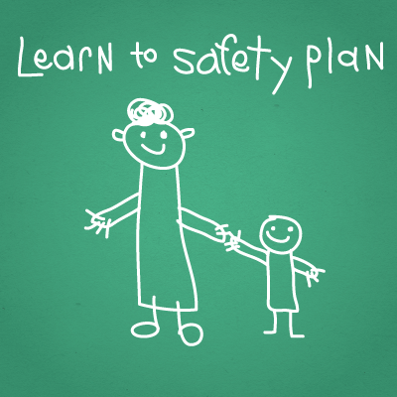
Making a safety plan

Slide 14
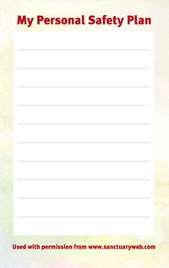
SAFETY PLANS
A list of simple activities that a person can choose when feeling overwhelmed so that he/she can avoid losing control of emotions
A safety plan can help keep you more able to respond
Notes:
Safety is one of the three pillars of trauma informed care and is at the core of all efforts to create trauma informed organizations and systems. For this reason Multiplying Connections endorses the concept promoted by the developers of the Sanctuary Model that all individuals - staff and clients - in a trauma informed organization should develop a personal safety plan. Sanctuary describes this plan as "a list of simple activities that a person can choose when feeling overwhelmed so that the person can avoid engaging in the unsafe, out-of-control or toxic behavior he or she is accustomed to resorting to under stress and instead, use an activity that is safe, effective and self-soothing."
Take a few minutes to read over the document on creating a safety plan. Using the index cards on the tables, take a few minutes to write down a few steps for your personal safety plan

Slide 15
Things to include
Three things you can do in the moment when you are triggered.
Three things you can do regularly to take care of yourself.
Keep the plan with you.

Slide 16
Windows & Mirrors
Cultural Context
  Beyond food, festivals, “costumes”
Avoiding “Assimilation Wars” & Melting Pots
  Allowing people to be their authentic selves
Family & Community Engagement

Slide 17

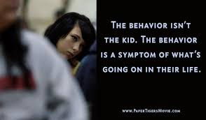
Paper Tigers:
A Documentary

Slide 18


Slide 19
Contact Information
Mastery Charter-Shoemaker Campus
Phillys7thWard.org
@selmekki
Sharif.El-Mekki@Masterycharter.org

