Slide 1
How do we build a culture within our schools?
Comment construire une culture au sein de nos écoles?
Notes:
Part one aims and objectives

Slide 2
Our aims today/nos objectifs aujourd’hui
What is culture
How can a school culture help our students
How can we build a culture in our schools?
Qu’est-ce que la culture?
Comment une culture scolaire peut-elle aider nos élèves?
Comment construire une culture dans nos écoles?

Slide 3
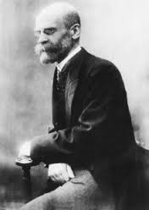
culture
culture
Norms & values
Normes & valeurs
mores
mœurs
Notes:
In groups – what do we think we mean by these words

Slide 4
Their task is to develop social solidarity*
Culture: the ideas, customs, and social behaviour of a particular people or society.
Mores: the essential or characteristic customs and conventions of a society
Norms & values: attitudes and behaviours that are considered normal, typical or average within that group

Slide 5
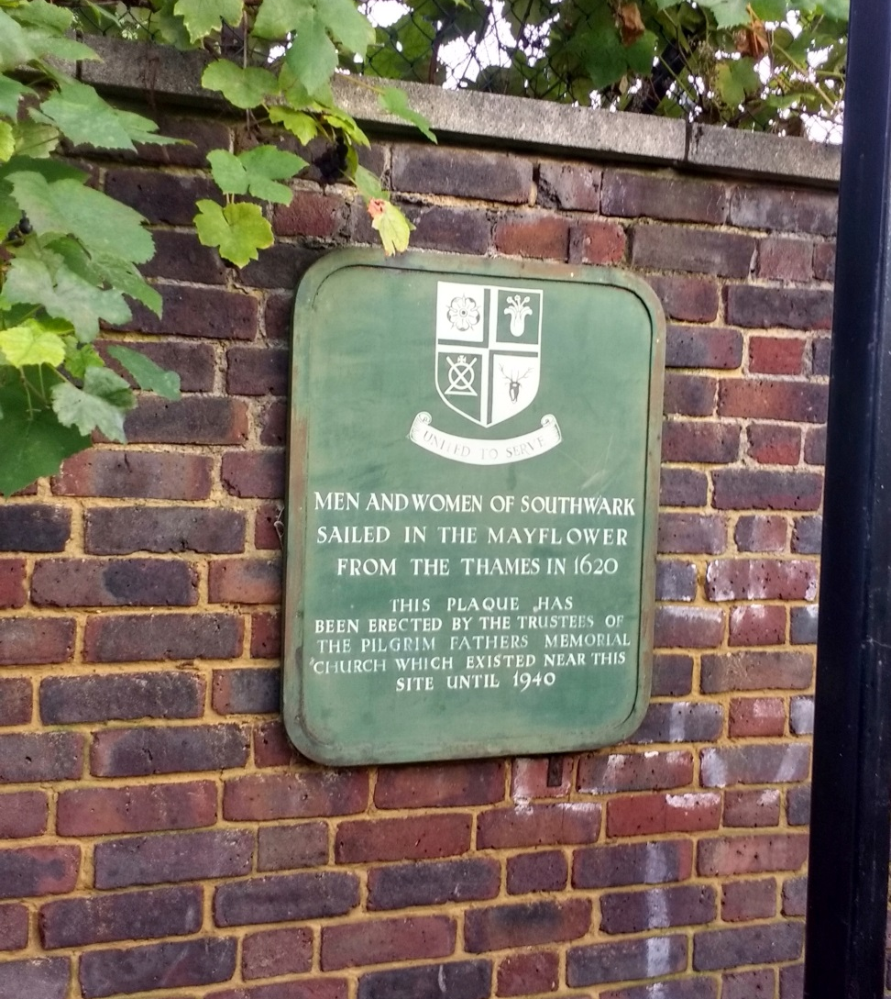

St Saviour’s & St Olave’s
Notes:
A small school in central London with a lot of history … pics of students in uniform, house stuff CRIST stuff

Slide 6
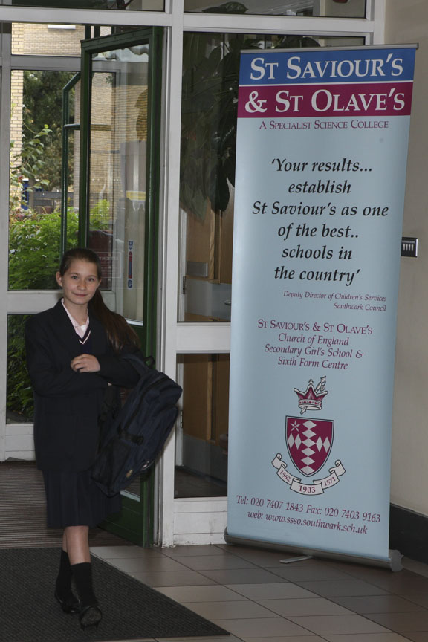
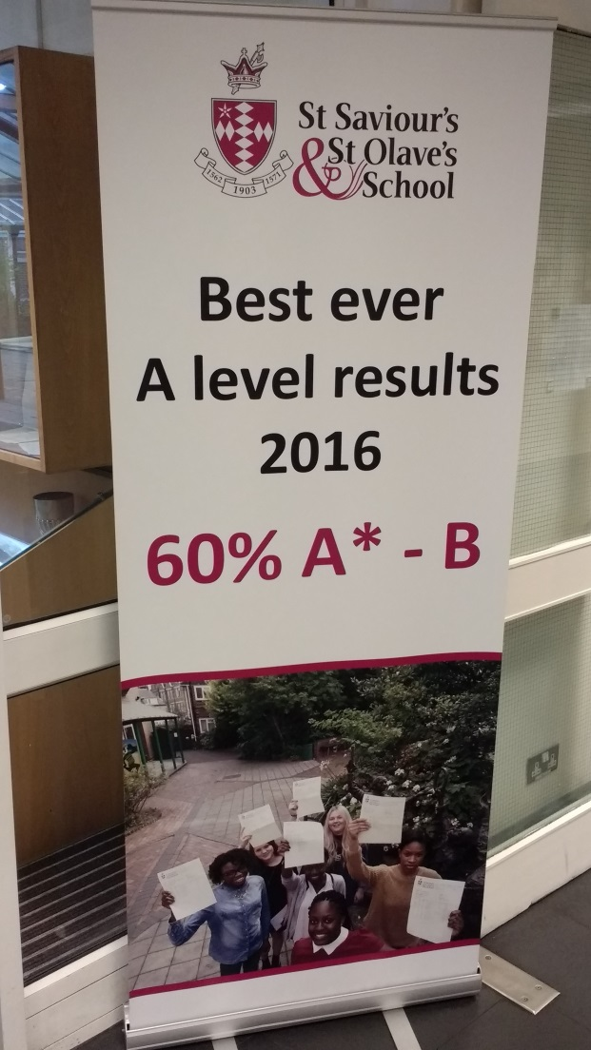
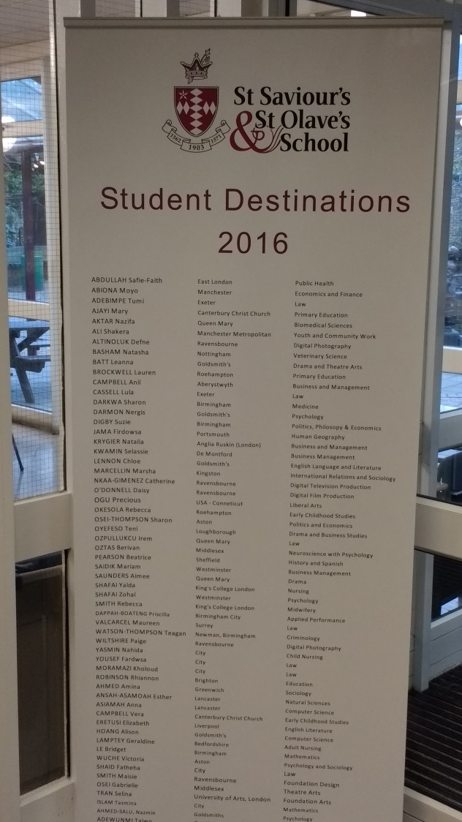

Slide 7
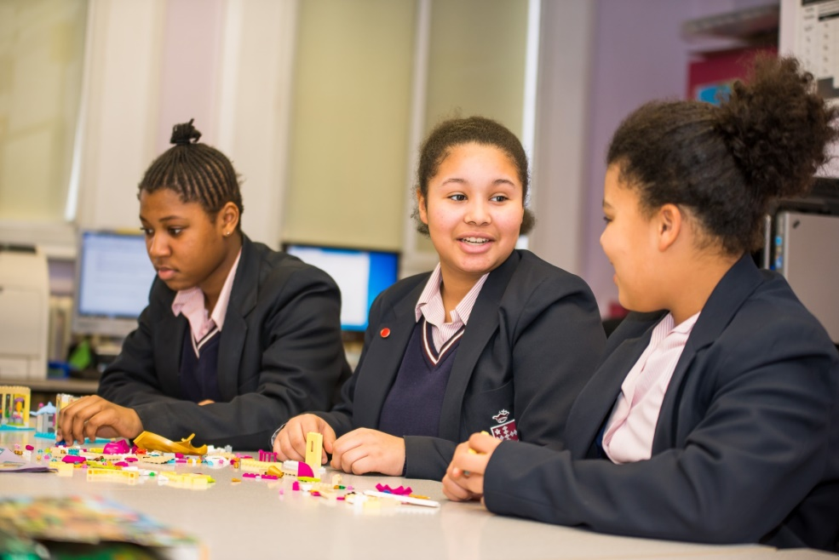
St Saviour’s & St Olave’s
820 students
11-18
Girls only
State school but a “church” school.
All ability levels
Many special needs
50 languages
50% below poverty line
Academically successful

Slide 8

School uniform compulsory to age 16
L’uniforme scolaire est obligatoire pour les filles jusqua a l’age de seize ans

Slide 9
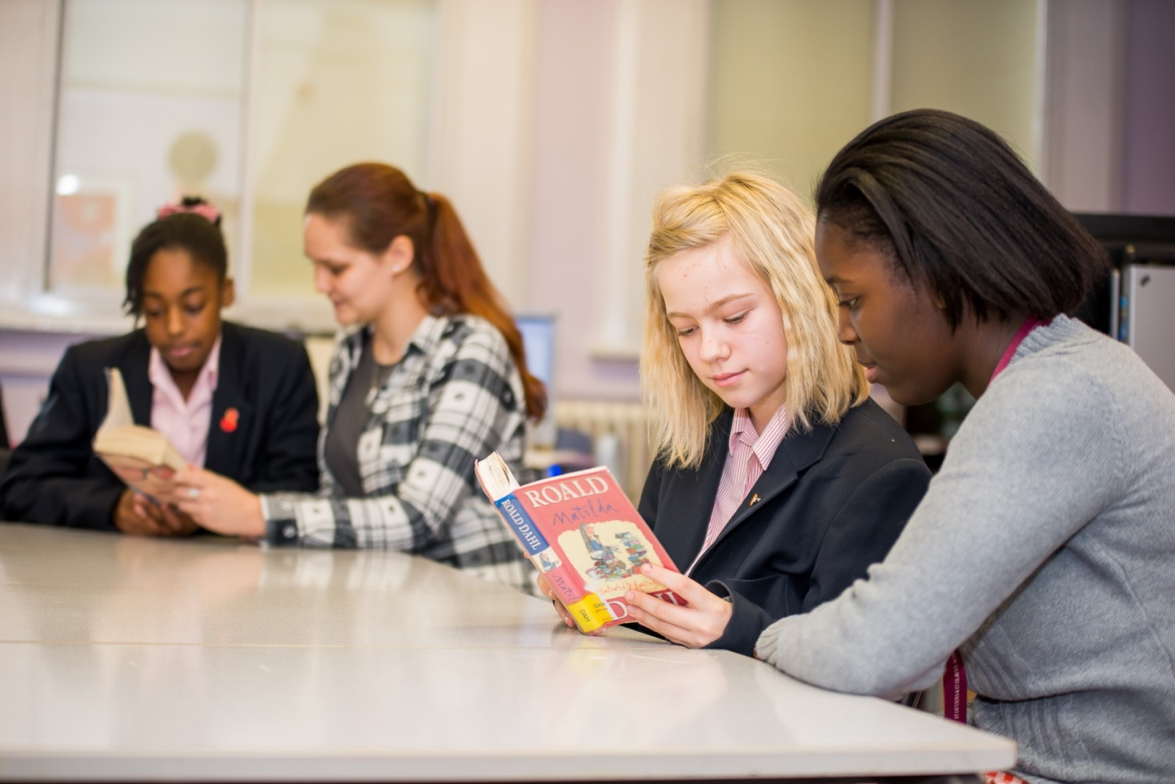
Older students are leaders and help younger students with literacy
Les etudiants plus ages sont des leaders et aident les jeunes avec en train de lire

Slide 10
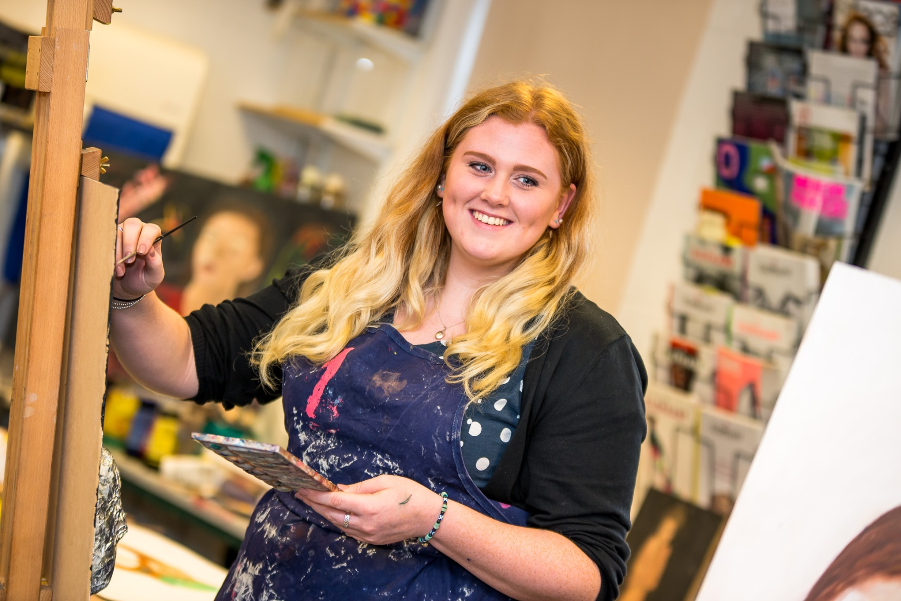

Slide 11
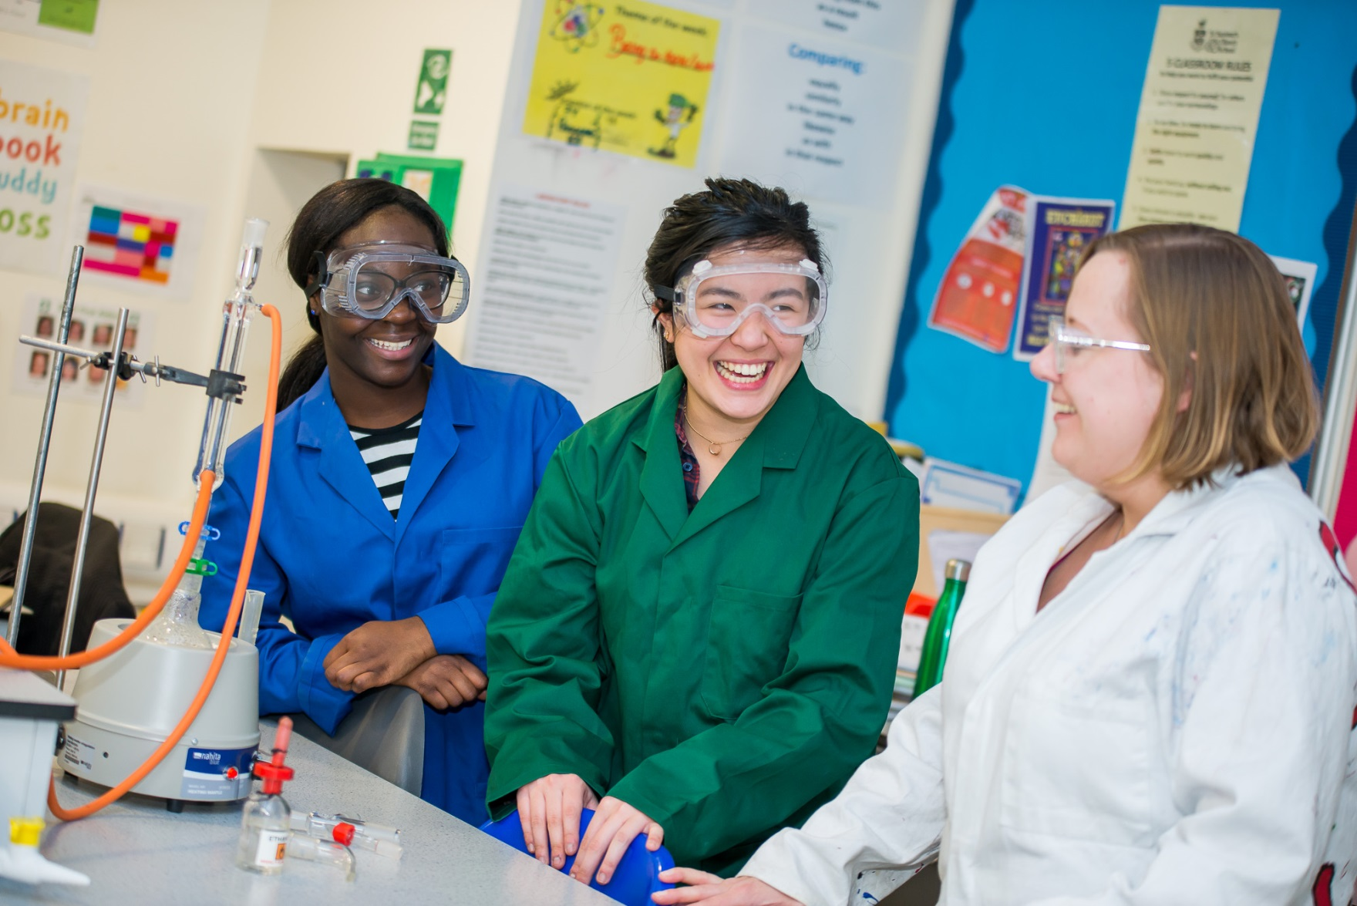

Slide 12
We asked our students, what was important/ Demandez à nos étudiants
Compassion
Respect
Inclusive
Supportive
Transformative
La compassion
Le respect
Compris
Soutien
Transformatif

Slide 13
We are different – in England we monitor students success by group
Income (free school meals)
Ethnicity ( fifteen different groups)
Special Educational Needs
Gifted & Talented
English schools must publish examination results for these groups
Nous surveillons la resussite des eleves par groupe
Revenu
Ethnicite (quinze groupe differents)
Besoins speciaux,
Talentueux
Les ecoles en Angleterre doivent publier les resultats des examens pour ces groupes

Slide 14
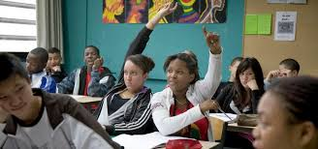
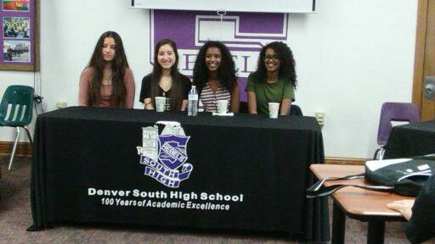
We are very different …

Slide 15
Mais nous sommes très similaires

Slide 16
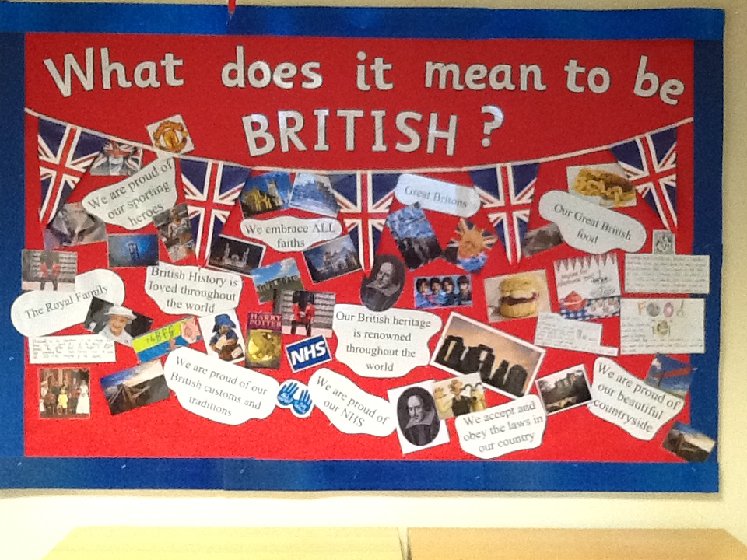
British values
All schools must promote British values …

Slide 17
All schools must promote British values …
actively promotes the fundamental British values of democracy, the rule of law, individual liberty and mutual respect and tolerance of those with different faiths and beliefs.'
Les valeurs britanniques de la démocratie, l’état de droit, la liberté individuelle et le respect mutuel et la tolérance de ceux qui ont des croyances différentes

Slide 18
How do we lead our schools in building a culture?
Comment pouvons-nous mener nos ecoles im construire la culture?
Paternalistic
Authoritarian
Democratic
Laissez faire

Slide 19
We asked our students, what was important/ Demandez à nos étudiants
Compassion
Respect
Inclusive
Supportive
Transformative
La compassion
Le respect
Compris
Soutien
Transformatif

Slide 20
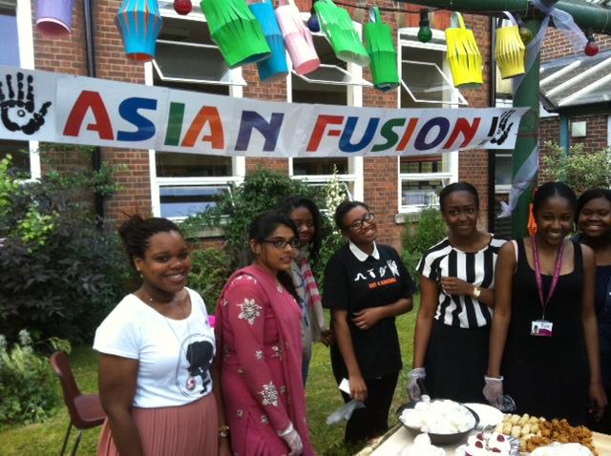

Slide 21
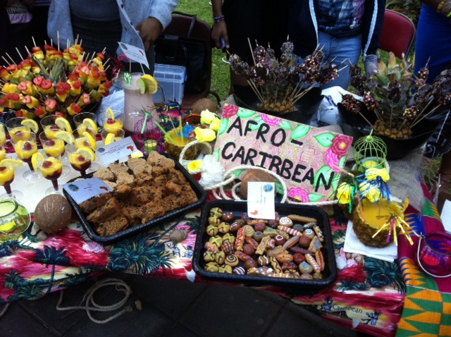

Slide 22
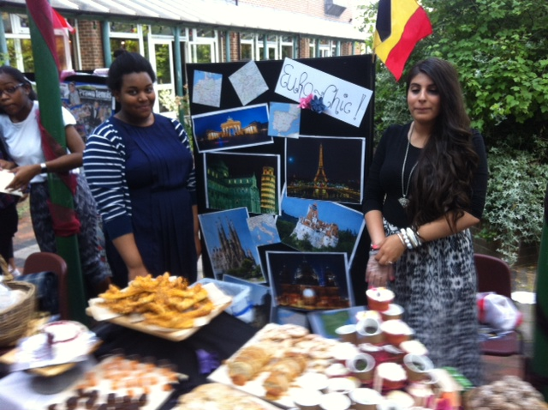

Slide 23
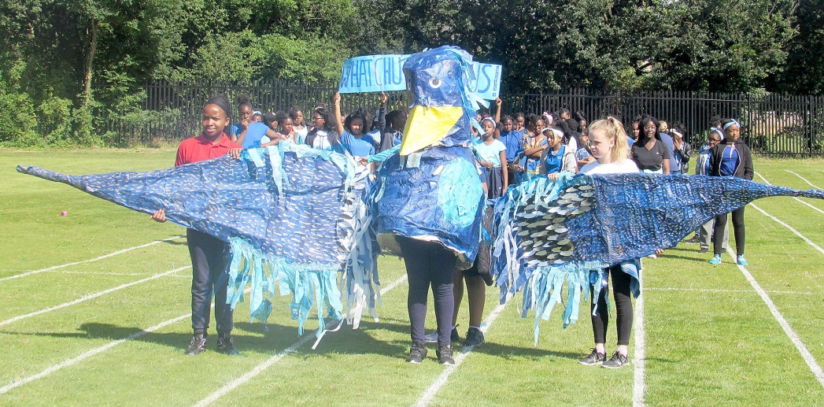
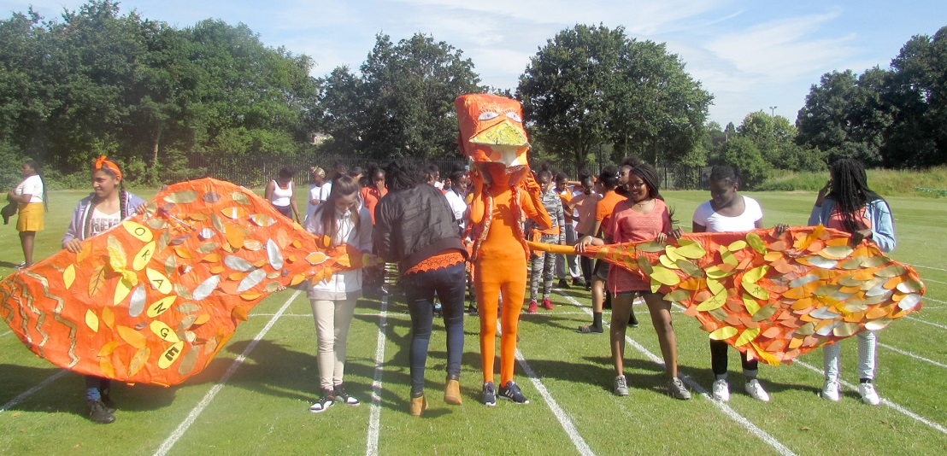
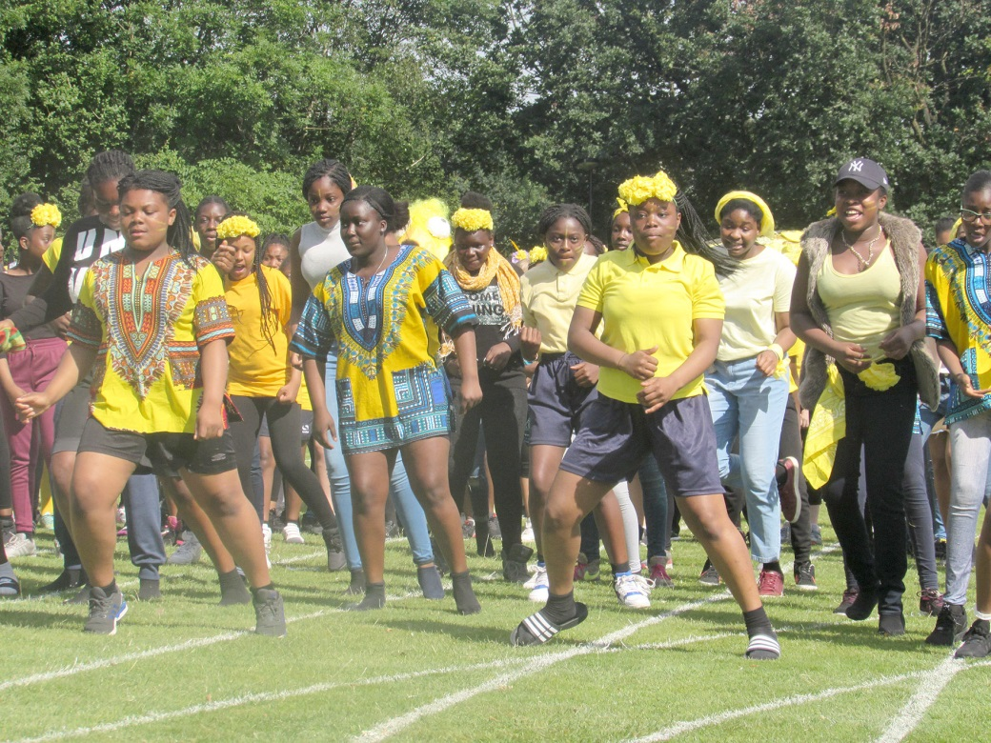
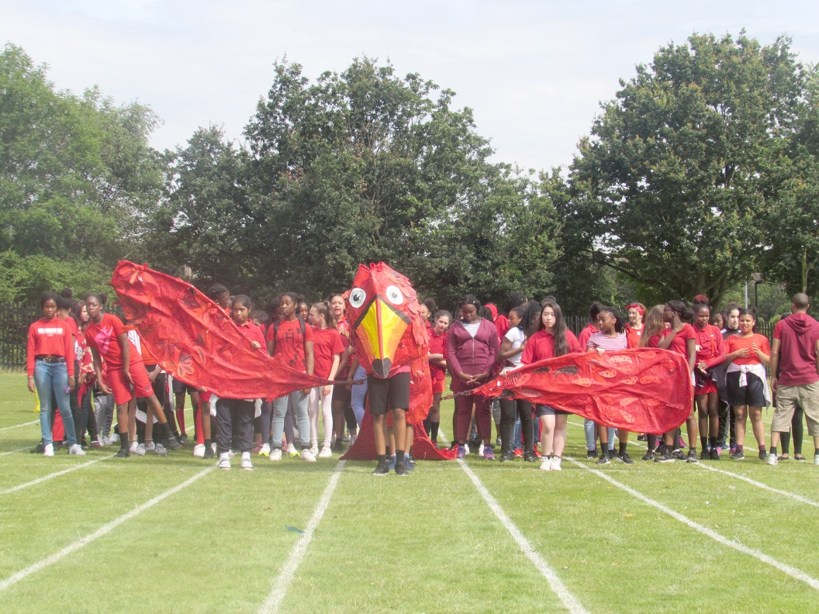
Sports Day: House parade

Slide 24
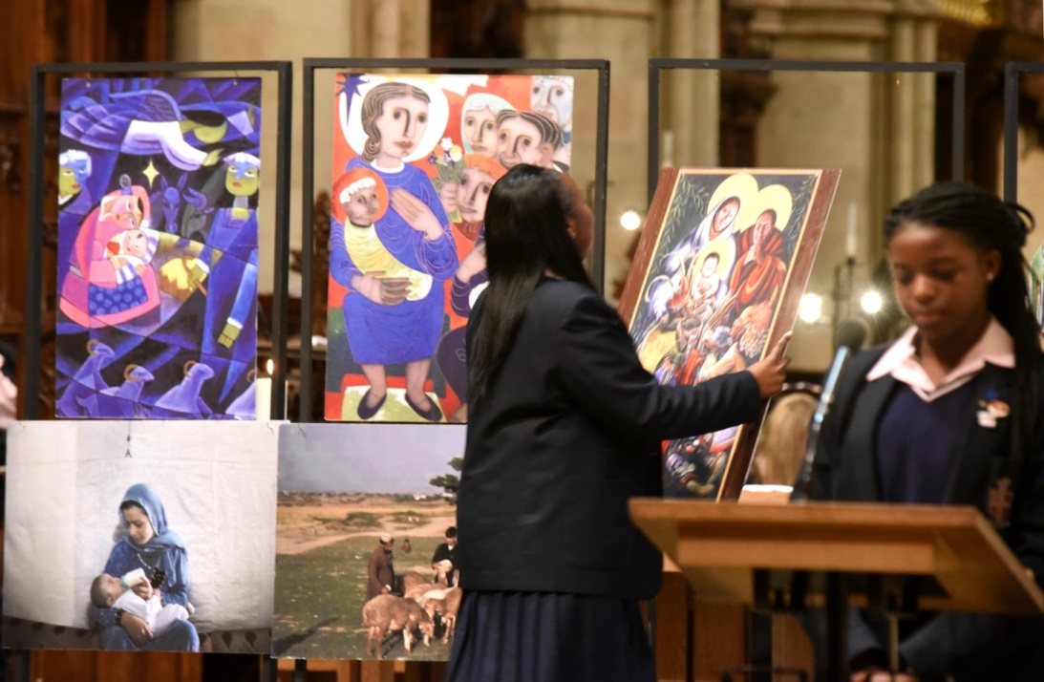
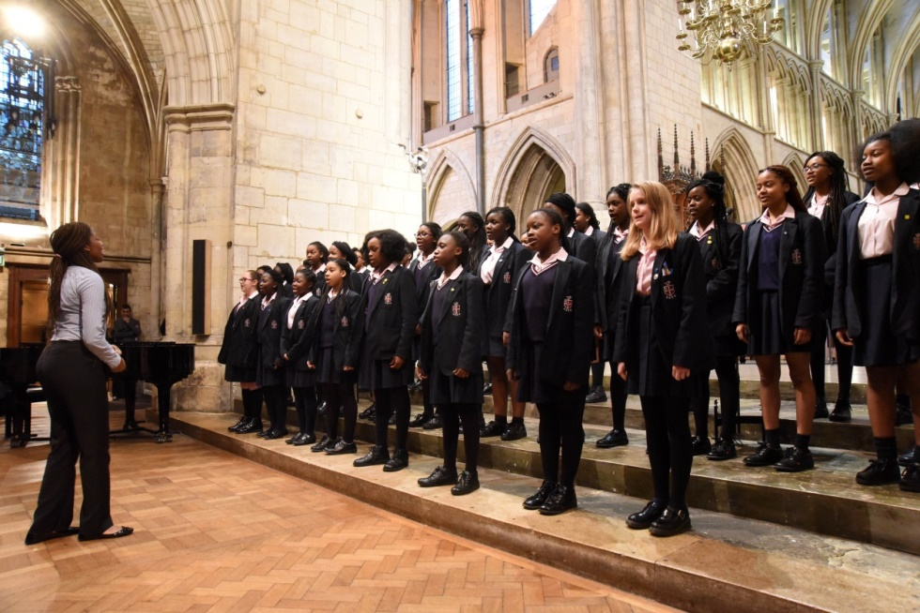
Celebrating the school’s birthday: our choir sings at Southwark Cathedral
Nous celebrons l’anniversaire de l‘ecole a la cathedral de Southwark avec notre choeur gospel

Slide 25
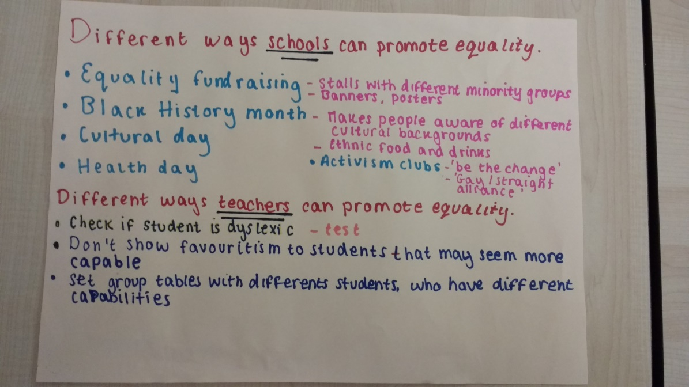
We asked our students how we should promote equality
Nous avons demande a nos etudiants comment nous devrions promouvoir l’egalite

Slide 26
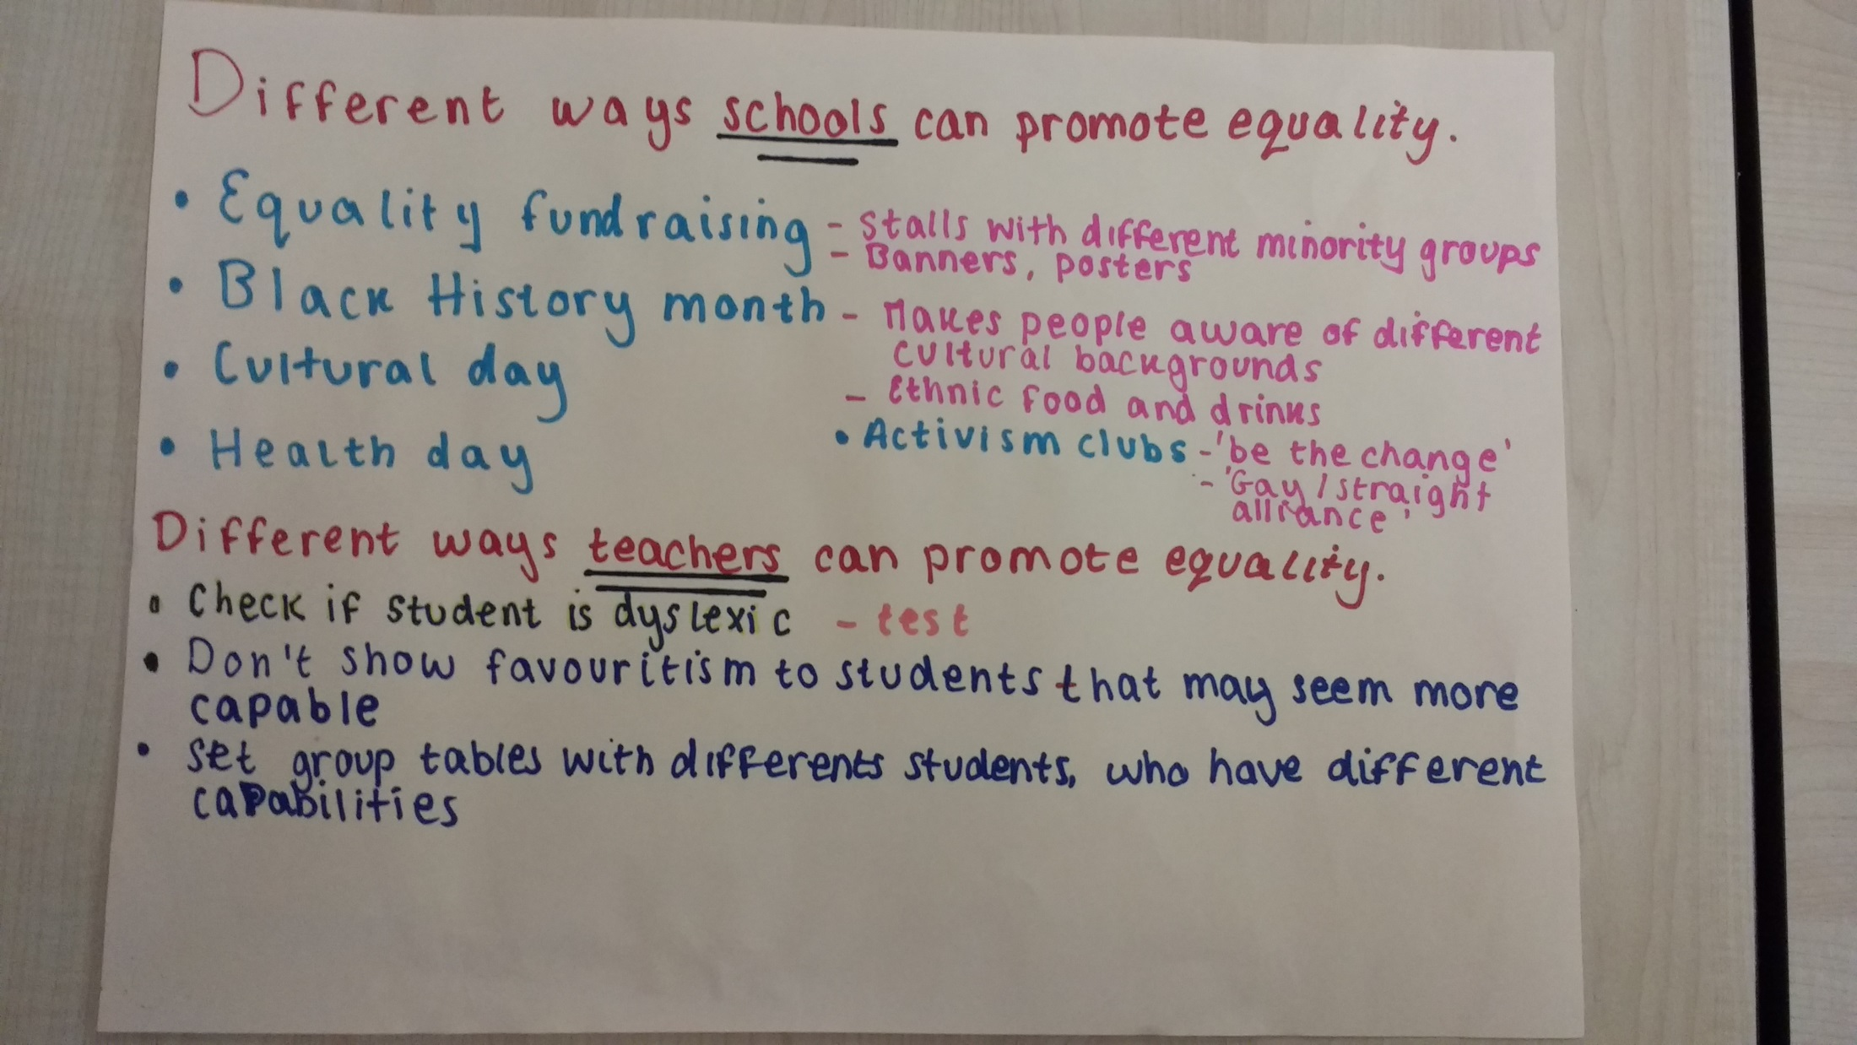
We asked our students how we should promote equality

Slide 27
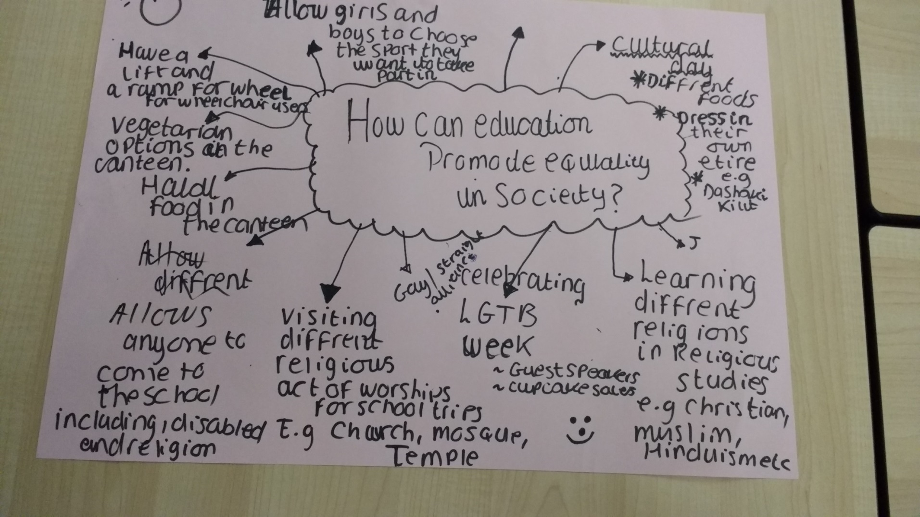
We asked our students how we should promote equality

Slide 28

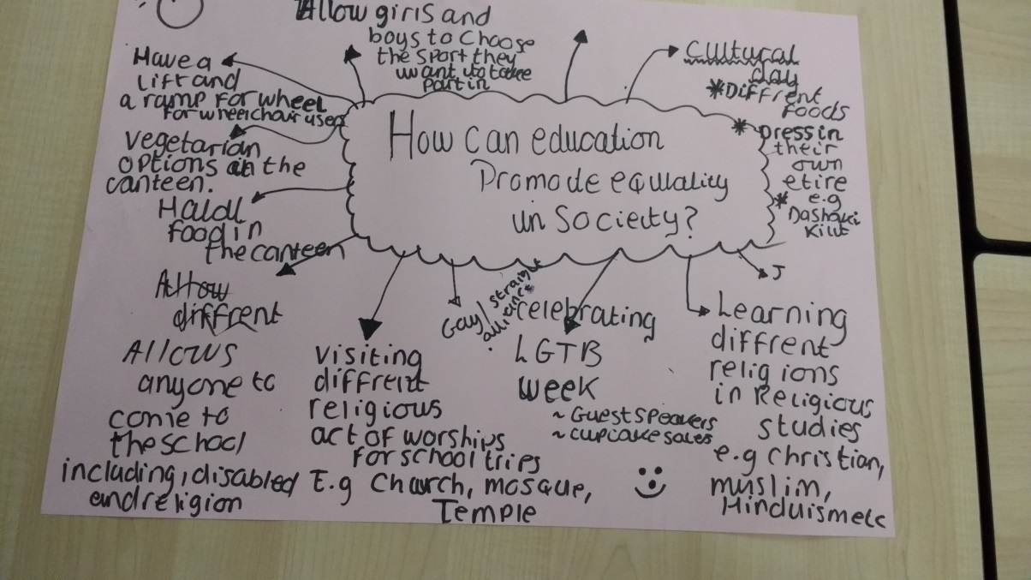
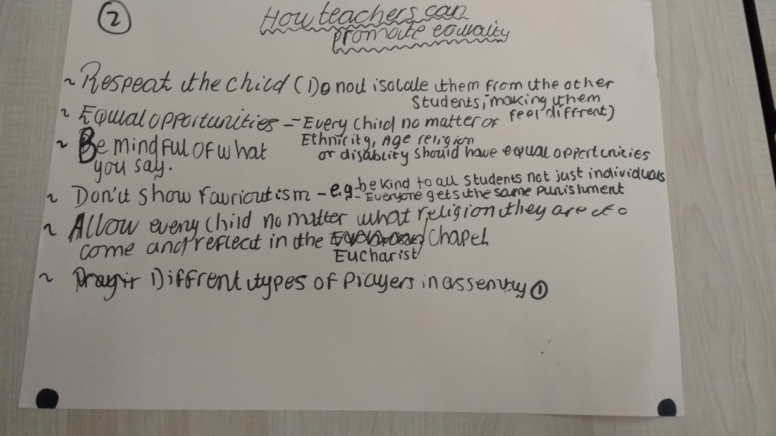

Slide 29
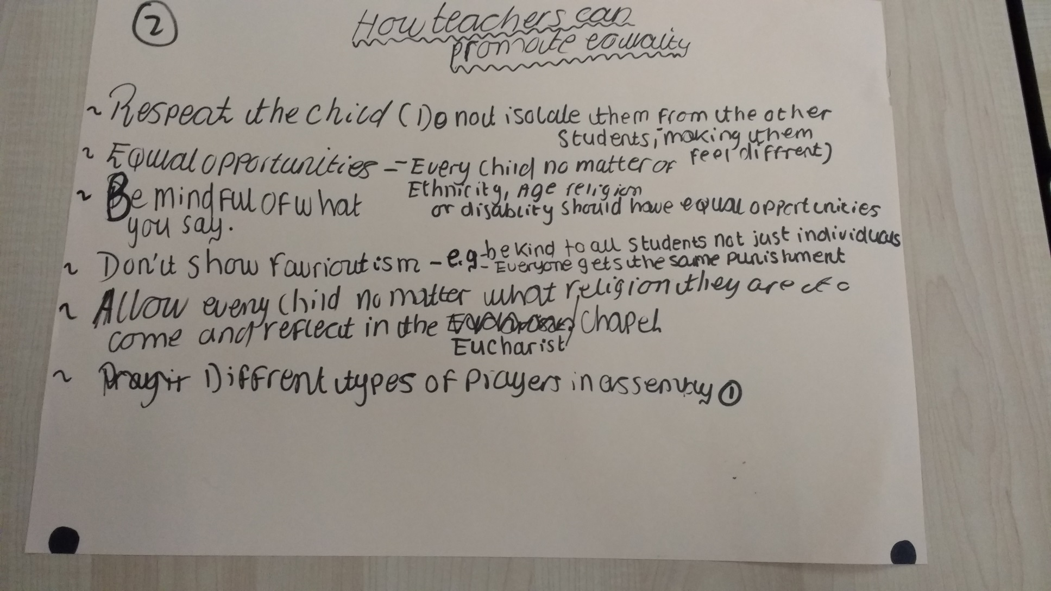

Slide 30
Conclusion
Outline three ideas that you will take back to your school or district from today’s activities
Décrivez trois idées que vous ramènerez à votre école ou à votre district des activités d'aujourd'hui

Slide 31
Notes from group discussion
Actions constrained by what governments will allow – USA and England using data to monitor success rates of different groups.
USA able to involve parents as translators, classroom helpers, much less parent involvement in Europe.
Important that students see people who look like them and talk like them.
Use of former students as role models, schools can use social media to set up alumni networks, display pictures of former students who have become successful.

