Slide 1

Administrators and Teachers' Readiness for Inclusion
Conference on Integrating Refugees and Immigrants into Schools
Return Seminar of the 2016 US Department of State
European Administrators Program
at ESENESR
Poitiers, France
January 12, 2017
Notes:
Thank you to the US Department of State’s Bureau of Educational and Cultural Affairs, IREX, and the French Ministry of Education for assembling all of us together form a learning community regarding administrators and teachers’ readiness for inclusion. As a former school principals in public schools in America, I am always thrilled to be learning together with other school administrators.

Slide 2
Refugees and Immigrants
They are here.
Are we ready for them?
244 million in 2015 worldwide
41% increase from 2000
www.migrationpolicy.org.
Notes:
Refugees and Immigrants are here in Europe and the US. Some are undocumented, some are official refugees, some are seeking asylum. According to the Migration Policy website, 244 million people are living in a country other than the country of their birth—that is a 41% increase from 2000.
Since many of the women immigrants and refugees are of child bearing age, the number of children is a staggering number. Worldwide there are over 106 million refugee children according to the UN High Refugee Commission. And this usually does not include the number of undocumented young people who show up in our countries, and may not be in schools to be counted.
Having newcomer refugee and immigrant children in our schools is not an issue that is here today and gone. This is an issue that will shape this generation and generations to come. We, as school administrators from the developed world, have a responsibility of leadership 1) to learn from each other, 2) to encourage research and study, 3) to ask deep learning questions and 4) to seek answers to complex questions to help make this movement of people a positive force in the future of our humanity, a positive force in an ever-increasingly inter-dependent world.
This presentation will explore our readiness for this tremendous challenge.

Slide 3
Outline of our Conversation
They are here. Are we ready for them?
Trauma sets the stage
Administrators set the school environment
Teachers build the relationships
And then
Exploring the world we want to live in
Notes:
For today’s session, we will do the following.
Translate the slide.
Other presentations will discuss the role of target language development, of the issues of integration of language and curriculum or language alone. Other presentation may address the issues of tracking secondary students into college preparatory or career/technical courses. This presentation focuses more on the school culture, the classroom culture of readiness.

Slide 4
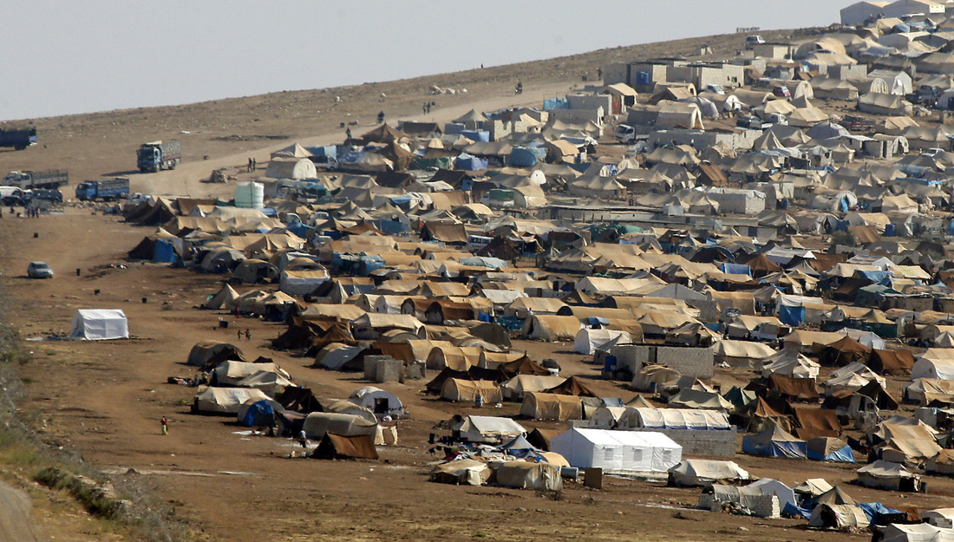
Global Warming?
A Syrian refugee camp near Turkey. Source: Gregorio Borgia, Associated Press. 2009
Photo: Gregorio Borgia, AP
Notes:
For the sake of this presentation, we will use the Syrian refugee crises as the story line for our discussion. If these refugees and asylum seekers had not come by the millions, we would probably not be here today.
In many cases refugees and immigrant journeys to our countries, begin with displacement first WITHIN their own countries.
Between 2006 and 2009, the people of Syria suffered during the most severe drought that country has experienced since the beginning of its instrumental record. As water became scarce, crops failed, and cattle died on a huge scale. As many as 1.5 million Syrians, out of a population of just over 20 million, moved from the countryside to the outskirts of already overflowing cities (Kelley et al., 3242). The children in our schools may have been born in these temporary camps, or displaced earlier in their lives.

Slide 5
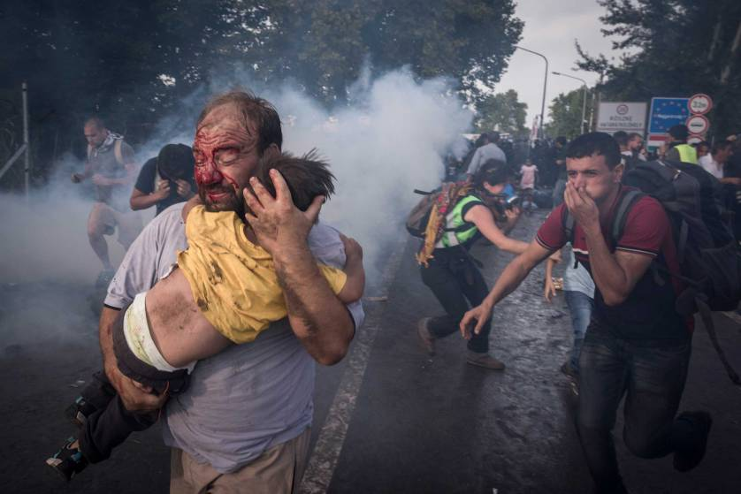
Parents who love their children took the journey FOR their children.
Notes:
All ready displaced, families were in stress. Then the war started. Children saw terrible things in war. Children survived unbelievable hardships!
If you ask most immigrants why they make the sacrifices to leave home for a new country, they will say that they want their families to have the basics. . security, safety, food and water, shelter.
Refugees and asylum seekers endure extreme hardships to move to our countries. They have learned to trust no one. In some cases, they have learned to hate.
They leave behind the sick and the elderly. They leave behind their history and their culture. They leave behind their education and expertise. In short, they leave behind what made them who they are. . .all that is included in their identity.
But they also carry with them HOPE. Without HOPE they wouldn’t come.

Slide 6
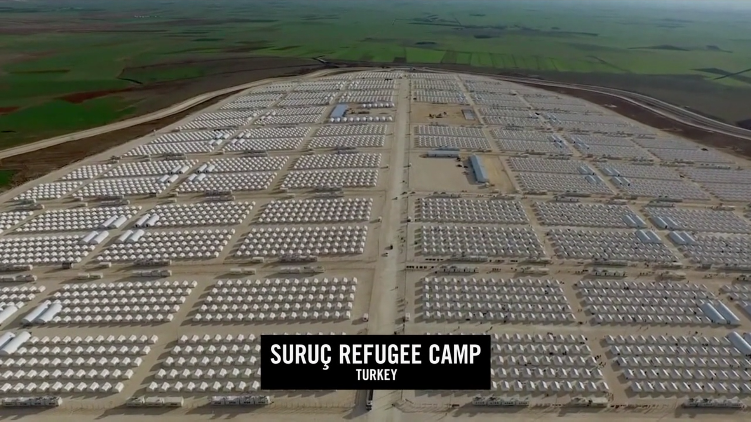
The first stop to safety might be a border refugee camp like this
http://i.imgur.com/Z7AOsS2.png
Notes:
Parents with HOPE may end up in refugee camps as a first stop that brings the basics. . Food, water, safety of a sort.
These families may have lived for generations in the same home with extended family members. These families were contributing citizens 1) who paid taxes, 2) educated their children, 3) went to work every day to put food on the table. And now they live in camps like this.
In some cases they have had family members killed. Aunts and uncles have new blended families, or families may have left some of their children behind. Families may have sacrificed funds for only some of the families to flee. . .and others had to stay behind in the war torn area due to lack of funds for all.
Think of the many layers of family and individual stress that comes with the act of leaving as a refugee.

Slide 7
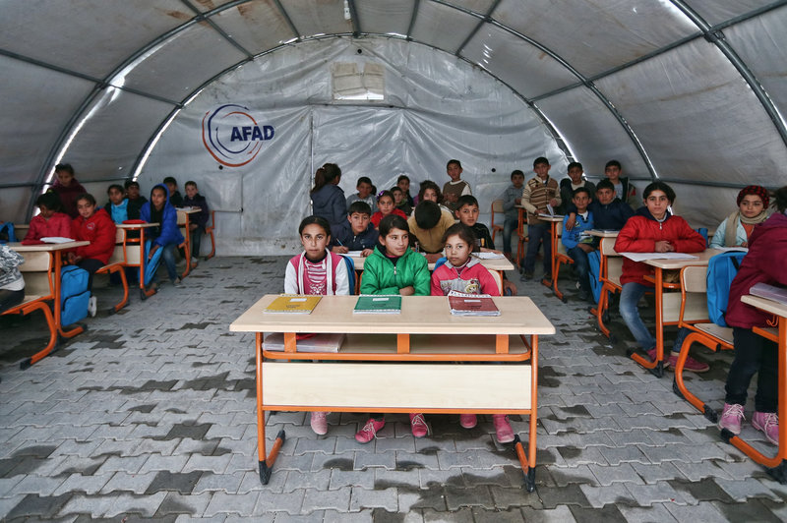
But hopeful parents send their children to schools in refugee camps.
Photo: Carl Court, Getty Images
Notes:
Hopeful parents send their children to schools even in the refugee camps like this one in Suruc Turkey.
Even if these conditions are not ideal, HOPE for the future drives families to educate their children.
And yet, parents are also realistic.
Parents say the following, “School children usually do homework in the evening, but here they can’t. There is no electricity. My kids have just come out of a big trauma so I don’t pressure them as I did in Syria. We had a stable routine there (in Syria). Seeking refugee in itself is a tragedy. “

Slide 8
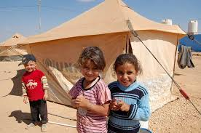
In the words of refugee children who might come as unaccompanied children
.
Photo: UNICEF, Australia
Notes:
While these Syrian children in Jordanian refugee camps are smiling for the camera, they explained in a film, In their own words, “
“We had a good life in Syria. Syria was fine. Now we don’t have any one to take care of us. Our mum died, and our dad had to work. Now everyone is in a different place. (referring to aunts and grandparents who were taking care of them). So we are sent here.”

Slide 9
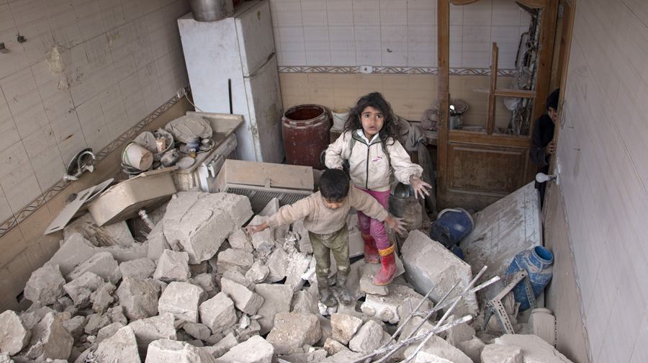
WORDS of refugee children
I’ve lived through bombings
I saw how they bombed people
War Planes, snipers and missiles
I saw things I shouldn’t have seen during the bombings and the “trouble.”
Photo: AFP, file, PressTV
Notes:
In the same film by UNICEF, the children say
I’ve lived through bombings
I saw how they bombed people
War Planes, snipers and missiles
I saw things I shouldn’t have seen during the bombings and the “trouble.”

Slide 10
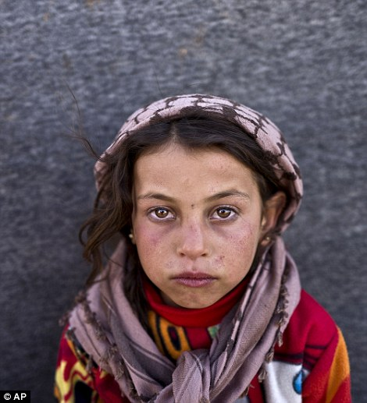
The WORLD of the refugee children
“We walked for miles through the mountains to come to Lebanon refugee camps.
I don’t want my family to beg on the streets.”
“So I push my wheelbarrow loaded over a mile to the other side of the camps for people. They pay $1.
I would like to be a surgeon to help old people because at the hospital they leave them outside to die.”
Photo: AP
Notes:
Read from Slide and translate

Slide 11
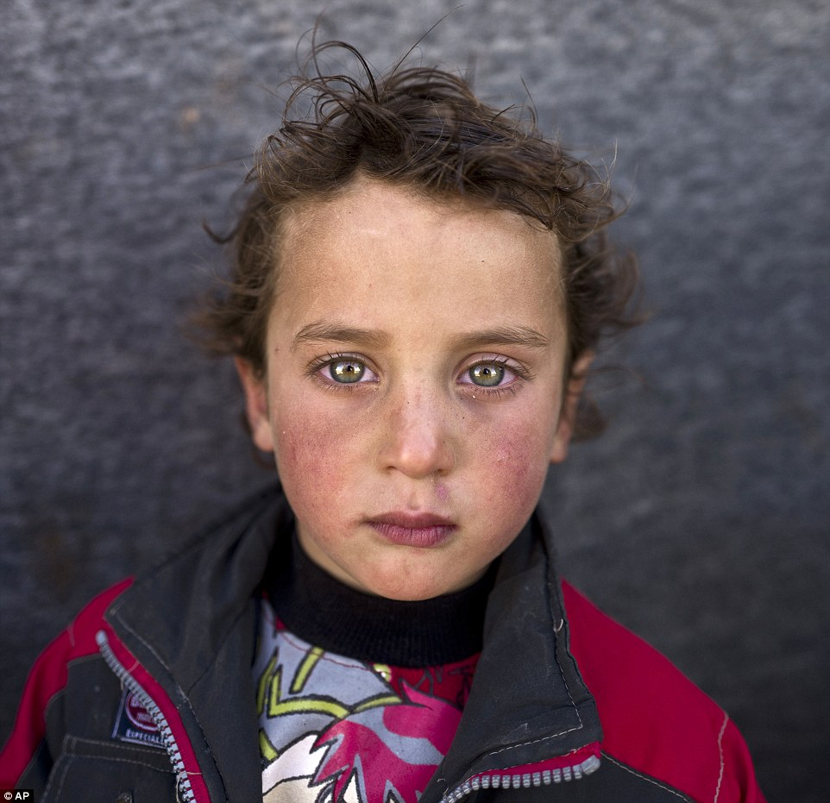
In the words of refugee children in
OUR SCHOOLS
I couldn’t understand or concentrate because I was thinking of the troubles. I couldn’t forget it. It stayed on my mind.
Notes:
I couldn’t understand or concentrate because I was thinking about the troubles. I couldn’t forget it . It stayed on my mind.

Slide 12
Are we ready for these children in our schools?
A Lebanese teacher says to us:
“These refugee children live in very different circumstances. Teachers fail if they can’t measure children’s concentration levels. They need to pay special attention to these children.”
Notes:
Are we ready for these children in our schools? Are our teachers equipped to help these children? A Teacher in Lebanon refugee camps reminds us: “These refugee children live in very different circumstances. Teacher’s fail if they can’t measure children’s concentration levels. They need to pay special attention to these children.”
How can we prepare for these children? First we should understand the influence of trauma on brain development.

Slide 13
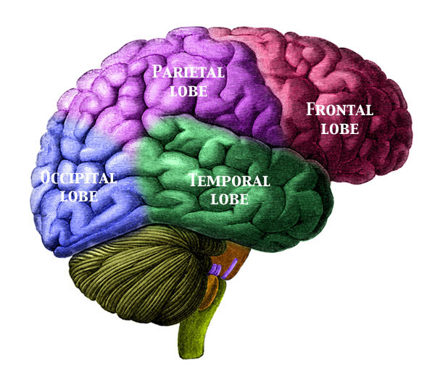
How Childhood Trauma Influences
Brain Development
Survival
Regulation
Social
Emotional
Cognition
Perry, B. D. Traumatized Children: How childhood trauma influences brain development, Journal of California Alliance for the Mentally Ill, 11:1, 48-51, 2000)
Notes:
According to Holt and Jordan in the Ohio Department of Education inspired graphic above, the children having experienced the trauma depicted by our story at the beginning of this presentation, will have brain development based on survival.
Their brain development, like all children, will go from the base of the brain in the cortex, and then move upward in the brain superstructure to the regulation, social/emotion and cognition.
But for these refugee children, the flight or fight survival mode is highly developed, alert, programmed for use in an instant. The executive parts of the brain that deal with self regulation respond to the stressful conditions and reflect survival tendencies. As educators, it is important to notice that cognition area is least developed area in these traumatized children’s brain.
Brain patterns can be changed, but it takes concentrated, emotionally safe environments to reprogram the brain and to develop underdeveloped areas of the brain.
Understanding this affect of trauma on learning, educators are beginning to adapt. For example, in the US, some states have begun to legislate Welcoming School Cultures to improve learning, and are finding much success, particularly in urban areas of high poverty and crime like Cleveland Ohio where I am from.
Perry, in his article, Traumatized Children: How Childhood trauma influences brain development, says it simply, “Children reflect the world in which they are raised.” If that world is filled with the experiences of refugee life, the brain patterns of stress and fear response will be more fully developed. Chronic activation of this area of the brain, may ‘wear out” the parts of the body including the hippocampus, the key area of memory and cognition.
And what is the first thing we usually do as educators, we put the children in language learning situations—which is highly cognitive. The child coming from a life of trauma may exhibit hyperactivity, anxiety, impulsivity, and other behaviors not usually tolerated in school environments.
To interrupt the established patterns from the situation like many of our refugee children have faced, we must first focus on the therapeutic interventions that activate the portions of the brain that have been altered by the repeated trauma of the life experiences. We talk about this later in this presentation.

Slide 14
Trauma and Children
Birth to 5 years—
  May show little social interaction, uncalled for crying, and show trauma in play
6 -11 years—
  Anxious, depressed, angry, unable to concentrate or socialize with peers, vomiting, headaches or stomach aches
Notes:
Not all of the trauma of the war or the process of leaving home is left in the home country. For refugees children from war torn areas, this stress often continues as they resettle. We call this post-traumatic stress disorder (PTSD). The effect of PTSD changes according to age, gender and culture. According to Claudia Maria Vargas, refugees may show helplessness and despair long after resettlement. PTSD may show up as depression, anxiety, inattention, and survival guilt. One of our other American colleagues mentioned this is his short presentation earlier.
Children from birth to 5 years, may show little social interaction, uncalled for crying and show trauma in play.
Children 6-11 may show anxiousness, be depressed, angry, unable to concentrate or socialize with peers. They may vomit, have headaches or stomach aches without being physically ill.
No child is too little to not be affected by the trauma of war and the issues of flight from this situation. But it interesting to note, that children 6 to 11 are 3 times more likely to suffer from PTSD than adolescents, because of the way that the brain was developing during this time of stress.

Slide 15
Trauma and Children
Adolescents
  School difficulties, eating disorders, alcohol abuse, teenage pregnancy, general ‘acting out.’
  Changes how they think about the world
  Problems in relationships including peers, family and teachers.
  Most at risk are those who have lost family and community connections.
  Vargas, C. M., Trauma and Victimization, Issue of Visions Journal, 2007, 3 (3), pp. 12-13
  Refugees and Trauma, from the National Child Traumatic Stress Network, http://nctsn.org/trama-types/pes/refugee-trauma/learn-about-refugee-trauma.
Notes:
Read slide.
As school principals of secondary schools, we know that adolescents generally have their own issues, and refugee children are dealing with all of the regular teenage issues as well as the trauma of war and resettlement. Notice that the most at risk are those who have loss of community connections or lost family. This affects the unaccompanied children perhaps the most.
And yet, remember that the refugees have strengths--they are also filled with determination, hope, and will work to create a better life for themselves and their children. These are the survivors. We must learn to find their strengths and build on them. My colleague, Marina, presented about FUNDS of KNOWLEDGE yesterday. This is the importance of building on strengths to help these children overcome their gaps in learning.

Slide 16
These memories are now in our classrooms. . .
I’ve lived through bombings
I saw how they bombed people
War Planes, snipers and missiles
I saw things I shouldn’t have seen during the bombings and the “trouble.”
Photo: AP, Press TV
Notes:
Remember the words of the children,
I’ve lived through bombings
I saw how they bombed people
War Planes, snipers and missiles
I saw things I shouldn’t have seen during the bombings and the “trouble.”

Slide 17
Are we ready to listen?
I couldn’t understand or concentrate because I was thinking of the troubles. I couldn’t forget it. It stayed on my mind.
Notes:
Children tell us how they feel: But we need to be ready to listen. Are we listening?
This refugee child tells us, “I couldn’t understand or concentrate because I was thinking about the troubles. I couldn’t forget it . It stayed on my mind.”

Slide 18
What can schools do?
Are we ready for these traumatized children in our schools?
Notes:
The arts can be one way that we provide opportunities for this trauma to be processed in these children. But when do we introduce the arts to our refugee children? After they learn the language of the host country? Or because they have interrupted schooling, do we eliminate the arts because they need increased language and required subjects to graduate on time?
The arts are very important in the total education of refugee children. The arts and their creative expression can provide prevention and therapy for these children. I will use the study completed in Montreal by Rousseau and others and discussed in Creative Expression Workshops in Schools, to give some examples. Additionally, we have seen the higly successful arts therapy programs Denver Colorado, in Akron, Ohio, and Windsor, Ontario that showed excellent results.

Slide 19
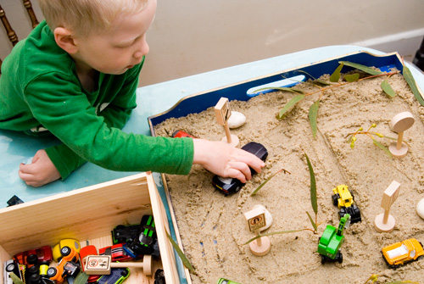
Sand play for preschoolers
Photo: South African Sand Play Therapy Association
Notes:
The aim of the Montreal sand play program was to improve the social adjustment of children from immigrant and refugee families to help them express the multiple cultures that they have experienced, or are experiencing. Children in this age group represented death and violent events in ways unexpected for these young children. But this gave teachers and mental health workers an opportunity to provide a supportive environment to work through the trauma. The Rousseau et al, state an important point, “Religious signifiers were at the forefront of attribution of meaning and of the imagined reconstruction process.” In many of our schools we would not use religious signifiers at sand play tables.

Slide 20
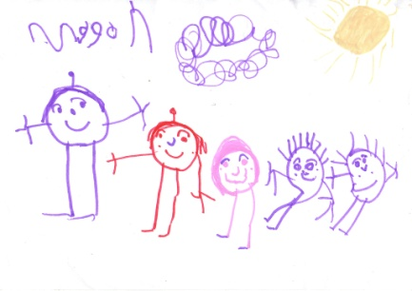
Story telling and Drawing for Elementary Students
1st activity: centered around myths, tales or legends from different cultures
2nd activity: an original story real or pretend that depicts the past, the trip, the arrival in the host country, and the future.
3rd activity: memory patchwork myths and tales from home, stories of family experiences
Notes:
For elementary children, Rousseau’s team in Montreal had the children do a process of drawing and story telling. The drawing was an integral part due to the limited language capabilities often found in these children, and was part of the regular school art program for all children, but done with the help of trained mental help workers as a staff development for teachers.
The first activity centered on using myths, tales, and legends from different cultures—if possible from the regions of the world represented by the children, and told the story of migration from one place to another.
The second activity the children were asked to draw and tell an original story that had a past, described the trip, the arrival in the host country and most importantly the future. Often the children incorporated parts of the myths or folk tales in their own stories, or used the structure provided in the folk tales for their own story.
The last activity involved the children talking to their parents about what to put into the patchwork. This represented their families more directly and helped to bring the family into the classroom culture.
Focus groups from Rousseau’s study showed that this program improved teachers’ understanding of the children’s pre-migration life, family experiences, and changed their perception of the students’ behavioral difficulties, and emotional strengths and weaknesses.

Slide 21
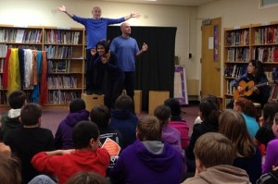
Drama Therapy for Adolescents
Photo: www.playbacktheatre.org
Notes:
For the teenagers in our secondary schools, the Montreal researchers studied drama therapy. Interactive and spontaneous, playback theatre bases its material on the stories of the community.
Performances are carried out by a team of actors, an emcee (called the conductor), and a musician—all could be a team of teachers from the school. As the show begins, audience members respond to questions from the conductor, then watch as actors and musician create brief theatre pieces on the spot. Later, students come to the stage to tell longer stories, choosing actors to play the main roles. Although performances often focus on a theme of interest or concern, the performers follow no narrative agenda, but bring their dramatic skills and their humanity to embodying on the stage the concerns and experiences of audience members..
A ninth grader who took part in a Playback Theatre activity said: “When I was the one telling a story, I could see things for what they were–better than trying to think back about it. It shows you what you could have done better, or what more could have been done, by seeing it in action.”
The Canadian study showed that there was a marked improvement in academic performance, especially in mathematics following the activities using the Playback Theatre techniques. These are just some examples that have been carefully researched and show significant results.

Slide 22
Understanding TRAUMA and its impact on our students is a
READINESS SKILL
FOR
TEACHERS AND ADMINISTRATORS
Notes:
So the first readiness skill for teachers and administrators is understanding trauma—its affect on learning and brain development, on the way that Post Traumatic Stress Disorder manifests itself at various childhood development stages, and to know of various strategies to work with the students who show PTSD. The examples given are just that, examples, of what can be done to help students. These samples all provide 1) a verbal and nonverbal means of expression to circumvent the language barrier that probably exists, 2) builds on the cultural identity of the mainstream and minority cultures, and 3) provides a secure place for working through issues. The teachers involved also are sensitized to the children’s life experiences and can provide more support in the process of healing and adapting to the new reality.
If needed or desired: this could be a place for an Interactive session: In what ways have trauma issues been handled in your schools? Pair and Share.
And Now we might ask: how can we create a welcoming school for all of the children we serve?

Slide 23
School Wide Readiness for Refugee and Immigrant Children
Notes:
Recognizing that refugee children and their parents come with increased trauma, how can we provide for these students as well as immigrant children who may have quite different, less traumatic experiences? How do we provide for the second generation of minority children who come to our schools, or will come to our schools in the next decades? These are questions that we need to work collaboratively to discover, and then to share with each other.

Slide 24
Does our school welcome her?
I would like to be a surgeon to help old people because at the hospital they leave them outside to die.”
Photo: AP, Daily Mail
Notes:
READ SLIDE
Does our school have a readiness for learning that meets her needs? What are the conditions for her achieving success for her life goals?

Slide 25
Conditions for Learning
Safety—
  Physically Safe
  Emotionally Safe
  Intellectual Safe
  Low Risk Environment
11%
Increase in academic success.
Decrease in safety incidents
-- Cleveland Metropolitan School District
Fisher, Frey and Pumpian, How to Create a Culture of Achievement in Your School and Classroom
Notes:
For conditions to be right for learning, safety is a first consideration for refugee and immigrant children. This safety is physical, emotional safety, intellectual safety and in a low risk environment.
The Cleveland Metropolitan Public Schools, the urban area near where I live, has instituted a district wide focus on conditions for learning. By working on the conditions of learning, have raised the academic success of their students 11% in the past year. This indicates, that the culture of a school is as important as the curriculum and skills of the individual teachers. Most school improvement plans measure academic achievement goals, decisions are made that provide for the academic focus. Teaching techniques and curriculum tools are discussed—it is an academic focus. That is the explicit curriculum of the school. School culture on the other hand is the implicit curriculum of the school.
The School Culture should be openly and purposely discussed, assessed and developed.
In their book, How to Create a Culture of Achievement in Your School and Classroom, Fisher, Frey and Pumpian, state that the mission is part of the culture, but culture also includes the actions, traditions, symbols, ceremonies, and rituals that are closely aligned with the mission.
Knowing the background of immigrant and refugee children, and Maslow’s Hierarchy of Needs, we know that part of the conditions for learning, or school culture has to be a safe environment that includes all aspects of safety. . .physical, emotional, and intellectual. Think of the impact of intellectual safety where culture may greatly shape what is and isn’t safe to think and talk about.

Slide 26
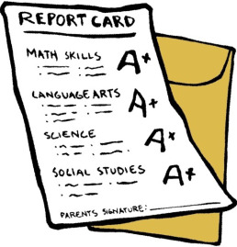
Conditions for Learning
Challenge and Engagement
  High Expectations
  Educational Opportunities that are connected to life’s goals
  Strong Personal Motivation
  Engaging curriculum
  Robust opportunities to learn
Notes:
TRANSLATE SLIDE:
Other conditions for learning, are high expectations, to connect with life’s goals, and the strong personal motivation that sometimes comes with immigrant and refugee children. Do we give the girl in our earlier photo the opportunity to become a surgeon even though she comes to us with limited language ability and disrupted schooling? Do we provide for her an engaging curriculum and robust opportunities to learn, or is she tracked into a career and technical tract because of her language skills? Other presentations earlier today have talked about aspects of conditions for learning.

Slide 27

Conditions for Learning
Peer, Social and Emotional
  Understand and manage emotions
  Understand and manage relationships
  Pro-social values and dispositions, attitudes and mindsets.
  Support, Care and Connections
  Meaningful connections with adults
  Experience of care, respect and inclusivity
  Positive peer relationships
  Effective and available support.
Notes:
TRANSLATE SLIDE:
With adolescents we know that the friendship networks are a vital part of inclusive schools—how are peer to peer relationships fostered? How are the different social norms for gender issues orchestrated in the schools? Do the teachers take time to really understand and know their students? How do we foster or hinder this in the structure of schedules? What support, both academic and emotional are offered at the school?
Schools are populated by individuals. Are the teachers, staff, parents, and students all represented in the culture of the school? Do they ALL feel included? Do they ALL feel honored? Do they ALL feel served?

Slide 28
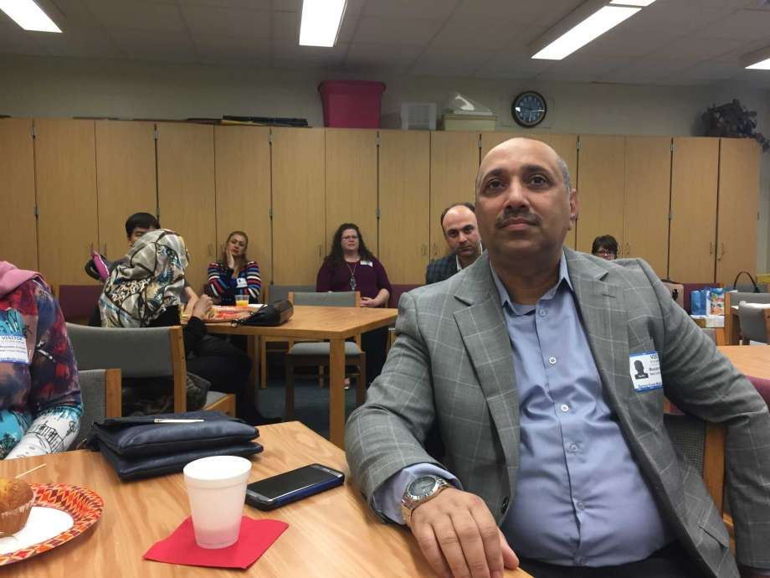
This parent made many sacrifices to bring his family to this school.
Is his culture respected by the school?
Is he welcome at the school?
Photo: Jaimy Jones, Houston Chronicle
Notes:
This parent comes to the school meeting, not really understanding the language or the customs here, but he wants to learn for the sake of his children. He is there because he has HOPE, he wants more for his children.
Is our school ready for him? Is the culture of the school welcoming and inclusive for him?

Slide 29
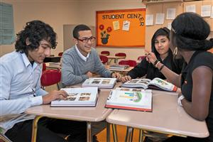
Welcome parents into Your School
Offer parent materials in several target languages
Use parents to help orient other parents in the native languages
Seek out and publicize community resources that serve the immigrant community—in some schools in US community serves are integrated in the school building.
Photo: Thomas Jefferson Newcomers Academy, CMPS
Notes:
How do we welcome parents in our schools?
TRANSLATE SLIDE:
While you may not be able to have literature in all languages represented in your school, you can provide some key parent information in one or two targeted languages with the largest enrollment. Just having these booklets printed in other languages, when coupled with an apology for not having one in a new parents’ home language will be a recognition that you understand the barriers established with the lack of the target language. In US and Canadian schools where refugee and immigrant children are thriving, you will see many parent volunteers in the schools.
In Begley School in Windsor Ontario, they have a community room where Arabic speaking mothers can take pre-school children to play as a drop in nursery school. This establishes 1) good parenting development for young mothers, 2) it serves as an informal pre-school for future students in the school, 3) it provides an opportunity for isolated mothers to gather together and feel welcome, and 4)it is an opportunity for the school to teach school habits to families.

Slide 30
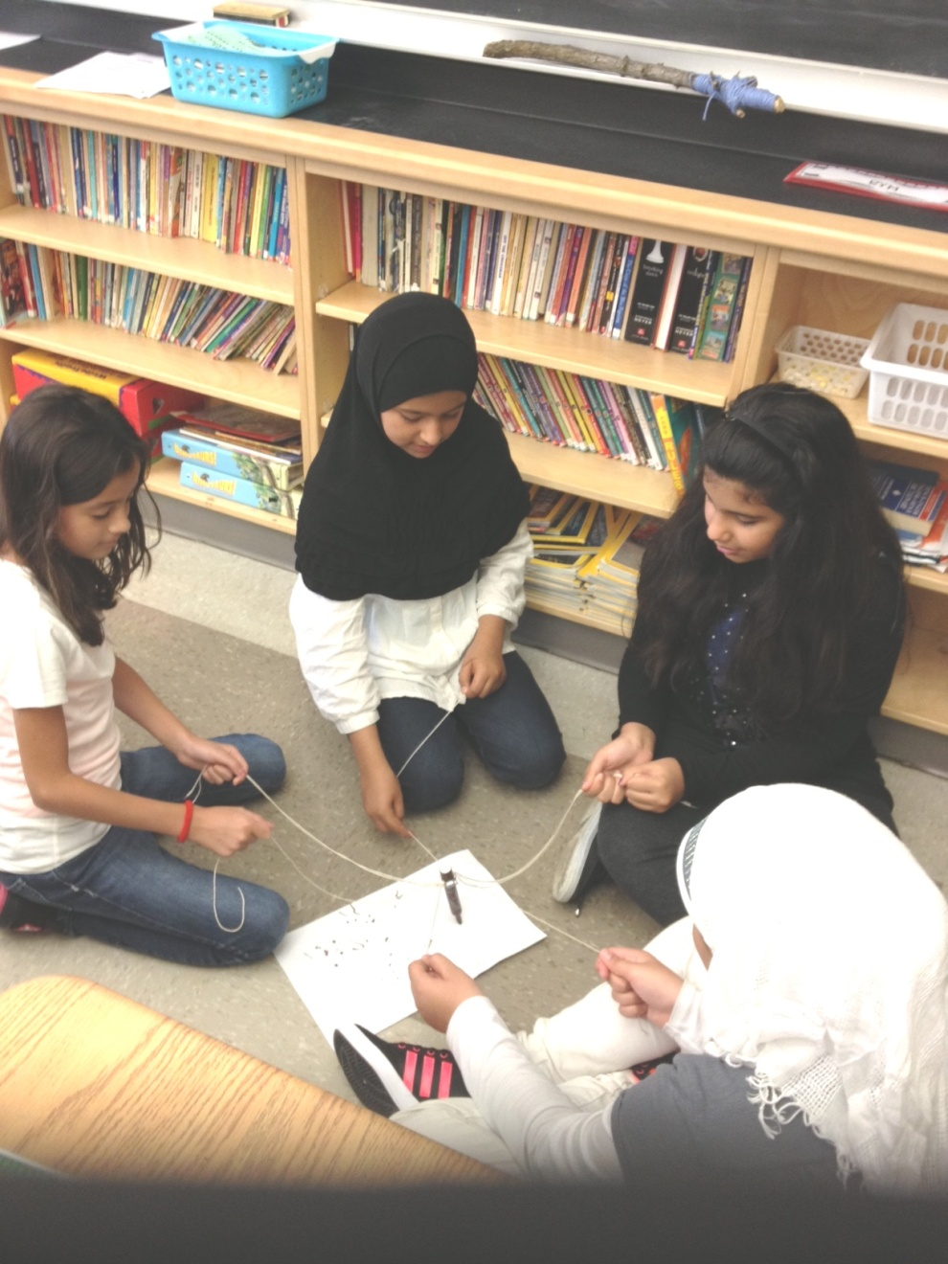
Honor their Cultures
Display a list near the school entrance showing the cultural and linguistic backgrounds of all students.
Add books, internet sites, and such in the students’ home languages for the school library.
Value students’ ability to use two languages as appropriate in daily routines, in group work, and informally.
Photo: Begley School, Windsor, Ontario
Notes:
How do we honor the cultures of the immigrants and the refugees.
TRANSLATE SLIDE
Honoring culture can be done school wide in various ways. At Begley School in Windsor, the Arabic welcome signs greet everyone as they enter. The school library has books in Arabic for children and families to check out to foster the home language and to build literacy in the home language. In some group work in the classrooms, children are encouraged to talk in Arabic or English in group work. This helps in understanding for all children, particularly those who are limited in the new targeted language. It also communicates to the parent that their language also has value.

Slide 31
Build Understanding
Be explicit about school routines and requirements, especially calendars, holidays, school timetables.
Discuss parenting laws and expectations in the new country.
Encourage parents to help the child with their first language at home
Provide suggestions for home activities, routines for homework, etc.
Notes:
How do we build understanding?
Look for as many opportunities to include parents, to give repeated explanations, and to honor the culture and language of the families. In the US, many non-profits and civil societies work with schools in providing services to schools. For example, REFUGEE RESPONSE, an NGO, provides home tutoring to children. Their belief is that by offering the afterschool tutoring in the home, the parents also learn. Additional inclusionary information is passed along informally to the parents because in the safe environment of the home. Refugee Response finds that the whole family benefits more than in other after-school tutoring programs that are offered in the school.

Slide 32

Include the Community
Encourage community groups to use school facilities for cultural and community events to foster a sense of community ownership of school
Ask for cultural artifacts, interpreters, and guest speakers from the community
Encourage cross cultural experience for service learning activities
Notes:
Vital to long term welcoming school cultures is the inclusion of the community.
TRANSLATE SLIDE:
Recently, I have been working in a failing school district near my home, where nearly 33% of the children are Spanish speaking and at the poverty level. The school district had received money to build a new high school, closing two old buildings, and combining it in one bigger school. At the open house for this new school building, not one word was given in Spanish. No literature was in Spanish, no translation was given in Spanish. These are Puerto Rican families, US citizens by birth who can move freely from Puerto Rico to Ohio. Yet, many parents do not speak any English.
Children often are expected to interpret the messages for their parents. What is lost in the translation of a child’s understanding of the messages? When children are expected to be the translators for their parents, it reverses the role of parent and child. This is a loss of dignity and pride for the parents.
If the school administrators had just included the Puerto Rican community with at least one Spanish speaking guest speaker who could have talked with pride about the new school and the hope it brings for their community, think of the powerful message that would have been given to the Puerto Rican parents.
This is a negative example, but I share it with the hopes of it not being repeated in schools around the world.

Slide 33
Building a Positive School Culture
That is welcoming
In which the conditions for learning are ever present
In which we examine how our behaviors affect us, others, and our world
In which there is a shared belief that we are part of something special and great
In which the language creates and facilitates personal pride, purpose and power.
Notes:
TANSLATE SLIDE:
Building a positive school culture is the role of the school administrator but will involvement with the teachers, staff, parents and community. Fisher, et all, reminds us that “students enter the culture of the school with an intact cultural identity that has been formed from already being part of one or more home and community cultures. The job of school, then, is to foster a bicultural student body—one that recognizes the home culture while creating a school culture that is caring.” Fisher goes on to say, that they “believe that teaching tolerance, understanding, and respect is a nonnegotiable part of creating an effective school culture.” What is the alternative to a bicultural experience? Students will feel prejudged and unwanted. This other extreme is wholesale rejection.
As school administrators we can develop a school culture that is based on tolerance, understanding and respect.

Slide 34
School policies affect culture of school
The role of language learning
The role of second language in classroom and corridors
The schedule of offerings for refugee students
Opportunities for social interactions (in US sports, music, clubs, etc.)
Resource allocations—academic over social/emotional
Notes:
TRANSLATE SLIDE
In some cases local school administrators are not in the position to make all of the policies that determine how welcome a school is. It could be that the policy is to have all second language learners isolated in a special school, part of a school building, or in special classes most of the day. It could be the official policy of the educational officials that all limited language students be tract into career and technical education as it advances them toward graduation easier and faster.
In American schools, refugee children often find social success and integration in the school clubs, sports and music activities prior to feeling success academically. The sports teams like football (soccer), or music activities like singing groups, or international clubs that celebrate differences can be outlets and activities for students who are struggling academically. At North High in Akron near our university, the soccer team has consistenly won the City Championship. Most all of the students on the soccer team are refugees from Nepal, Bhutan, and Iraq.
School administrators may also find that they can determine resource allocations. In one of the Denver Public Schools we visited with the European School Administrators, the school staff voted to have larger class sizes (28 instead of 25) in order to have another social worker/counselor in the school. The teachers knew that if the social/emotional was taken care of the learning would come. They needed the special expertise to help them with the children they served.

Slide 35
Support of staff
Professional development of staff in preparation
  ELL learners
  Trauma and its role
  Culturally relevancy
Support of new staff/faculty
On-going support emotionally, coaching, opportunity to dialogue for faculty
Notes:
Another important aspect for the school administrator is readiness of a school for immigrants and refugees is to build in support for the staff. All staff members should have professional development in working with second language learners. That means that history, mathematics, physics and chemistry teachers should have professional development on how to teach limited language students. This is important to separate the inability of knowing a language with the ability to learn complex, advanced skills/thoughts. Different instructional strategies should be utilized to strengthen the concepts for all students.
Additionally all the teachers, support staff, and administrators should have professional development on trauma and its role in brain development, and in learning. Teachers need to know how to identify it, when to refer to specialists. As I reviewed the evaluation of the European School Administrators visit to America, one of the themes that clearly was evident, was the feeling of being part of community of other administrators with the same challenges. Leadership can be lonely. Leadership of schools like this ven lonlier. We need to support each other.
All teachers, support staff, and administrators should have awareness of the cultures represented by the student body and community they serve. This can be done with cultural specific training or cultural general sensitivity training.
Once we do this professional development, we have to remember to include new staff and faculty and to have on-going support and coaching for all staff. Situtations change, children change, and new issues should be addressed.

Slide 36
When?
When is special education appropriate.
When is counseling needed?
When to get publically involved within the community for advocating for services and facilitating best practices for education?
When to be an advocate for world refugee issues and global justice?
Notes:
School administrators and policy makers must know when to refer refugee and immigrant children to special education or other services. When is counseling needed? When do we as educators get publically involved within our communities for advocating for services and to truly facilitate best practices for refugee education? When do we as educators advocate for world refugee issues, and global justice. Thse are questions that should drive our future conferences on this deep and diverse topic of refugee children’s education.

Slide 37
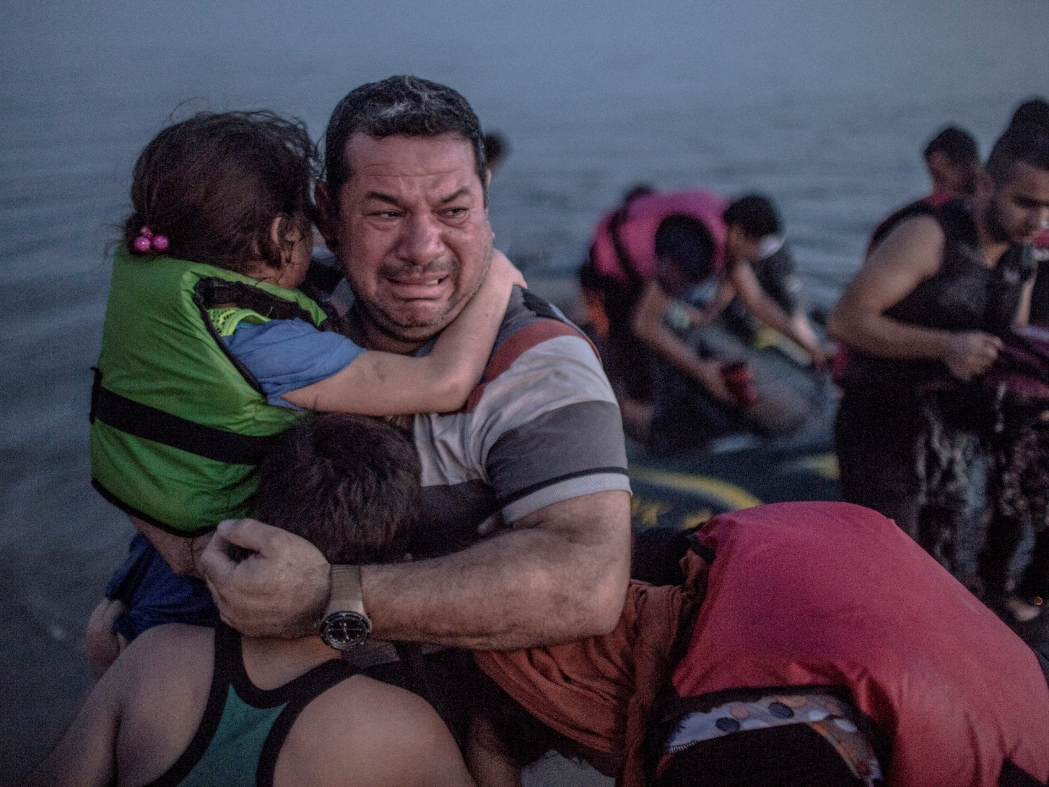
Will his sacrifices have been worth it?
Photo: The Independent
Notes:
Remember this photo from the beginning of my talk. We have to remember to ask, will his sacrifices have been worth it? Does our school provide for his children in a way that the love that he shows as he hugs them, the anguish in his face at the sacrifice, will he believe that the future is now in his and his children’s hands.
Interaction Opportunity: Ask for suggestions for a chart to include other aspects administrators need to think about to ready their schools for immigrant and refugee children.

Slide 38
If we have welcoming schools, how can we have welcoming classrooms?
Notes:
School administrators can work to develop welcoming schools, are teachers ready to provide the teaching and learning for refugee and immigrant children?
According to research done in my home institution, Kent State University, rarely are regular classroom teachers in the US provided any professional development in how to teach children with out the target language. Only 12% of American teachers received more than 8 hours of professional development training focused on ELLs according to the National Center for Education Statistics, in 2002. However, this may change due to the current new federal legislation that requires schools to be assessed on how well English Language Learners do in all academic areas. This will move accountability for this increasing population from the English as a Second Language teachers to ALL teachers.

Slide 39
Challenges Facing Teachers of
Refugee Children
Pedagogical challenges
Trauma
Cultural Dissonance
Irritation, frustration, and expectations
Notes:
Teachers have different issues that school administrators.
Teachers face pedagogical challenges—what are the best ways to teach children with these backgrounds?
Teachers must understand the ways that trauma interrupts learning, how to create welcoming classrooms,
Teachers must also interact daily with the cultural mixes in their classrooms.
Teachers may also find that their job more frustrating, harder, and less rewarding.

Slide 40
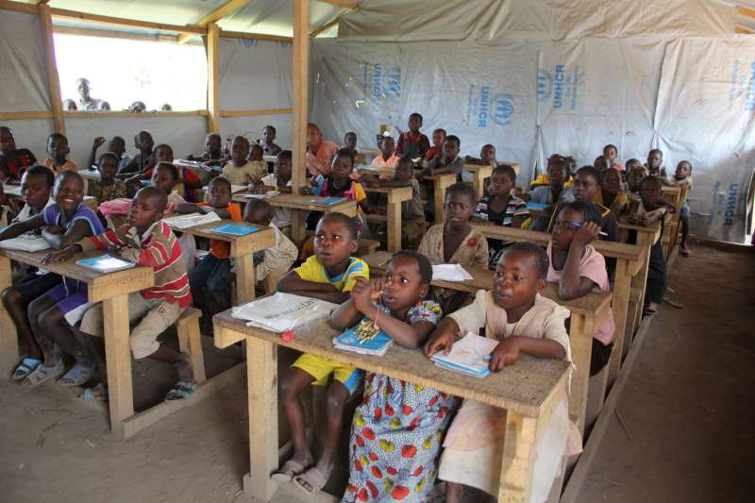
Teachers need to realize that schooling may have interrupted or lacking.
      Photo: UNHCR, September 15, 2015
Notes:
Only 50% of refugee children are in school
And even worse, 22% of refugee adolescents are in school.
And when they are in school, they are in schools like this one in Central African Republic with more than 50 students for a teacher, and no supplies.
Teachers will also need to know that for the some students in their classrooms they will be having many firsts– for some it may be the first time sitting at a desk, for some it may be the first time using pencils. Routines need to be established: 1) what is the proper procedures to go the restrooms and how and when to ask a question, 2) expectations for behavior. Just because children are of school age, we can not assume that they know the patterns of schooling.
Pairing a new student with a student from the same linguistic and cultural background, of course, can assist in making these first days comfortable. However, because of numbers of new students at the beginning of a school year, teachers need to take time to establish routines, demonstrate routines, and practice routines to establish expectations. Routines should be developed prior to teaching regular curriculum. . .this is developing emotional safety first.

Slide 41
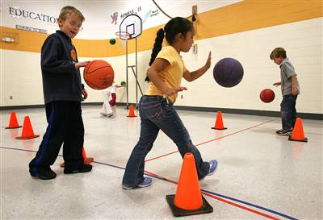
Trauma may cause problems with Classroom Routines
Photo: From the Pool to Classroom
Notes:
READ SLIDE. Sato and Hodge found that the children with trauma or PTSD symptoms had more troubles in the Physical Education classroom than in the structured, smaller spaces of a regular classroom. The noises of the gym such as dribbling balls or the echoes of the larger space was traumatic. If someone else screamed when they scored, the refugee children were afraid. Even regular lesson plans have to be altered.
One teacher in their study said about the class which was filled with all second language learners she was concerned about safety because so many children were approaching the assigned tasks wrong because they didn’t understand what to do, had no experience with the equipment or the play situation. For example, children from some cultures did not know what skipping or galloping were, and did not know how to dribble a ball.

Slide 42
Teachers need to be sensitive to cultural differences
Hofstede’s Comparisons of Culture
Notes:
Teachers need to be sensitive to cultural differences.
Hofstede’s land mark work nearly half a century below, still have relevance today for us to learn about differences in culture. If we take only four of Hoftstede’s dimensions in comparison: 1) uncertainy avoidance or risk taking 2) long term orientation versus short term orientation 3) individualism versus collectivism, and 4) power distance—hierachical or consensus building.
Let examine some ways the numbers of this chart can help us plan for instructional strategies that are appropriate for learning in a classroom with French, Syrian and Senegalese children. French students on the average will be will be challenged and reluctant to do a new project, or to approach learning in a way because of the high uncertainty avoidance. Look at the Senegalese and Syrians—their scores are lower on the uncertainty avoidance. These refugees have and by culture have a easier time adjusting to the unknown. Now add to this scenario what we know about the refugee trauma and brain development, and this adds an additional complexity to children adjusting to the new school expectations.
In long term orientation, a French child might be able to manage a long research paper in a secondary school. But the Syrian and Senegalese might need interval deadlines to help them manage the time commitment.
Because Syrian and Senegalese children have a stronger collective, not individual tendency, they may have more success academically to work in groups. French parents may resent their children to be placed in groups with the Syrian and Senegalese students.
Because of their respect for those in authority, the Syrian and Senegalese students might not approach a French teacher as willing to ask questions about an assignment. The power distance is high. . .therefore, the approachability of teachers may be altered.
Knowing these generalities, and adding in the complexity of brain development issues of refugees from war torn areas, the French teacher in our example could be challenged with the diversity of the classroom mix.

Slide 43
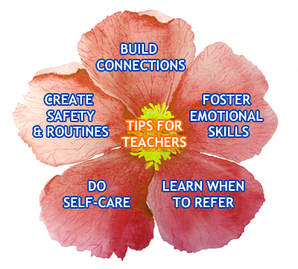
Teachers need to establish relationships with these students
Photo: Calgary Board of Education: Teaching Refugees with limited Formal Schooling.
Notes:
Remember the issues of brain development and trauma. To re-establish brain patterns for increased cognitive abilities, teachers should invest time and effort in establishing relationships with students.
As we have said early in this presentation, create safety and classroom and school routines. Clear expectations transitions (moving from classroom to classroom, going to lunch, etc. should be established and maintained.
Then the classroom teacher should build connections with the student in some way. This can be part of the daily lesson plan that scaffolds past experiences and skills with new expectations.
Knowing how to foster emotional expressions somewhere in the curriculum—through the arts, through specially designed assignments in the regular classroom. Through trusting relationships, students will work through the trauma of migration and resettlement.
Teachers need also to know when to ask for help with any student. Learning that some problems require more intervention, more social/emotional therapy, and difference expertise that social workers, counselors, or other agencies may have is also an important skill for regular classroom teachers.
And lastly, but just as important, teachers need to realize that teaching children with complex and interrupted educational experiences is taxing. Teachers should be willing to participate in school wide support groups, and share with other teachers who are dealing with the same problems.

Slide 44
Teachers need to set expectations to match academic abilities
All of the research says that these children can overcome many odds in achieving academically
Because of language and loss of previous schooling, expectations should NOT be lowered.
Teachers need to recognize the learners’ abilities, strengths, and experiences though programming that builds on these capabilities.
Notes:
TRANSLATE SLIDE:
By building on past experiences, strengths, and establishing relationships, a teacher can help the student overcome obstacles and see the possibilities.

Slide 45

Cognition Recommendations
Meta-cognition development
  consciously apply learned strategies while engaging in new activities, this could be called culturally scaffolding on previous learned experiences.
  gain awareness of the strategic options that learners have and gain the ability to choose the most effective method of learning for the new skill to be taught.
  monitor , evaluate and adjust expectations during the lesson
  plan for future expectations based on evaluation of past successes.
Notes:
TRANSLATE SLIDE:
For those who attended Marina Aleixo’s Funds of Knowledge presentation yesterday you will be familiar with this approach.
For refugee children culturally appropriate scaffolding of learning will help them advance at great rate in all subjects. This teaching skill may need to be developed for existing teachers, especially those at the secondary level who are used to teaching content only in a pre-described sequence, and with the lecture method of memorizing for routine tests.
Interaction Opportunity: Share ideas in small groups of what are the concerns that teachers have with instructional strategies, discipline, interaction with refugee and immigrant children. List these concerns on a chart for future planning of professional development.

Slide 46
As School Administrators are we ready for the refugee and immigrant children in our schools?
Notes:
As School Administrators the challenges of educating refugee and immigrant children will change our roles. We will need new expertise, develop new habits, search for new best practices, and be risk takers as leaders in implementing change. At the beginning of this presentation we asked the question, They are here, are we ready for them? We talked about trauma setting the stage, as administrators we have to set the school culture and environment, teachers must build the relationships, and then communities must work with us in finding inclusionary practices.
Only then we can ask ourselves, is this the kind of world we want to live in? Today’s terrorism does not allow any of us the safety and security that we used to have. We all must work together, learn together, and support each other to insure that we help the children we teach today to create the kind of world we all want to live in.

Slide 47

WORLDWIDE
2015 alone, the number of migrants had surpassed 244,000,000.
65,000,000 forcibly displaced persons,
  21,000,000 refugees,
  3,000,000 asylum seekers and
  over 40,000,000 internally displaced persons.
Notes:
The problem is not a problem of today only. Looking at these statistics, we realize that the issue of education of refugee and immigrant children is an issue worldwide. It is an issue that should be discussed in pre-service teacher education classrooms in the universities. It is a professional development need for teachers from around the world, not only in the developed world like Europe and North America. It is an opportunity for research and writing to share best practices and to learn from each other.
Programs such as this are beginning this kind of sharing. We appreciate the French Ministry of Education, IREX, ESERESR, US Department of State, and the 20 European School Administrators and their governments who are all part of this conference. We thank these visionaries for this return conference to help us all deepen the understanding, to share the best practices, and to raise the questions in helping us better serve the new mobile population of the world.

Slide 48
References
Colorado Department of Education, Immigrant Integration Educator Resource Guide. Denver, Colorado. 2016.
Fisher, D., Frey, N. & Pumpian, I. How to Create a Culture of Achievement in Your School and Classroom. ?????
Hollis, E. Culture in School learning: Revealing the Deep Meaning. Routledge NY & London, 2015. 3rd Edition.
Hooper, K. Zong. J. Capps, R., & Fix, M. Young Children of refugees in the United States: Integration Successes and challenges. Migration Policy Institute. March 2016.
Massachusetts Advocates for Children. Helping Traumatized Children Learn.
McHugh, M. & Sugarman, J. Transatlantic Symposium Report: Improving Instruction for Immigrant and Refugee Students in Secondary Schools. Migrant Policy Institute. November 2015. Washington DC.
National Child Traumatic Stress Network, (http://nctsn.org) 12/20/2016.
Perry, B. d., Traumatized children: How childhood Trauma influences brain development. (http://www.aaets.org/article106.htm) 12/20/2016.
Ontario Ministry of Education, Supporting English Language Learners with Limited Prior Schooling: A practical guide for Ontario educations, grades 3-12.
Rousseau, C., Lacroix, L., Singh, A., Gauthier, M, Benoit, M. Creative Expression Workshops in School: Prevention programs for immigrant and refugee children. Journal of the Canadian Academy of Child and Adolescent Psychiatry, 2005, August. 14(3), 77-80.
Sato, T. & Hodge, S. R. Elementary physical education teachers’ experiences in teaching English language learners. Education and Urban Society, 2016. Vol. 48 (3), 262-287.
Teaching refugees with Limited Formal Schooling, (http://teachingrefugees.com/socio-eotional-supports/leadership/) 12/20/2016.
UNICEF Australia, Children of Syria in Their Own Words, https://www.youtube.com/watch?v=nIqZxz2mt_c
12/20/2016.
UNESCO, A Teacher’s Guide on the Prevention of Violent Extremism. Paris, France. 2016.
Vargas, C. M. Red flags and clinical principles, heretohelp. (http://www/hereto help.bc.ca). 12/20/2016.

