Slide 1
SUMMER CAMP

Slide 2
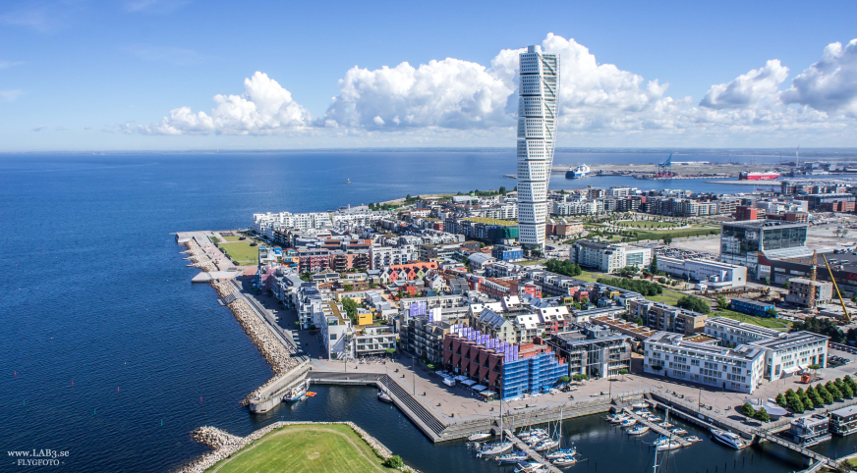
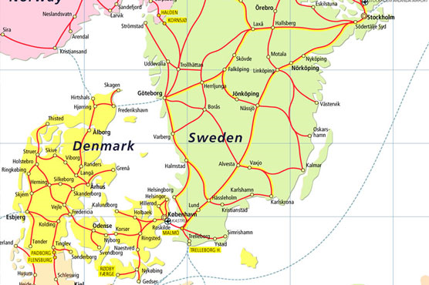
Background
Malmö is a city of 325.000 inhabitants in the Copenhagen Metroarea of 4.1 million - 2.9 million in Denmark and 1.2 million in Sweden with a linking bridge between the two cities of Copenhagen and Malmö
Long history of being the gateway to Scandinavia and receiving refugees and immigrant-workers
Two schools – one for newcommers and one vocational school

Slide 3
Background
August 2015: 10 classes, 175 students
October 2015 – January 2016:
1 new class per week (18 in each class)
June 2016: 395 students at my school
195 students at other schools
Desirers
Help with homework
Meet swedish friends
Learn swedish
Excursions
Learn about Sweden
Lern to drive, swim and bicycle
Different sport activities

Slide 4
Summer camp - Challenges
Summer school
The city of Malmö has a long tradition of summer school
This organization usually enrolls 500 students and 20 staff for two weeks. Mathematics, Swedish and English on a secondary level.
Newcommers have the legal right to attend summer school
Challenges
The large numbers of newcommers that Malmö received during 2015/16
The level of knowledge in Swedish wasn’t at secondary level.
The organization of the ‘ordinary’ summer school and the summer school for newcommers would be for aprox. 1000 students and 40 staff – a far too big organization for one school to handle
Newcommers need to continuously train their second language skills.
The newcommers had nothing to do during the summer and if they knew of something to do, they didn’t have the money to do it.
To meet the desirers of the students

Slide 5
Summer camp – We were lucky
We were lucky
The department of education in Malmö had been granted a governemental-funded project called PlugIn 2.0. A project to reduce drop-outs at upper secondary school. The project manager was – on my request - transferred to my school earlier that semester.
They – in turn – were connected to the organization called Hela Malmö (The whole of Malmö or Heal Malmö). Hela Malmö is sprung from the different youth organizations in different sports clubs in Malmö.
We had an empty school building
Teachers and paraprofessionals with multi-language skills
An educational department and an existing community that was willing to help

Slide 6
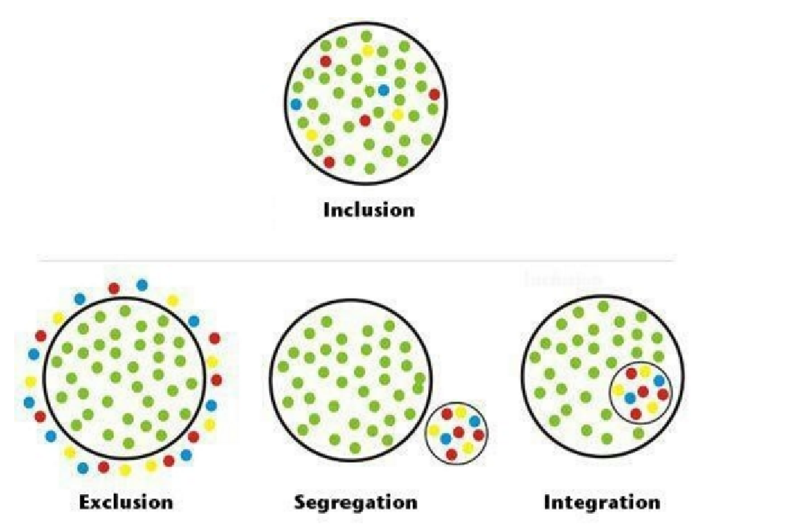
Summer camp – Hela Malmö
Hela Malmö (The whole of Malmö, To heal Malmö)
Started 2004 as a school project
Main focus: Inclusion
          Getting young people involved in meaningfull after-school activitites and creating jobs for young adults
Target groups: 10-20 yrs
No. of participants: 4.000 youths

Slide 7




Summer camp – Not a ’one man’s work’
Malmö University
The Recreation department in the city of Malmö
Department for social services ni the city of Malmö
Save the children (Sweden)
Association for unaccompanied children
Representatives from different sports and kultur associations

Slide 9
Summer camp
Hours
08.30-11.45 School
11.45-12.30 Lunch
12.30-15.00 Activities
Summer camp
Swedish | Alfphabetization | Grade 1-3 | Grade 4-6 | Grade 7-9 | High school
No. of groups | 3 | 4 | 3 | 2 | 0
Mathematics |  | Grade 1-3 | Grade 4-9 |  | High school
No. of groups |  | 0 | 1 |  | 1

Slide 10
Summer camp
I provided and paid for
Teaching staff & Paraprofessionals
School lunch
Rooms/Housing for some activities at school
Hela Malmö provided staff and activities for the afternoon.
Hela Malmö came to school during a two week period in may and presentet summer camp together with paraprofessional with multilanguage skills. Information was sent to caretakers, parents, the homes for the unacompanied and posters was put up at school.

Slide 11
Summer camp
Movie
https://youtu.be/mm_hGa7lh8s

Slide 12
Summer camp - Statistics
Statistics
Out of about 550 students (3 to 18 months in Sweden)
343 answered that they would attend (62%)
178 came the first day (52%). That number increased to 201
125 did the exam on the last day (62%)
13 students achieved so good of a result so they got in to regular upper secondary school (grade 9)
Ramadan might have pulled down the numbers
Cost
€95.000 in teacher payment and paraprofessionals (grants from the State)
€7.000 in school lunch
€2.000 in bus/boat/train tickets

Slide 13
Summer camp
 | I need | I wish for (A lesser need for) | I allready have
Important | Lerning through experience Partership Student voice Communicate in students first language prior to the activites. Be aware of your limitiations Techerrs and paraprofessionals with language skills | Use student voice to devolop/think outside the box Community partnership Funding
Less important

Slide 14
Summer camp
Harder to adapt | Easy to adapt
On a scale from 1 to 10;
How likely is it for me to adopt Summer camp to my school?
1 10
Hard Easy

