Slide 1
Newcomer education in NL
2015
58.000 refugees asked for asylum in the Netherlands
Mainly from Syria, Eritrea, Afghanistan, Iraq
12% (over 7.000 students) were 12-18 yrs old
All children from 5 - 18 yrs must go to school
All regular schools have the right to start an ISK-department for newcomers (ISK = international switching class)
In 2016: more than 100 secondary ISK-departments
Fast preparation of students (1,5/2 yrs) through individual routes for the regular Dutch education
Mandatory classes in Dutch, math, sports and social science

Slide 2
Two types of ISK-schools
1. Regional locations, specialised in ISK-learning
2. ISK-classes within regular secondary schools

Slide 3
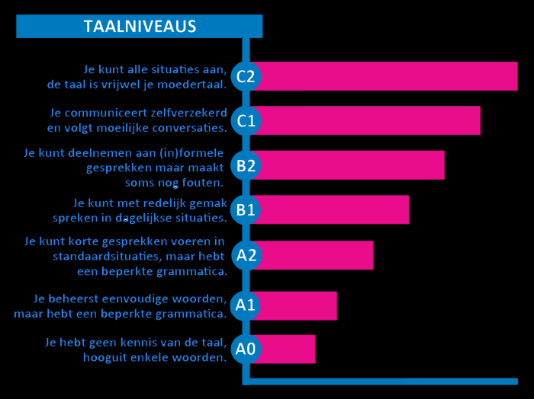
Language, Language, Language

Slide 4
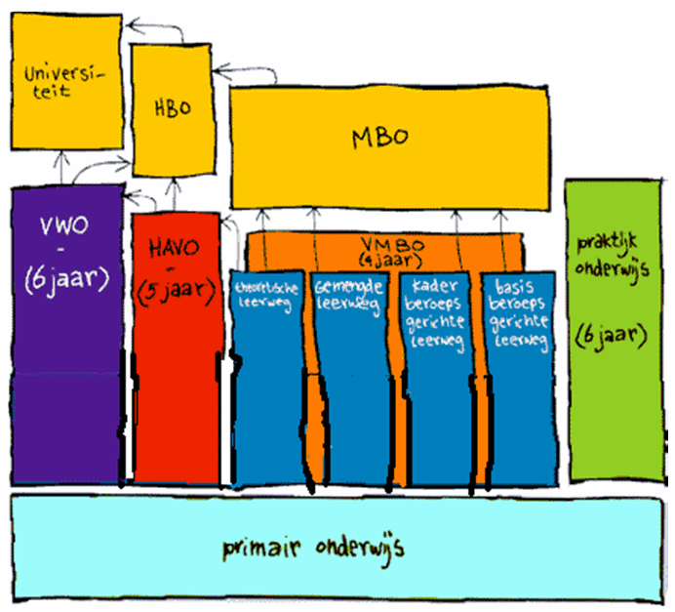

Slide 5
Huge problems for newcomer students aged over 10
Language acquisition is slow. 7 years?
Universities and vocational colleges for higher education require languages skills at C-level.
Cynical side to this too: classes often taught in English.

Slide 6
challenges
  16 individual levels in one classroom
  a huge variety of age and development
  expertise and education of teachers
  mental health care of the students

Slide 7
Present bottlenecks
Little integration with Dutch students, especially those who study at the higher levels (havo, vwo)
1/3 of the refugee students continue their education at too low a level, seen academically
Many relocations of refugees (7 or 8 times
Care for unaccompanied minors
Many unaccompanied minors do not finish their education after they turn 18
- no more supervision
- relocation
- motivation
Great fluctuation in numbers of students

Slide 8
Success factors
  a central intake with certified tests
  all schools are committed
  we share the financial risks (student numbers fluctuate)
  students integrate more easily in the school community
  students can more easily follow classes in the regular system

Slide 9
What went well, was successful?
Netwerks got up and going quite well: lowan and ITTA (experts on education for newcomers).
School authorities, the ministery for education, and institutions like lowan are working together very efficiently.
Teacher training is being improved: second language learning and intercultural competence part of curriculum.
Buddy system, newcomers coupled with successful predecessors in 'giving back' programmes.
Peer to peer coaching in schools.

