Slide 1

Professional Building Inspector
Master Building Inspectors

Slide 2

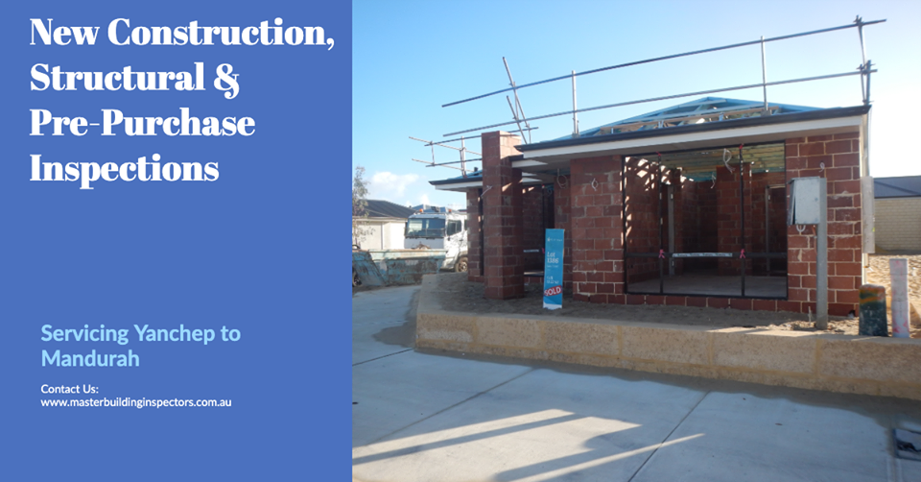
Investing your money in wrong property can be a pain in future. Hire building inspector who can guide you on your purchase of a building property.

Slide 3
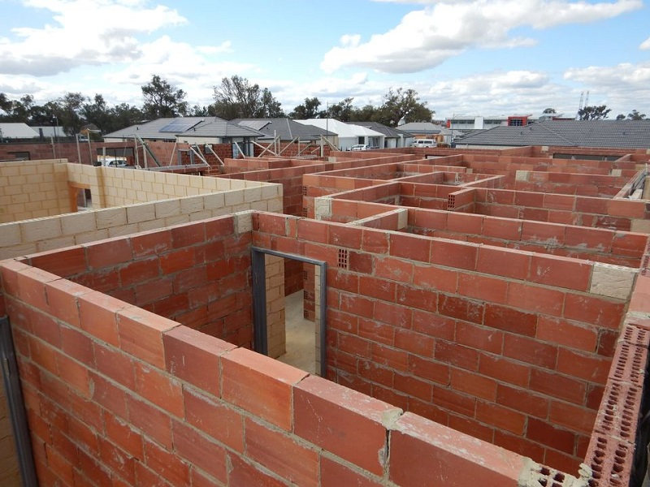

Slide 4

Why Use Master Building Inspectors
Full Professional Indemnity & Public Liability Insurance
Registered Builders
Active members of the Housing Industry Association WA
Free site consultations
Comprehensive reports with photos
Report turnaround within 24 hours

Slide 5
Services
Structural building inspections
Pre-Purchase building inspections
New construction building inspections
Slab inspections
Brickwork inspections
Roof frame inspections
Lockup inspections
Handover inspections
Dilapidation building inspections
Specific building inspections
Strata reports
Maintenance reports

Slide 6
Contact Details
Address - PO Box 6249, Swanbourne 6010 W.A
Call us - 1300 852 496
Email - info@masterbuildinginspectors.com.au
https://www.masterbuildinginspectors.com.au/

