Slide 1
Uses of the Baobab tree
By Aronas Baniulis

Slide 2
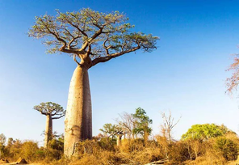
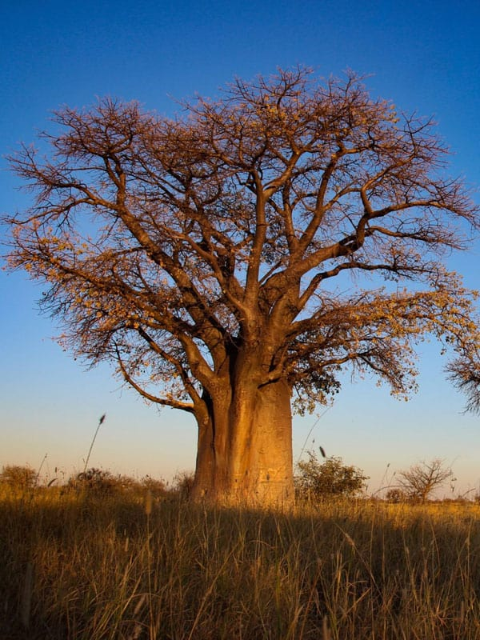
What does a baobab tree look like?
Notes:
2

Slide 3
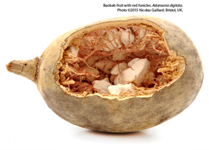
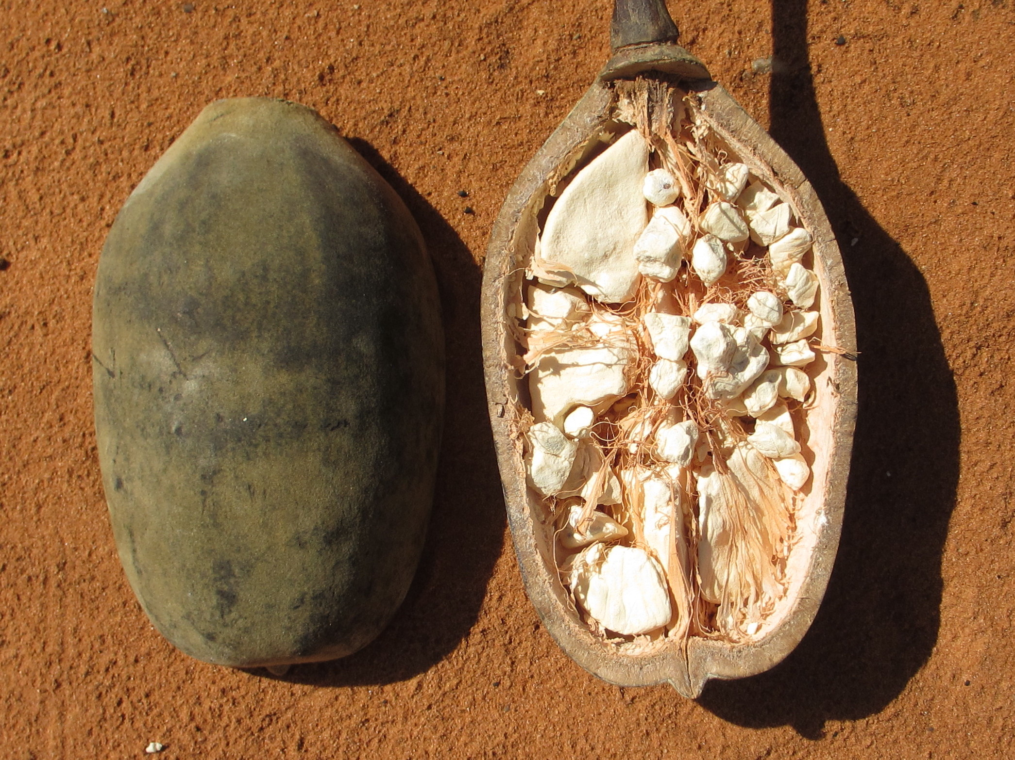
What does a baobab fruit look like?
3

Slide 4
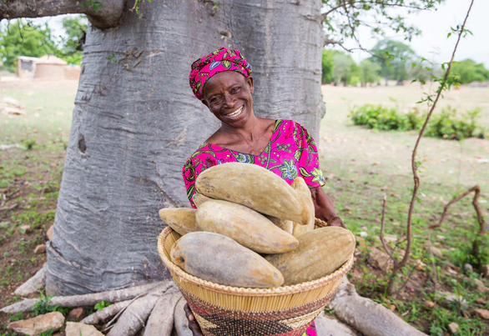
Facts about the baobab tree
The leaves, bark and seeds of the baobab tree are believed to cure many diseases (malaria, tuberculosis, influenza, anaemia, toothache, dysentery and various microbial infections).
Baobab leaves and fruits are believed to strengthen the human immune system.
Baobab fruits and leaves are rich in nutrients and are used as food.
Recycled baobab bark is used in rope, bags and clothing.

Slide 5
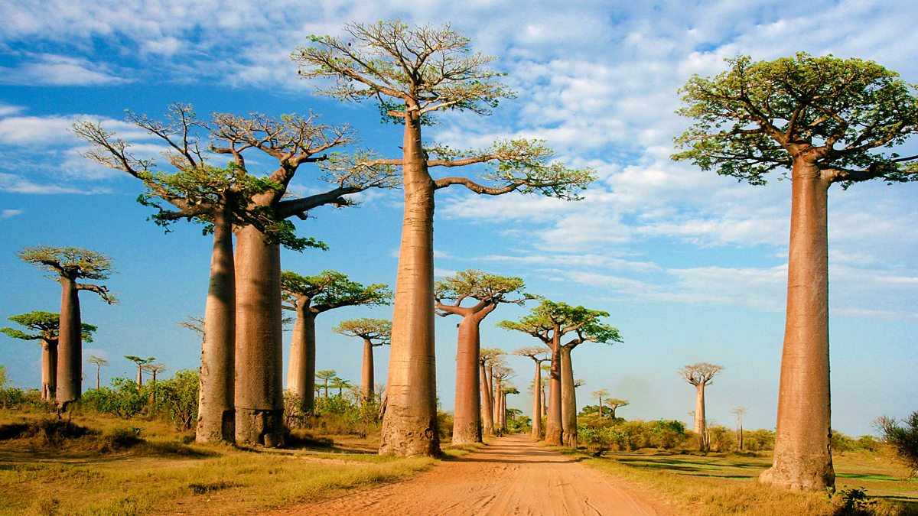
5. Baobab seeds are used to make cosmetic oils.
6. Women in Africa have been using the baobab fruit for centuries as a natural source of health and beauty.
7. The baobab fruit produces baobab powder, which is particularly rich in vitamin C, high in fibre and antioxidants.
8. Baobab trees can provide shelter for many animals. Animals eat the bark of baobab trees to survive in times of drought.

Slide 6
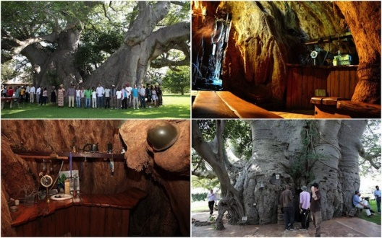
9. You can even set up a café in the trunk of a baobab tree. One 6,000-year-old baobab tree is home to a café.
10. The hollow trunks of baobab trees can be used to store water.
11. The flesh of the baobab fruit is used to make juice, jam or fermented beer.
12. The roots of the baobab tree are used to make red dye.

