Slide 1
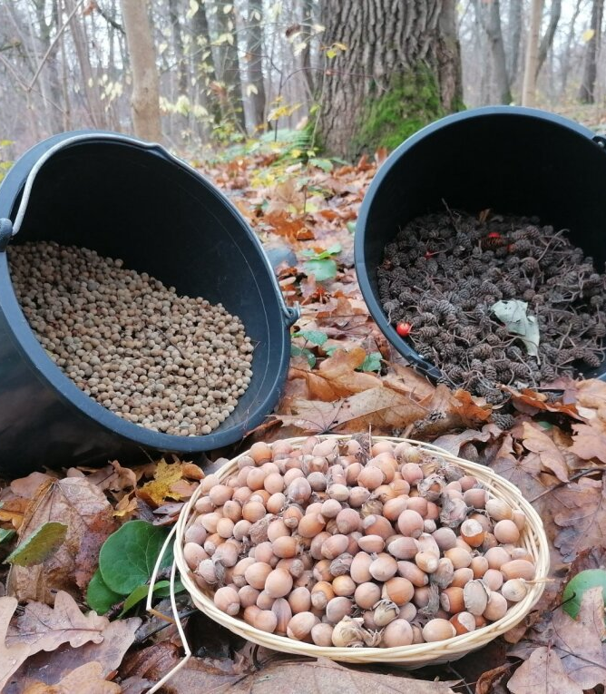
Facts about the seeds of trees. Acorn Chestnut Pine cone
By Tajus Vaičiūnas

Slide 2
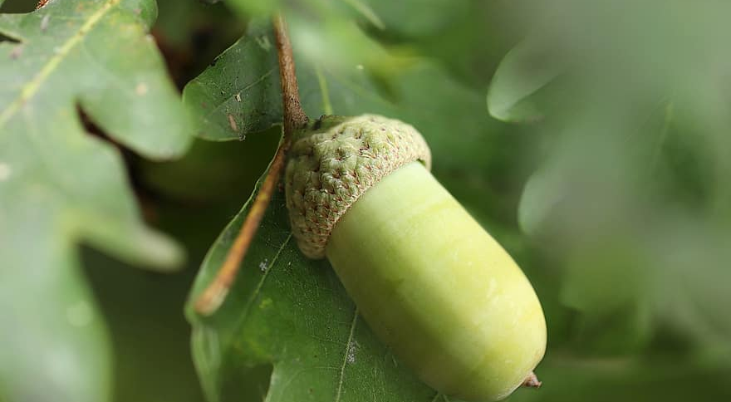
Acorn - oak seed,walnut,food

Slide 3
Acorn
Acorn is a large dry monoecious fruit 2-5 cm long with a thick hard shell. The shape is oblong-ovoid, almost up to a third shrouded in a hard shell. Acorn coffee is made from acorns, consumed as a substitute for coffee or just a hot drink. In some countries, acorns are used for food. Crushed into flour are used for bakery products. From acorns, nutritional oil is sometimes extracted. Acorn feed is fed to pigs, sheep, fed poultry.

Slide 4
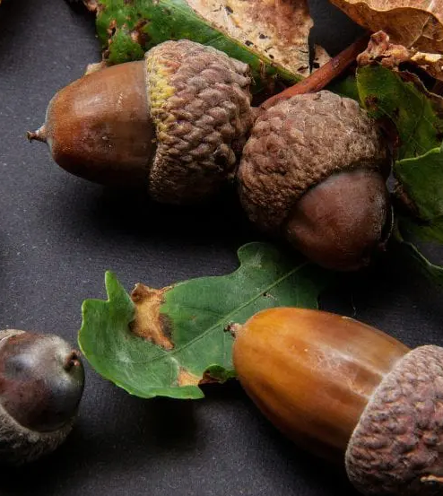
Acorn
Acorns are grown by oaks one to four on the stalk. Ripens and falls in September-October. The acorns that have fallen to the ground are spread out by animals, such as jackals.

Slide 5
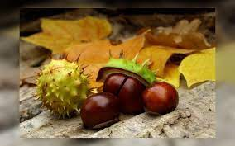

Chestnut seed

Slide 6
Chestnut seed
Chestnuts are leaf-throwing or evergreen trees and shrubs, depending on the species, grow from small bushes 2 m high, large trees up to 40 m high.
The leaves are large, consisting of 5–11 smaller petioles. The rings are concentrated in whiskers.
The chestnut fruit is spherical or ovoid in shape, prickly, otherwise it is a box, when opened inside of which we will find large, spherical brown seeds with a diameter of 2-7 cm.

Slide 7
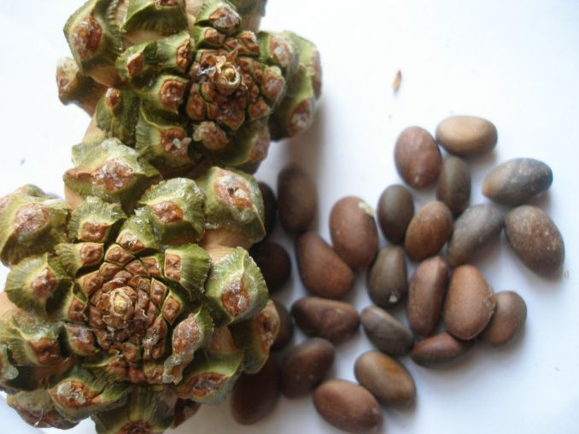
Pine seed-Pine cone

Slide 8
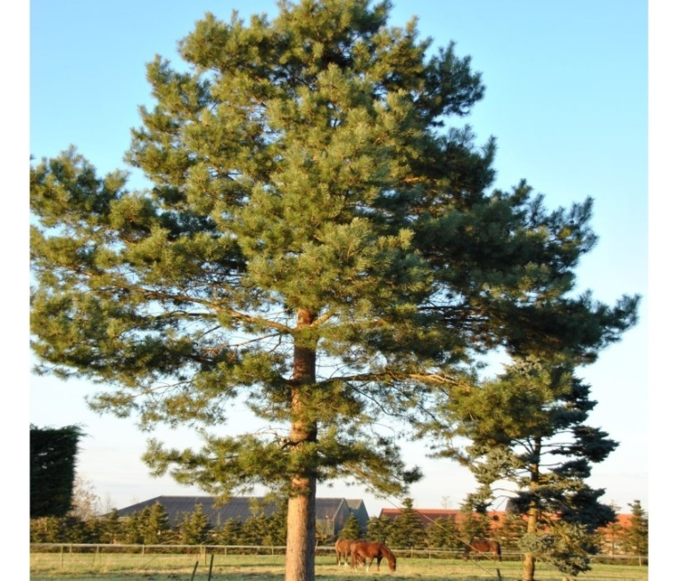
Pine seed-Pine cone
Common pine is one of the most common conifers in the world. It has spread on its own almost throughout Europe, Asia Minor, the Caucasus, Siberia, Mongolia, Russia.

Slide 9
Pine seed-Pine cone
Did you know that pine blooms at the age of ten to fifteen?
In addition, the fruits ripen only every second year.
Fruits ripen in the fall from September to October.
From small cones at this time, seeds are formed, which initially remain hidden inside.
Only when dry, the scales of the cone open and release the seeds.
If we listen well, spreading the fruit, sometimes we can hear a faint crunch.
Either the cones remain on the tree after dropping the seeds, or they also fall to the ground.

