Slide 1
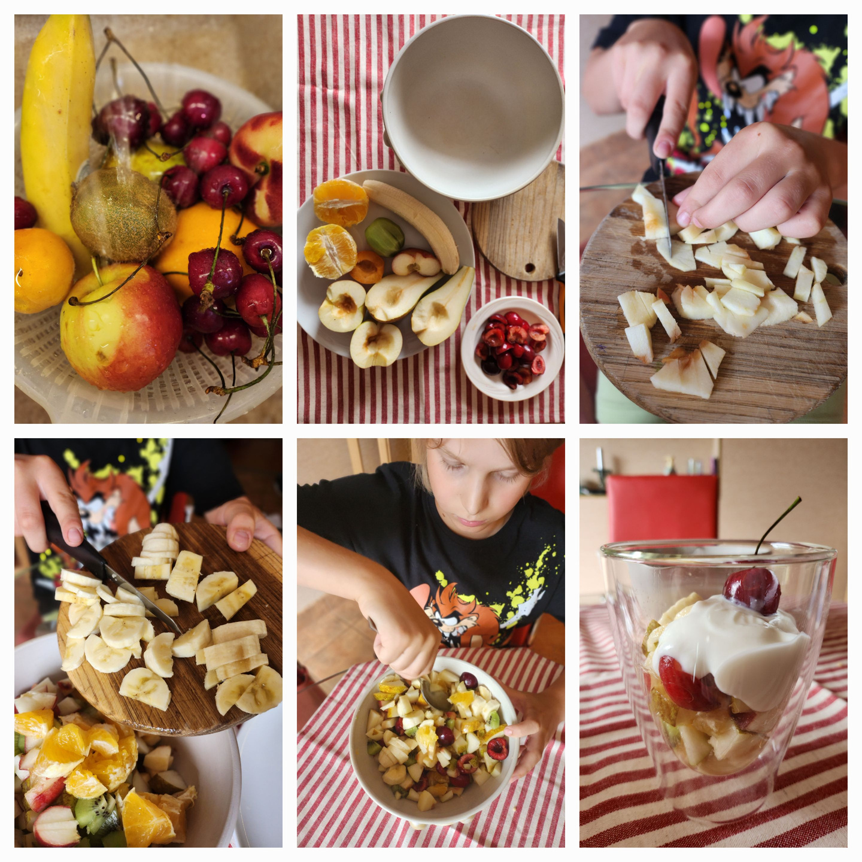
FRUIT SALAD

Slide 2
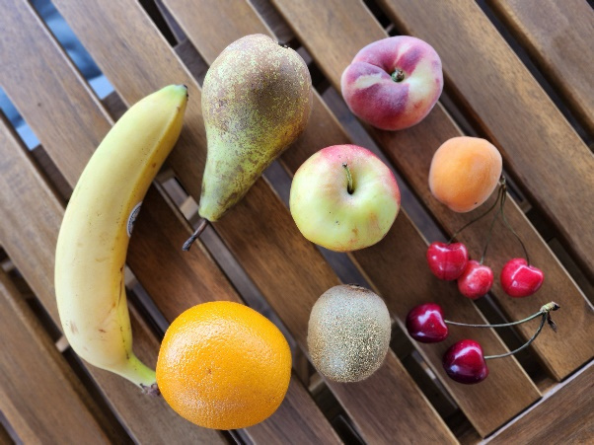
There is a great variety of fruit trees in the world.We decided to make a salad from the bounty of different trees.

Slide 3
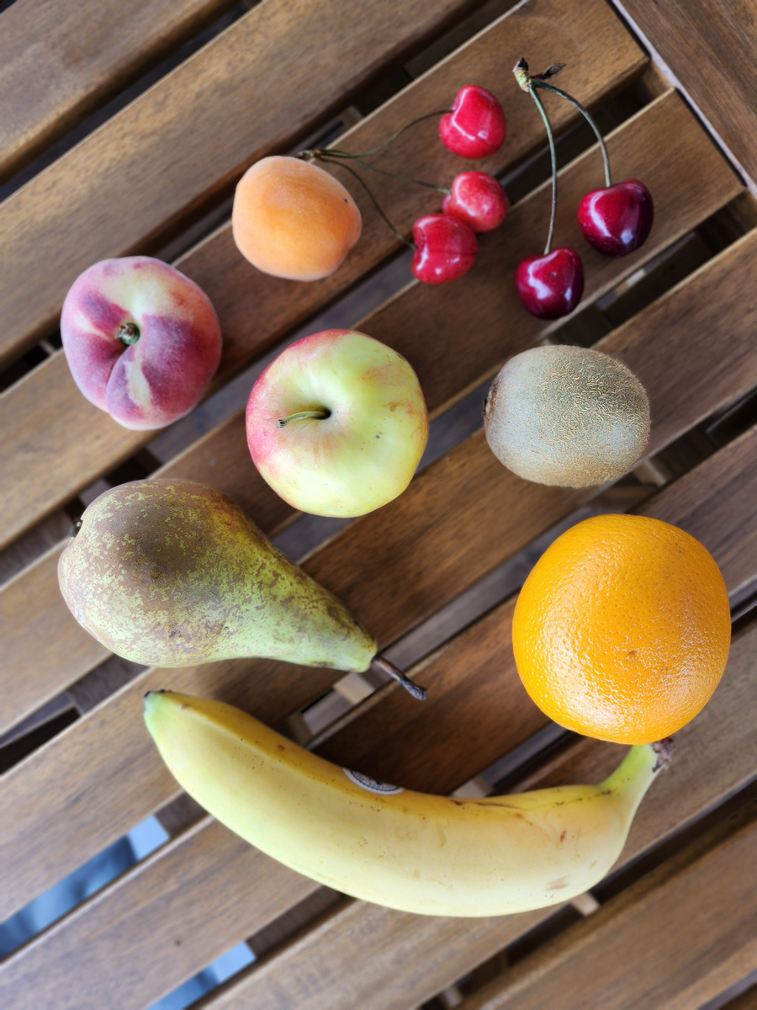
Ingredients:
  apple
  pear
  cherries
  banana
  orange
  kivi
  apricot
  peach

Slide 4

Preparation process:
  Wash all the fruits.
  Prepare fruits for cutting:
    Peel the fruits (banana, orange, kivi).
    Remove the pits from the cherries, apricot and peach.
  Cut all the fruits into pieces.
  Mix everything in a large bowl.
  You can add maple syrup or yogurt and enjoy this delicious dessert!

