Slide 1
RESEARCH PROJECT – APPLE TREE
by Dorians, 4th grade student of
Riga Lithuanian secondary school

Slide 2
Summary
I will observe an apple tree in my garden over several months and record changes.
Subject of the study
Apple tree in my garden.
Aim of the project
To observe the development of an apple tree from budbreak to fruits.

Slide 3
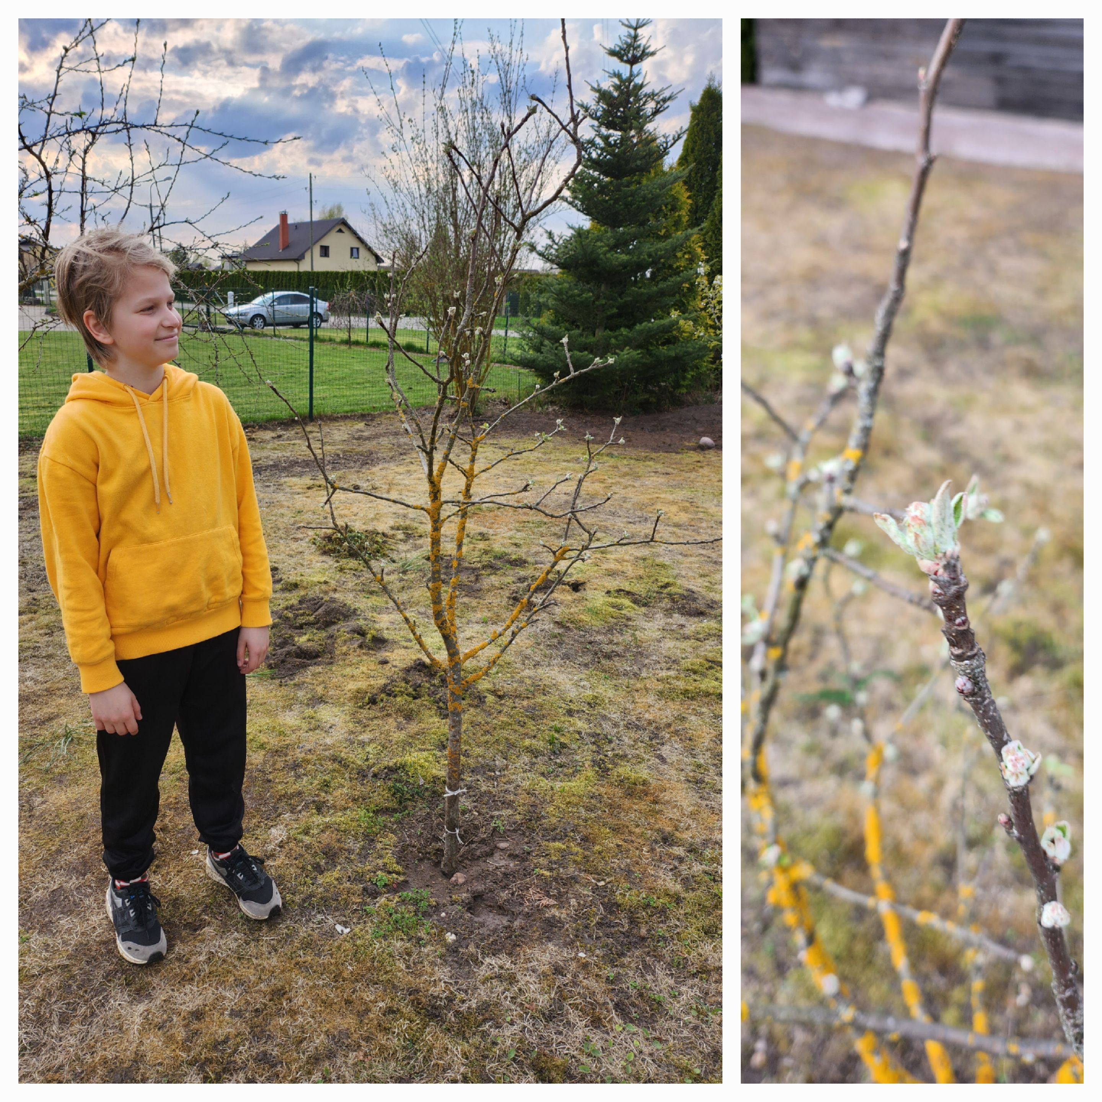
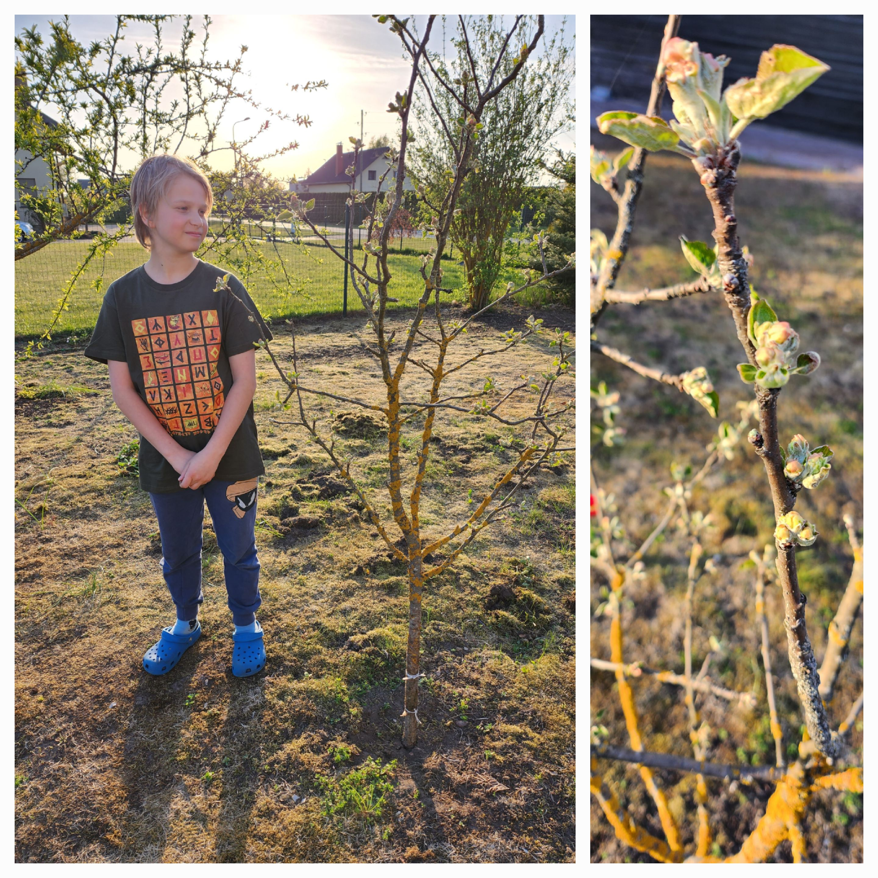
Project progress
I started observing the apple tree on April 24. Since the spring was cold, the apple tree had just started to bloom a few buds.
The next picture was taken on 9th of May. Compared to the previous picture, the leaves were already more out of the buds.

Slide 4
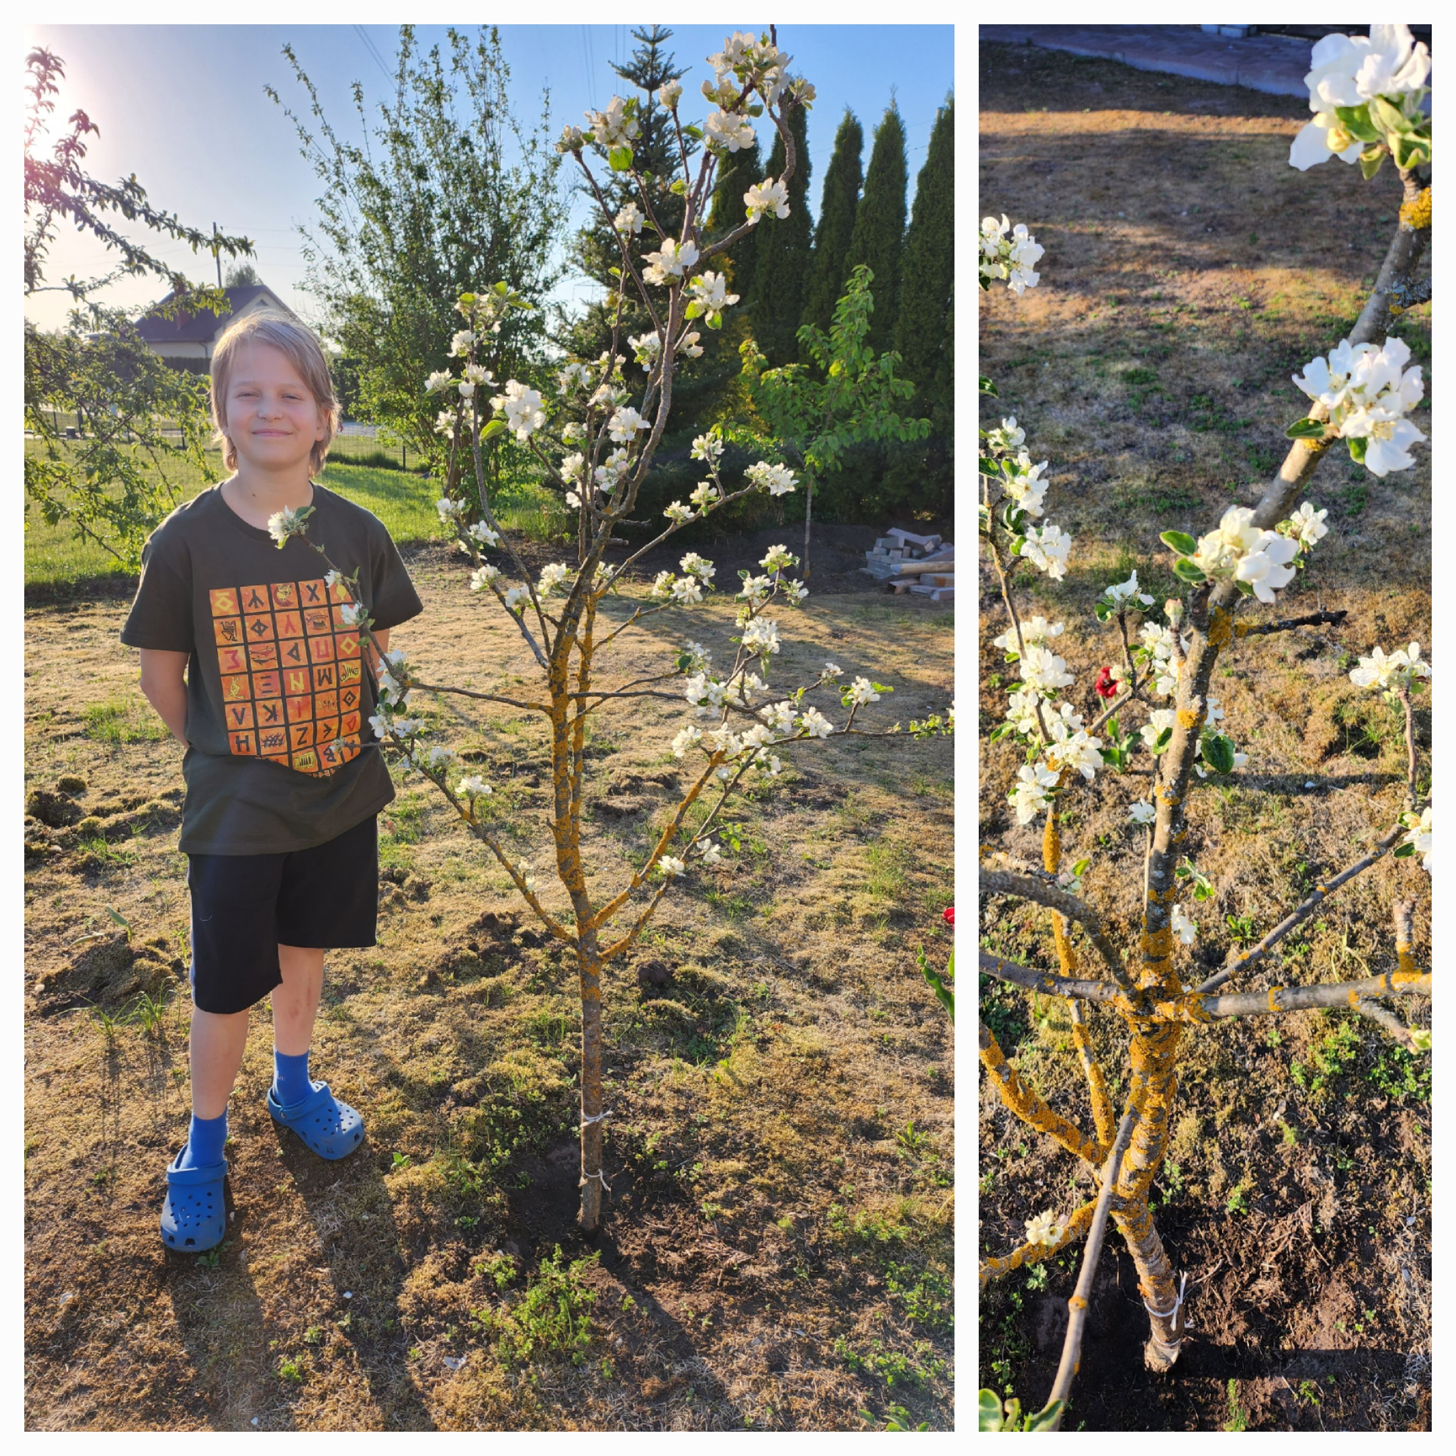
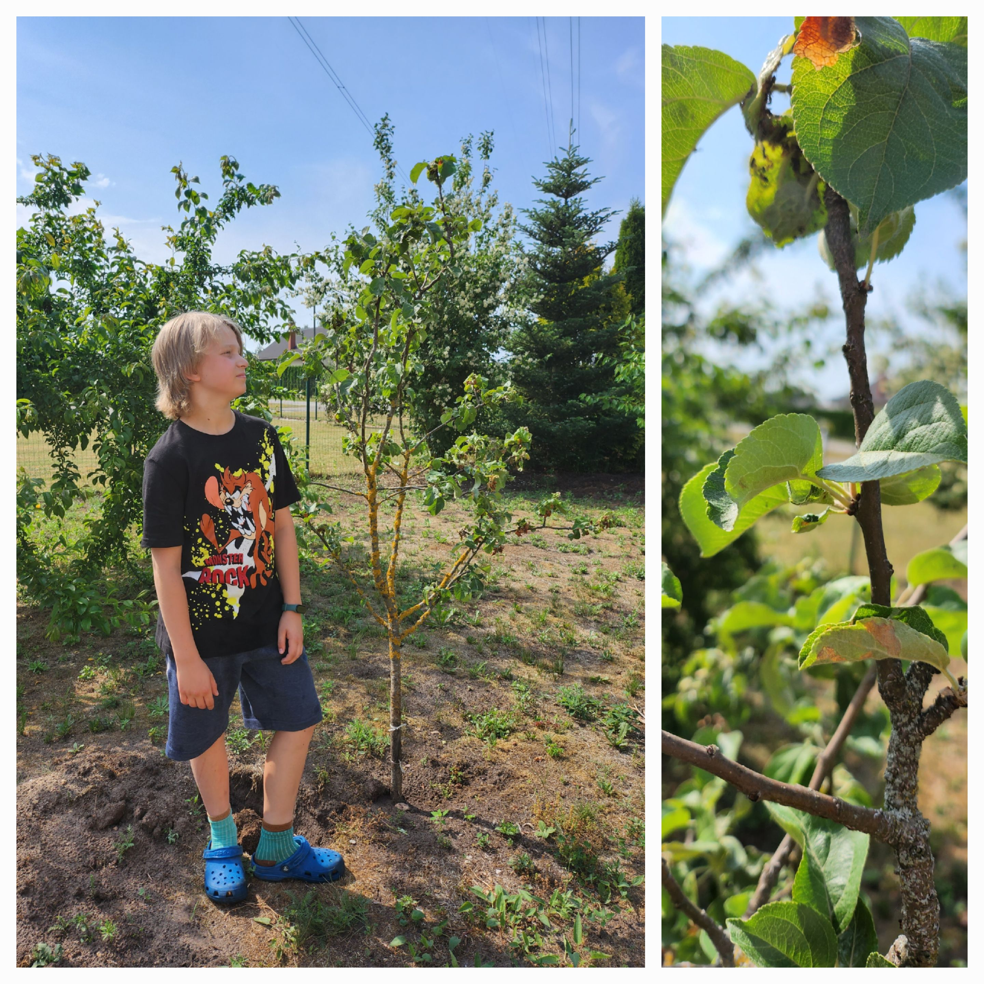
Project progress
The next photo was taken in June, as we can see, the apple tree has already blossomed, the green leaves are in their maturity and glorius phase. Small apple fruits begun to form.
14th of May - the beautiful apple blossoms have bloomed.

Slide 5
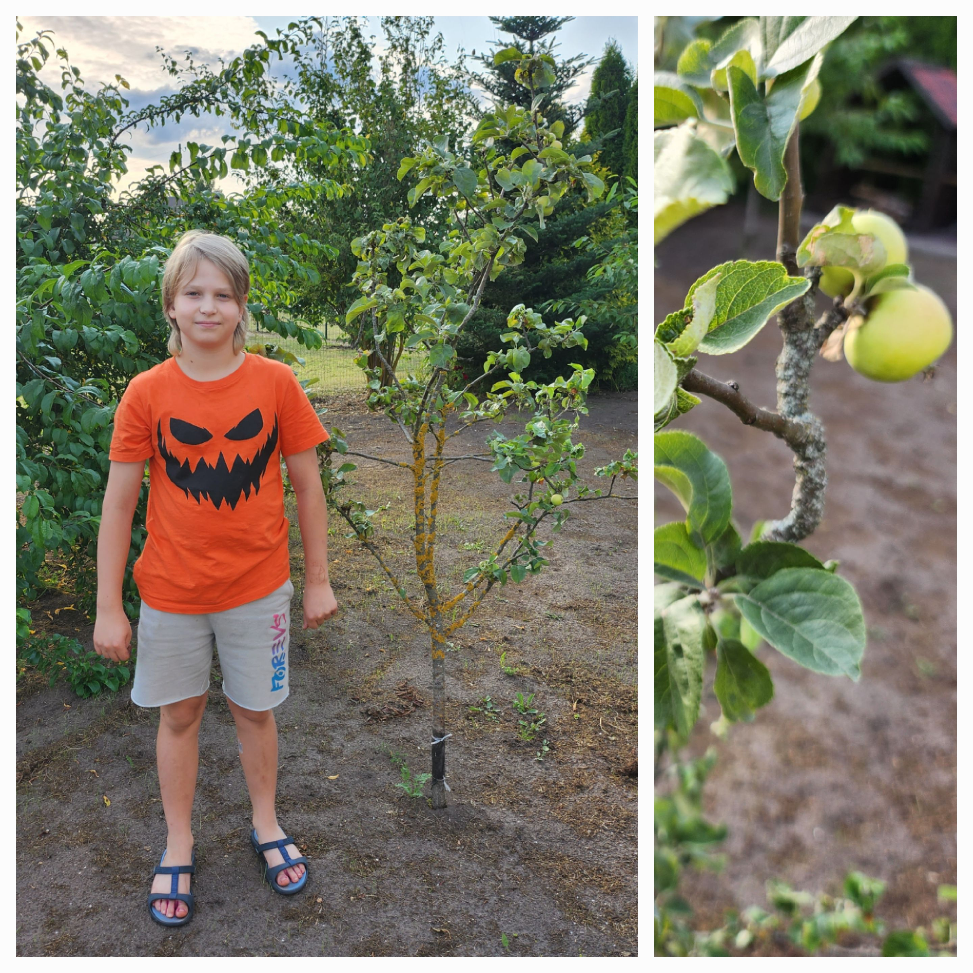
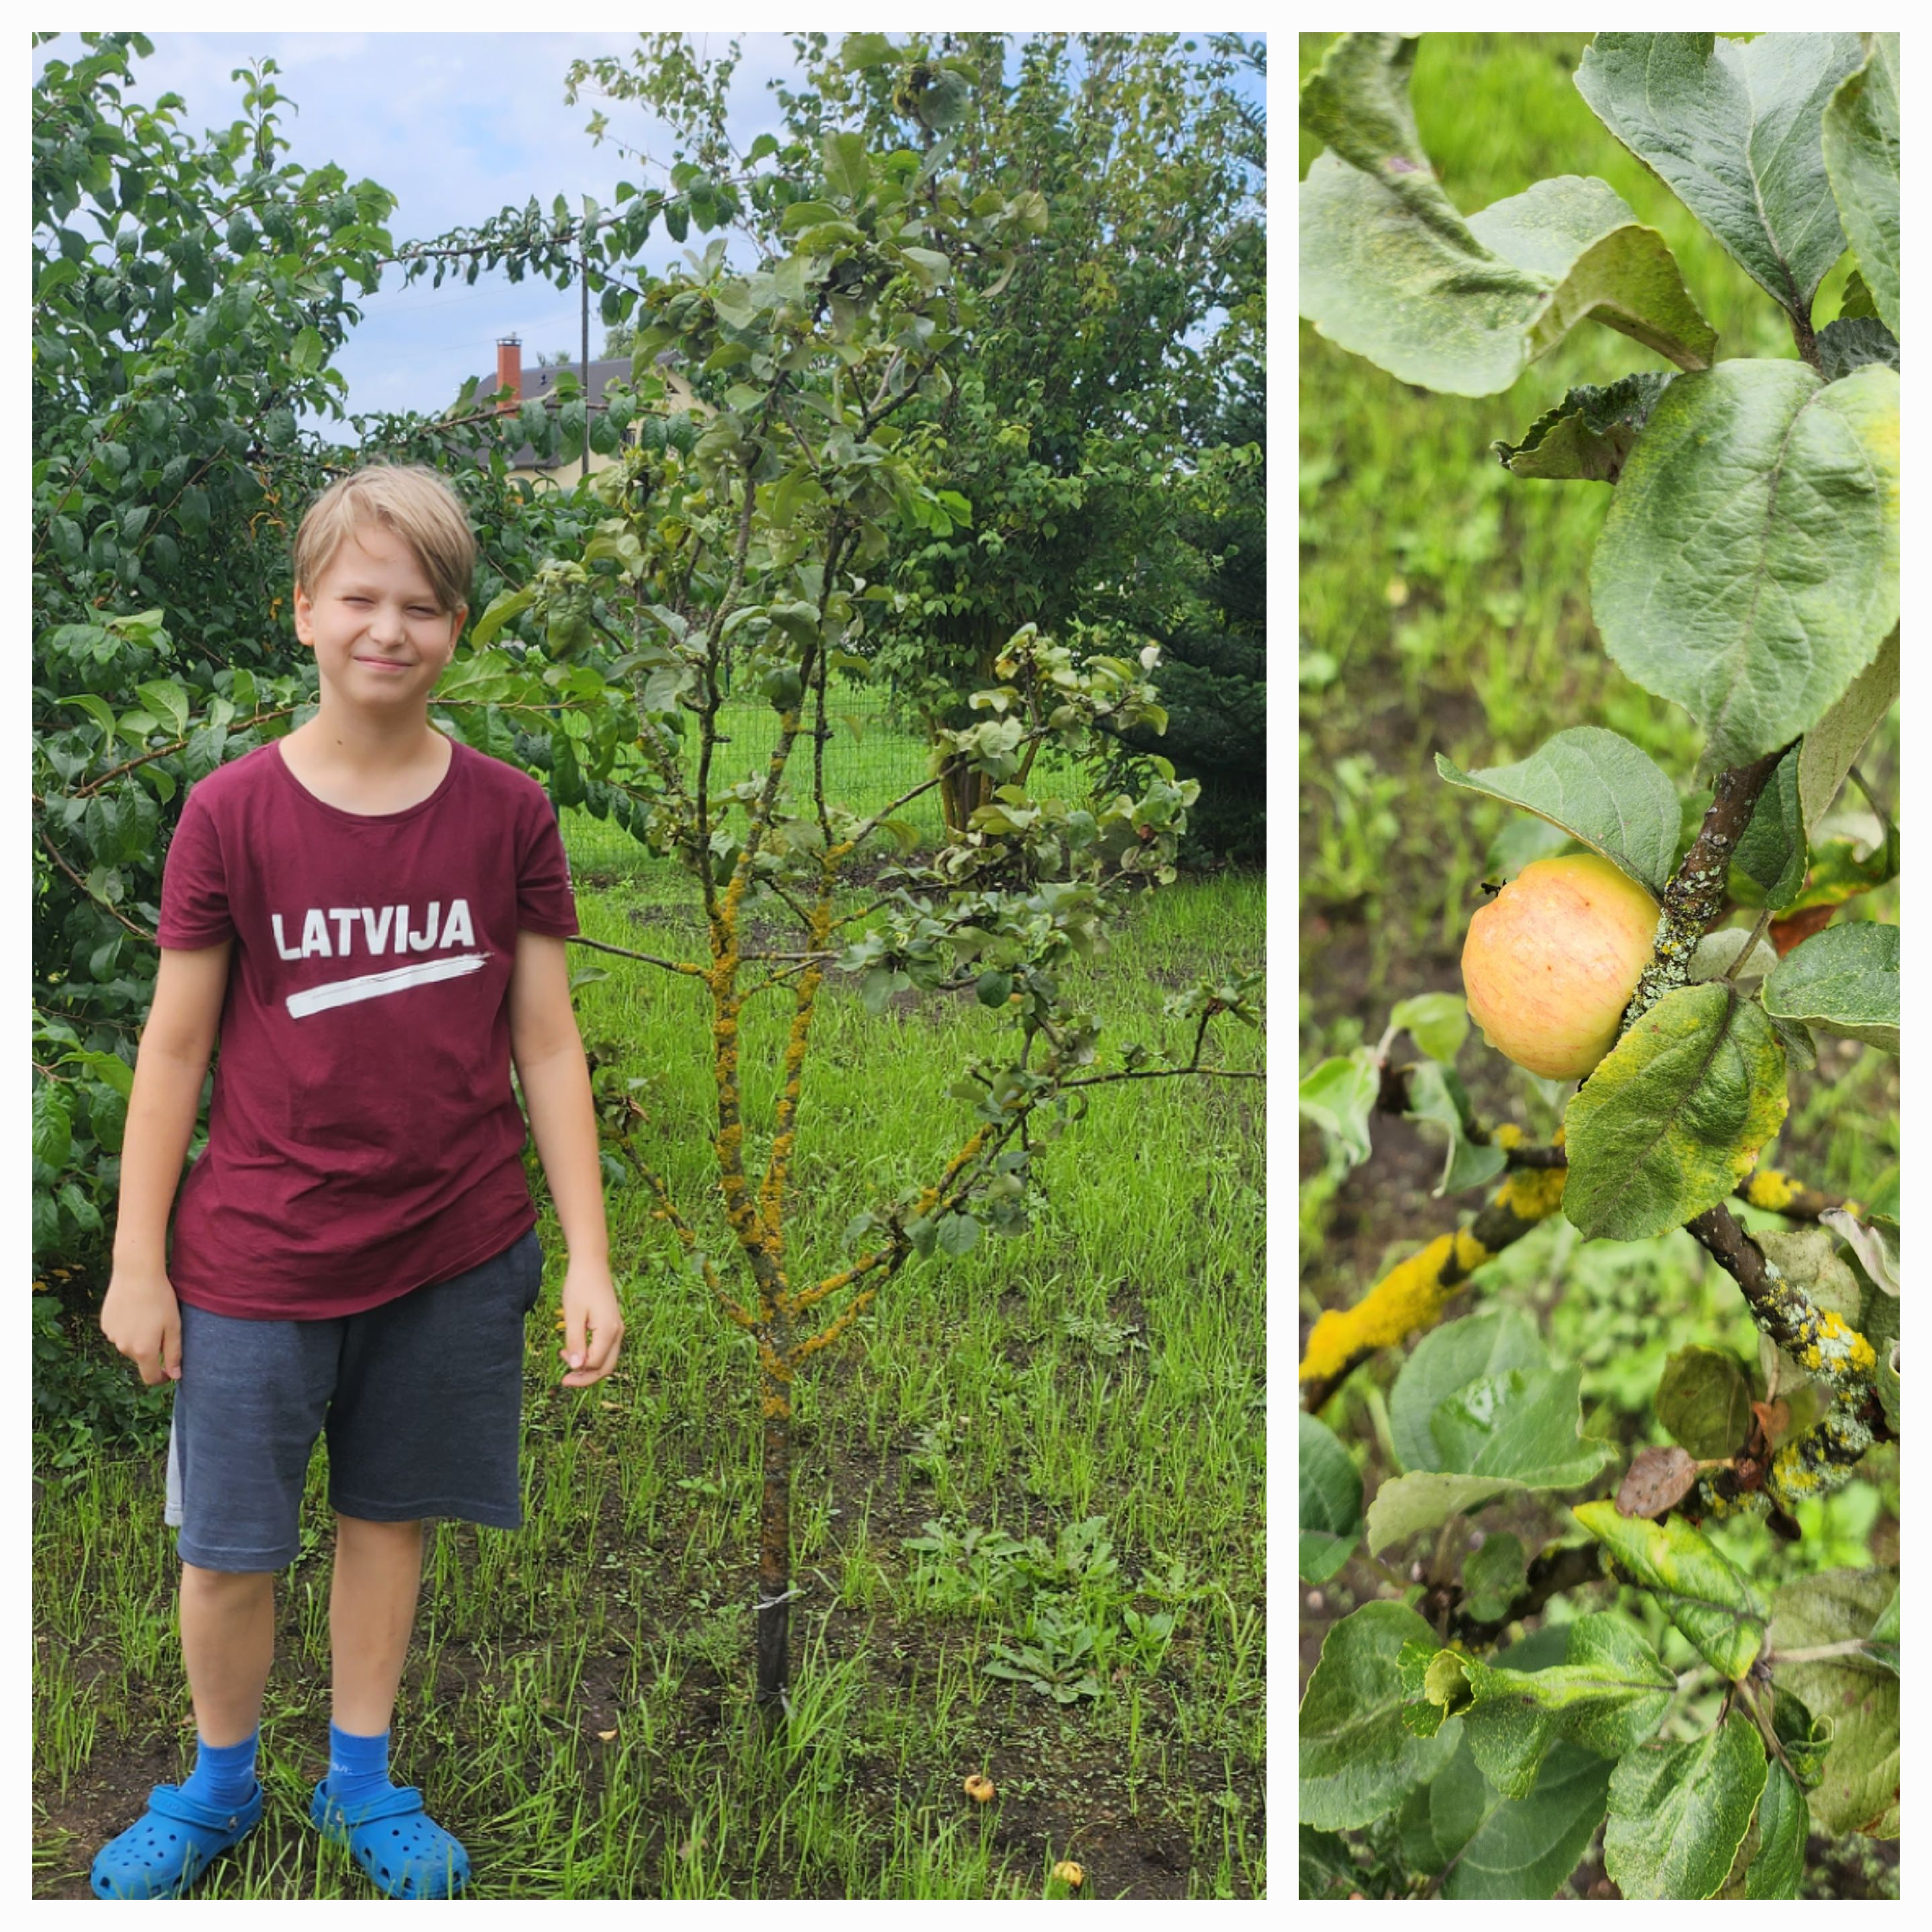
Project progress
15th of July – small apple fruits started to form. There were only a few.
On 3rd of May I saw that apples were bigger than before and they started to change their color.

Slide 6
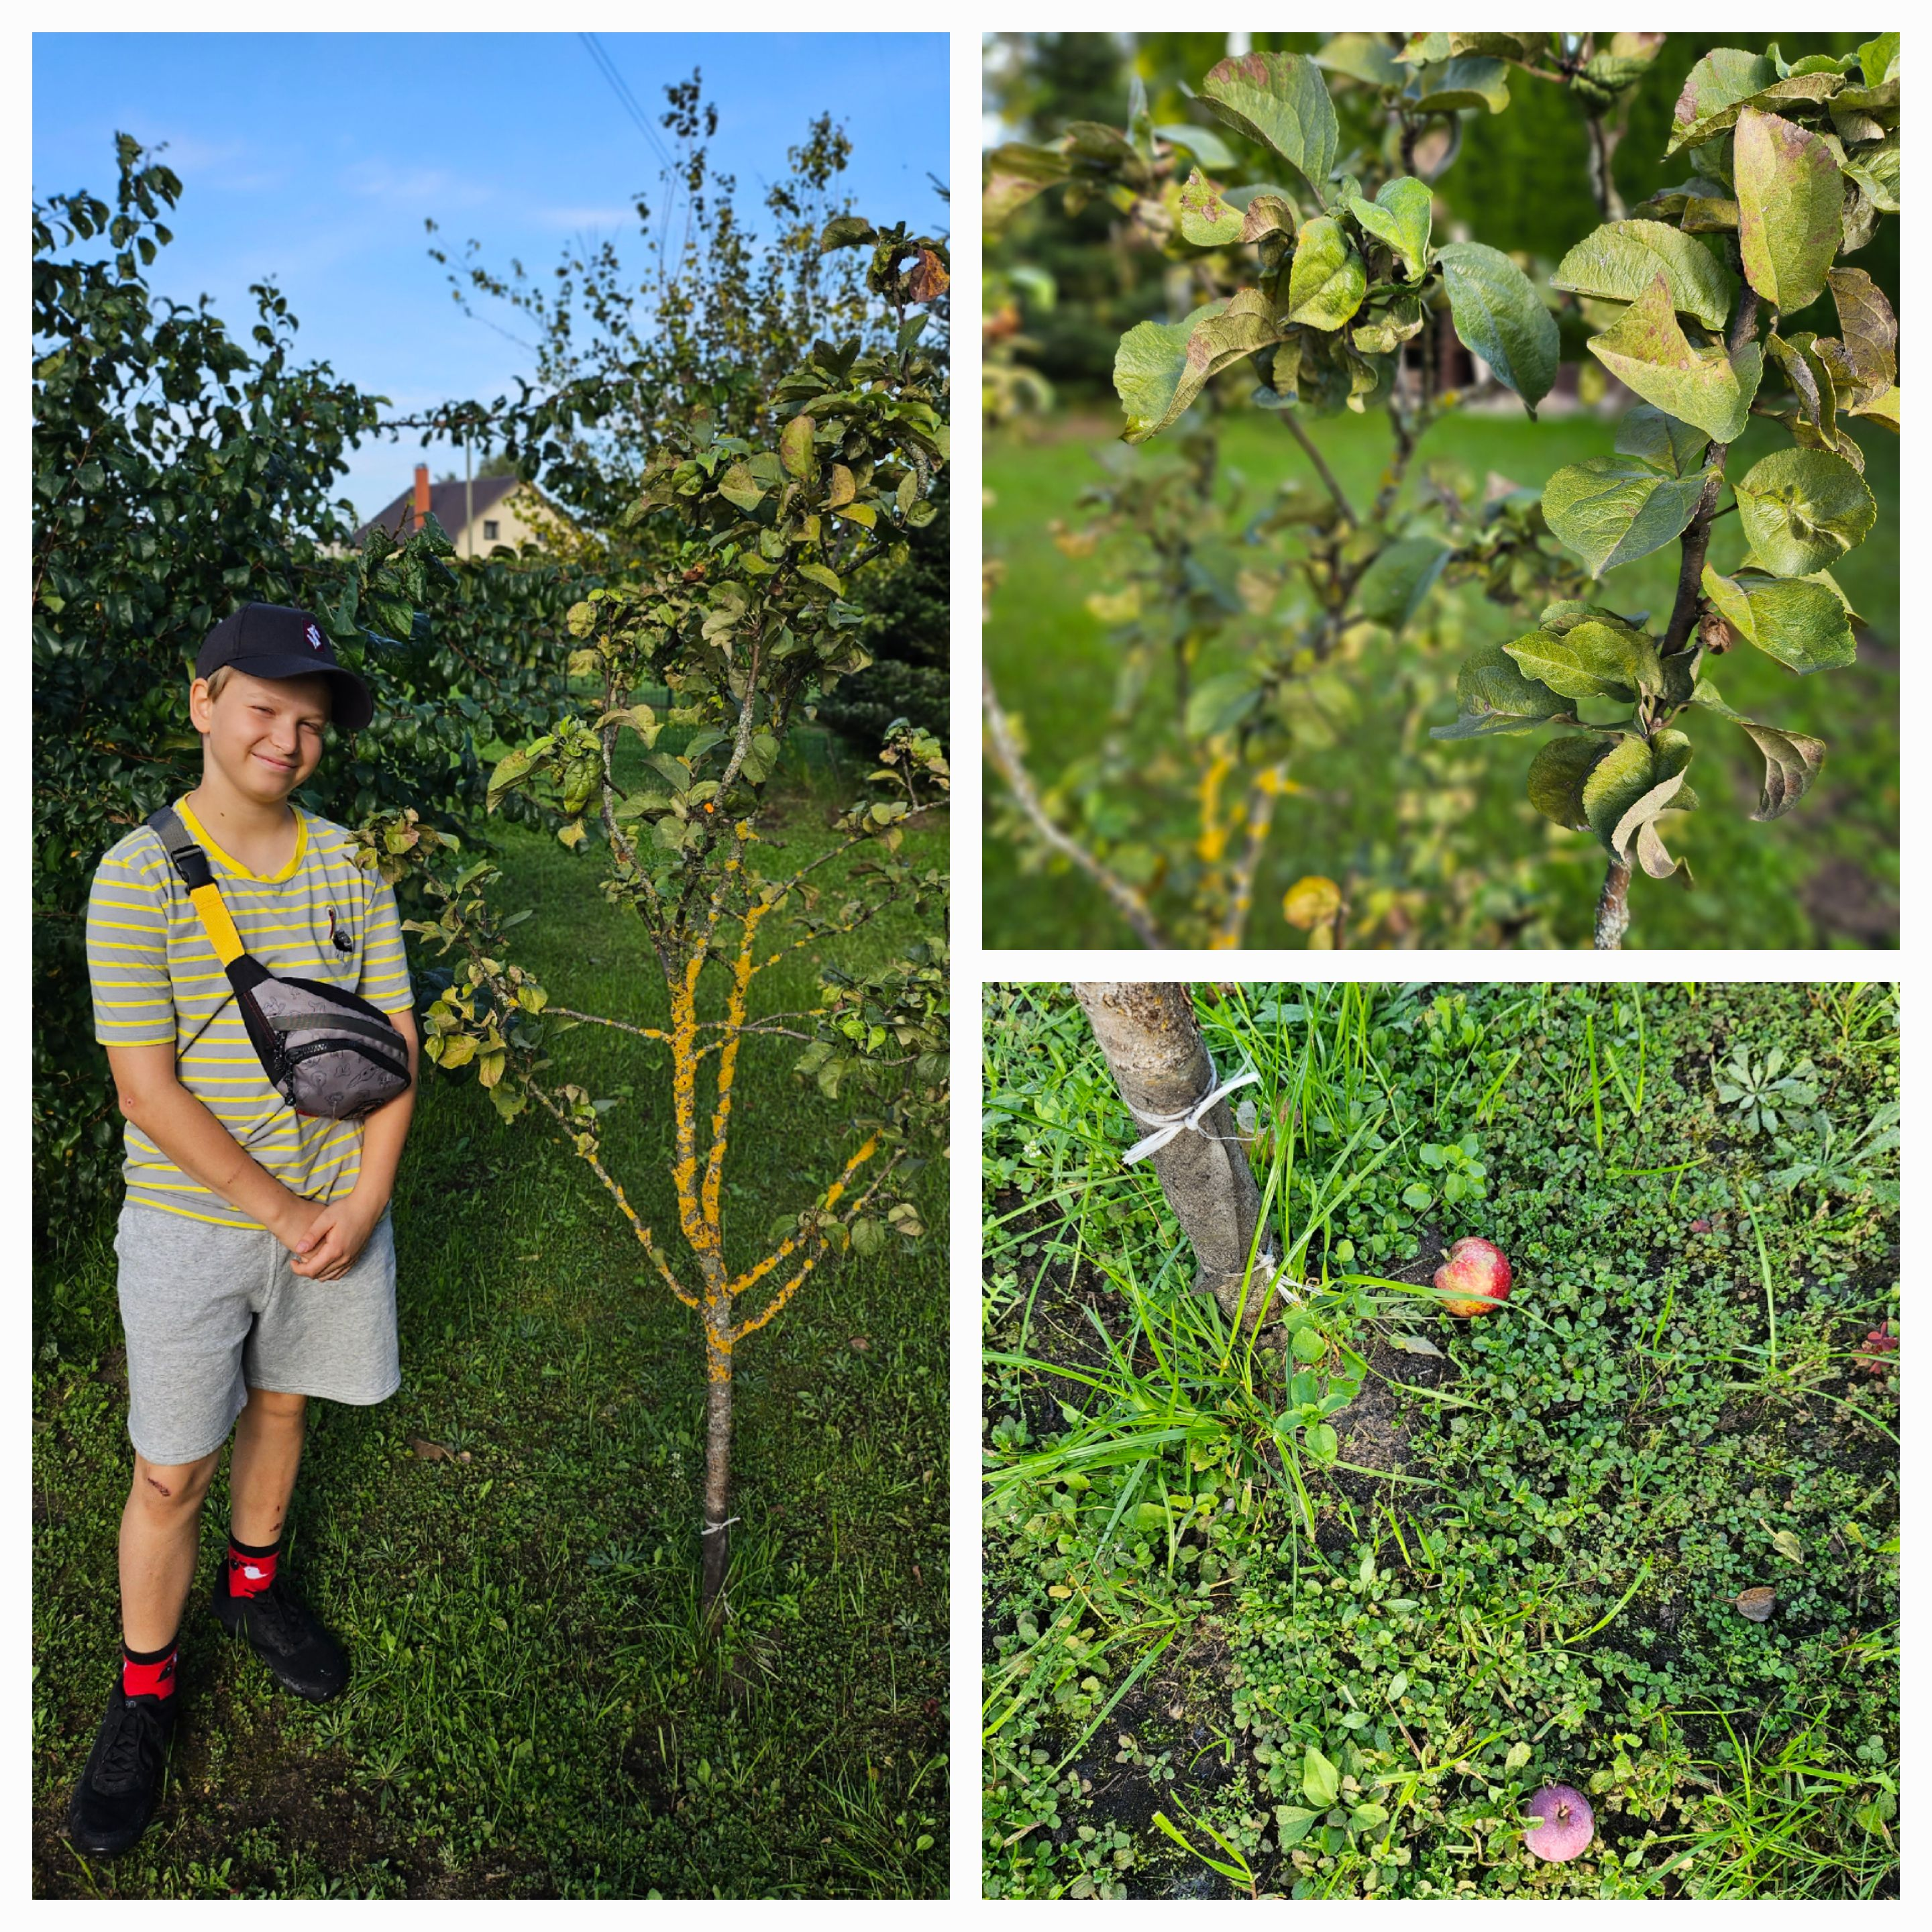
Project progress
I continued to wait for the apples to ripen until they were ready to eat. But one day there was a storm and heavy rain. The next morning I went to the apple tree and saw that the rain had washed the apples off the branches. They were still hard on the ground, not ready to eat. So this is the last picture of the project and I didn't get to taste the apples this year.

Slide 7
Conclusion
It was very interesting to observe the apple tree in different seasons and at different stages of development throughout the seasons.
It turned out that natural conditions have a major impact on yields. In my case, the apples were not ripe because of strong winds and rain.

