Slide 1
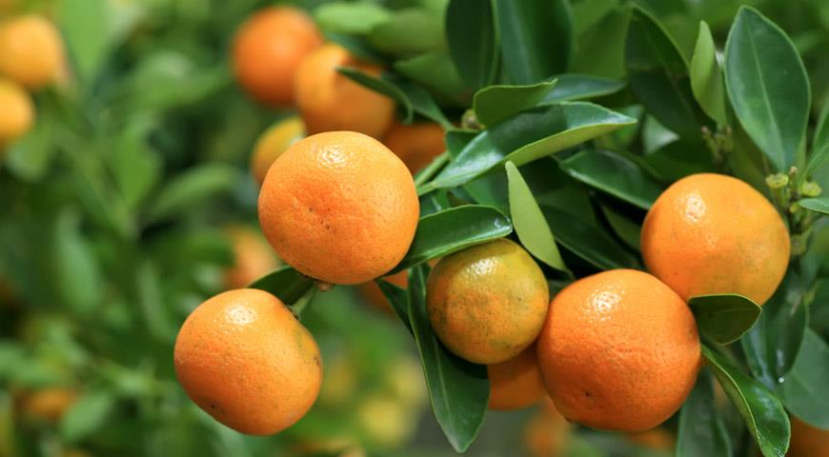
tangerine tree
RESEARCH
Summary. Is it possible to grow a tangerine tree at home?
Research object. I will study how heat, light and water affect the germination of a plant seed. I chose tangerine seeds.
The aim. I will study the effect of different conditions (heat, light, water) on seed germination.

Slide 2
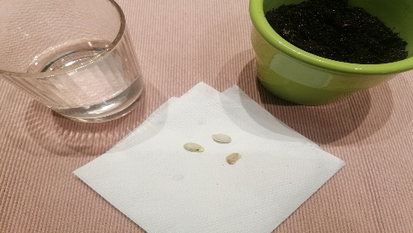
Research tasks.
Research methods.
1. Create different conditions for seed germination.
2. To observe the germination of seeds.
3. Write down and analyze the obtained data.
4. Provide recommendations on how to germinate seeds.
Information search, observation, analysis, recording of conclusions.
Tangerine seeds, 2 pots with soil, water.

Slide 3
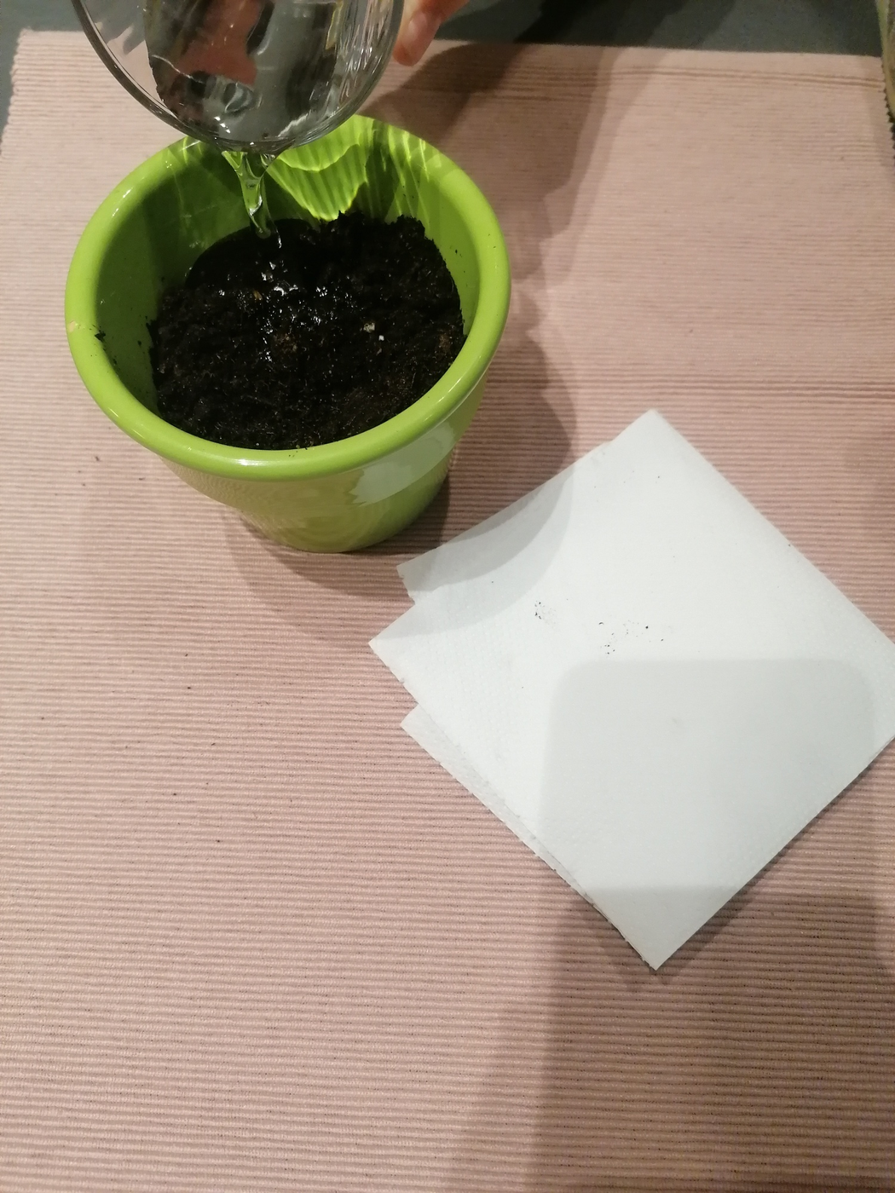
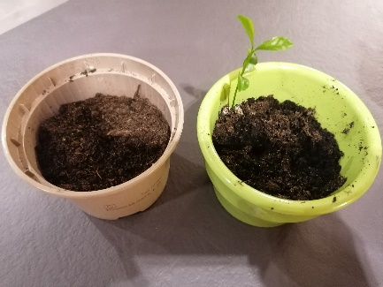
Investigation progress
On December 13, 2022, I planted 4 mandarin seeds (which I found after eating mandarins). I watered them liberally and left one pot warm on the windowsill and took the other one out to the garage. I watered the pot in the room twice a week, and the one in the garage - when I remembered, maybe every two weeks.
Result
One month after planting, the planted seeds germinated on a warm windowsill (January 9, 2023). And already on January 24, the seedling was 7 cm high.
And the planted seeds, which were rarely watered and left to germinate in the garage, did not germinate.

Slide 4
Research findings.
After doing some research, I found out that a germinated seed needs:
light
heat
humidity
love

Slide 5
Used literature.
https://www.patarimupasaulis.lt/sumanios/738-mandarinu-medis-svarbiausios-prieziuros-taisykles
https://www.manonamai.lt/lt/kiemas/g-9043-pavyks-beveik-kiekvienam-mandarinmedis-is-kauliuko

Slide 6
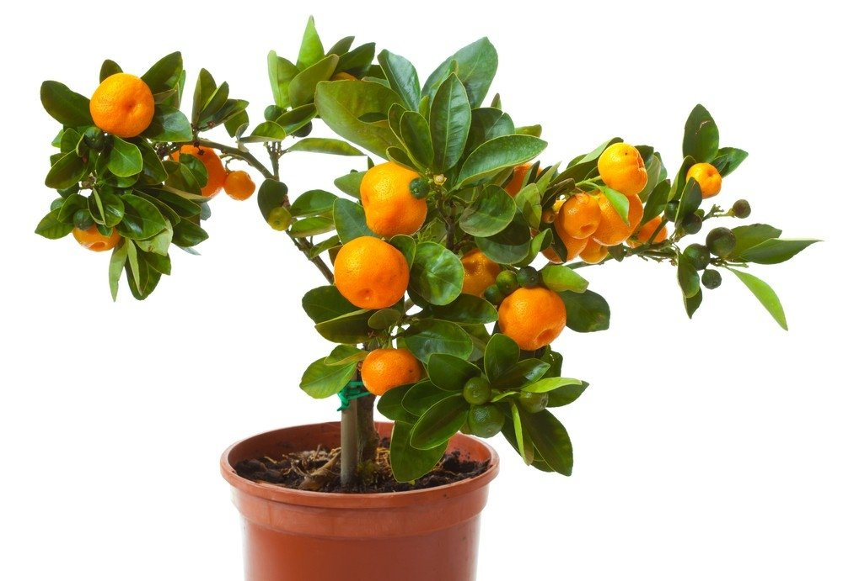
We will wait for the fruits
Information from a woman who grows citrus fruit trees: "It can bloom in the same year when the branch is grafted, but fruit can be produced only in the third or fourth year of growth" p. Jūratė R.
https://www.lrt.lt/naujienos/gyvenimas/13/245851/vilniete-patare-kaip-namuose-uzsiauginti-citrinu-mandarinu-apelsinu-ir-daugeli-kitu-vaisiu

