Slide 1
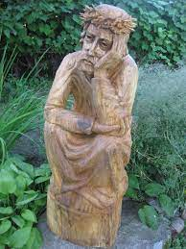
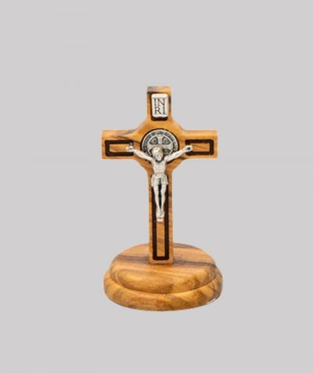
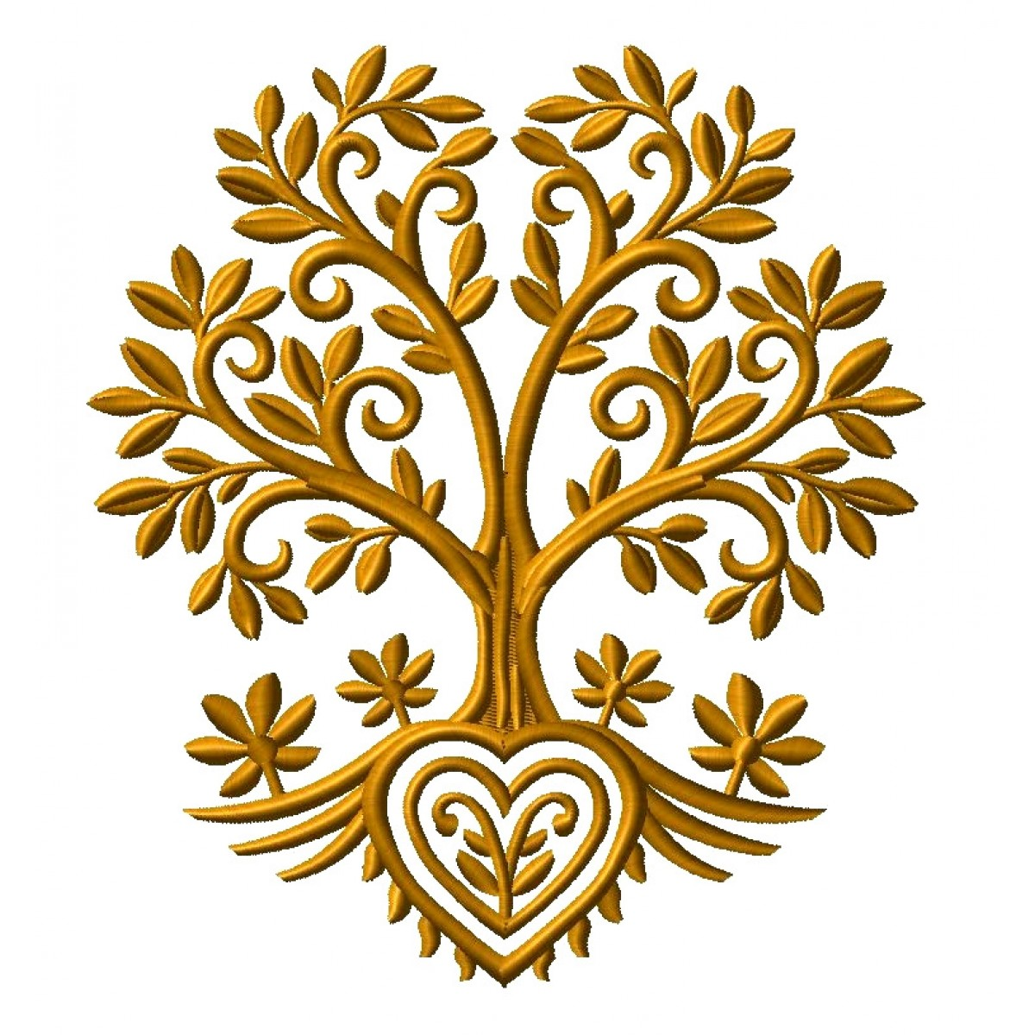
Tree in folk art
The use of wood in folk art is very common. All kinds of crosses are carved from wood, chests made of trees are later decorated with all kinds of ornaments. The tree itself in folk art is also a symbol, as an example the tree of life, the tree of the world, and so on. . I will tell you about two types of folk art: cross-crafting and caregivers (lith. rūpintojėliai).

Slide 2
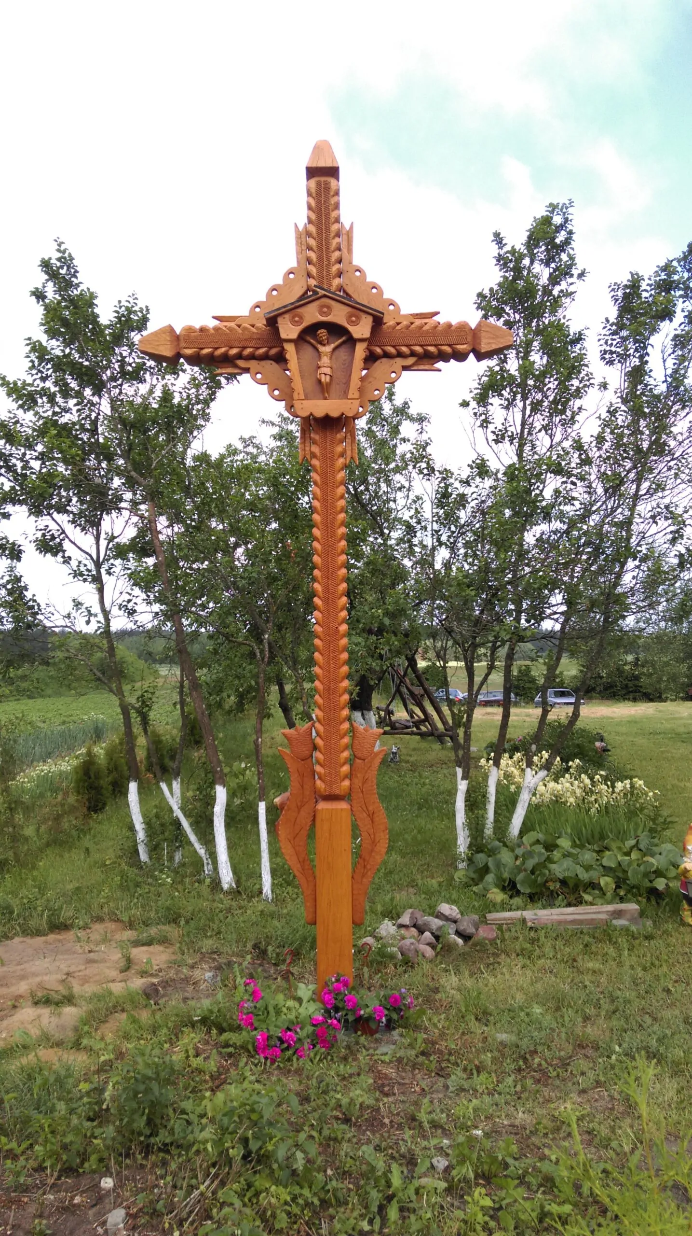
cross-crafting
Lithuanian cross-crafting – making traditional Lithuanian crosses, a branch of Lithuanian folk art, was inscribed in the UNESCO List of Masterpieces of the Intangible and Oral Heritage of Humanity in 2001. Cross-crafting is a unique branch of Lithuanian folk art art, the only one of its kind in the world! Lithuanian crosses are the christian (in the post-war years - and secular content) buildings of folk small architecture, consisting of architectural, decorative, sculptural forms, the purpose and meaning of which are defined by their content, motifs of creation and place of construction.

Slide 3
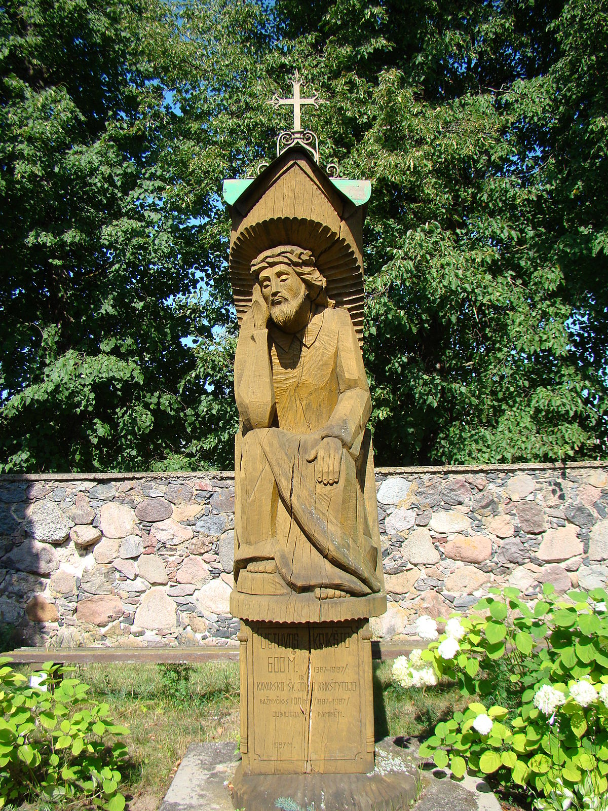
Caretaker (lith. Rūpintojėlis)
The caretaker– a sculpture of folk art – is the poise of a worried Jesus Christ sitting, leaning, supporting his chin with his right hand. It is one of the most popular objects of Lithuanian fine art and folk art, one of the symbols of the Lithuanian nation. Christ is depicted sitting on a promotion, leaning over, usually with his right hand resting his head, and placing his left on his knees, with a crown of thorns on his head, drops of blood on his face and body, with a face full of sorrow. Most often, the sculpture is sculpted from wood, but there are also stone works of art. In Lithuania, Caregivers are depicted in both ordinary and forest chapels, which are placed in trees.

